Slide 1
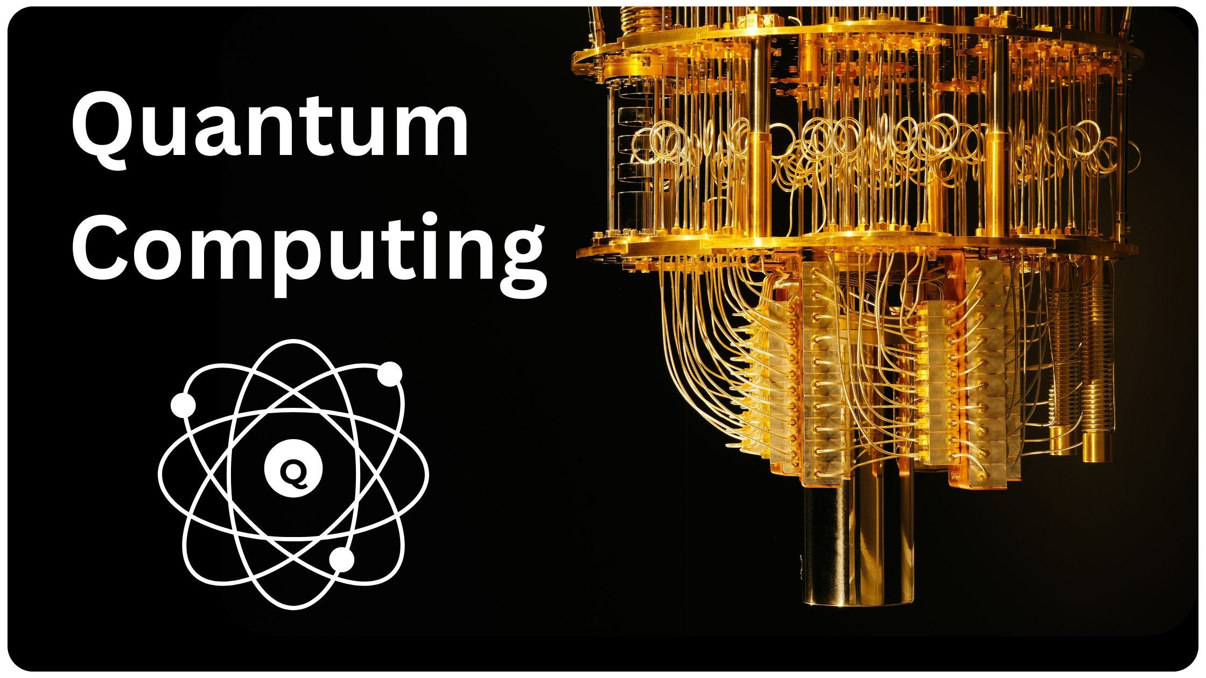
Divakaran A P
Techolas Technologies

Slide 2
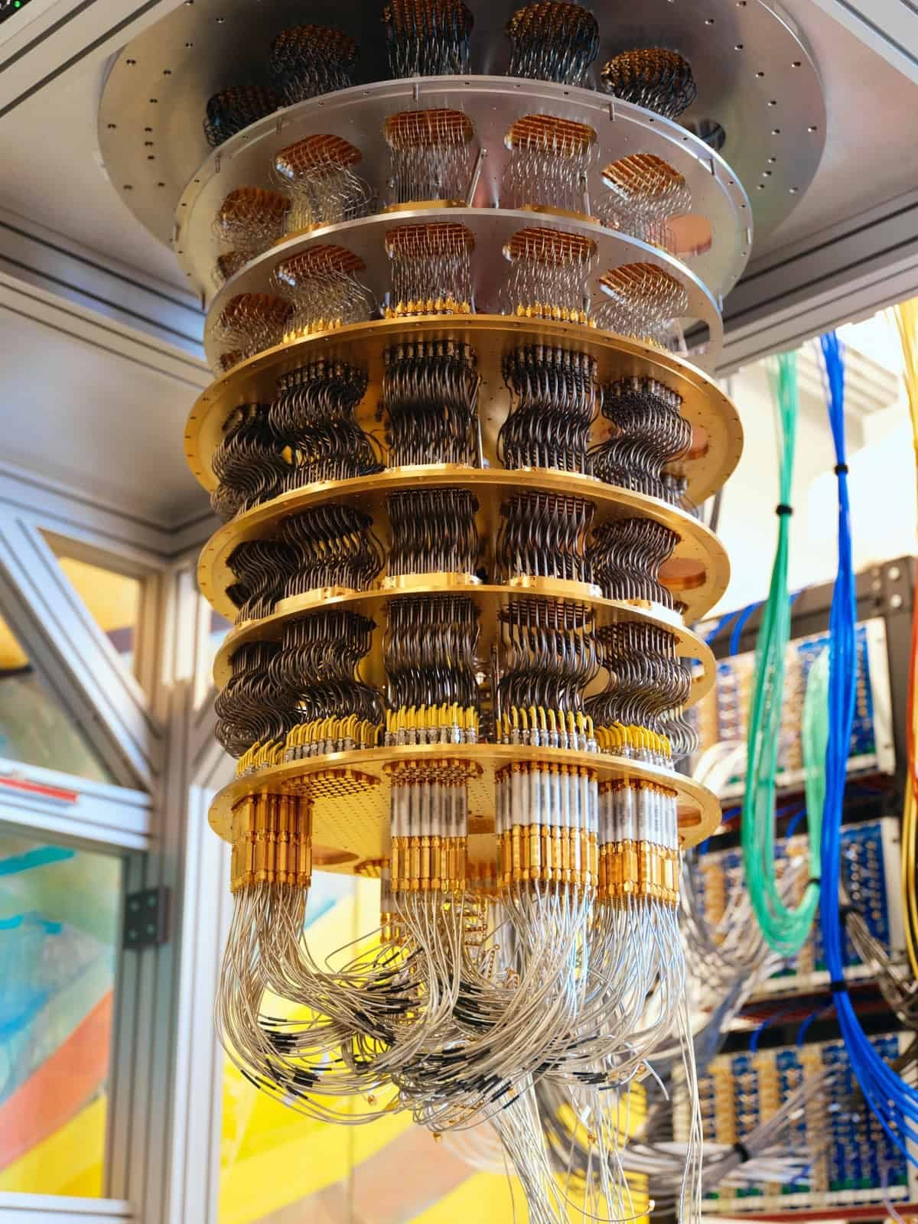
What is Quantum Computing ?
Quantum computing is an advanced computing paradigm that uses the principles of quantum mechanics to process information exponentially faster than classical computers for certain tasks.
1. Cryptography & Security
Breaking classical encryption and developing quantum-safe cryptographic algorithms.
2. Drug Discovery & Molecular Simulation
Simulates molecules at the quantum level to accelerate new medicines and material design.
3. Optimization Problems
Solves complex optimization tasks in logistics, supply chain, finance, and energy systems.
4. Machine Learning & AI Acceleration
Quantum ML algorithms can process high-dimensional data faster than classical models.

Slide 3
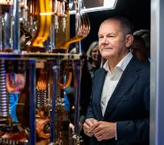
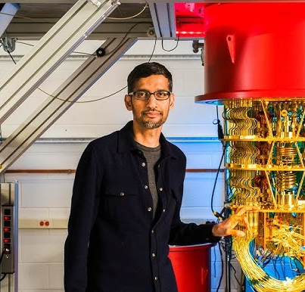

Slide 4
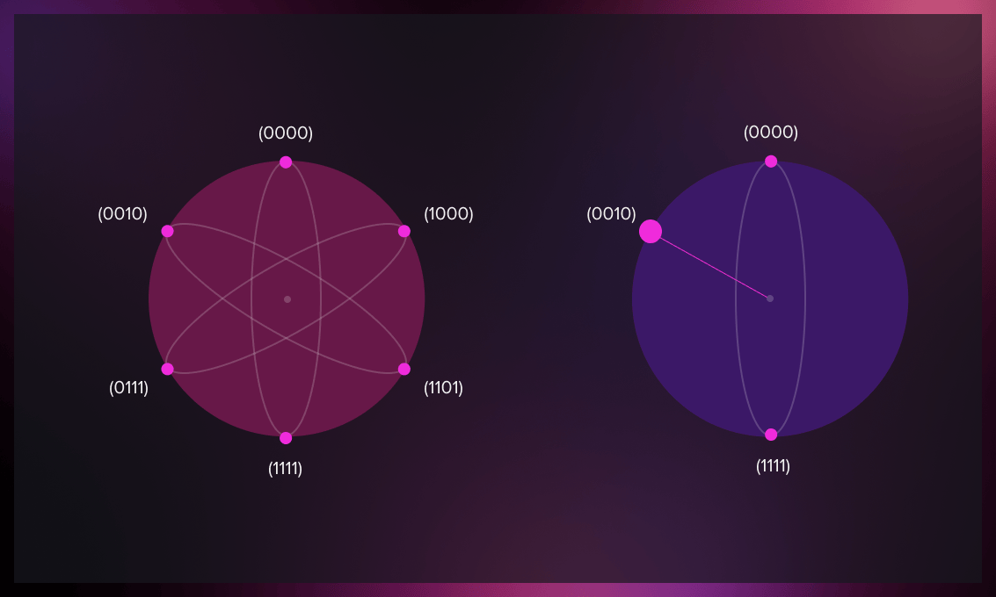
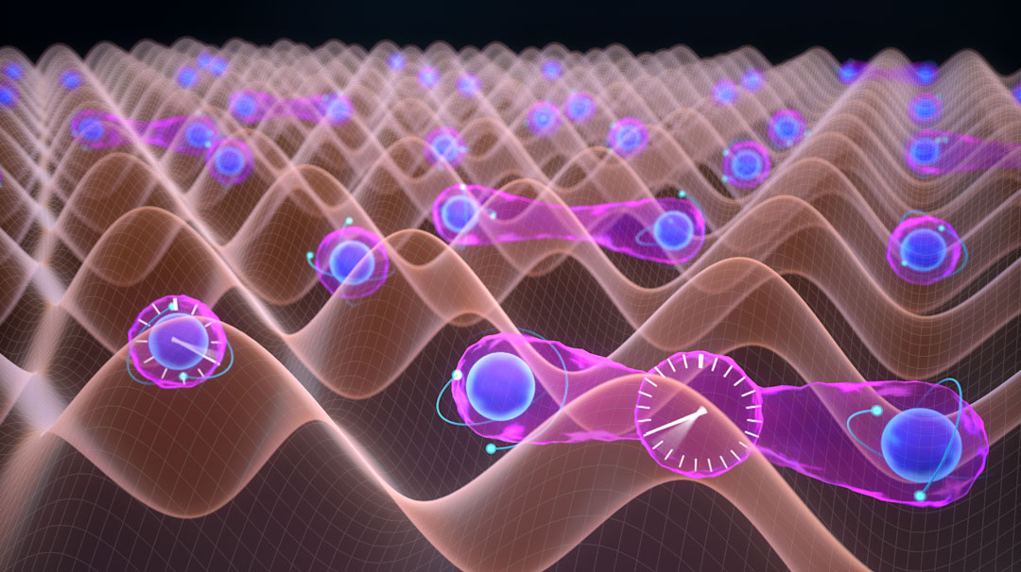
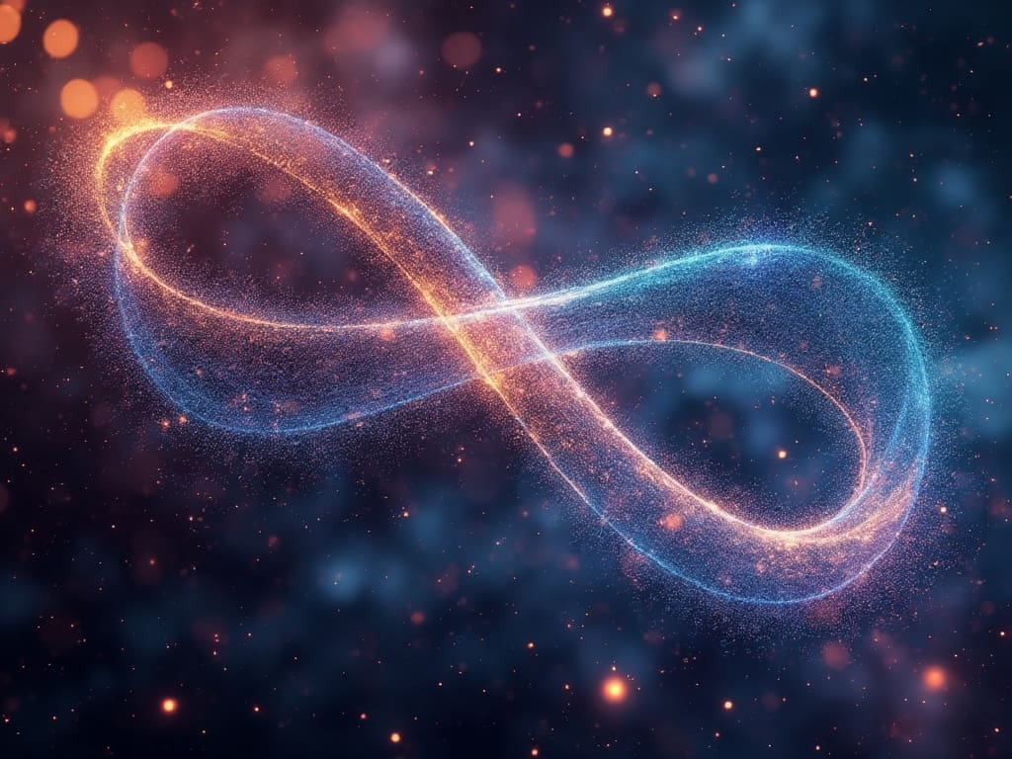
Important Concepts
Qubits: Basic units of quantum information that can exist in multiple states (0 and 1) simultaneously.
Superposition: A qubit can hold multiple states at once, enabling massive parallelism.
Entanglement: Strong correlation between qubits that enables coordinated processing.
Quantum Gates: Operations that manipulate qubits using quantum logic.

Slide 5
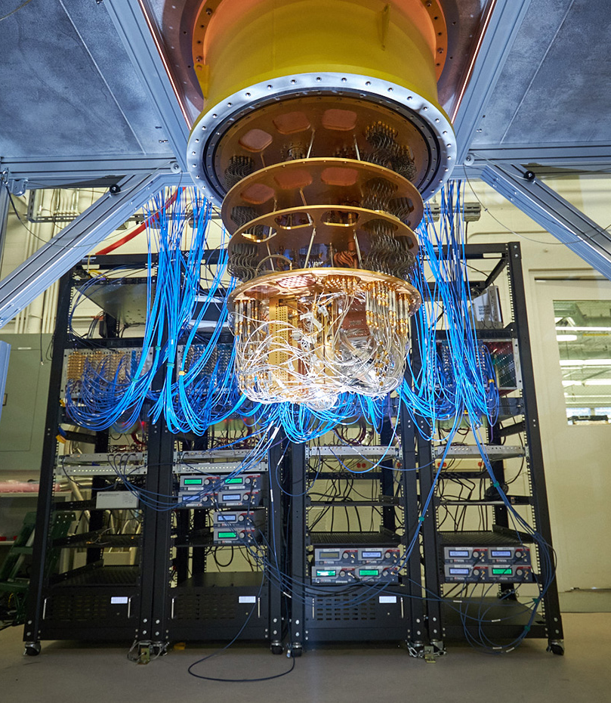
The Problem - Million-Dollar Errors
Quantum computers are highly sensitive to noise, decoherence, and hardware imperfections, which lead to unpredictable errors.
These errors significantly reduce gate fidelity, circuit accuracy, and the overall reliability of quantum computations.
Current quantum hardware lacks real-time prediction of when and where errors will occur.
Without error prediction, quantum algorithms require repeated execution, causing high cost, longer computation time, and low efficiency.
There is a need for an intelligent system that can forecast quantum errors in advance, enabling better circuit optimization and resource utilization.
REAL-WORLD IMPACT:
• System downtime: $50K-$100K per hour
• Hardware damage: $2M-$5M per incident
• Lost research: Priceless quantum data
• Delayed breakthroughs: Competitive disadvantage
CURRENT REALITY: Reactive error detection = Too late!

Slide 6
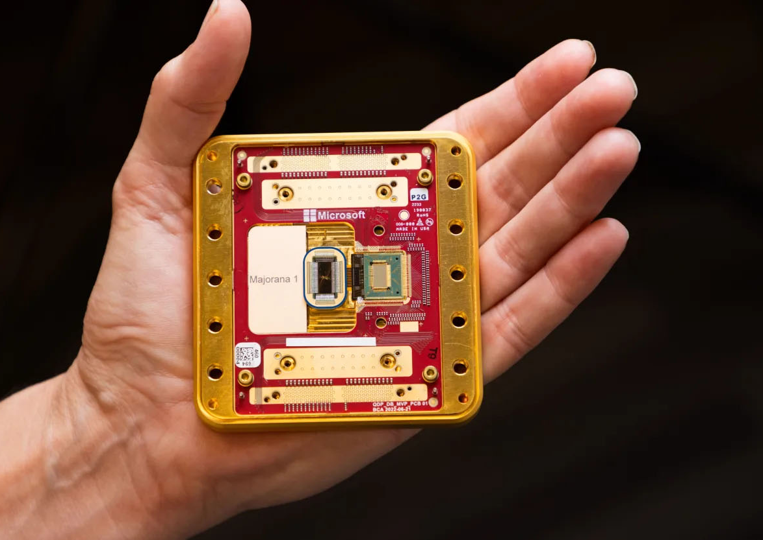
THE SOLUTION
FROM: from physical error detection
TO: Error prediction beforehand
• Machine learning models analyze system parameters
• Predict errors BEFORE they occur

Slide 7
DATA – NISQ FAULT LOGS 100K
a simulated dataset of 100K quantum circuit executions across 6 hardware families, capturing circuit structure, hardware noise conditions, and fidelity outcomes, labeled with the type of error (if any) that occurred — built for a multiclass error-classification model.

Slide 8
Quantum_Error_Prediction_Data_v4.csv — 100,000 rows × 33 columns, one row per simulated quantum circuit run.
Identifiers & metadata (3 cols)
circuit_id — unique string ID per run (QC000000...)
device_family — categorical, 6 values: Osprey, Condor, Heron, Eagle, Falcon, Hummingbird
device_version — constant, always "v4" (not useful for analysis, safe to drop)
Circuit structure (6 cols) — describes what the circuit actually does
qubit_count, gate_depth, gate_type (12 gate types like CZ, H, Z, X, RZ), cnot_gate_count, single_qubit_gate_count, swap_gate_count, measurement_count
Fidelity & error-rate metrics (4 cols) — how well the circuit performed
gate_fidelity, readout_fidelity, error_rate_gate, readout_error — all continuous floats, near 0.95-0.999 fidelity range
Hardware/physical characteristics (8 cols) — device-level noise conditions at run time
t1_time_us, t2_time_us (coherence times), gate_duration_ns, execution_time_us, idle_time_us, calibration_age_hr, qubit_connectivity, crosstalk_level, temperature_mK
Measurement outcomes (3 cols)
shots (2048/4096/1024/8192), bitstring, ideal_bitstring — actual vs. expected measurement results
Engineered/derived features (5 cols) — likely computed in the notebook, not raw sensor data
fidelity (overall run fidelity, distinct from gate_fidelity), depth_per_qubit, t2_t1_ratio, gate_density, noise_score
Target variables (2 cols)
error_detected — binary Yes/No
error_type — 6-class label: readout, amplitude_damping, leakage, depolarizing, phase_damping, none

Slide 9
MODEL SELECTION
XGBoost WON:
• Best Performance: 93% Accurate
• Recall : 87%
• f1 Score : 80%

Slide 10
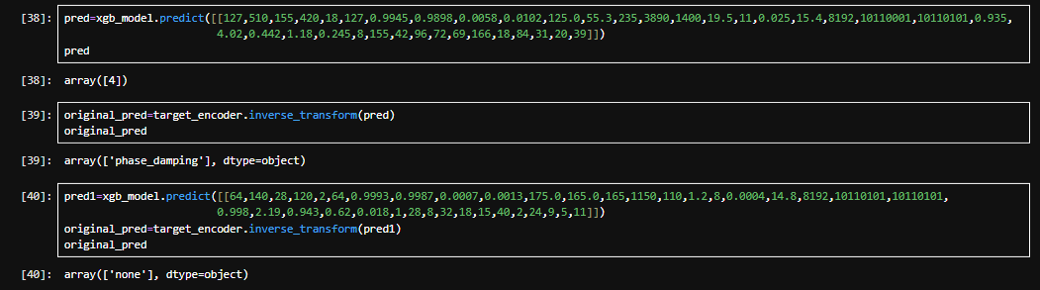

Slide 11
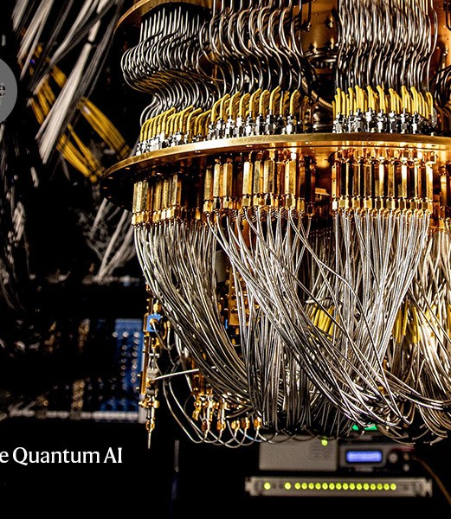
Quantum Computing
Thank you

