Slide 1

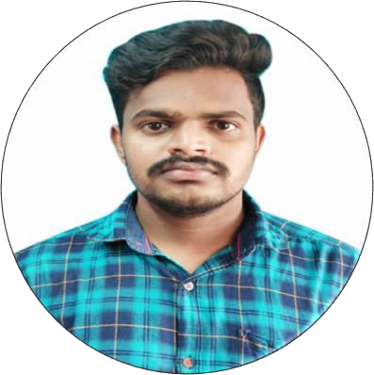




DIVAKAR BABU MUPPDI
Presentation Title | Author | Date © Capgemini 2017. All rights reserved | 1
Education and certificates Bachelor of Engineering and Technology with EEE (2017-2021)
Analyst/Software Engineer
Skills
Base Location: MUMBAI
Email ID: muppidi-divakar.babu@capgemini.com
Mobile No: +91 9133034813
Grade: A4
C#
Basics, OOPS, Exception
Handling, Generics, Events
Collections &
Delegates,
.
Strengths
.NET
Framework
ADO.NET,Entity Framework,LINQ, ASP.NET with MVC5, ASP.NET CORE WEB API.
Achievement
Hands on experience on C#, ADO.NET, LINQ, Entity framework, Sql Server, ASP.NET MVC5, ASP.NET CORE WEB API.
ADO.NET
Basics, Connected and Disconnected Architecture.
ONLINE SHOPPING CART:
Created an ONLINE SHOPPING APPLICATION With MS
SQL SERVER as Backend and ASP.NET CORE WEB API as middleware and ANGULAR as frontend, Used HTML, CSS and TypeScript for designing responsive web pages.
Good Knowledge of C# programming
RDBMS
Fundaments of MS SQL Server Database
Good in developing web pages using HTML, CSS, JAVASCRIPT.
Classes in all layers were designed using C# and ASP.NET CORE WEB API. Database was designed in SQL Server.
Connecting the application with database was done using ASP.NET CORE WEB API.
UI
Technology
HTML5, CSS,JavaScript,
ES6, Typescript and Angular
Proficient in creating Sinle Page Web Application in Angular with routing
Full Stack developer with Angular and Full Stack .NET Developer
Tools
Git and GitHub, SQL Server Management Studio, Visual Studio, Visual Studio Code.
Hands on experience in developing web pages
using HTML5, CSS3, Object Oriented Java script,
TypeScript, ES6, JSON, XML.

