Slide 1
Organization in Programming
Wei Gao Silicon Edge Robotics (FTC Team 10341)

Slide 2
File Naming
Keeping it Clean and Simple

Slide 3
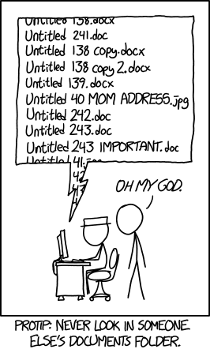
Copy of Copy of Copy of Copy of Copy of Copy of Copy of Copy of Copy of Copy of Copy of Copy of Copy of Copy of Copy of Copy of Copy of Copy of Copy of Copy of Copy of Copy of Copy of Copy of Copy of Copy of Copy of Copy of Copy of Copy of Copy of Copy of Copy of Untitled.doc (xkcd #1459)

Slide 4
Naming Files
Make it meaningful
Make it easy to read
CamelCase or snake_case often used
Shorter is often better
Abbreviations don’t help

Slide 5
Naming Examples
Great: get_telemetry_data.py
Relatively short
Function very obvious
Good: telemetry.py
Function obvious
Vague content
Better: datalog_01-01-1970.txt

Slide 6
Naming Examples (cont.)
Bad: gettelemetryandprintdatatoscreen.py
Function obvious, but hard to read
Too long, could be more concise
Ex: telemetry_handler.py
Really bad: gtd01.py
Short, but undescriptive and vague
Probably only the programmer knows what “gtd” means
Could be mistaken for similar files

Slide 7
Bottom line: Keep it concise

Slide 8
Naming in Code
Variable Naming and Code Structure

Slide 9
Names in Programming
A good name goes very far in code
Well-named variables and methods easy to use

Slide 10
Variable and Method Naming
Similar to file naming
Keep it concise and meaningful
Should be related to function
Notes:
It’s like that one adage about cells, that function dictates structure. Ok, that was probably a bad analogy.

Slide 11
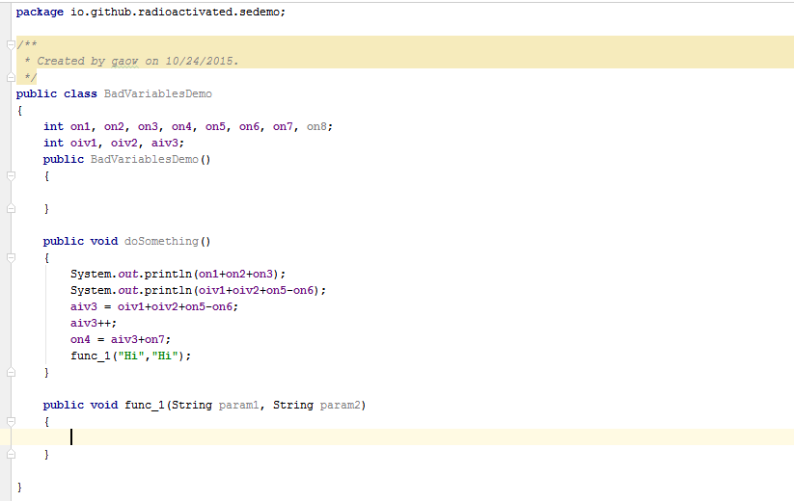
Lack of consistency in inline declarations is confusing
Inconsistent variable name
Value used twice should be assigned to separate variable
‘on’ variables are used to store both input and results - inconsistent
Undescriptive names

Slide 12
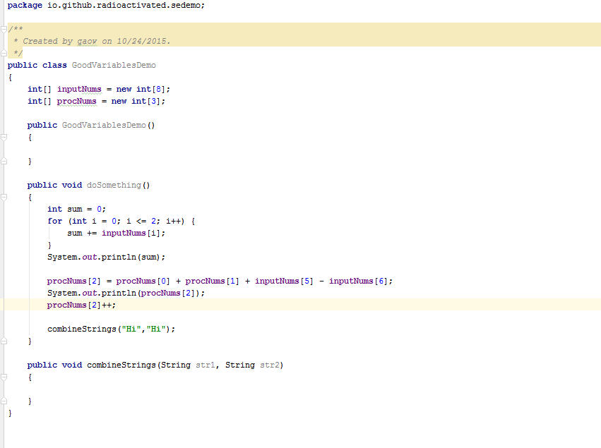
Arrays make inline declarations of related variables more concise
Use your for loops!
Name now describes function

Slide 13
A name can make all the difference. Choose wisely.

Slide 14
Code Documentation
“Say, what’s this wall of text for again?” –You, revisiting an old project

Slide 15
Comments
USE THEM

Slide 16
Commenting Code
Comments allow inline documentation in code
Use to describe a portion of text
You’ll understand it after weeks of break
Other programmers will be able to understand it

Slide 17
Special Case: The TODO
Literally a marker for things “to do”
TODO comments can be used to highlight code that:
Needs work
Has a potential solution
You want to document said possible solution

Slide 18

Fancy blue highlighting in IntelliJ/Android Studio for TODOs

Slide 19

Comment Styles
Inline comments
Ex: run_code(); //runs code
Can annotate just a few lines of code
Block comments
Can span multiple lines
Good for large documentation
Can impede flow of code reading
Auto-generated block comment

Slide 20
To repeat…

Slide 21
Comments
USE THEM

Slide 22
Miscellaneous Dos and Don’ts
Pseudorandom tips for a better code

Slide 23
Learning From The Code
Don’t copy and paste
Easy to make errors
Especially when each copy/paste has small changes
You don’t learn what the code does
Do replicate the code separately
Allows in-depth study without fear of breaking original code

Slide 24
Tedium in The Code
Don’t copy and paste identical code in different parts
Includes methods, variables, calculated values, etc.
A change to the code forces a change to every copy/pasted part
Not worth your time
You can and will make mistakes in the process
Do make methods and variables for repeated code
If it’s used more than once, make a method or variable for it!

Slide 25
Spaghetti Code
Avoid spaghetti in the code!
Messy, hard to debug
Easy to break by changing a seemingly unrelated line

Slide 26
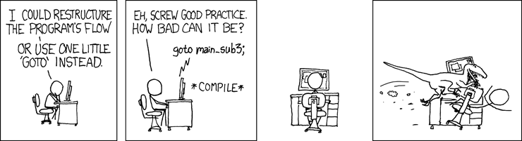
xkcd #292

Slide 27
Questions?

