Slide 1
Organization in Programming
Wei Gao Silicon Edge Robotics (FTC Team 10341)

Slide 2
Part 1: File Naming

Slide 3
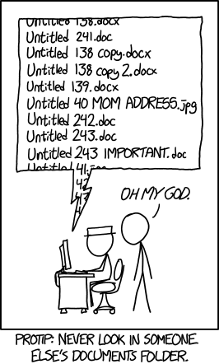
Copy of Copy of Copy of Copy of Copy of Copy of Copy of Copy of Copy of Copy of Copy of Copy of Copy of Copy of Copy of Copy of Copy of Copy of Copy of Copy of Copy of Copy of Copy of Copy of Copy of Copy of Copy of Copy of Copy of Copy of Copy of Copy of Copy of Untitled.doc (xkcd #1459)

Slide 4
Naming Files
Make it meaningful
Make it easy to read
CamelCase or snake_case often used
Shorter is often better
Abbreviations don’t help

Slide 5
Naming Examples
Great: get_telemetry_data.py
Relatively short
Function very obvious
Good: telemetry.py
Function obvious
Vague content
Better: datalog_01-01-1970.txt

Slide 6
Naming Examples (cont.)
Bad: gettelemetryandprintdatatoscreen.py
Function obvious, but hard to read
Too long, could be more concise
Ex: telemetry_handler.py
Bad: gtd01.py
What the heck does ‘gtd’ or ‘01’ mean
Undescriptive
Note: May be good for obfuscation

Slide 7
Bottom line: Keep it concise but descriptive

Slide 8
Part 2: Naming in Code
Variable Naming and Code Structure

