Slide 1
The invention of the quartz clock
By eitan cohen

Slide 2
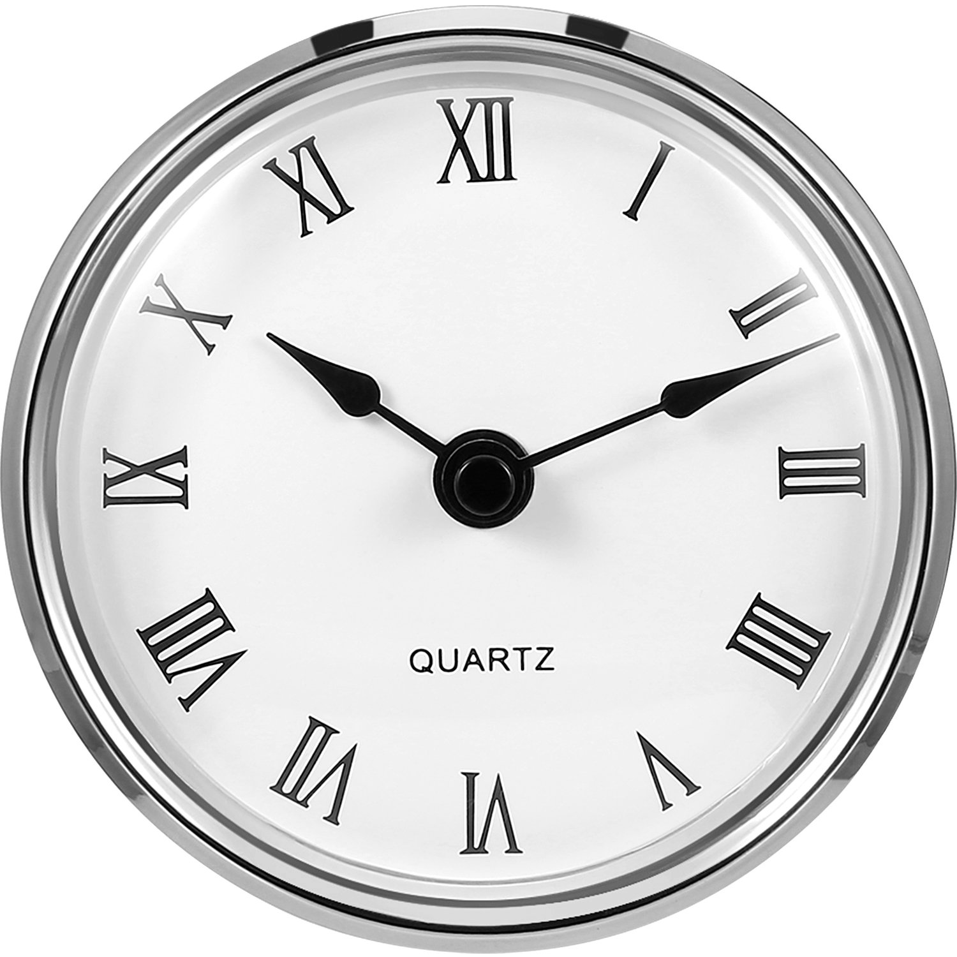
Why I chose the invention
Quartz clocks are interesting

