Slide 1
MongoDB
CRUD Operations
161094 - Divansh Anupam
Report

Slide 2
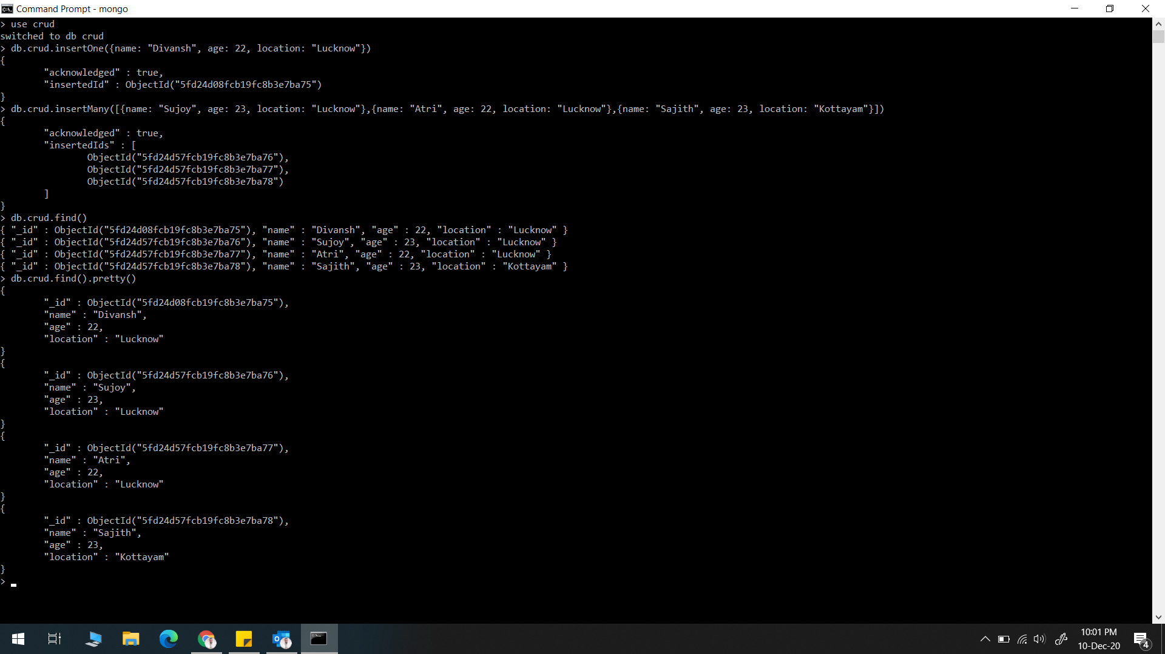
insertOne() & insertMany()

Slide 3
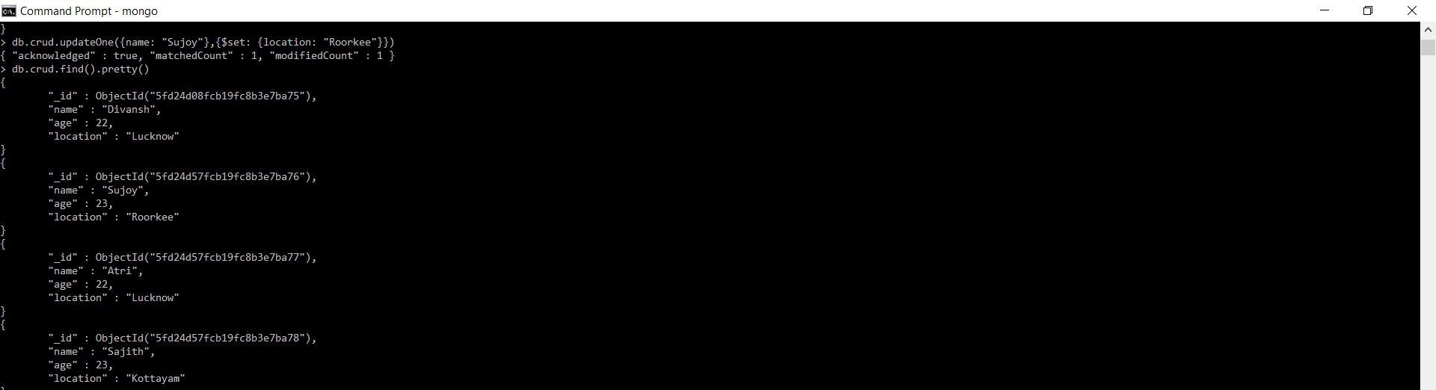
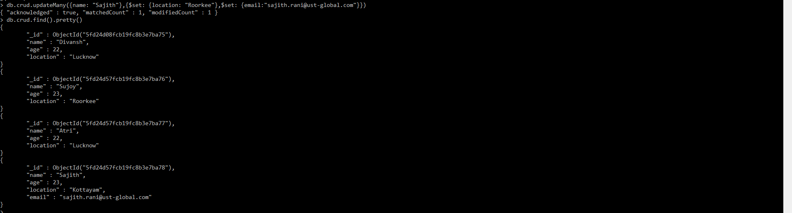
updateOne() & updateMany()

Slide 4
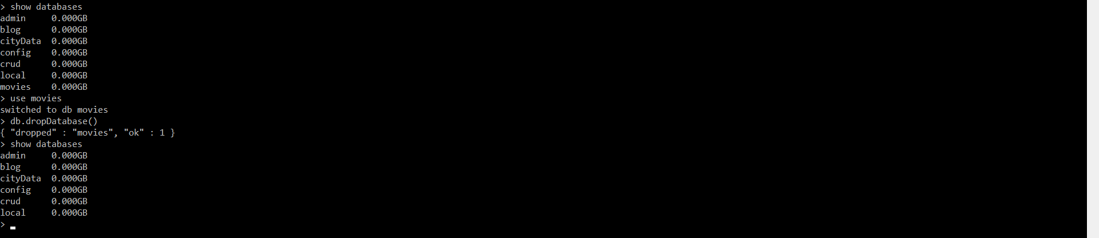
db.dropDatabase()

Slide 5
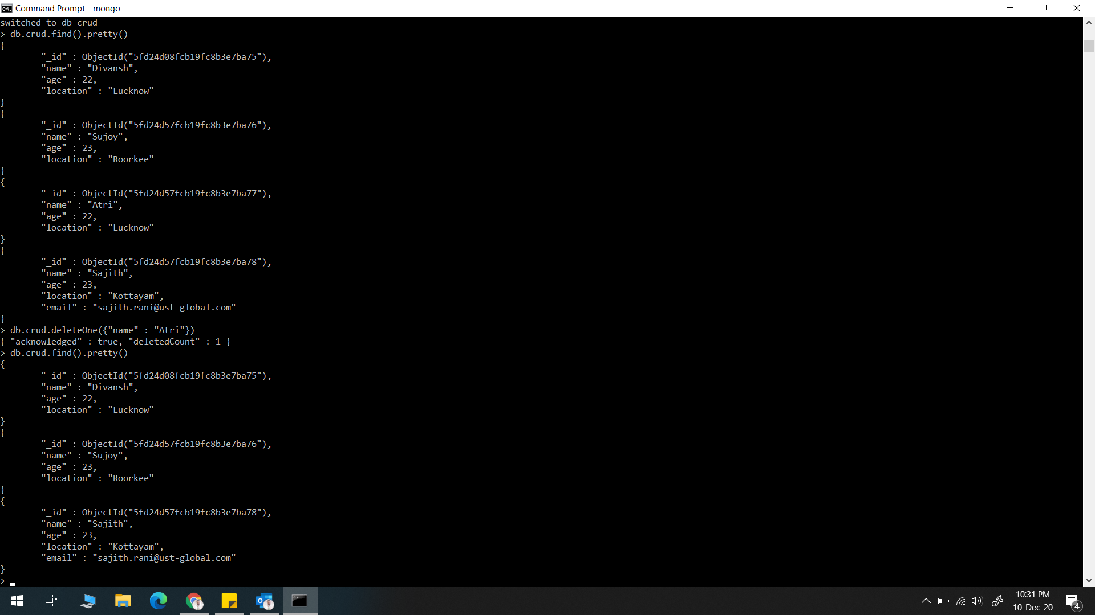
deleteOne()

Slide 6
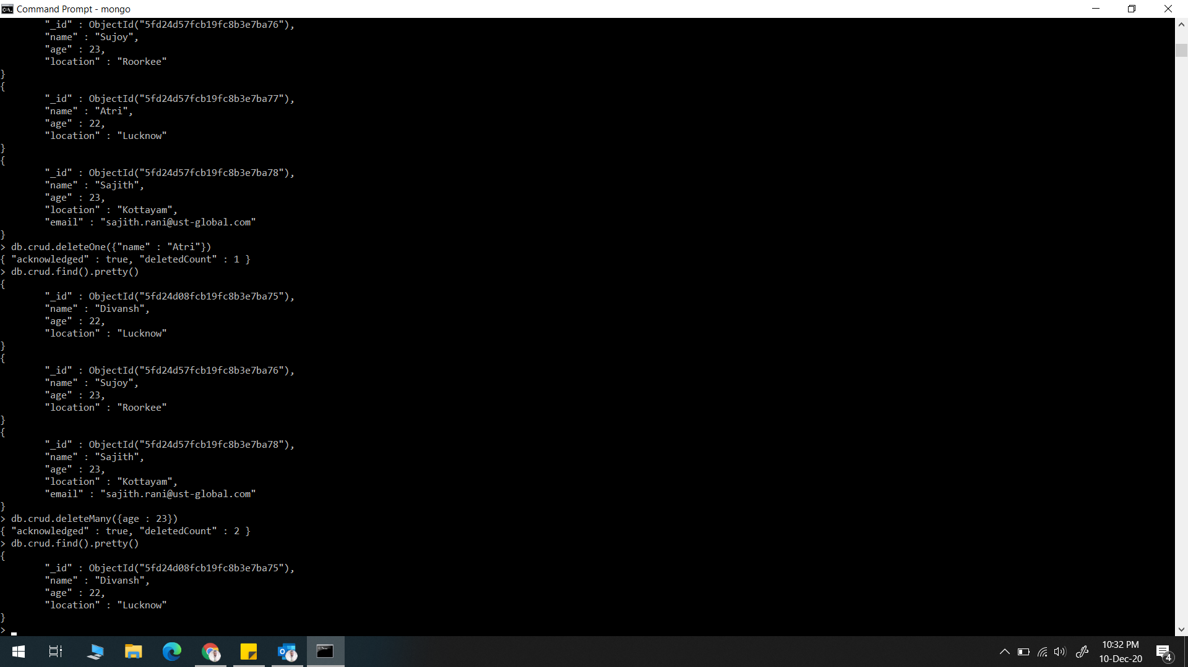
deleteMany()

