Slide 1
MongoDB
CRUD Operations
161094 - Divansh Anupam
Report

Slide 2
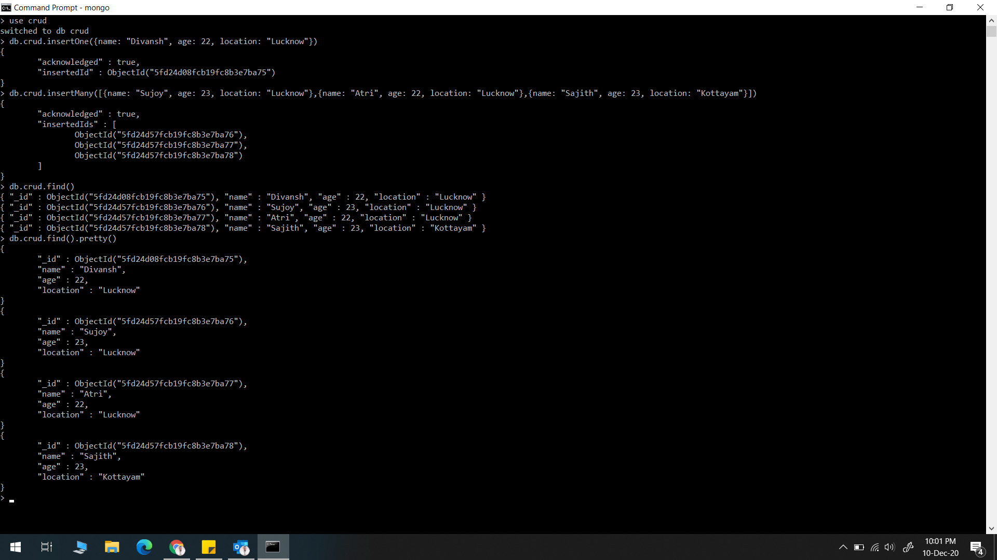
insertOne() & insertMany()

Slide 3
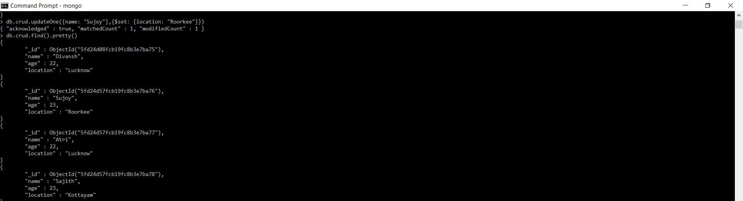
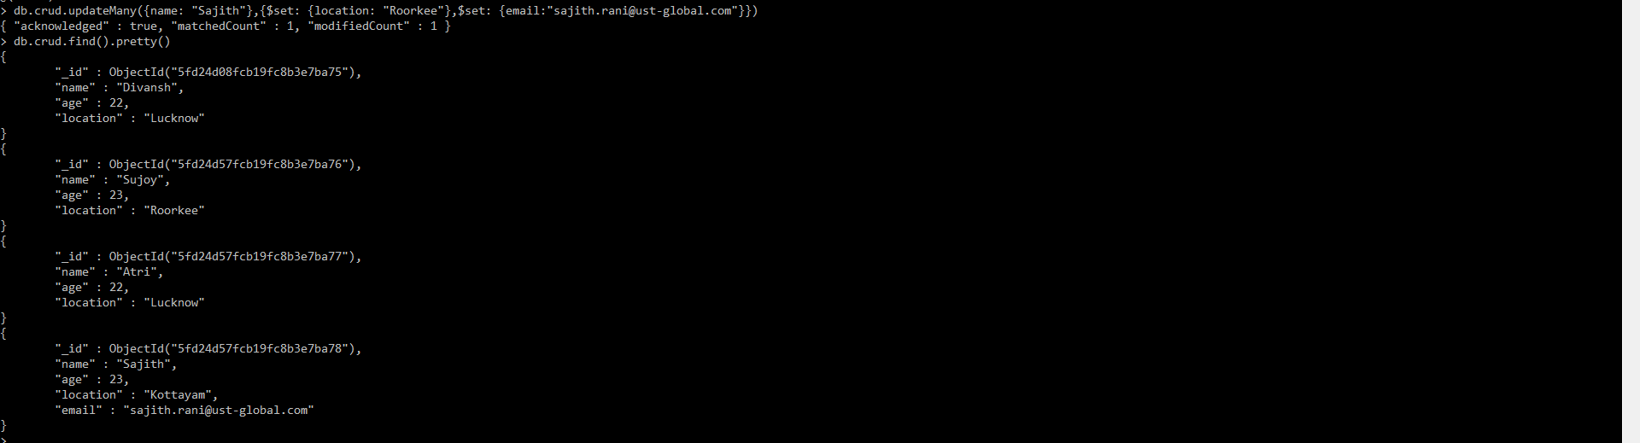
updateOne() & updateMany()

Slide 4
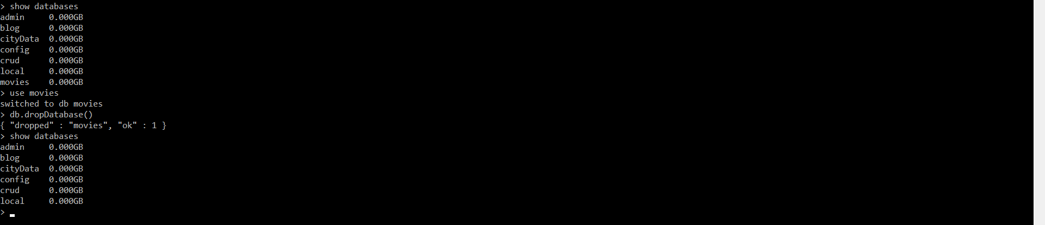
db.dropDatabase()

Slide 5
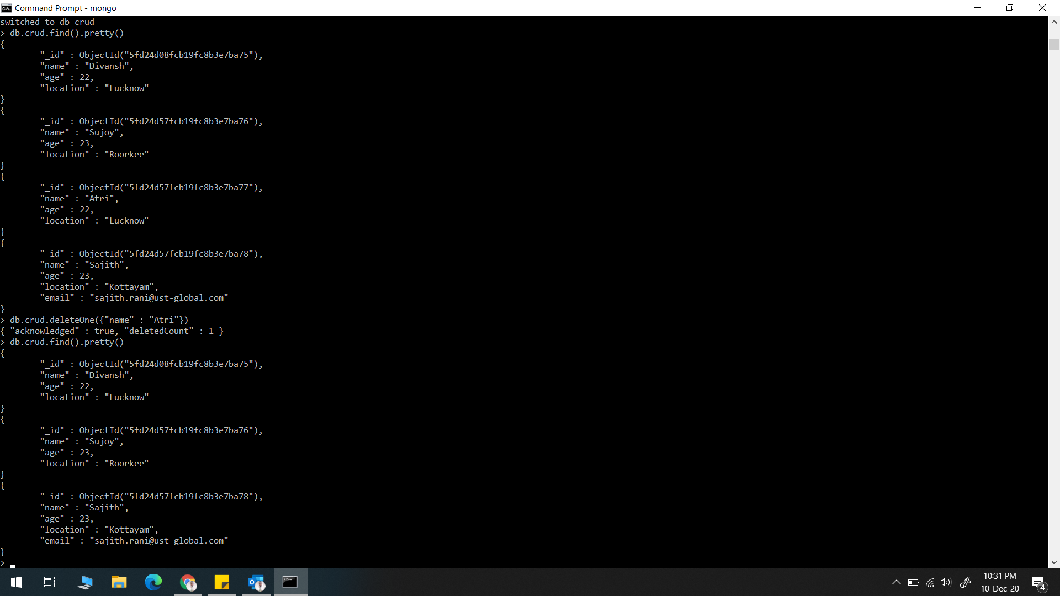
deleteOne()

Slide 6
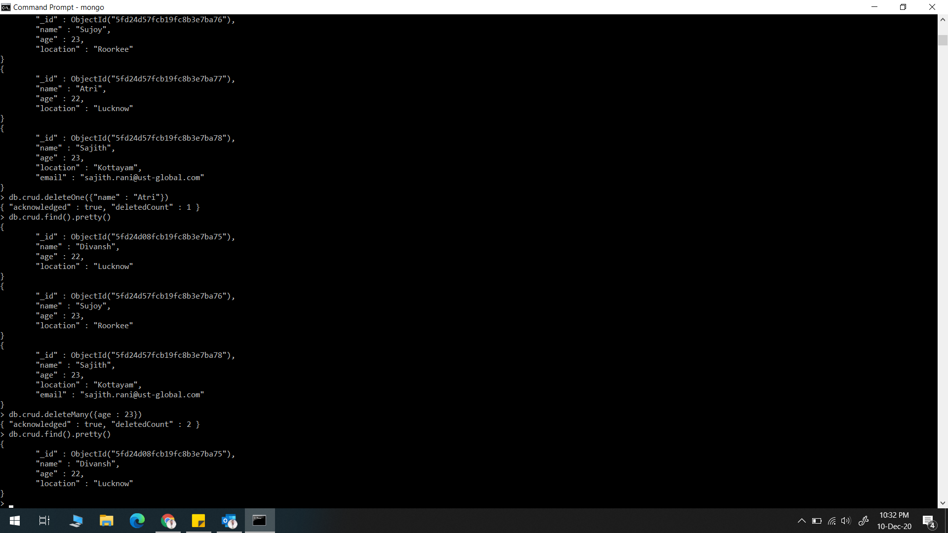
deleteMany()

Slide 7
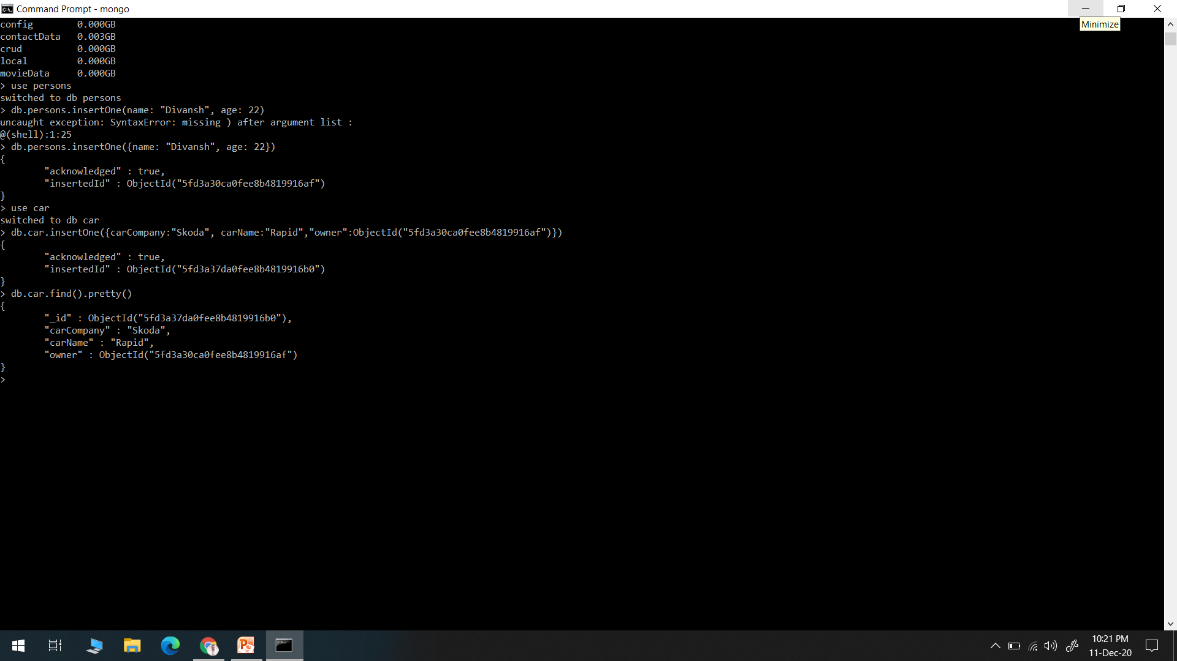

Slide 8
One to Many
db.person.insetOne({Name: “Manoj”, age:56})
db.cars.insertOne(
{
model:“AUDI",
price:“500000"
owner:Object(“bgfahsk87124")
}
)

Slide 9
db.cities.insertOne(name:“Lucknow",cordinate : {lat:22,long:34})
db.citizens.insertMany(
[
{
name: ”Divansh”,
cityId: ObjectId("5fd1c6191f3c730b599ba720")
},
{
name: ”Atri”,
cityId: ObjectId("5fd1c6191f3c730b599ba720")
},
]
)

Slide 10
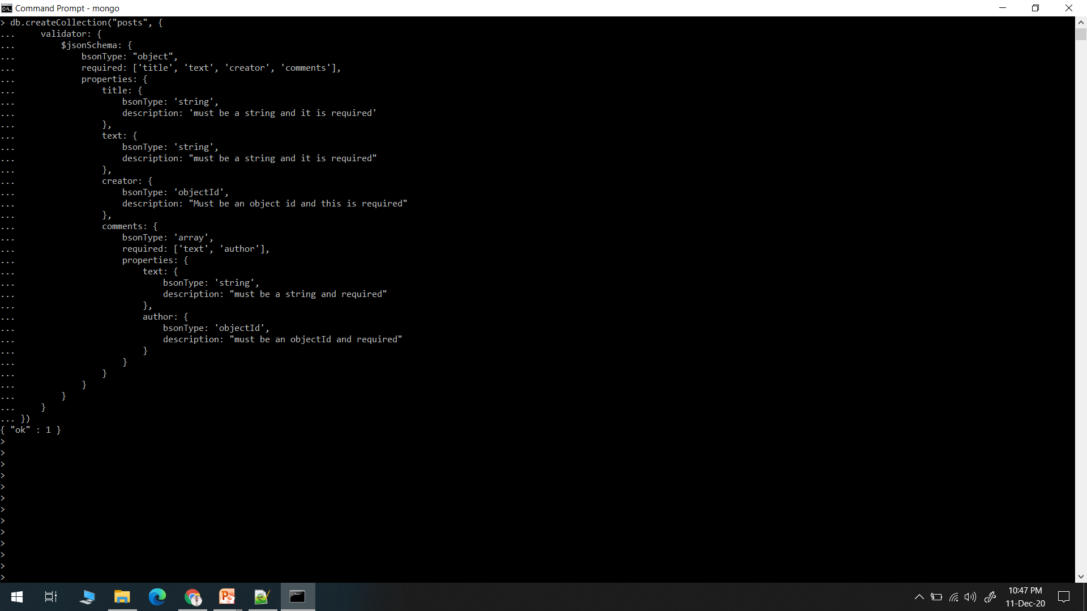

Slide 11
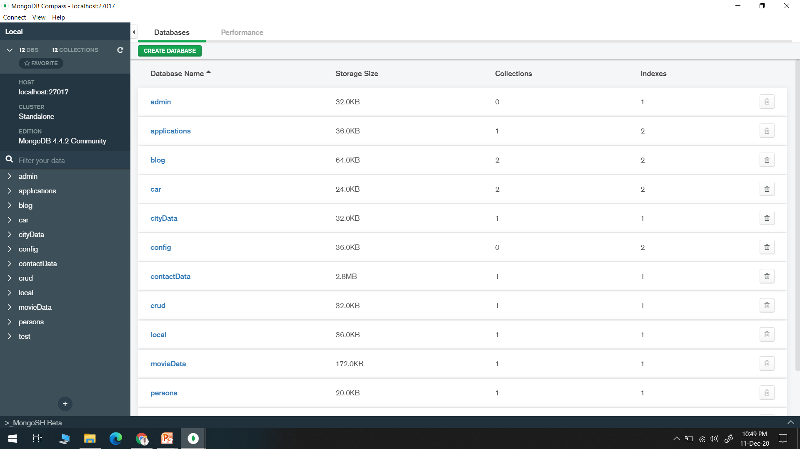

Slide 12
