Slide 1


Working With Data.
D AY 0 6 · H I N D U C O L L E G E A M R I T S A R · B C A S E M E S T E R I I I · P H A S E 2 C O N T I N U E S
P R O G R A M
Python Internship
L E D B Y
Zlaark
Yesterday you organized widgets. Today we fill them with real data — CSV files, spreadsheets, tables. Your apps start remembering things.
S E S S I O N
6 of 24
2 A U G U S T 2 0 2 6

Slide 2






How we’ll spend our 90 minutes today.
Today is the densest day of Phase 2 — six pandas concepts, one cheatsheet, and a dashboard exercise that combines everything you have learned so far.
A G E N D A · D AY 0 6
D U R A T I O N
90 min
00:00 – 00:10
00:10 – 00:25
00:25 – 00:40
Day 5 Recap & Q&A
Layout primitives, session_state, the personal info form. Quick check.
DataFrames + Loading Data
What a DataFrame is, how to load a CSV, the three read_*
functions you will actually use.
Inspecting + Filtering + Sorting
head / info / describe , boolean masks, sort_values . The 80% you will do every day.
00:40 – 00:55
00:55 – 01:10
01:10 – 01:30
Exercise: Student Dashboard
Build a Streamlit app that loads a CSV and filters by branch/city. Combines Day 5 sidebar + Day 6 pandas.
loc vs iloc + New Columns
Label-based vs position-based indexing. Adding and modifying columns.
pandas Cheatsheet
The 10 commands you’ll use 90% of the time. A printable reference card worth bookmarking.

Slide 3


Yesterday you built a form. Today we feed it data.
R E C A P · 1 0 M I N
Quick check that Day 5’s form app runs. If it doesn’t, we fix it now — today’s exercise builds on the sidebar pattern.
W H AT W E C O V E R E D Y E S T E R D AY DAY 05
C H E C K Y O U R L A P T O P N O W VERIFY
# You should have Day 5's form files:
$ ls day5/ 10_form_solution.py 11_form_extended.py
...
# Run the form — should open in browser:
$ streamlit run 10_form_solution.py # → Browser opens at localhost:8501 # → Fill the form, click Submit
# → Success message + summary appears
IF THE FORM DOESN’T RUN — raise your hand. Common issue: forgot to activate .venv first. Run source
.venv/bin/activate (macOS) or
.venv\Scripts\Activate.ps1 (Windows), then retry.
"”
Widget keys — the habit that pays off in Phase 4
"”
The 5 layout primitives — columns , sidebar , tabs , expander , container / empty
"”
session_state — making variables persist across the run-loop
"”
Layout patterns cheatsheet — when to use which primitive
"”
Built a personal info form with st.form — the Phase-4 data-collection pattern

Slide 4





pandas is a spreadsheet you control with code.
You already know spreadsheets — rows, columns, filters, sorts. pandas gives you the same operations, but as Python code. Repeatable, scriptable, and able to handle files Excel chokes on.
C O N C E P T · W H Y PA N D A S
I N E X C E L WHAT YOU KNOW
Rows and columns
A grid of data. Each column has a name, each row has a position.
Filters
Show only rows where column X meets a condition.
Sorts
Reorder rows by one or more columns, ascending or descending.
Formulas
SUM, AVERAGE, COUNT — aggregate a column or a selection.
Pivot tables
Group by one column, aggregate another. The most powerful Excel feature.
Powerful, but every action is a click. Not repeatable. Not scriptable.
I N PA N D A S THE CODE VERSION
DataFrame
A table. Rows have an index, columns have names. The central pandas object.
df[df["age"] > 20]
Boolean mask filtering. One line of code, repeatable.
df.sort_values("marks")
Sort by a column. Chain multiple sorts.
df["marks"].mean()
Aggregate a column. Same idea, code syntax.
df.groupby("city")["marks"].mean()
Group by + aggregate. The pivot table, as one line.
Same operations. Code instead of clicks. Scriptable, repeatable, scales to millions of rows.
KEY IDEA
If you can do it in Excel, you can do it in pandas. The mental model is the same — the syntax is Python.

Slide 5

A DataFrame is a table. Rows have an index, columns have names.
C O N C E P T · T H E D ATA F R A M E
That’s it. Every pandas operation is about selecting rows, selecting columns, or transforming them. Once you internalise this mental model, the API becomes obvious.
A D ATA F R A M E — S T U D E N T S . C S V
T H E M E N TA L M O D E L
C O LU M N S ↓ N A M E S
1
A DataFrame is 2D
Rows + columns. Like a spreadsheet. Like a SQL table. Like a CSV file loaded into memory.
index | name | age | city | branch | marks
0 | Aarav | 20 | Amritsar | BCA | 85
1 | Priya | 21 | Jalandhar | BCA | 92
2 | Rahul | 22 | Amritsar | BSc-IT | 78
3 | Meera | 20 | Ludhiana | BCA | 88
2
A Series is 1D
A single column (or a single row). Every column in a DataFrame is a Series. Most operations work on both.
I N D E X →
3
The index is NOT a column
The leftmost numbers (0,1,2,3) are the index — row labels, not data. Don’t confuse them with the first data column.
R O W ← D F .CLOOLCU[M1 N] ↑ D F [ " M A R K S " ]
4
dtypes matter
Each column has a dtype: int64 , float64 , object (strings), bool ,
datetime64 . Mismatched dtypes cause silent bugs. Check with df.dtypes .
KEY IDEA
Selecting rows, selecting columns, transforming them. That’s 90% of pandas. The other 10% is just syntax.

Slide 6


Three loaders. read_csv covers 90% of what you will ever do.
C O N C E P T · L O A D I N G D ATA
pandas can read CSV, Excel, JSON, SQL, HTML tables, Parquet, and a dozen other formats. In this program, you will use three. Master those three.
pd.read_csv(filepath)
CSV files. The most common format. Comma-separated, plain text. What you will use 90% of the time.
BEST FOR Tabular data exported from any tool. Logs, exports, datasets.
loading_demo.py
import pandas as pd
# === Load a CSV ===
df = pd.read_csv("students.csv")
# → returns a DataFrame
pd.read_excel(filepath)
Excel files ( .xlsx , .xls ). Requires the openpyxl package — pip install openpyxl .
# === Common useful arguments ===
df = pd.read_csv( "students.csv",
BEST FOR
When the source is an Excel file with formatting, multiple sheets, or formulas.
sep=",", header=0, index_col=0, nrows=100, encoding="utf-8",
# delimiter (default comma)
# row number to use as column names # column to use as row index
# only load first 100 rows (big files) # for files with non-ASCII chars
pd.read_json(filepath)
JSON files. Common for API responses. Each row becomes a dict, the list of dicts becomes a DataFrame.
BEST FOR Data from web APIs (Day 11), NoSQL databases, config files.
)
# === Loading from a URL (Day 11 preview) ===
url = "https://example.com/data.csv"
df = pd.read_csv(url) # works the same way!
# === Quick check it loaded === print(df.shape) # (rows, cols) print(df.head()) # first 5 rows
TIP
If read_csv fails, check: (1) is the file in the same folder? (2) is the path correct? (3) is the encoding utf-8 ? 90% of loading errors are one of these three.
0 6 / 1 8

Slide 7





Three commands. Run them every time you load a DataFrame.
Before you do anything else, run these three. They tell you the shape, the structure, and the statistical summary. Five seconds of inspection saves an hour of debugging.
C O N C E P T · I N S P E C T I N G D ATA
df.head(n=5)
First n rows. Confirms the data loaded correctly and the columns look right.
name | age | city | branch | marks
Aarav | 20 | Amritsar | BCA | 85
Priya | 21 | Jalandhar | BCA | 92
Rahul | 22 | Amritsar | BSc-IT | 78
Meera | 20 | Ludhiana | BCA | 88
Sanjana | 21 | Amritsar | BCA | 91
df.head() df.head(10)
# default 5 rows # first 10 rows
df.info()
<class 'pandas.core.frame.DataFrame'> RangeIndex: 28 entries, 0 to 27
Data columns (total 5 columns):
# Column Non-Null Count Dtype
Structure summary. Column names, dtypes, non-null counts, memory usage. The most overlooked command.
name
age
city
branch
marks
28 non-null
28 non-null
28 non-null
28 non-null
28 non-null
object int64 object object int64
df.info()
df.describe()
age
marks
Statistical summary of numeric columns. Count, mean, std, min, max, quartiles.
count
28.0
28.0
mean
20.8
84.7
std
1.0
6.4
min
19.0
72.0
25%
20.0
80.0
50%
21.0
85.0
75% | 21.0 | 90.0
max | 23.0 | 95.0
df.describe()
BONUS df.shape returns (rows, cols) as a tuple. df.columns returns the column names. df.dtypes returns the dtype of each column. Run these too.

Slide 8
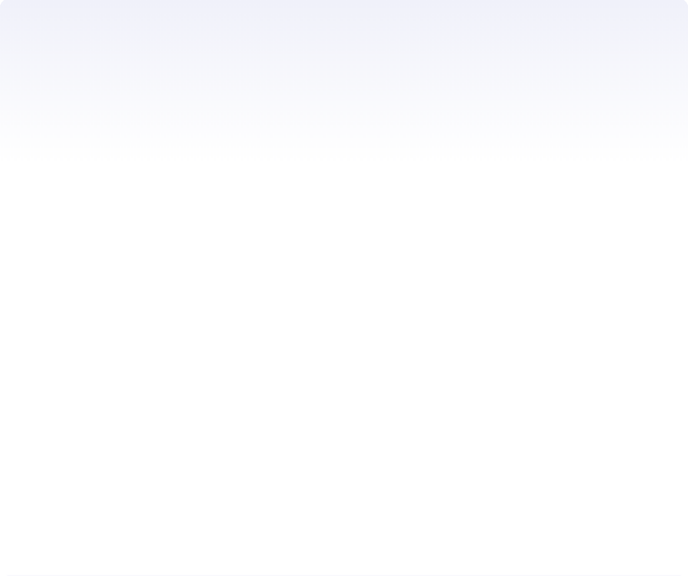

Filtering = create a boolean mask, then use it to select rows.
C O N C E P T · F I LT E R I N G
D AY 0 6 · W O R K I N G W I T H D ATA
This is the single most important pandas pattern. Once you get boolean masks, every filter becomes obvious.
T H E M E N TA L M O D E L
S T E P 1 C R E AT E A M A S K ( S E R I E S O F T R U E / FA L S E , O N E P E R R O W )
df["age"] > 20
→ [False, True, True, True, False, ...]
↓
S T E P 2 U S E T H E M A S K T O S E L E C T R O W S
df[mask]
→ only rows where True
filtering_demo.py
PYTHON
import pandas as pd
df = pd.read_csv("students.csv")
# === Step 1: Create a mask ===
# A mask is a Series of True/False, one per row.
mask = df["age"] > 20
# → [False, True, True, True, False, ...]
# === Step 2: Use the mask to select rows ===
older = df[mask]
# → only rows where mask is True
1
The mask is a Series — Same length as the DataFrame. Each value is True or False.
2
df[mask] returns rows where True — A filtered DataFrame. Original is unchanged.
3
Combine masks with & (and), | (or), ~ (not) — Wrap each in parentheses: df[(df["age"] > 20) & (df["city"] == "Amritsar")] .
# Or as a one-liner (common in real code):
older = df[df["age"] > 20]
# The original df is UNCHANGED.
# df[mask] returns a new filtered DataFrame. # Next slide: combining multiple conditions.
K E Y I D E A
Every filter is two steps: create a mask (a True/False Series), then use it to select rows ( df[mask] ). Master this pattern, and every filter becomes obvious. Next slide: combining multiple conditions.

Slide 9

Combining conditions: AND, OR, contains, isin.
C O N C E P T · F I LT E R I N G , PA R T 2
D AY 0 6 · W O R K I N G W I T H D ATA
One condition is rarely enough. Real filters combine multiple conditions — and pandas has specific syntax for each pattern.
filtering_advanced.py
PYTHON
F O U R PAT T E R N S
import pandas as pd
df = pd.read_csv("students.csv")
&
AND — & — Both conditions must be True. Wrap each in parens: (df["x"]
> 5) & (df["y"] < 10) .
# === 1. Multiple conditions (AND) ===
# Both must be True. Use & (bitwise and). # WRAP EACH CONDITION IN PARENTHESES.
amritsar_bca = df[
(df["city"] == "Amritsar") &
(df["branch"] == "BCA")
]
|
OR — | — Either condition can be True. Same paren rule: (df["x"] > 5)
| (df["y"] < 10) .
~
NOT — ~ — Invert a mask. ~(df["age"] > 20) gives rows where age ≤ 20.
String contains — .str.contains() — Substring match on a text column. Case-sensitive by default; add case=False to ignore.
Aa
∈
Is in a list — .isin() — Filter by a set of allowed values. Faster than chaining multiple == with | .
# === 2. Multiple conditions (OR) ===
# Either can be True. Use | (bitwise or).
young_or_old = df[ (df["age"] < 20) |
(df["age"] > 22)
]
# === 3. String contains ===
G OTC H A Always wrap each condition in parentheses when combining with & or | . df[df["age"] > 20 & df["city"] == "Amritsar"] raises a TypeError. Pandas operator precedence is different from Python —
the parens are not optional.
0 9 / 1 8

Slide 10



sort_values — reorder rows by one or more columns.
C O N C E P T · S O R T I N G
D AY 0 6 · W O R K I N G W I T H D ATA
Simple, but with two gotchas: ascending defaults to True , and inplace defaults to False . Get these wrong and you will wonder why your sort didn't work.
T H E M E N TA L M O D E L
Single column
df.sort_values("marks") — sort by one column, ascending by default.
Multiple columns
df.sort_values(["city", "marks"]) — sort by city first, then by marks within each city.
Descending
Pass ascending=False to flip the order.
Returns a copy
Default: returns a new DataFrame, original unchanged. Use inplace=True to modify the original.
sorting_demo.py
PYTHON
import pandas as pd
df = pd.read_csv("students.csv")
# === Sort by one column, ascending ===
sorted_df = df.sort_values("marks")
# lowest marks first
# === Sort by one column, descending ===
top_first = df.sort_values("marks", ascending=False)
# highest marks first
# === Sort by multiple columns ===
# Sort by city (A-Z), then by marks (high-low) within each city
city_then_marks = df.sort_values( ["city", "marks"], ascending=[True, False]
)
# === Modify in place (rare — prefer the copy) === # df.sort_values("marks", inplace=True)
# → modifies df directly, returns None
# === Reset the index after sorting ===
sorted_df = df.sort_values("marks", ascending=False).reset_index(drop=True)
# → index becomes 0,1,2,3... again
PAT T E R N
Almost always: df.sort_values("col", ascending=False).reset_index(drop=True) . The reset_index keeps the index clean after rows are reordered.
1 0 / 1 8

Slide 11
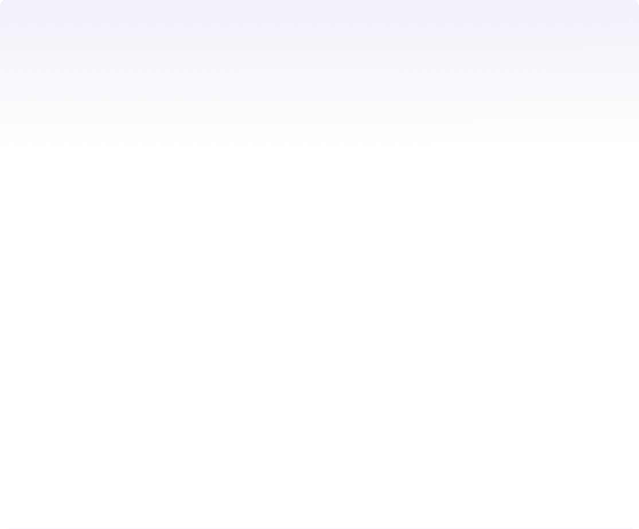

loc uses labels. iloc uses positions. They are NOT interchangeable.
C O N C E P T · L O C V S I L O C
D AY 0 6 · W O R K I N G W I T H D ATA
This trips up every pandas beginner. loc looks up by row label and column name. iloc looks up by row number and column number. Different inputs, different outputs.
L O C · L A B E L - B A S E D
df.loc[row_label, col_name]
Uses the INDEX (row labels) and COLUMN NAMES
Inclusive on both ends: df.loc[0:3] returns rows 0,1,2,3 (4 rows)
# Row with index label 2
df.loc[2]
# Rows 0 through 3 (INCLUSIVE — 4 rows)
df.loc[0:3]
# Specific rows + specific columns
df.loc[[0, 2, 4], ["name", "marks"]]
# Boolean mask filtering
df.loc[df["age"] > 20, ["name", "marks"]]
I L O C · P O S I T I O N - B A S E D
df.iloc[row_position, col_position]
Uses POSITIONS (0,1,2,3...) like a Python list
Exclusive on the end: df.iloc[0:3] returns rows 0,1,2 (3 rows)
# Row at position 2 (third row)
df.iloc[2]
# Rows 0 through 2 (EXCLUSIVE — 3 rows)
df.iloc[0:3]
# First 3 rows, first 2 columns
df.iloc[0:3, 0:2]
# Last row
df.iloc[-1]
G OTC H A
When the index is default (0,1,2,3...),
df.loc[2] and
df.iloc[2] return the same row. But
df.loc[0:3] returns 4 rows,
df.iloc[0:3] returns 3 rows. The slicing is different. Always check which one you meant.
1 1 / 1 8

Slide 12
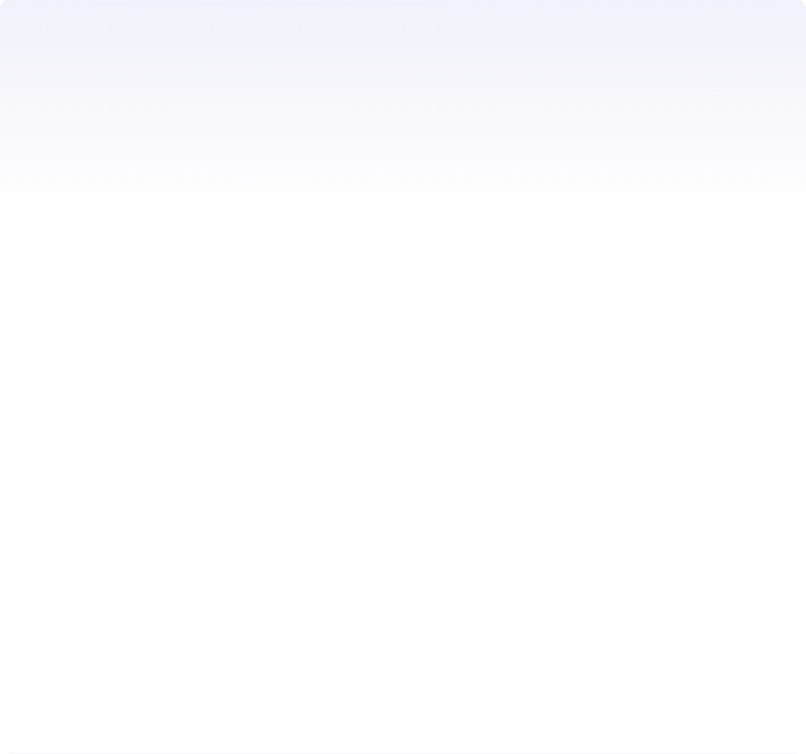



New columns = old columns + an operation. Same syntax as variables.
C O N C E P T · A D D I N G + M O D I F Y I N G C O L U M N S
D AY 0 6 · W O R K I N G W I T H D ATA
Creating a new column is just df["new"] = ... . The right side can be a constant, a calculation on other columns, or a function applied row-by-row.
T H R E E PAT T E R N S
columns_demo.py
PYTHON
import pandas as pd
df = pd.read_csv("students.csv")
1
Constant value
df["status"] = "active"
every row gets the same value.
# === 1. Add a constant column ===
df["school"] = "Hindu College Amritsar"
# === 2. Column arithmetic ===
# Convert marks (out of 100) to percentage
df["percentage"] = df["marks"] / 100 * 100
2
Column arithmetic
df["total"] = df["marks"] + df["bonus"]
element-wise operation on two columns.
# === 3. Apply a function ===
def to_grade(marks: int) -> str: if marks >= 90: return "A" if marks >= 80: return "B" if marks >= 70: return "C" return "F"
3
Row-wise transform
df["grade"] = df["marks"].apply(to_grade)
apply a function to each value in a column.
df["grade"] = df["marks"].apply(to_grade)
# === 4. Modify an existing column ===
df["city"] = df["city"].str.upper()
# → "amritsar" becomes "AMRITSAR"
# === 5. Conditional column (np.where) ===
import numpy as np
df["passed"] = np.where(df["marks"] >= 40, "Yes", "No")
# === 6. Drop a column ===
df = df.drop(columns=["school"])
# or: df.drop("school", axis=1, inplace=True)
PAT T E R N
df["new_col"] = ... is how you create or overwrite. The right side can be anything that produces a Series of the right length: a constant, column math, .apply() , np.where() , or another column.
1 2 / 1 8

Slide 13

Bookmark this slide. These 10 commands are 90% of pandas.
C H E AT S H E E T · T H E 1 0 C O M M A N D S Y O U ' L L U S E M O S T
D AY 0 6 · W O R K I N G W I T H D ATA
You've seen most of these today. Here they are in one place, with a one-line example each. Print this. Tape it to your laptop.
01
pd.read_csv(path) Load a CSV file into a DataFrame.
df = pd.read_csv("students.csv")
02
df.head(n)
First n rows. Default 5. Quick sanity check.
df.head(10)
03
df.info()
Structure summary. Columns, dtypes, non-null counts.
04
df.describe()
Statistical summary of numeric columns.
df.info()
df.describe()
05
df["col"] Select one column. Returns a Series.
names = df["name"]
06
df[mask] Filter rows with a boolean mask.
df[df["age"] > 20]
07
df.sort_values("col") Sort by a column. ascending=True by default.
df.sort_values("marks", ascending=False)
08
df.loc[row, col] Label-based selection. Rows + columns by name.
df.loc[0:3, ["name", "marks"]]
09
df["new"] = ... Add or modify a column.
df["grade"] = df["marks"].apply(to_grade)
10
df.groupby("col") Group rows by a column. Chain with .mean(), .sum(), .count().
df.groupby("city")["marks"].mean()
PAT T E R N
Load with read_csv , inspect with head/info/describe , filter with df[mask] , sort with sort_values , select with loc , transform with df["new"] = ... . That's the whole workflow.

Slide 14

03 / 03
PA R T 3 O F 3 · C L O S I N G E X E R C I S E
Build a student dashboard. Sidebar + pandas.
Today's exercise combines Day 5's sidebar pattern with Day 6's pandas. Load a CSV, filter by branch and city, display the results. The dashboard pattern every group will reuse in Phase 4.
1
B R I E F · 5 MIN
2
B U I L D · 15 MIN
3
E X T E N D · 5 MIN

Slide 15
Load students.csv . Filter by branch and city. Display the result.
E X E R C I S E · B R I E F · 5 M I N
A real dashboard pattern. Controls in the sidebar (Day 5), data filtering with pandas (Day 6), results in the main area. Every group project will have some version of this.
T H E B R I E F
TA S K
S A M P L E D ATA
C S V
S TA R T I N G S C A F F O L D
TO D O
Build a Streamlit app called dashboard.py that loads students.csv , displays the full table, and lets the user filter by branch and city using sidebar widgets.
R E Q U I R E M E N T S
Load the CSV with pd.read_csv
Show the full DataFrame using st.dataframe
Sidebar: a selectbox for branch (All + unique branches)
Sidebar: a selectbox for city (All + unique cities)
Filter the DataFrame based on selections
Show the filtered DataFrame below the full one
B Y T H E E N D
Every student has a working dashboard that filters a real CSV by two columns. The pattern groups will reuse in Phase 4.
students.csv
name,age,city,branch,marks Aarav,20,Amritsar,BCA,85 Priya,21,Jalandhar,BCA,92 Rahul,22,Amritsar,BSc-IT,78 Meera,20,Ludhiana,BCA,88 Sanjana,21,Amritsar,BCA,91 Vikram,23,Jalandhar,BSc-IT,75 Anjali,20,Amritsar,BCA,89 Karan,22,Ludhiana,BCA,82 ... (28 rows total)
# dashboard.py — starting scaffold
import streamlit as st import pandas as pd
st.title("Student Dashboard")
# 1. Load the data
df = pd.read_csv("students.csv")
# 2. Sidebar controls with st.sidebar: st.write("**Filters**") # TODO: branch selectbox
# options = ["All"] + df["branch"].unique().tolist()
# branch = st.selectbox("Branch", options) # TODO: city selectbox
# city = st.selectbox("City", options)
# 3. Show full data st.write("**All students**") st.dataframe(df)
# 4. Filter (TODO) # filtered = df
# if branch != "All":
# filtered = filtered[filtered["branch"] == branch] # if city != "All":
# filtered = filtered[filtered["city"] == city]
# 5. Show filtered (TODO)
# st.write(f"**Filtered: {len(filtered)} students**") # st.dataframe(filtered)
RU N I T
streamlit run dashboard.py . Pick a branch + city in the sidebar. The filtered table updates live.

Slide 16



One way to solve it. There are others — this is just clean.
E X E R C I S E · S O L U T I O N W A L K T H R O U G H
Walk through this line by line. Then go back to your own version and compare.
dashboard.py
S O L U T I O N
L I N E B Y L I N E
6 S T E P S
import streamlit as st import pandas as pd
Title
Standard st.title . The page heading.
Load the data
pd.read_csv loads the CSV into a DataFrame. One line.
Sidebar controls
Build option lists: ["All"] + unique values . The "All" option is the no-filter default. Both widgets keyed.
Show full data
st.dataframe renders an interactive table. Below it, a count of total rows.
Filter
Start with the full df, then apply each filter only if the user picked something other than "All". The universal dashboard pattern.
Show filtered + stats
st.dataframe again for the filtered result. Bonus: average marks of the filtered set, formatted to 1 decimal.
1
2
3
4
5
6
1
st.title("Student Dashboard")
2
df = pd.read_csv("students.csv")
3
with st.sidebar:
st.write("**Filters**")
branches = ["All"] + df["branch"].unique().tolist() cities = ["All"] + df["city"].unique().tolist()
branch = st.selectbox("Branch", branches, key="filter_branch") city = st.selectbox("City", cities, key="filter_city")
4
st.write("**All students**")
st.dataframe(df)
st.write(f"Total: {len(df)} students")
5
filtered = df
if branch != "All":
filtered = filtered[filtered["branch"] == branch]
if city != "All":
filtered = filtered[filtered["city"] == city]
6
st.write(f"**Filtered: {len(filtered)} students**") st.dataframe(filtered)
if len(filtered) > 0:
st.write(f"Average marks: {filtered[\"marks\"].mean():.1f}")
OT H E R S O LU T I O N S E X I S T — You could use st.data_editor for editable tables, st.metric for the count, or groupby for per-branch averages. All valid. This version is the most readable for a beginner.

Slide 17



Finished early? Add stats. Or peek at tomorrow.
E X E R C I S E · E X T E N D + W H AT ' S N E X T
Three extension ideas for fast students. Plus a preview of Day 7 — when your data gets visual.
E X T E N S I O N I D E A S
F O R FA S T S T U D E N T S
W H AT ' S N E X T · D AY 7
C H A R T S & DA S H B O A R D S
1
Add a marks-range slider
In the sidebar, add st.slider("Marks range", 0, 100, (0, 100)) and filter: filtered = filtered[(filtered["marks"] >= low) & (filtered["marks"] <= high)] . Now users can filter by marks range.
Line charts
Plot a column over time. df.plot() or st.line_chart .
Show summary stats with st.metric
Below the filtered table, use st.metric(label="Average", value=f"
{filtered["marks"].mean():.1f}") in 3 columns: average marks, highest mark, lowest mark. Looks like a real dashboard.
Bar charts
Compare values across categories. df.plot.bar() or st.bar_chart .
2
Full dashboard
Combine sidebar + dataframe + metrics + charts. The Phase-2 capstone pattern.
3
Add a search box
In the sidebar, add st.text_input("Search by name") . Filter: if search: filtered = filtered[filtered["name"].str.contains(search, case=False)] . Now users can search by name.
T O M O R R O W — Your data stops being a table and starts being a picture. The moment dashboards feel real.
I F YO U ' R E S T U C K — Pair with a neighbour. Read the error message out loud. Raise your hand. We move at the room's pace.

Slide 18
Today your apps learned to remember.
Tomorrow we make that data visible — line charts, bar charts, a real dashboard. The day Phase 2 starts feeling like a product.
Q & A · C L O S I N G · 5 M I N
O P E N T H E F L O O R
A S K N O W
B E T W E E N S E S S I O N S
G E T U N S T U C K
W H AT ' S N E X T · D AY S 7 – 8
P H A S E 2 C O N T I N U E S
"Which pandas concept felt most unclear — DataFrames, filtering, loc/iloc?"
✓
Email · hello@zlaark.com
For pandas questions, paste your code + the error + a sample of your CSV.
Day 7 — Charts & Dashboards. Line charts, bar charts, a real dashboard.
"Did the boolean mask pattern click, or does it feel backwards?"
✓
Web · www.zlaark.com
Program updates and resources.
Day 8 — Solo challenge. The gate before group formation on Day 15.
"Anything from the pitfalls slide you've already hit?"
✓
In-session · raise a hand
No question is too small. We move at the room's pace.
Phase 4 preview — Every group project will use today's filter pattern.
See you on Day 7.
P R E PA R E D BY Z L A A R K F O R H I N D U C O L L E G E A MR I T S A R · 2 A U G U S T 2 0 2 6

