Slide 1


D AY 0 4 · H I N D U C O L L E G E A M R I T S A R · B C A S E M E S T E R I I I · P H A S E 2 B E G I N S
"The best way to predict the future is to invent it."
— ALAN KAY, 1971
Meet Streamlit.
P R O G R A M
Python Internship
L E D B Y
Zlaark
S E S S I O N
4 of 24
Today your Python stops being scripts that print to a terminal. It becomes an app people can click through — in a browser, no HTML, no CSS, no JavaScript. Just Python.
3 1 J U LY 2 0 2 6

Slide 2

“
D AY 0 4 · O P E N I N G R E F L E C T I O N
T O D A Y ’ S F R A M E
The best way to predict the future is to invent it.
ALAN KAY
— Xerox PARC, 1971
Alan Kay invented the graphical user interface — the windows, icons, and mouse you’ve used your whole life. Today, you build your first UI. Not in HTML or JavaScript — in Python, with Streamlit. The future of your project starts with one line: st.title("My App") .
”

Slide 3




How we'll spend our 90 minutes today.
More keyboard than Day 3. Today is the day your Python becomes something you can see and click. Every concept gets typed live.
A G E N D A · D AY 0 4
D U R A T I O N
90 min
00:00 – 00:10
00:10 – 00:25
00:25 – 00:55
Live Demo: Build an App Incrementally
Start with st.title , add text_input , add a button, add balloons, add a conditional. Five steps, one file.
Day 3 Recap & Q&A
Git status, commit, push. Quick check that everyone pushed Day 2 work to GitHub.
The Streamlit Run-Loop
The mental model: every interaction re-runs your whole script. This is the shift from scripts to apps.
00:55 – 01:10
01:10 – 01:25
01:25 – 01:30
The st.* Command Cheatsheet
title, write, text_input, button, slider, selectbox, radio, checkbox, columns, sidebar. The 10 commands you'll use 90% of the time.
Closing Exercise: Unit Converter
Build a length/weight/temperature converter with a selectbox, a number input, and live result.
Q&A and Day 5 Preview
Open floor, then a quick look at Widgets & Layout.

Slide 4


Yesterday you learned to save your code. Today we make it clickable.
Quick check that your Day 2 work is on GitHub. If it's not, we fix it now — you'll need that code for the group project in Phase 4.
R E C A P · 1 0 M I N
W H AT W E C O V E R E D Y E S T E R D AY DAY 03
C H E C K Y O U R G I T H U B N O W VERIFY
# Open your repo in a browser: # github.com/yourname/day3-practice # You should see: # - clean_contacts.py # - contacts.txt # -
.gitignore # - README.md # - A green contribution square for yesterday # Verify locally — clone to a fresh folder: $ git clone https://github.com/yourname/day3-practice.git test $ cd test && python clean_contacts.py ('Aarav', 'aarav@example.com') ('Priya', 'priya@example.com') ...
IF YOUR REPO IS EMPTY OR clean_contacts.py FAILS — raise your hand. We fix it in 5 minutes before we start Streamlit. Today builds on Day 2, not Day 3.
"”
Why Git matters — the two-people-one-file problem, solved
"”
Git vs GitHub — the tool vs the place (and the email-match gotcha)
"”
The core loop — status / add / commit / push, typed live
"”
.gitignore — what NOT to commit ( .venv , secrets, pycache )
"”
Merge conflicts — escalating demos, from easy auto-merge to manual resolution

Slide 5






A Python file that opens in a browser. That's the whole pitch.
Normally, building a web app means learning HTML, CSS, JavaScript, and a backend framework. Streamlit skips all of that — you write Python, it renders the UI.
C O N C E P T · W H AT I S S T R E A M L I T
W I T H O U T S T R E A M L I T THE TRADITIONAL WAY
HTML
For the structure — headings, buttons, inputs
CSS
For the look — colors, fonts, layout, spacing
JavaScript
For the interactivity — what happens when you click
A backend (Flask, Django, Node)
To handle the Python logic on a server
Deployment config
Nginx, Gunicorn, WSGI, ports, domains
Four new languages. A week of setup. Before you write a single line of useful code.
W I T H S T R E A M L I T THE PYTHON WAY
Python
The language you already know from Days 1–3
streamlit (pip install)
One library, installed on Day 1
app.py
One file. Functions you already know how to write.
streamlit run app.py
One command. A browser tab opens.
Streamlit Community Cloud
Free deployment, one click, on Day 22
Same language. One file. One command. A working app in 5 minutes.
KEY IDEA
Streamlit is not a web framework. It's a Python library that turns your functions into UI components. st.title() is just a function call — it renders a heading. st.button() is just a function call — it renders a button and returns True or False.

Slide 6
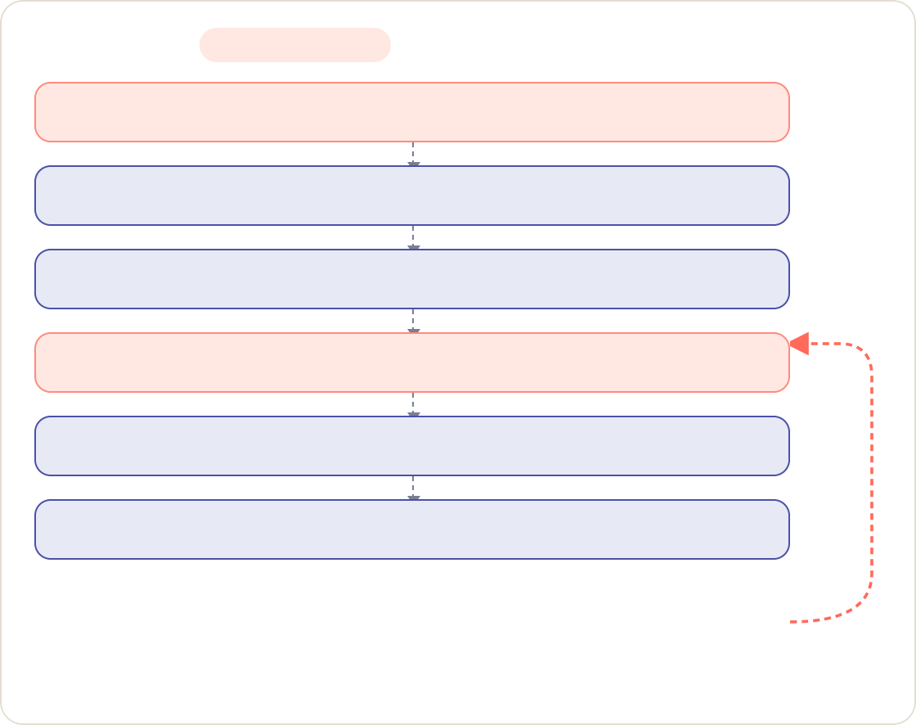





Every click re-runs your entire script. Top to bottom.
This is the #1 thing that confuses beginners. A script runs once. A Streamlit app runs every time the user interacts with it. Get this, and everything else clicks.
C O N C E P T · T H E M E N TA L M O D E L S H I F T
T H E R U N - L O O P
EVERY INTERACTION
W H AT T H I S M E A N S I N P R A C T I C E
USER OPENS BROWSER
01
1
Variable values update automatically
When a user types in a st.text_input , the variable gets the new value on the next run. You don't write "event handlers" — you just read the variable.
STREAMLIT RUNS APP.PY TOP TO BOTTOM
02
2
No state survives between runs (yet)
Every time the script re-runs, all your regular variables reset. This is by design. We'll cover
st.session_state on Day 5 for the rare cases you need to remember things.
PAGE RENDERS IN BROWSER
03
LOOPS FOREVER
Widgets return values, not events
st.button("Click me") returns True if the user just clicked it, False otherwise. You use it in an if statement, like any boolean.
USER CLICKS / TYPES IN A BOX
04
3
STREAMLIT RUNS APP.PY AGAIN, TOP TO BOTTOM
05
Order matters
Code runs top to bottom. If you reference a variable before its widget is defined, you get a NameError. Lay out your file like a recipe — inputs first, logic in the middle, output at the bottom.
4
PAGE RE-RENDERS WITH NEW VALUES
06
KEY IDEA A Streamlit app is not a program that waits for events. It's a program that re-runs itself every time the user does anything. Once you internalise this, Streamlit feels obvious.

Slide 7


PA R T 2 O F 3 · L I V E D E M O
D AY 0 4 · M E E T S T R E A M L I T
02 / 03
Build an app,
one line at a time.
02
Five steps. One file. By the end, you'll have an app that greets you by name, with a button and balloons.
Type along — don't just watch.
1 st.title
*
2 st.text_input
*
3 st.button
*
4 st.balloons
*
5 if conditional

Slide 8

Step 1 — A heading on the page.
L I V E D E M O · S T E P 1 O F 5 · T Y P E A L O N G
D AY 0 4 · M E E T S T R E A M L I T
Open VS Code. Create a new file called app.py . Type ONE line. Save. Run streamlit run app.py in the terminal. A browser opens. That's it.
B R O W S E R P R E V I E W · W H AT T H E S T U D E N T S E E S
app.py
PYTHON
# app.py — your first Streamlit app
import streamlit as st
localhost:8501
My First Streamlit App
(just a heading, but it's live in a browser)
RERUN
st.title("My First Streamlit App")
# Save the file (Ctrl+S / Cmd+S)
# In the terminal (with .venv active):
# $ streamlit run app.py #
# A browser tab opens at http://localhost:8501
# You see a page with the heading "My First Streamlit App" # That's a working app. One import, one function call.
One import · one function call · one heading rendered live in the browser.
1
import streamlit as st — Standard import. We alias as st by convention — every Streamlit command starts with st.
2
st.title("...") — A regular Python function call. It renders an H1 heading on the page. The string is the heading text.
3
streamlit run app.py — The command that starts the Streamlit server. Keep the terminal open — closing it stops the app.
T I P
Every time you save app.py , Streamlit auto-detects the change and shows a "Rerun" button in the top-right of the browser. Click it (or press R ) to refresh.

Slide 9
Step 2 — A text box that remembers what you type.
L I V E D E M O · S T E P 2 O F 5 · T Y P E A L O N G
D AY 0 4 · M E E T S T R E A M L I T
Add ONE line below the title. Save. Click "Rerun" in the browser. Now there's a text box. Type your name — the variable name holds whatever you typed.
B R O W S E R P R E V I E W · W H AT T H E S T U D E N T S E E S
app.py
+ 1 LINE
PYTHON
import streamlit as st
localhost:8501
st.title("My First Streamlit App")
My First Streamlit App
What's your name?
RERUN
# NEW LINE — a text input
name = st.text_input("What's your name?")
Aarav
# `name` is now a string variable. # It holds whatever the user typed. # If empty, it's an empty string "".
(nothing else happens yet — we haven't used name )
Each keystroke re-runs the entire script — watch the terminal flicker as you type.
# Save. Click "Rerun" in the browser (or press R). # Type your name in the box.
# Nothing else happens yet — we haven't USED `name`. # That's Step 3.
1
st.text_input("...") — Renders a text box with a label above it. The label string is required — Streamlit uses it for accessibility.
name = ... — The function RETURNS the current value of the text box. Assign it to a variable, just like input() .
2
3
Re-runs on every keystroke — Every time you type a character, Streamlit re-runs the whole script with the new value
K E Y_{of} O B S E R VAT I O N Type a character, watch the terminal. You'll see Streamlit re-running your script. That's the run-loop in action, visible for the first time.
name . This is the run-loop from slide 5.

Slide 10


Step 3 — A button. And finally, we use name.
L I V E D E M O · S T E P 3 O F 5 · T Y P E A L O N G
D AY 0 4 · M E E T S T R E A M L I T
Add a button. When the user clicks it, st.button returns True. Use that in an if statement — same as any boolean. Now the app responds to a click.
B R O W S E R P R E V I E W · W H AT T H E S T U D E N T S E E S
app.py
+ 1 LINE
PYTHON
import streamlit as st
localhost:8501
st.title("My First Streamlit App")
name = st.text_input("What's your name?")
My First Streamlit App
What's your name?
RERUN
# NEW LINE — a button
Aarav
clicked = st.button("Greet me")
Greet me
# `clicked` is True if the user just clicked, # False otherwise.
Hello, Aarav! Welcome to Streamlit.
# Use it in an if statement:
st.button("...") — Renders a button. Returns True on the run triggered by the click, False on every other run. This is the run-loop in action.
Click → clicked=True → greeting renders. Refresh → button resets.
1
2
clicked and name — Standard Python boolean logic. We check BOTH that the button was clicked AND that the user typed a name. Without name , we'd greet an empty string.
3
st.write(...) — The Swiss-army knife of Streamlit. Renders almost anything — strings, dataframes, charts, even Matplotlib figures. For now, it prints a string.
K E Y I D E A st.button does NOT set up an event handler. It returns a boolean. You use it in an if . This is the Streamlit mental model — widgets are functions that return values, not events.
1 0 / 1 8

Slide 11


Step 4 — Balloons. Because every first app deserves a celebration.
L I V E D E M O · S T E P 4 O F 5 · T Y P E A L O N G
D AY 0 4 · M E E T S T R E A M L I T
One line. When the user clicks the button with a name typed in, balloons animate across the screen. A real, visual reward for a real interaction.
B R O W S E R P R E V I E W · C L I C K + N A M E = B A L L O O N S
app.py
+ 1 LINE
PYTHON
import streamlit as st
localhost:8501
🎈
My First Streamlit App
What's your name?
RERUN
st.title("My First Streamlit App")
name = st.text_input("What's your name?") clicked = st.button("Greet me")
🎈
if clicked and name:
st.write(f"Hello, {name}! Welcome to Streamlit.")
# NEW LINE — celebrate!
Aarav
Greet me
🎈
st.balloons()
Hello, Aarav! Welcome to Streamlit.
# Save. Rerun. Type your name. Click. # Balloons fly across the screen.
# That's a real interaction — user input,
# a click, a conditional, and a visual reward. # Five lines of Python. No HTML. No CSS.
# No JavaScript. No backend setup.
🎈
🎈
Balloons rise across the page for ~3 seconds — then settle.
1
st.balloons() — A pure fun function. Renders an animation of balloons rising across the screen. No arguments, no return value. Just delight.
W H Y T H I S M AT T E R S The balloons aren't the point. The point is that a 5-line Python file just produced a working, interactive, browser-based app. That's what Streamlit does. That's what the next 20 days build on.
The checkpoint for Step 4 — If you see balloons when you click the button with your name typed in, every concept
from today is working. The run-loop, widgets as functions, conditionals driving UI — all of it.
2

Slide 12




Step 5 — What happens when the button ISN’T clicked?
L I V E D E M O · S T E P 5 O F 5 · T Y P E A L O N G
D AY 0 4 · M E E T S T R E A M L I T
Add an else branch. Now the app shows different content depending on state. This is the run-loop in action — the same file renders different pages.
app.py
+ ELSE BRANCH
PYTHON
R E A D I N G T H E N E W C O D E
import streamlit as st
1
The else branch — Standard Python. When clicked and name is False, the else runs. This is how you show different UI in different states — same file, different output.
st.title("My First Streamlit App")
name = st.text_input("What's your name?") clicked = st.button("Greet me")
2
Nested if inside else — We check name again inside the else, to give a more helpful message. The pattern: branch on user state, give feedback at every step.
if clicked and name:
st.write(f"Hello, {name}! Welcome to Streamlit.") st.balloons()
else:
3
Three possible outputs — The same file now renders three different pages depending on the values of name and clicked . No router. No page variable. Just conditionals.
# NEW — what shows when NOT clicked
if name:
st.write(f"Hi {name}. Click the button above for a surprise.") else:
st.write("Type your name above, then click the button.")
K E Y I D E A
There is no “current page” variable. There is no router. The same Python file renders different output based on the values of name and clicked . The run-loop handles the rest. Next slide: the three states visualised.

Slide 13
Same file. Three different rendered pages.
S T E P 5 · V I S U A L I S E D — T H R E E S TAT E S , O N E F I L E
D AY 0 4 · M E E T S T R E A M L I T
The values of name and clicked decide which page you see. No router. No page variable. Just Python conditionals + the run-loop.
1
No name, no click
name="" · clicked=False
2
Name typed, no click
name="Aarav" · clicked=False
3
Name + click
name="Aarav" · clicked=True
localhost:8501
EMPTY
localhost:8501
TYPED
localhost:8501
CLICKED
My First Streamlit App
What's your name?
My First Streamlit App
What's your name?
My First Streamlit App
What's your name?
🎈
🎈
|
Aarav
Aarav
Greet me
Greet me
Greet me
Type your name above, then click the button.
Hi Aarav. Click the button above for a surprise.
Hello, Aarav! Welcome to Streamlit.
T H E PAT T E R N
Every Streamlit app you build will follow this shape: read widget values → branch on them → render different output. The run-loop re-evaluates the whole file on every interaction. There is no hidden state.
1 3 / 1 8

Slide 14
Bookmark this slide. These 10 commands are 90% of Streamlit.
You've seen 4 of these in the live demo. Here are the other 6, with a one-line example each. We'll use all of them by Day 8.
C H E AT S H E E T · T H E 1 0 C O M M A N D S Y O U ' L L U S E M O S T
st.title(text)
Renders an H1 heading. The biggest text on the page.
st.title("My App")
0 1
st.write(...)
Renders almost anything — strings, dataframes, charts, figures. The Swiss-army knife.
st.write(f"Hello, {name}!")
0 2
st.text_input(label)
Renders a text box. Returns the typed string.
name = st.text_input("Your name")
0 3
st.button(label)
Renders a button. Returns True on the click run, False otherwise.
if st.button("Click me"): ...
0 4
st.slider(label, min, max, default)
Renders a slider. Returns the current number.
age = st.slider("Age", 0, 100, 20)
0 5
st.selectbox(label, options)
Renders a dropdown. Returns the selected option.
color = st.selectbox("Color", ["Red", "Green", "Blue"])
0 6
st.radio(label, options)
Renders radio buttons. Returns the selected option.
size = st.radio("Size", ["S", "M", "L"])
0 7
st.checkbox(label)
Renders a checkbox. Returns True/False.
if st.checkbox("Show advanced"): ...
0 8
st.columns(n)
Splits the page into n side-by-side columns. Use as a context manager.
col1, col2 = st.columns(2) with col1: st.write("Left")
0 9
st.sidebar
A special container for the left sidebar. Access widgets through it.
name = st.sidebar.text_input("Your name")
1 0
PATTERN — Every st.* command is just a Python function. It renders something on the page AND returns a value. You call it, you assign the return, you use it. That's the whole API.

Slide 15

PA R T 3 O F 3 · C L O S I N G E X E R C I S E
0 3 / 0 3
Build a unit converter.
With a selectbox.
Three categories — length, weight, temperature. A number input. A live result. The pattern you'll reuse in every Streamlit app from here on.
3
1 B R I E F
· 5 M I N
2 B U I L D
· 1 0 M I N
3 E X T E N D
· 5 M I N

Slide 16
Build a length, weight, and temperature converter.
A selectbox to pick the category. A number input for the value. A live result that updates as you type. The pattern: input → logic → output.
E X E R C I S E · B R I E F · 5 M I N
TASK
T H E B R I E F
STARTING SCAFFOLD
C O N V E R T E R . P Y
Build a Streamlit app called converter.py that lets the user pick a conversion category (length, weight, or temperature), enter a value, and see the converted result live.
R E Q U I R E M E N T S
Use st.selectbox to pick the category: ["Length", "Weight", "Temperature"]
Use st.number_input for the value to convert
Show the result with st.write or st.success
Length: meters ↔ feet (1 m = 3.281 ft)
Weight: kg ↔ pounds (1 kg = 2.205 lb)
Temperature: Celsius ↔ Fahrenheit (°F = °C × 9/5 + 32)
B Y T H E E N D
Every student has a working converter with at least one category. Two categories is good. All three is excellent.
# converter.py — starting scaffold
import streamlit as st
st.title("Unit Converter")
# 1. Pick the category
category = st.selectbox(
"What do you want to convert?", ["Length", "Weight", "Temperature"]
)
# 2. Get the value
value = st.number_input("Enter a value:", value=0.0)
# 3. Branch on category and compute
if category == "Length":
# TODO: convert meters ↔ feet
result = value * 3.281 unit = "feet"
elif category == "Weight":
# TODO: convert kg ↔ pounds
result = value * 2.205 unit = "pounds"
elif category == "Temperature":
# TODO: convert Celsius ↔ Fahrenheit
result = value * 9/5 + 32
RUN IT — streamlit run converter.py . Try all three categories. The result should update live as you type or change the dropdown.

Slide 17

Finished early? Make it harder. Or read the pitfalls.
Three extension ideas for fast students. Three pitfalls everyone hits. Pick one of each.
E X E R C I S E · E X T E N D + P I T FA L L S
EXTENSION IDEAS
F O R FA S T S T U D E N T S
PITFALLS YOU'LL HIT
E V E R Y O N E H I T S T H E S E
1
Add a direction toggle
Instead of always converting m→ft, add a st.radio to let the user pick direction: "m → ft" or "ft → m". Branch your logic on it. Now your app handles 6 conversions instead of 3.
Widget returns None on first render
Some widgets (like st.selectbox with no default) return None before the user picks. Always set a default, or check if value is not None: before using it.
Forgetting to assign the return value
Writing st.button("Click") without clicked = ... means the click is lost. Every widget returns a value — capture it.
Variables don't persist between runs
If you set counter = 0 at the top of your file and try to increment it on button click, it resets to 0 every run. This is by design. Use st.session_state (Day 5) when you really need persistence.
2
Format the result nicely
Use st.metric instead of st.write for the result. It renders a big number with a label and an optional delta. Looks more like a real dashboard. Try st.metric(label="Result", value=f"
{result:.2f} {unit}") .
3
Add a sidebar with history
Use st.sidebar to add a notes panel where the user can type what they just converted. (Note: this won't persist across reruns yet — that's st.session_state , coming on Day 5.)
IF YOU'RE STUCK — Pair with a neighbour. Read the error message out loud (half of debugging is just reading carefully). Raise your hand if both fail. We move at the room's pace.

Slide 18
Today your Python became an app.
Tomorrow we go deeper — widgets that organise, layouts that look intentional, the sidebar pattern. The apps start looking like real products.
Q & A · C L O S I N G · 5 M I N
O P E N T H E F L O O R A s k N o w
B E T W E E N S E S S I O N S G e t U n s t u c k
W H AT ' S N E X T · D AY S 5 – 8
P h a s e 2 C o n t i n u e s
"Did the run-loop mental model click, or does it still feel weird?"
Email · hello@zlaark.com
For Streamlit questions, paste your app.py and the error.
Day 5 — Widgets & Layout
Sliders, dropdowns, columns, sidebar.
"Which st.* command from the cheatsheet confused you?"
✓
Web · www.zlaark.com
Program updates and resources.
✓
Days 6–7 — Data & charts
pandas, line charts, bar charts, dashboards.
"Anything from the unit converter that didn't work?"
✓
In-session · raise a hand
No question is too small. We move at the room's pace.
✓
Day 8 — Solo challenge
The gate before group formation on Day 15.
See you on Day 5.
P R E PA R E D BY Z L A A R K F O R H I N D U C O L L E G E A M R I T S A R · 3 1 J U LY 2 0 2 6

