Slide 1
Analytics Internship First Evaluation
-By Priya Sarkar
Data Science
Mentor-Roopam Upadhyay

Slide 2


Project(s) portfolio/Business case
Sentiment Analysis
Training the machine to predict whether a movie review is positive or negative

Slide 3


Why would we want to do this?
It allows business to track:
- Flame detection (bad rants)
- New product perception
- Brand perception
- Reputation management
It allows individuals to get:
- An opinion on something (reviews) on a global scale

Slide 4
Several fields of computing merge
Natural language processing
It deals with the actual text element. It transforms it into a format that the machine can use.
Artificial intelligence
It uses the information given by the NLP and uses a lot of maths to determine whether something is negative or positive: it is used for clustering.

Slide 5
Goal & scope of project(s)
The Problem Statement
1 - How does a machine define subjectivity & sentiment?
2 - How does a machine deal with subjective word senses?
3 - How does a machine assign an opinion rating?
Goal
Understand what is Sentiment Analysis/ Machine Learning and How is it done
Device an algorithm/model
Increase the Efficiency of the model
Understand how the recent methods used in the market for the problem
Incorporating it in my model
5

Slide 6
Project (s) lifecycle/Methodology
Steps for Text Classification
Text Processing
Matrix Formation
Using the Classifier
6

Slide 7
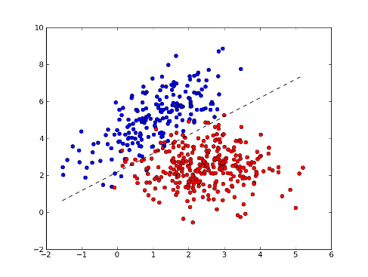
How a typical Classifier Works
“Bad” count
Nos of times “good” appeared

Slide 8
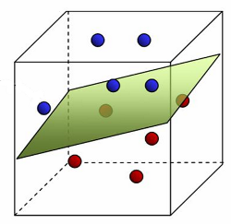
An Actual Classifier

Slide 9
Cleaning the Review
Actual review
\The Classic War of the Worlds\" by Timothy Hines is a very entertaining film that obviously goes to great effort and lengths to faithfully recreate H. G. Wells' classic book. Mr. Hines succeeds in doing so. I, and those who watched his film with me, appreciated the fact that it was not the standard, predictable Hollywood fare that comes out every year, e.g. the Spielberg version with Tom Cruise that had only the slightest resemblance to the book. Obviously, everyone looks for different things in a movie. Those who envision themselves as amateur \"critics\" look only to criticize everything they can. Others rate a movie on more important bases,like being entertained, which is why most people never agree with the \"critics\". We enjoyed the effort Mr. Hines put into being faithful to H.G. Wells' classic novel, and we found it to be very entertaining. This made it easy to overlook what the \"critics\" perceive to be its shortcomings.“ word count-160

Slide 10
Steps of Text Cleaning
Step 1:Removing Punctuations
[[u'The', u'Classic', u'War', u'of', u'the', u'Worlds', u'by', u'Timothy', u'Hines', u'is', u'a', u'very', u'entertaining', u'film', u'that', u'obviously', u'goes', u'to', u'great', u'effort', u'and', u'lengths', u'to', u'faithfully', u'recreate', u'H', u'G', u'Wells', u'classic', u'book'], [u'Mr', u'Hines', u'succeeds', u'in', u'doing', u'so'], [u'I', u'and', u'those', u'who', u'watched', u'his', u'film', u'with', u'me', u'appreciated', u'the', u'fact', u'that', u'it', u'was', u'not', u'the', u'standard', u'predictable', u'Hollywood', u'fare', u'that', u'comes', u'out', u'every', u'year', u'eg'], [u'the', u'Spielberg', u'version', u'with', u'Tom', u'Cruise', u'that', u'had', u'only', u'the', u'slightest', u'resemblance', u'to', u'the', u'book'], [u'Obviously', u'everyone', u'looks', u'for', u'different', u'things', u'in', u'a', u'movie'], [u'Those', u'who', u'envision', u'themselves', u'as', u'amateur', u'critics', u'look', u'only', u'to', u'criticize', u'everything', u'they', u'can'], [u'Others', u'rate', u'a', u'movie', u'on', u'more', u'important', u'baseslike', u'being', u'entertained', u'which', u'is', u'why', u'most', u'people', u'never', u'agree', u'with', u'the', u'critics'], [u'We', u'enjoyed', u'the', u'effort', u'Mr', u'Hines', u'put', u'into', u'being', u'faithful', u'to', u'HG'], [u'Wells', u'classic', u'novel', u'and', u'we', u'found', u'it', u'to', u'be', u'very', u'entertaining'], [u'This', u'made', u'it', u'easy', u'to', u'overlook', u'what', u'the', u'critics', u'perceive', u'to', u'be', u'its', u'shortcomings']]
Step 2:Changing to Lower Case

Slide 11
Step 3: Negation Handling
[u'the', u'classic', u'war', u'of', u'the', u'worlds', u'by', u'timothy', u'hines', u'is', u'a', u'very', u'entertaining', u'film', u'that', u'obviously', u'goes', u'to', u'great', u'effort', u'and', u'lengths', u'to', u'faithfully', u'recreate', u'h', u'g', u'wells', u'classic', u'book', u'mr', u'hines', u'succeeds', u'in', u'doing', u'so', u'i', u'and', u'those', u'who', u'watched', u'his', u'film', u'with', u'me', u'appreciated', u'the', u'fact', u'that', u'it', u'was', 'not-good', u'standard', u'predictable', u'hollywood', u'fare', u'that', u'comes', u'out', u'every', u'year', u'eg', u'the', u'spielberg', u'version', u'with', u'tom', u'cruise', u'that', u'had', u'only', u'the', u'slightest', u'resemblance', u'to', u'the', u'book', u'obviously', u'everyone', u'looks', u'for', u'different', u'things', u'in', u'a', u'movie', u'those', u'who', u'envision', u'themselves', u'as', u'amateur', u'critics', u'look', u'only', u'to', u'criticize', u'everything', u'they', u'can', u'others', u'rate', u'a', u'movie', u'on', u'more', u'important', u'baseslike', u'being', u'entertained', u'which', u'is', u'why', u'most', u'people', 'never-agree', u'with', u'the', u'critics', u'we', u'enjoyed', u'the', u'effort', u'mr', u'hines', u'put', u'into', u'being', u'faithful', u'to', u'hg', u'wells', u'classic', u'novel', u'and', u'we', u'found', u'it', u'to', u'be', u'very', u'entertaining', u'this', u'made', u'it', u'easy', u'to', u'overlook', u'what', u'the', u'critics', u'perceive', u'to', u'be', u'its', u'shortcomings']

Slide 12
Step 4: Using Part of Speech Tags
[u'classic', u'very', u'entertaining', u'obviously', u'great', u'faithfully', u'recreate', u'h', u'classic', u'watched', u'appreciated', u'was', 'not-good', u'standard', u'predictable', u'had', u'only', u'slightest', u'obviously', u'different', u'look', u'only', u'criticize', u'rate', u'more', u'important', u'being', u'entertained', u'most', 'never-agree', u'enjoyed', u'put', u'being', u'faithful', u'hg', u'classic', u'found', u'be', u'very', u'entertaining', u'easy', u'overlook', u'perceive', u'be']

Slide 13
Step 5: Remove Stop Words
[u'classic', u'entertaining', u'obviously', u'great', u'faithfully', u'recreate', u'h', u'classic', u'watched', u'appreciated', 'not-good', u'standard', u'predictable', u'slightest', u'obviously', u'different', u'look', u'criticize', u'rate', u'important', u'entertained', 'never-agree', u'enjoyed', u'put', u'faithful', u'hg', u'classic', u'found', u'entertaining', u'easy', u'overlook', u'perceive']

Slide 14
Step 6: Synonym Replacer
classic['classic']
obviously['obviously']
great['great']
faithfully['faithfully']
recreate['animate']
h['hydrogen']
different['different']
look['expression']
criticize['knock']
rate['rate']
entertained['amused']
never-agree
enjoyed
put['put_option']
faithful['faithful']
hg['mercury']
classic['classic']

Slide 15
Step 7: Stemming
[u'classic timothi entertain obvious great faith anim hydrogen classic watched appreci not-the standard predict slightest obvious differ express knock rate import amus never-agree enjoyed put_opt faith mercuri classic found entertain easi overlook perceiv'
Word count-33

Slide 16
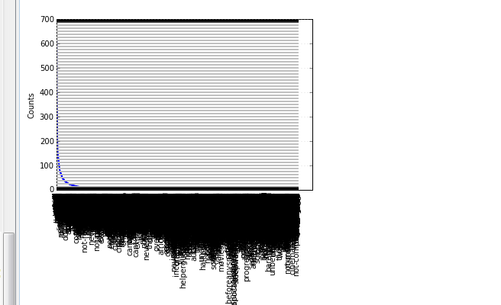
Vocabulary plot
Creating Word Frequency Model from Training Data Set on 1000 reviews and words with frequency more than 50

Slide 17
Feature List formed
Number of words found=171
[u'second', u'music', u'want', u'beauti', u'came', u'best', u'much', u'right', u'old', u'later', u'love', u'wrong', u'open', u'say', u'saw', u'take', u'ive', u'know', u'littl', u'definit', u'act', u'mean', u'creat', u'small', u'howev', u'found', u'realli', u'believ', u'horribl', u'differ', u'also', u'play', u'set', u'see', u'last', u'whole', u'real', u'funni', u'young', u'tri', u'great', u'next', u'high', u'terribl', u'hope', u'move', u'togeth', u'total', u'work', u'far', u'disappoint', u'worst', u'comic', u'involv', u'away', u'mayb', u'bore', u'true', u'gener', u'live', u'suppos', u'still', u'now', u'happen', u'care', u'especi', u'truli', u'earli', u'read', u'start', u'low', u'poor', u'put', u'usual', u'pretti', u'look', u'run', u'go', u'becom', u'chang', u'special', u'keep', u'final', u'need', u'written', u'quit', u'well', u'even', u'new', u'ever', u'call', u'recommend', u'tell', u'give', u'better', u'sometim', u'seen', u'seem', u'bad', u'said', u'interest', u'sever', u'make', u'left', u'just', u'yet', u'save', u'classic', u'die', u'get', u'talk', u'main', u'think', u'first', u'show', u'wonder', u'enough', u'mani', u'possibl', u'film', u'good', u'hard', u'dont', u'done', u'least', u'find', u'simpli', u'big', u'often', u'back', u'use', u'includ', u'aw', u'almost', u'thought', u'like', u'actual', u'doesnt', u'probabl', u'enjoy', u'direct', u'end', u'got', u'top', u'absolut', u'watch', u'complet', u'els', u'entertain', u'alway', u'turn', u'origin', u'given', u'sure', u'come', u'cast', u'kill', u'follow', u'certainli', u'rather', u'short', u'expect', u'guess', u'perhap', u'feel', u'long', u'nice', u'instead', u'entir', u'made']

Slide 18
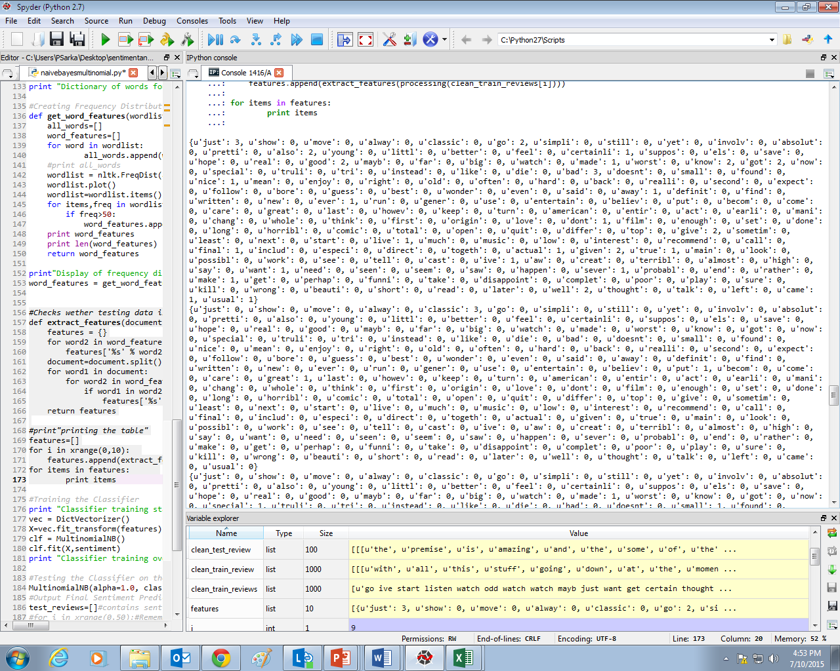
Term Frequency Matrix

Slide 19
Accuracy
Naïve Bayes Classifier
0.76
Multinomial Naïve Bayes
0.78

Slide 20
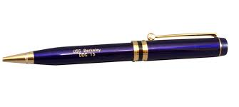
Model 2 & 3 (Word2Vec)
Why use Word2Vec??
How does a computer interpret pen as

Slide 21
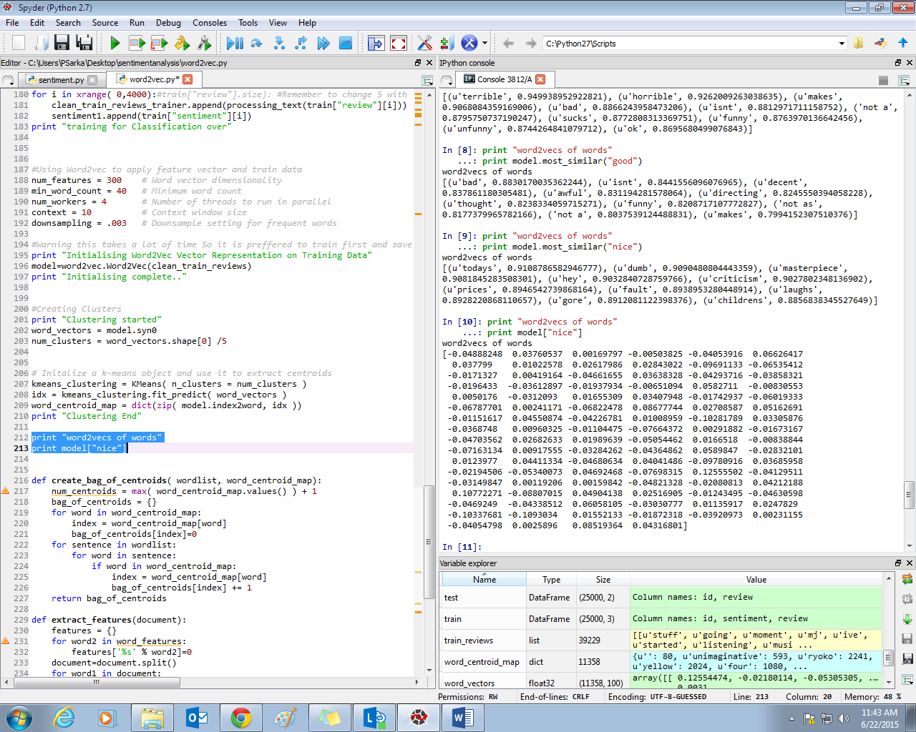
What does Word2Vec do ?

Slide 22
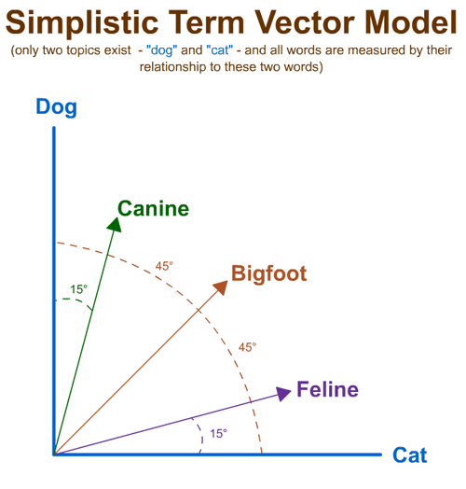
Vector Space Model
(1,5)
(3,4)
(4,1)

Slide 23
Similar Words
Man- Woman +King= Queen
King
Man-Woman
Queen
Man
Man-Woman
Woman

Slide 24
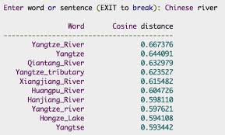
Similar words for “Chinese River”

Slide 25
Model 2 :Word Vector Averaging
[-0.0111241 0.02848253 -0.04023081 -0.02166399 -0.0204796 0.00136087 0.04371956 -0.00974234 0.00334368 -0.02464397 -0.01831384 -0.05262056 -0.00125508 0.02414955 0.01666516 0.01174625 0.0194638 -0.04336549 -0.01088388 -0.01263258 -0.05327574 -0.00747714 0.01970908 -0.00196925 0.02035549 -0.02607654 -0.01621382 0.01262914 -0.01283619 -0.04394707 -0.03737685 0.00875854 -0.01036146 -0.06039738 -0.01396595 0.0359245 -0.05191385 -0.0082779 -0.00111985 -0.00163523 -0.0308013 -0.0019137 -0.01884924 0.00255369 -0.00690738 -0.02144758 0.01232492 -0.02755745 -0.00603255 -0.01440641 -0.00274354 -0.03118427 -0.00496417 -0.02400475 -0.02952507 -0.04171624 -0.02800091 -0.0177113 -0.00702763 0.02680533 0.03460928 0.00167519 0.02093266 0.0069527 -0.02236105 0.01956328 0.00931486 -0.02506253 0.02591493 -0.0055708 -0.01395445 -0.05157988 0.02565113 -0.01006835 -0.0213313 -0.05584611 -0.02876022 -0.01048932 0.04095218 -0.04935334 0.00094005 0.05710537 0.01643824 -0.01858047 0.00897647 -0.02007549 -0.02341747 -0.03644618 -0.064363 0.02393283 -0.06494061 -0.03010365 -0.02945416 0.00098544 -0.02089091 -0.03016052 0.0195021 0.01619972 -0.00806704 -0.02649411] 1

Slide 26
Accuracy
0.8

Slide 27
Model 3: Word Clustering
Cluster 0
[u'passport', u'penthouse', u'suite', u'seattle', u'apple']
Cluster 1
[u'unnoticed']
Cluster 2
[u'midst', u'forming', u'forefront', u'feud', u'bonds', u'merge', u'collide', u'dispute', u'rivalry', u'hostile', u'torn', u'advancing', u'aftermath', u'clans', u'ongoing', u'paths', u'opposing', u'sexes', u'factions', u'journeys']
Cluster 3
[u'lori', u'denholm', u'sheffer', u'howell', u'elton', u'gladys', u'menjou', u'caroline', u'polly', u'isabella', u'rossi', u'nora', u'bailey', u'mackenzie', u'bobbie', u'kathleen', u'bianca', u'jacqueline', u'reid', u'joyce', u'bennett', u'fay', u'alexis', u'jayne', u'roland', u'davenport', u'linden', u'trevor', u'seymour', u'craig', u'windsor', u'fletcher', u'barrie', u'deborah', u'hayward', u'samantha', u'debra', u'frances', u'hildy', u'rhonda', u'archer', u'lesley', u'dolores', u'elsie', u'harper', u'carlson', u'ella', u'preston', u'allison', u'sutton', u'yvonne', u'jo', u'bellamy', u'conte', u'stella', u'edmund', u'cuthbert', u'maude', u'ellen', u'hilary', u'phyllis', u'wray', u'darren', u'morton', u'withers', u'bain', u'keller', u'martha', u'henderson', u'madeline', u'kay', u'lacey', u'topper', u'wilding', u'jessie', u'theresa', u'auteuil', u'dane', u'jeanne', u'kathryn', u'bentley', u'valerie', u'suzanne', u'abigail']

Slide 28
Cluster 4
[u'fest', u'flick']
Cluster 5
[u'lobster', u'deer']
Cluster 6
[u'humorless', u'dopey', u'limp']
Cluster 7
[u'enlightening', u'truthful']
Cluster 8
[u'dominates', u'showcases', u'electrifying', u'powerhouse', u'standout', u'versatility', u'astounding']
Cluster 9
[u'succumbs', u'comatose', u'humiliating', u'temper', u'looses', u'leans']

Slide 29
Document : Cluster Matrix
{0: 3, 1: 0, 2: 2, 3: 1, 4: 2, 5: 1, 6: 8, 7: 0, 8: 2, 9: 3, 10: 3, 11: 4, 12: 5, 13: 6, 14: 2, 15: 0, 16: 3, 17: 1, 18: 2, 19: 0, 20: 2, 21: 1, 22: 0, 23: 0, 24: 2, 25: 3, 26: 0, 27: 4, 28: 0, 29: 0, 30: 4, 31: 3, 32: 11, 33: 2, 34: 9, 35: 0, 36: 3, 37: 1, 38: 0, 39: 1, 40: 1, 41: 3, 42: 1, 43: 0, 44: 1, 45: 0, 46: 1, 47: 2, 48: 5, 49: 0, 50: 2, 51: 0, 52: 3, 53: 5, 54: 1, 55: 0, 56: 4, 57: 0, 58: 0, 59: 1, 60: 0, 61: 6, 62: 0, 63: 5, 64: 0, 65: 2, 66: 0, 67: 2, 68: 4, 69: 0, 70: 0, 71: 1, 72: 0, 73: 3, 74: 3, 75: 9, 76: 3, 77: 6, 78: 0, 79: 0, 80: 0, 81: 3, 82: 4, 83: 2, 84: 5, 85: 0, 86: 1, 87: 1, 88: 7, 89: 0, 90: 1, 91: 0, 92: 1, 93: 1, 94: 0, 95: 0, 96: 1, 97: 7, 98: 0, 99: 2}
{0: 1, 1: 1, 2: 3, 3: 1, 4: 3, 5: 0, 6: 1, 7: 0, 8: 3, 9: 0, 10: 0, 11: 0, 12: 2, 13: 0, 14: 0, 15: 0, 16: 1, 17: 3, 18: 1, 19: 1, 20: 0, 21: 0, 22: 0, 23: 0, 24: 0, 25: 0, 26: 3, 27: 1, 28: 1, 29: 0, 30: 0, 31: 3, 32: 2, 33: 0, 34: 0, 35: 0, 36: 6, 37: 0, 38: 0, 39: 1, 40: 0, 41: 2, 42: 0, 43: 1, 44: 2, 45: 0, 46: 0, 47: 2, 48: 4, 49: 0, 50: 1, 51: 0, 52: 0, 53: 2, 54: 1, 55: 0, 56: 2, 57: 3, 58: 1, 59: 0, 60: 0, 61: 1, 62: 0, 63: 0, 64: 0, 65: 0, 66: 0, 67: 6, 68: 0, 69: 0, 70: 1, 71: 0, 72: 1, 73: 0, 74: 1, 75: 1, 76: 0, 77: 1, 78: 0, 79: 0, 80: 1, 81: 0, 82: 0, 83: 2, 84: 3, 85: 0, 86: 0, 87: 0, 88: 0, 89: 0, 90: 0, 91: 0, 92: 0, 93: 1, 94: 0, 95: 0, 96: 0, 97: 0, 98: 0, 99: 1}

Slide 30
Accuracy
0.82
But can go upto
0.85

Slide 31
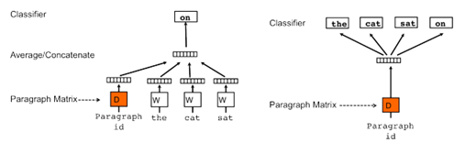
Doc2Vec

Slide 32
Similar Sentence
SENT_0= “Cosmetic Industry under downfall”
print model.most_similar("SENT_0")
[('SENT_48859', 0.2516525387763977),
(u'paradox', 0.24025458097457886),
(u'methodically', 0.2379375547170639),
(u'tongued', 0.22196565568447113),
(u'cosmetics', 0.21332012116909027),
(u'Loos', 0.2114654779434204),
(u'backstory', 0.2113303393125534),
('SENT_60862', 0.21070502698421478),
(u'gobble', 0.20925869047641754),

Slide 33
Model 4:Document Vectors
[ 0.28936372 0.10222173 -0.2201112 -0.31220078 -0.26354055 -0.15494929
-0.09821669 0.20138832 -0.22716093 0.03728786 0.15371289 -0.10760766
-0.02767396 0.1150018 0.02901398 0.03470395 -0.06638857 -0.30342425
0.21394115 0.01998165 -0.42447609 0.14854352 -0.04106722 0.08667924
0.24779968 0.20781698 0.08519302 -0.31391832 -0.18752399 0.05411481
-0.26571994 0.19964279 0.1312977 -0.37644597 -0.20463381 -0.1876701
0.05152065 0.05888451 0.08790773 -0.31899641 -0.15520438 0.04956145
-0.03427105 -0.19789277 0.08990572 -0.14348935 0.13733559 0.11366553
-0.18346596 0.30600249 -0.05600467 -0.12492852 -0.05860881 -0.08062604
-0.16020077 -0.09434545 0.05885994 0.01092672 -0.09810787 0.07515052
-0.04939408 0.18745408 0.08028983 -0.14728891 0.05832333 0.00520535
-0.39296031 0.08959818 0.39653922 -0.02296436 -0.02252969 0.30181751
-0.04354402 0.21615354 0.02565599 0.16944737 -0.13087031 0.31216233
-0.06684466 -0.04750233 -0.31377403 -0.11891238 0.11811488 -0.15893536
-0.27664245 0.05388277 -0.15402296 -0.24076274 0.04206577 -0.15386153
-0.19340038 -0.55836489 -0.28849548 0.15989898 0.12702296 -0.08018649
-0.02756827 0.08883878 -0.34516813 0.20182161]

Slide 34
Accuracy
0.5
But can go upto
>0.9

Slide 35
Value proposition
Bag Of Words- Widely known concept can be modified to obtain very interesting results
Word2Vec-Creates word vectors for each word. Word vectors contains both semantic and syntactic meaning in them. Can create
great accuracy upto 0.85
Doc2Vec-Product still under development. People trying to use it widely as applications still unknown. Sequence of words maintained.
Accuracy can be achieved >0.9 when trained on large dataset

Slide 36
Extra mile..(LEAN Initiative etc can be covered under this umbrella)
Word2Vec and Doc2 Vec
Both of these are Google products which have not yet been explored yet. They are said to have enormous potential in them and are being applied enormously in Text Classification.
Recent topic for talk show
Text by the Bay ,2015
New York conference on text Classification

Slide 37
Key take away!
First of all, the experience of corporate life and work culture
Friends and Collogues
Learnt a lot about data classification and the work done in this field
Created 4 models with tools being currently used in the market

Slide 38
Limitations/Challenges
Getting an insight into Data Science field being a complete newbie!
Word2Vector and Doc2Vector are both newly made products and has not yet been explored. Extracting information and utilizing them to get the best result was a challenging task
Word2Vector and Doc2Vector are big data models. So they did not show efficient results in Python. However they would hopefully do wonders when run on Hadoop

Slide 39
Bibliography
http://www-nlp.stanford.edu/pubs/glove.pdf
http://www.cs.bgu.ac.il/~yoavg/publications/acl2014syntemb.pdf
http://arxiv.org/pdf/1301.3781.pdf
http://arxiv.org/pdf/1301.3781.pdf
http://ai.stanford.edu/~ang/papers/acl11-WordVectorsSentimentAnalysis.pdf
http://sentiment.christopherpotts.net/vectors.html
http://cs.stanford.edu/~quocle/paragraph_vector.pdf
http://u.cs.biu.ac.il/~nlp/wp-content/uploads/Neural-Word-Embeddings-as-Implicit-Matrix-Factorization-NIPS-2014.pdf

Slide 40
Thank you

