Slide 1

Google Play Reviews Sentiment Analysis using BERT
CS688 Web Mining and Graph Analytics
Term Project Presentation
Assiya Karatay karatay@bu.edu

Slide 2
Agenda
Data Overview
Technologies
Visualization
Data Preprocessing
BERT Model
Model Evaluation
Conclusion

Slide 3
Data Overview
Google Play Store Reviews
The data contains over 12000 reviews of different app store applications by real users. The data also contains the rating that was given by them so it can be classified into positive or negative reviews. This is a good place to perform sentiment analysis tasks.
6.45 MB
12495 rows
12 columns: reviewId, username, userImage , content, score, thumbsUpCount, reviewCreatedVersion, at, replyContent, repliedAt, sortOrder , appId

Slide 4
Technologies Used
Google Colab
GPU
Torch, Transformers
NumPy, Pandas, MatPlotLib, Seaborn, Scikit-learn

Slide 5
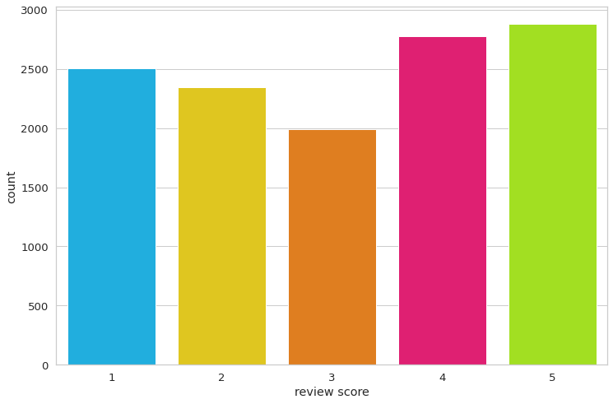
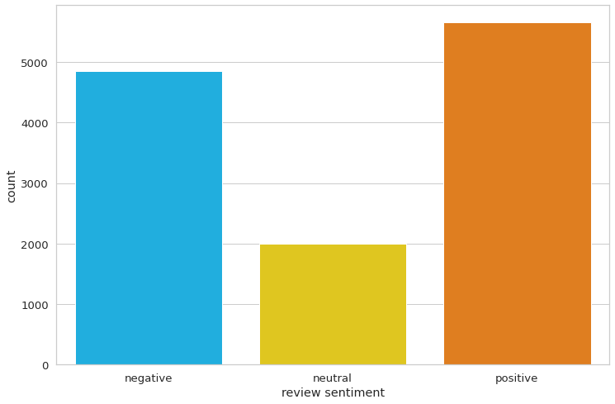
Data Visualization

Slide 6
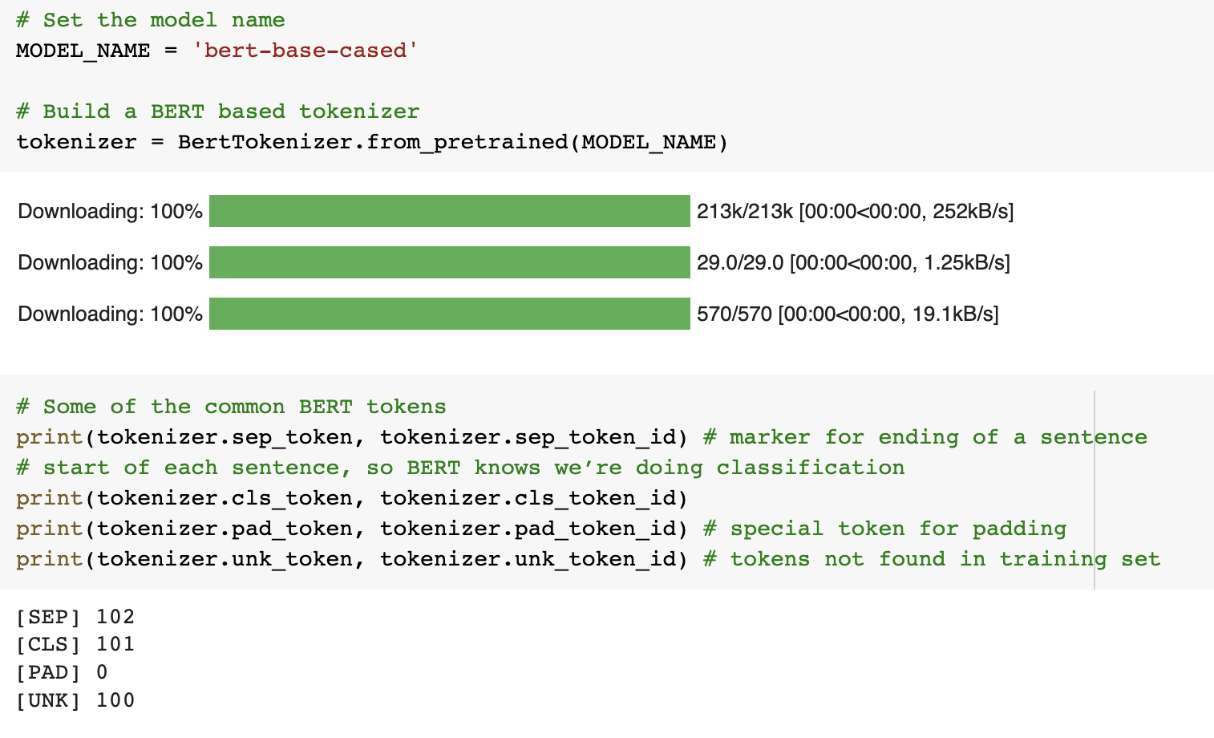
Data Preprocessing
Add special tokens to separate sentences and do classification
Pass sequences of constant length (introduce padding)
Create array of 0s (pad token) and 1s (real token) called attention mask
Use the cased BERT version which considers GREAT and great to be to different entities and BAD might be given more focus than bad.
The tokenizer will break the sentence into words and give numerical values to each word.

Slide 7
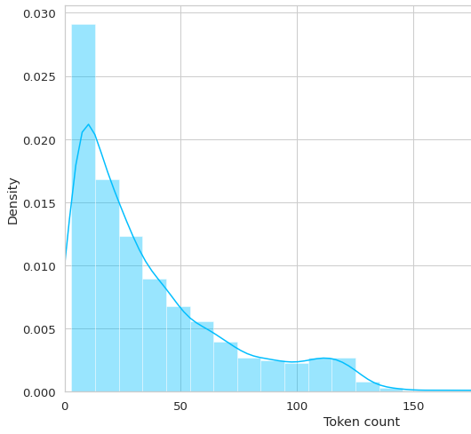
Data Preprocessing
The distribution of review lengths
BERT works with fixed-length sequences. We’ll use a simple strategy to choose the max length. Let’s store the token length of each review.
Most of the reviews seem to contain less than 120 tokens, but we’ll be on the safe side and choose a maximum length of 160.
Create a 80% train data and 10% test and 10% validation data

Slide 8
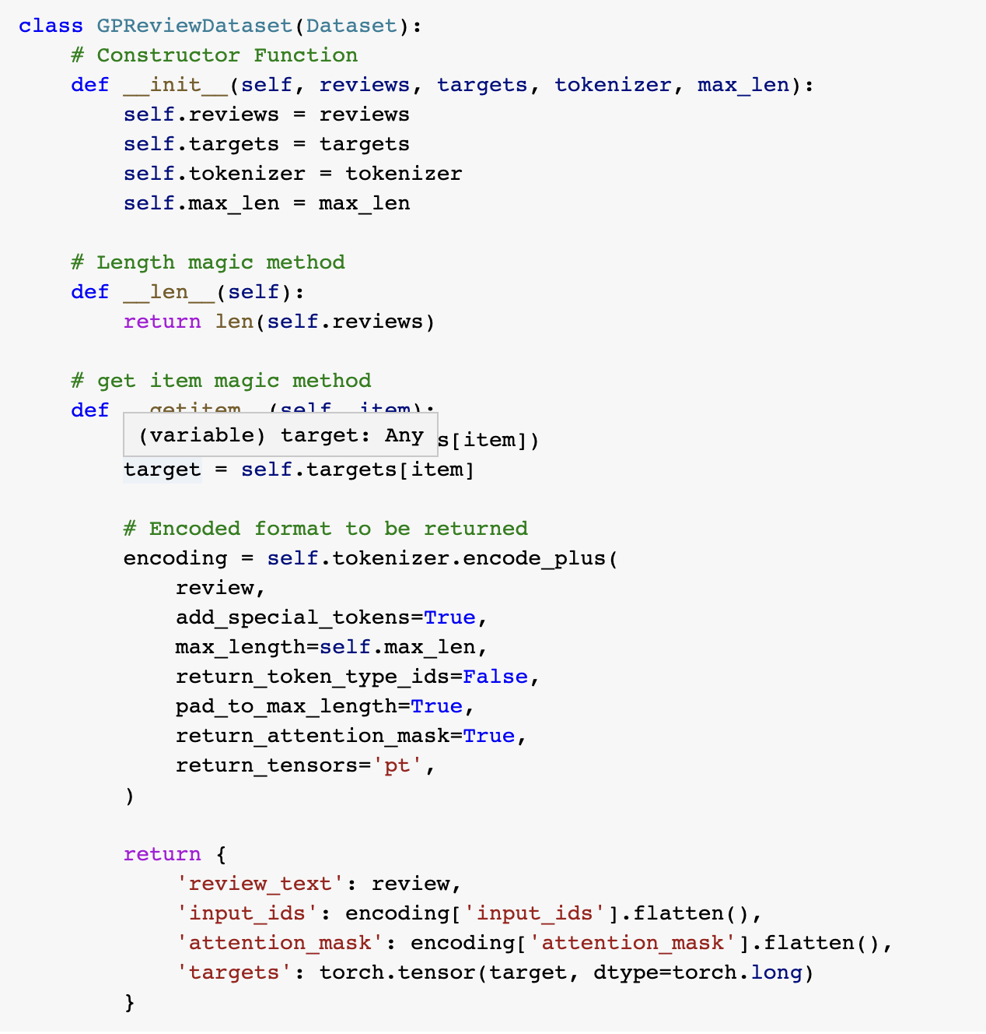
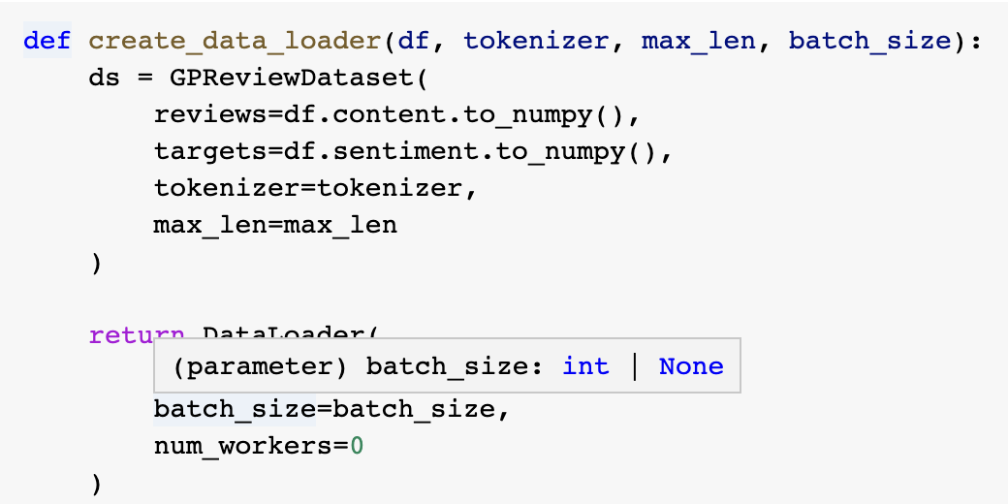
Data Preprocessing
Preparing Torch Dataset - To enter data into a PyTorch, we need a more robust data generator class. We will return the review text as well to validate our predictions easily.
Create a dataloader to release data in batches.

Slide 9
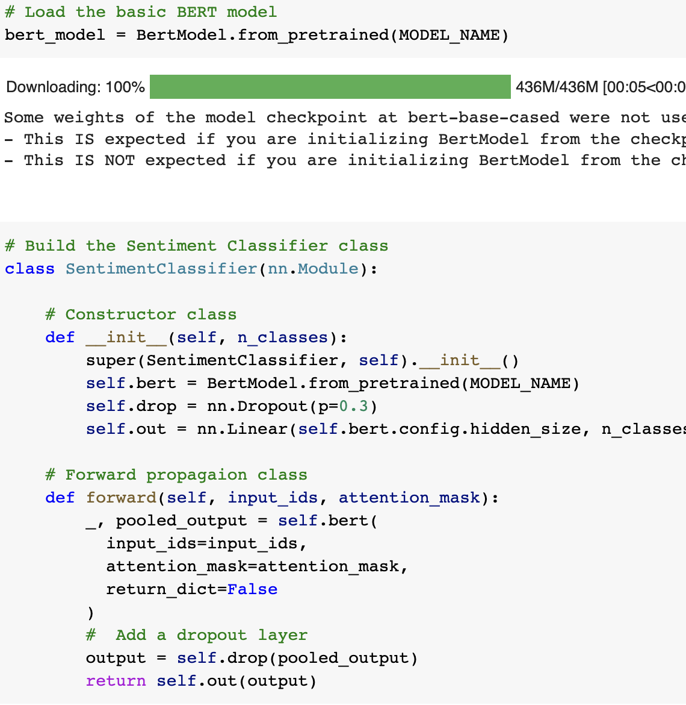
BERT Model
768 Hidden Units
10 Epochs of Training
Cross Entropy Loss function

Slide 10
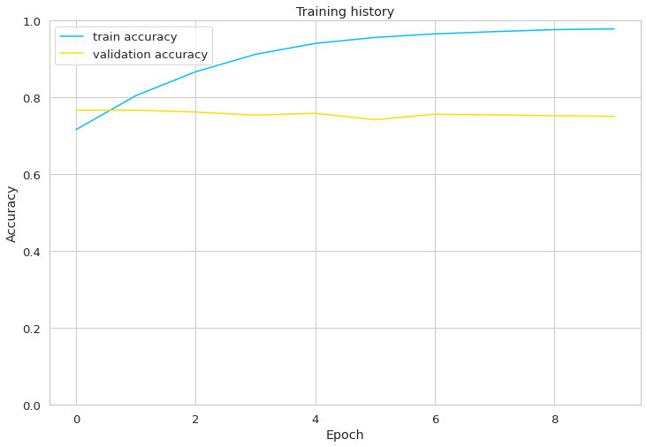
Model Evaluation
Train accuracy increased from 0.72 to 0.98
Val accuracy fluctuated around 0.75
Test accuracy - 0.73
Execution Time 44min 55s

Slide 11
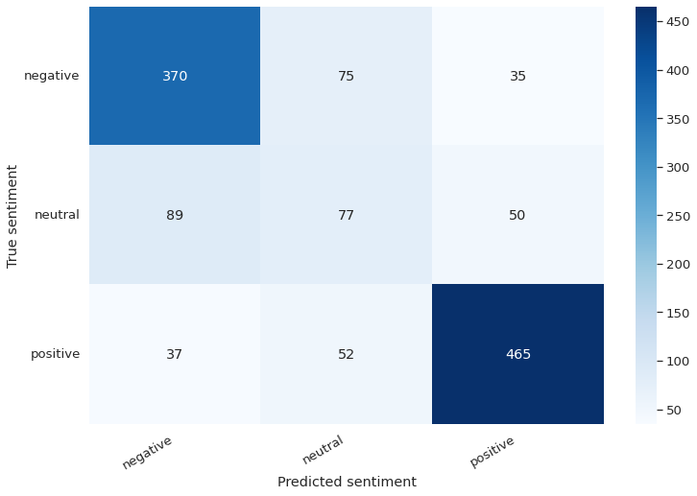
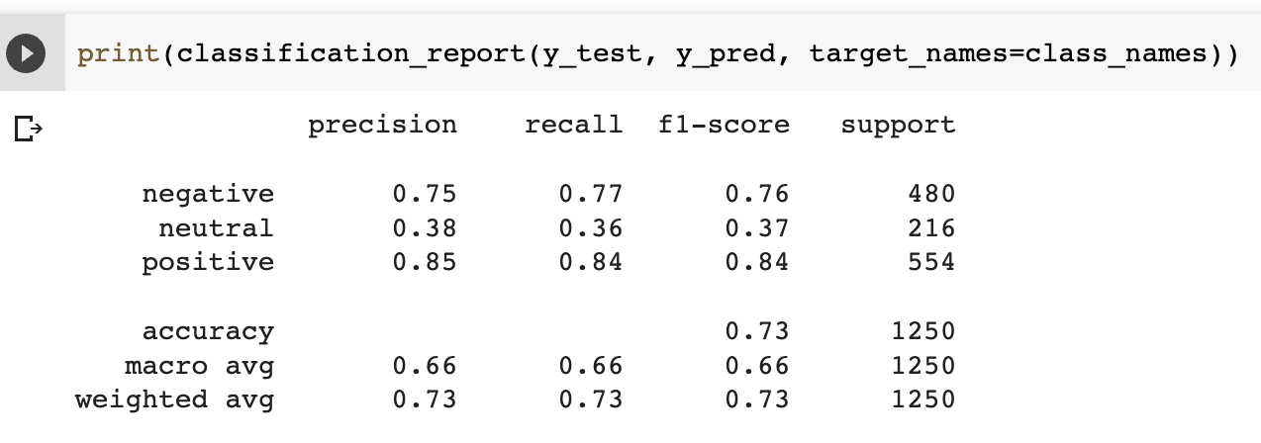
Model Evaluation
Predicting on raw text
Review text: I love completing my todos! Best app ever!!!
Sentiment : positive

Slide 12
Conclusion
We examined Google Play Store Reviews Data
Used different tokenizers for text data
Created PyTorch Dataset and dataloader
Built BERT model for classification
Processed multiclass classification model evaluation
Utilized Colab free machines with GPU
Successfully completed text analysis project on Python

Slide 13
Thank you!

