Slide 1
PROCUREMENT COMPARISON PORTAL
From a folder of vendor files
to a decision you can defend
Bids arrive messy, in whatever shape each vendor happens to send them. What comes out the other end is a ranked, checked comparison - with every number traceable to the page it came from.

Slide 2
THE SHAPE OF IT
Seven quiet handoffs, one continuous read
1
2
3
4
5
6
7
Intake
Recognition
Lineage
Reading
Filing
Measurement
Decision
Bids land as-is
Every file understood
Latest version only
Fine print, in full
Kept and linked
One yardstick
A ranked answer
Vendors send bids in whatever format they already use. Everything between that and your ranked comparison happens on the seven pages that follow.

Slide 3

STEP 1 OF 7
INTAKE
Bids land exactly as vendors send them
PDFs, scans, spreadsheets, Word files, folders within folders - none of it needs to be retyped, reformatted, or filed by hand before anything can happen.

Slide 4

STEP 2 OF 7
RECOGNITION
Every file is understood the moment it lands
A quotation, a technical datasheet, a deviation list, a set of meeting minutes - each is recognized for what it is on sight, however a particular vendor happened to name the file or bury it three folders deep.
Hundreds of pages, sorted in the time it takes to open one of them yourself.

Slide 5

STEP 3 OF 7
LINEAGE
Only the latest word from each vendor counts
A corrected file quietly retires the one it replaces, so a superseded number can never drift back into the comparison next to the current one.

Slide 6

STEP 4 OF 7
READING
The fine print gets read, line by line
Prices, technical parameters, stated exceptions, contract clauses - pulled out to the exact figure and the exact wording, from documents that would otherwise take a reviewer days to work through vendor by vendor.
Nothing is summarized or paraphrased away - the number you see is the number the vendor wrote.

Slide 7

STEP 5 OF 7
FILING
Every fact is kept, and never lost track of
Each figure is filed against its vendor and the exact document it came from - so nothing downstream is ever taken on faith, and any number can be traced back in seconds.

Slide 8

STEP 6 OF 7
MEASUREMENT
Every vendor is held to the same yardstick
Every stated requirement is checked against every vendor's stated facts, and every price is put on the same footing - currency, tax, freight, discount all accounted for. What you end up comparing is the real, landed cost, not the headline number two vendors happened to print differently.

Slide 9

STEP 7 OF 7
DECISION
You get a ranked answer you can stand behind
A comparison that names the cheapest compliant vendor, flags what's missing, and lets you trace any figure back to the page it came from - or challenge one, and watch the whole comparison recompute on the spot.

Slide 10
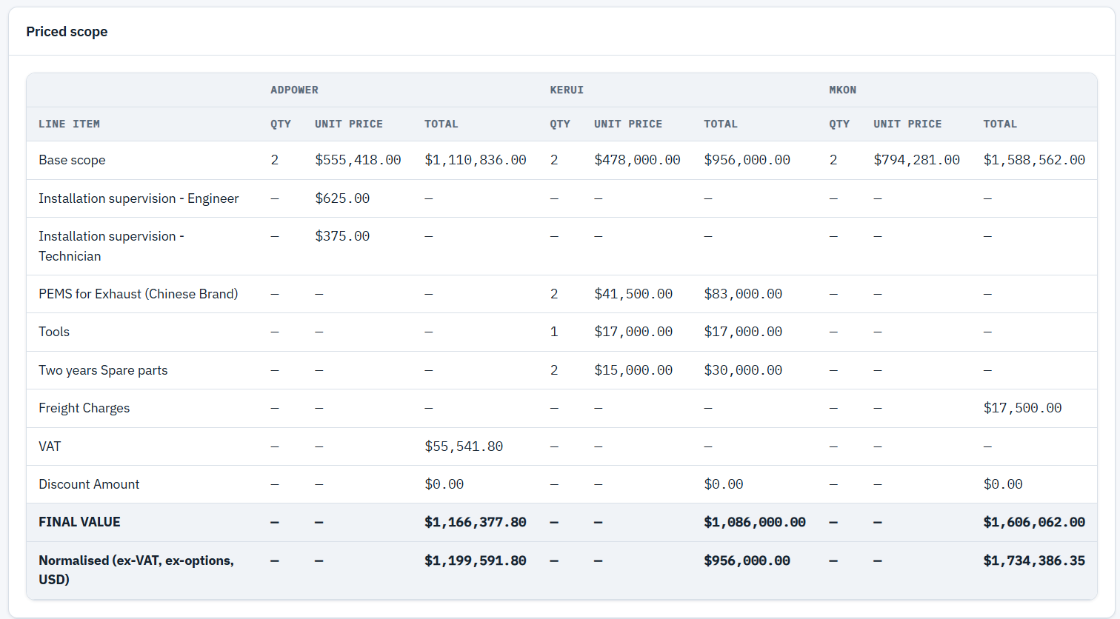
FROM THE PORTAL - PRICE COMPARISON
Every price put on the same footing

Slide 11
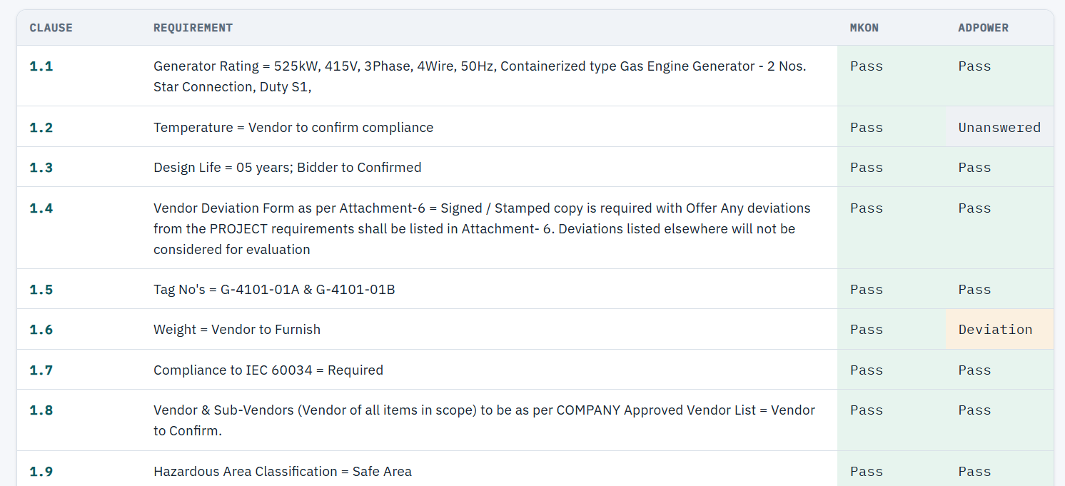
FROM THE PORTAL - TECHNICAL COMPLIANCE
Every vendor against the same requirements

Slide 12



WHAT THAT MEANS FOR YOU
The difference shows up before you finish reading
Hours collapse into minutes
Nothing gets missed on vendor eleven of twenty
A tender that took a week of reading now takes as long as it takes vendors to upload.
Every document gets the same careful read, whether it’s the first bid or the last.
Every number traces back to its source
When a losing bidder asks why, you can point to the exact page.

Slide 13



SECURITY & COMPLIANCE
Independently audited infrastructure, contractual data guarantees
AWS: audited, not self-declared
The infrastructure layer carries SOC 1, SOC 2, and SOC 3 reports, ISO 27001 / 27017 / 27018, PCI DSS Level 1, and FedRAMP authorization - attested by independent third-party auditors, not asserted by AWS itself.
Anthropic: your documents are never training data
Under Anthropic’s commercial and API terms, prompts and outputs sent to Claude are not used to train their models; enterprise customers can additionally require zero data retention beyond abuse screening.
OpenAI: the same guarantee, opted out by default
OpenAI’s API and enterprise terms exclude every submitted prompt and response from model training by default - nothing improves their models unless you explicitly opt in.
Per AWS, Anthropic, and OpenAI’s published compliance and data-usage policies - reconfirm current terms before citing this in a filing.

Slide 14



SECURITY & COMPLIANCE
Built to sit inside whatever perimeter your policy draws
Deployed inside your approved region
Infrastructure and model calls stay inside the network boundary you approve - an isolated environment per deployment, with no path for data to cross a border your policy doesn’t allow.
Encrypted at rest and in transit
Every stored document and every extracted fact sits behind managed encryption keys; every connection, including every call to a model provider, runs over TLS.
Access shaped around your org chart
Roles: buyer, reviewer, admin and per-project isolation, so a reviewer sees the tender they’re assigned to, not your whole portfolio.

Slide 15



SECURITY & COMPLIANCE
Nothing happens off the books
An audit trail your compliance team can read
Every classification, extraction, override, and re-run is already logged today - who, what, and when - independent of the comparison itself, and ready to extend into your own retention policy.
Hardened against the obvious attack surface
Uploaded archives are validated before they’re trusted - file type, size, and path checks that stop a malicious file from writing anywhere outside its own folder.
Dependencies watched, not just installed
Routine scanning catches a vulnerable library before it becomes your incident, as a standing part of how the portal ships - not a one-time check.

Slide 16

PROCUREMENT COMPARISON PORTAL
Bring your own tender documents -
we’ll walk it through end to end.
The same folder of vendor files you already have. The same ranked comparison your team already trusts.

