Slide 1



SMART INDIA HACKATHON 2026
TITLE PAGE
Problem Statement ID – SIH26001
Problem Statement Title- AI-Driven Early Warning & Landslide Risk Monitoring System in NER
Theme- Disaster Management
PS Category- Software/Hardware- Software
Team ID- SIH26001
Team Name (Registered on portal)- AEGIS
Lloyd Institute of Engineering & Technology, Greater Noida

Slide 2
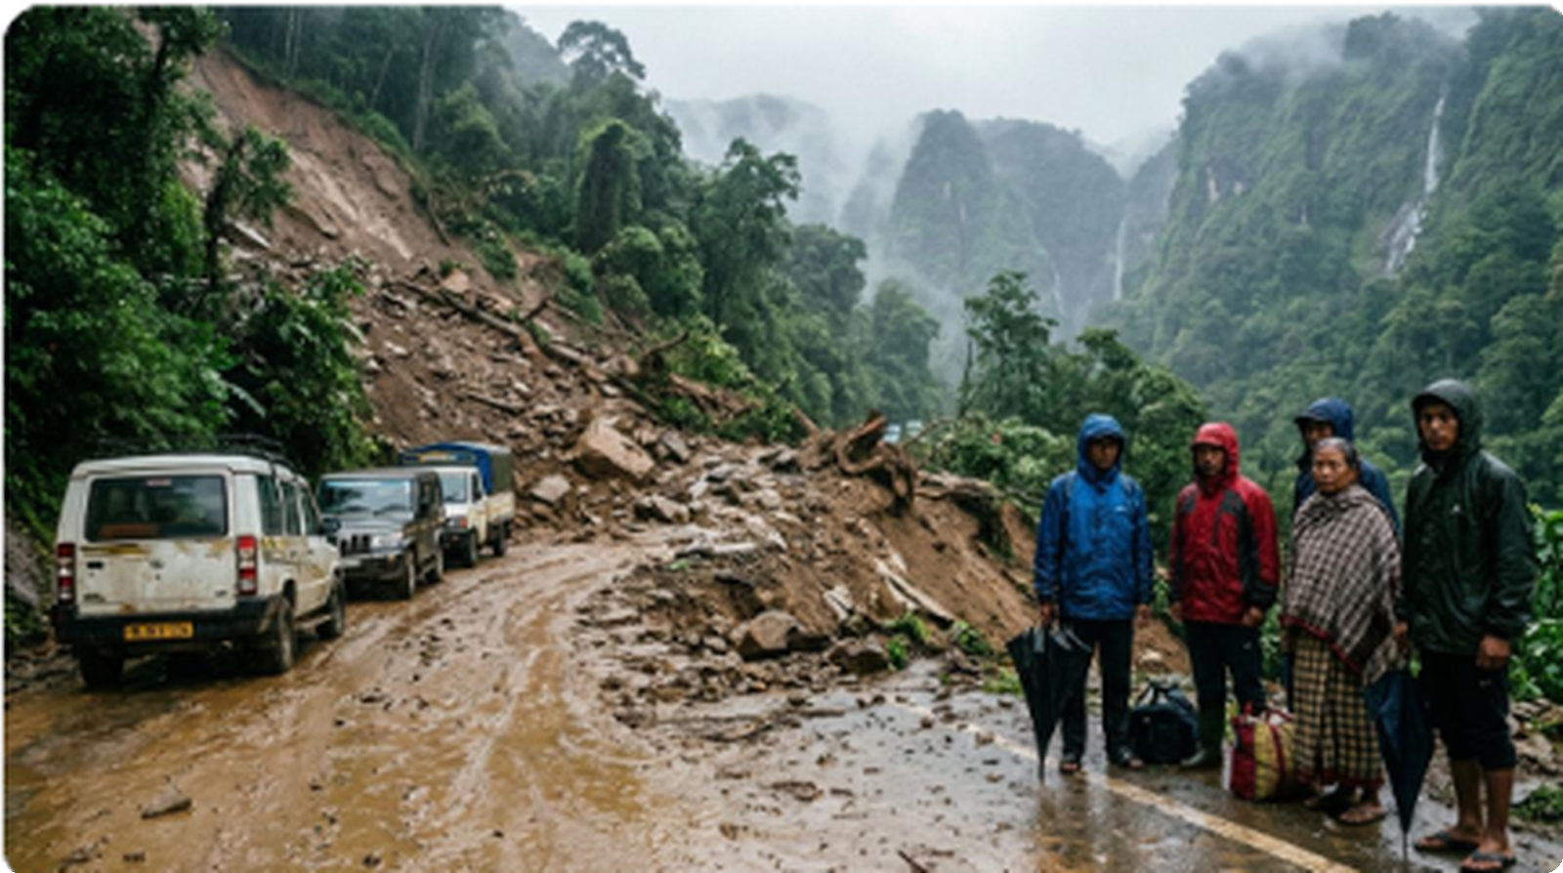








AEGIS
PROPOSED SOLUTION
❖ Ground Reality: Northeast Crisis
❖ AEGIS Solution: Unified 3-Tier Zero-Hardware Architecture
TIER 1: REAL-TIME DATA INGESTION & SATELLITE TELEMETRY
NASA SRTM DEM
IMD AWS & Radar
GSI NLSM Atlas
30m Elevation Grid
Live Doppler Telemetry
1:50k Susceptibility
Slope & Curvature
15-Min Dynamic Rain
30,842+ Past Slips
▼ FastAPI Spatial Core Ingestion Stream ▼
TIER 2: LANDSLIDENET AI & GEOTECHNICAL PHYSICS ENGINE
LandslideNet ML Core
Geotechnical Physics
NH-44 Cutoff: Monsoonal Debris Strands Mountain Lifelines
XGBoost + Random Forest
Dynamic I-D Rainfall Curves
70%
NON-HIMALAYAN FATALITIES
Occur across Northeast India (GSI Atlas)
89.3% Accuracy
0.92 ROC-AUC
<1.2s API Speed
SHAP Explainable
▼ Automated Risk Classification & CAP Dispatch ▼
MILLIONS
CITIZENS VULNERABLE
Vulnerable each monsoon (NDMA Report)
TIER 3: MULTI-AGENCY DISASTER ACTION & LAST-MILE ALERTING
Command Radar
1-Tap CAP Webhook
Offline BLE Mesh
100s OF CR
INFRASTRUCTURE LOSS
Annual highway & freight disruption
District EOCs & DDMAs
NDRF & SDRF Mobilize
0 KB Internet Needed
16-Zone Live Heatmap
Automated Highway Gates
12 Tribal Voice Sirens

Slide 3
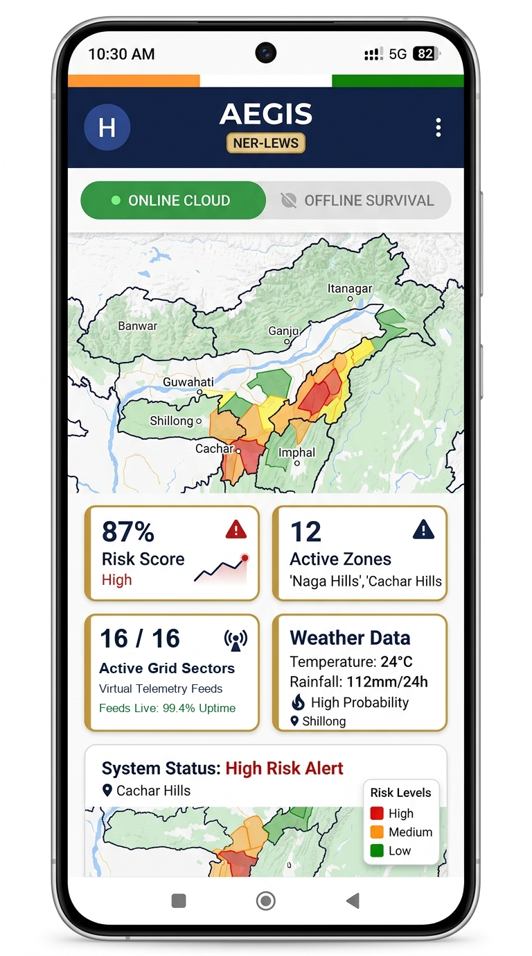

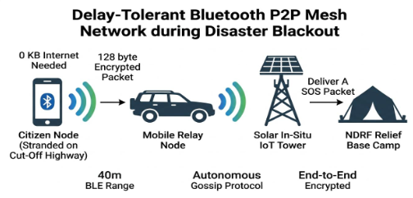
AEGIS
IDEA / PROTOTYPE & CORE USP
AI HAZARD SCORING
1-CLICK CITIZEN GPS
0–100% Dynamic Risk Index
'SAFE' vs 'CRITICAL RISK'
16 NER Zones • XGBoost + RF
Live Weather • Safe Shelter Route
1-TAP SOVEREIGN DISPATCH
12 REGIONAL LANGUAGES
NDRF & SDRF Mobilized
100% Tribal Dialect Voice
NH-44 Gates Closed • Priority SMS
Assamese • Khasi • Mizo • Meitei
CORE BREAKTHROUGH USP
0 KB INTERNET
100% Autonomous Offline
2.4 KM P2P MESH
Multi-Hop Bluetooth Relay
ZERO DRILLING
₹50–100 Lakhs Saved / Slope

Slide 4




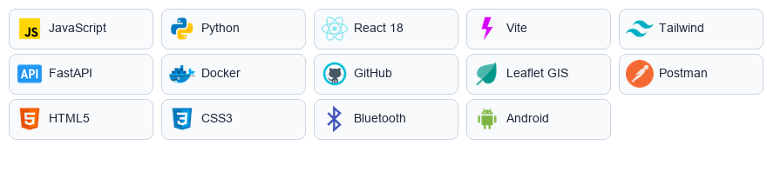

AEGIS
TECHNICAL APPROACH
❖ Technology Stack
❖ End-to-End System Workflow
Frontend : React 18, React Native, Vite, Leaflet GIS, Tailwind CSS, Lucide Icons, Web Audio API.
1. Ingestion & Radar
NASA 30m DEM • Open-Meteo • IMD
2. Geotechnical Trigger
7-Day API vs. I-D Thresholds (NER)
Backend : Python 3.12, FastAPI ASGI, REST APIs, SQLite Spatial, PostGIS, Pydantic V2.
AI and ML : LandslideNet v3.2 (XGBoost + Random Forest ensemble), SHAP Feature Weights.
API Services : Open-Meteo REST API, IMD AWS Telemetry, NASA SRTM DEM 30m, ntfy.sh.
4. LandslideNet AI
XGBoost + RF Ensemble (89.3%)
3. 30m Cell Downscaling
Blended IMD AWS + GSI 1:50k NLSM
Deployment : Netlify Edge CDN, Docker Containerization, GitHub Actions CI/CD, MeghRaj Ready.
Testing & Tools : Postman, PyTest, Jest, React Testing Library, ESLint, BLE Nearby Protocols.
5. 1-Click Dispatch
NDRF 1st Bn • NH-44 Barrier Gates
6. Offline BLE Mesh
0 KB Net • 12 Tribal Dialect Sirens
★ LandslideNet Validation: Precision: 88.1% | Recall: 91.2% | F1-Score: 0.896 | FAR: <11% | ROC-AUC: 0.92

Slide 5



AEGIS
FEASIBILITY AND VIABILITY
FEASIBILITY ANALYSIS
VIABILITY & SCALABILITY
100% OPEN APIS
Open-Meteo • IMD AWS • NASA DEM • 99.4% Verified SLA Uptime
PAN-REGIONAL SCALE
Direct Institutional Integration • NDMA SACHET & State EOC Webhooks
₹50–100 LAKHS SAVED
Per Slope vs Borehole Sensors • Zero In-Situ Drilling Hardware
SIGNIFICANT CASUALTY CUT
Actionable Early Warning Lead Time • Evacuation 4–6 Hours in Advance
<₹5,000 / MONTH
Total District Cloud Deployment • Hosted on NIC MeghRaj Sovereign Cloud
PREVENTS 100s OF CR DAMAGE
National Freight Asset Protection • Automated Highway Diversions & Barriers
0% WASHOUT RISK
Zero Physical Mountain Hardware • Immune to Monsoonal Flash Floods
LAST-MILE TRIBAL REACH
12 Vernacular Dialect Voice Sirens • Offline BLE Mesh for Isolated Valleys
❖ Primary Beneficiaries & Deployment Scenarios:
❖ Authoritative Data Sources & Compliance:
District Magistrates (DDMA)
Real-time command radar with 4–6 hrs advance lead time.
GSI NLSM Baseline
4.3L sq km susceptibility & 30k+ slips
IMD AWS Telemetry
Live hourly precipitation & Doppler feeds
NDRF & SDRF First Responders
Automated dispatch webhook with exact GIS rupture points.
Rural Hill Communities
12 tribal dialect voice sirens without internet dependency.
NDMA SACHET CAP
100% compliant with National Alert Protocol
NIC MeghRaj Cloud
Sovereign cloud hosting with 99.4% uptime SLA

Slide 6
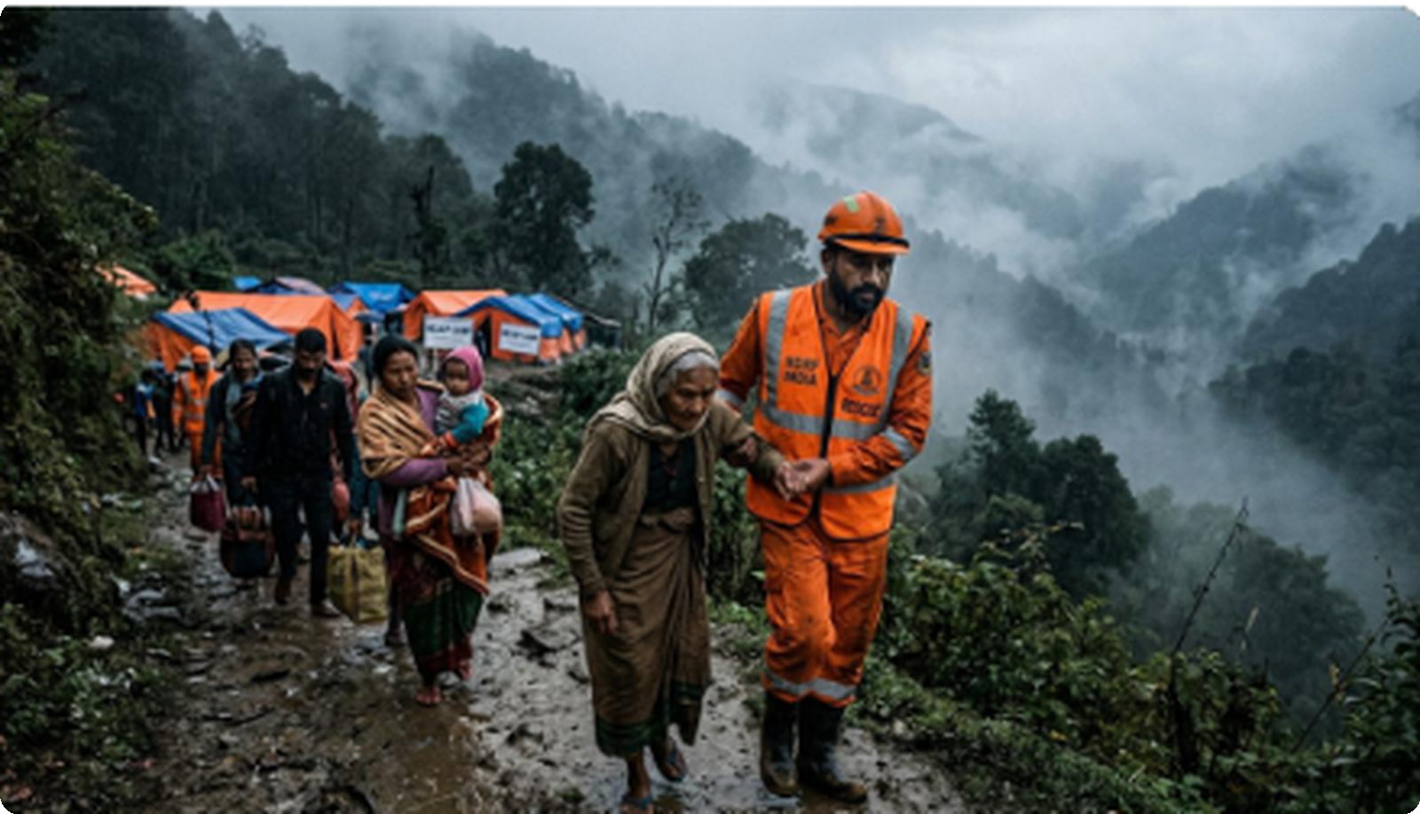
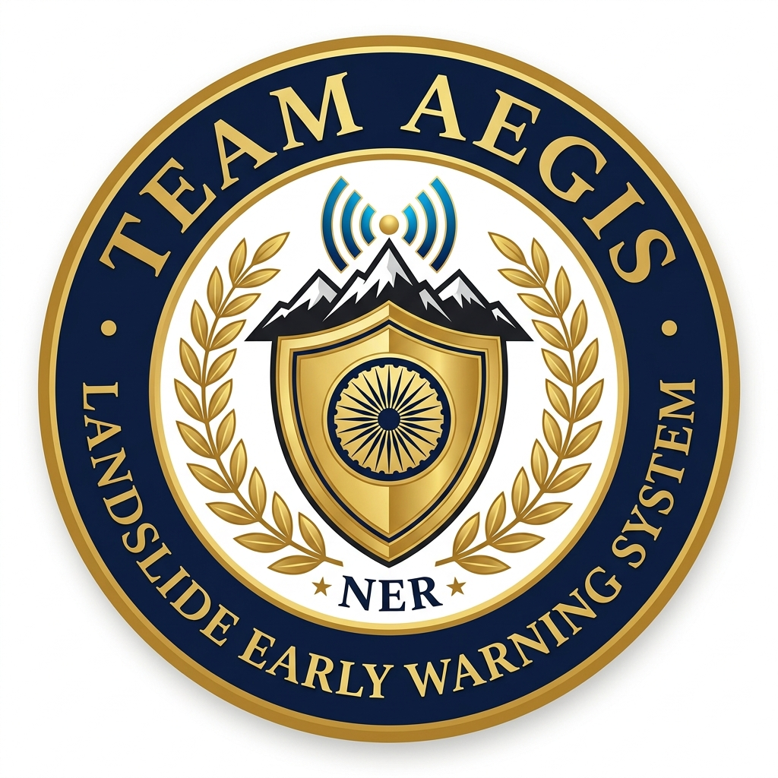
AEGIS
IMPACT AND BENEFITS
❖ Humanitarian Ground Mission
❖ Multi-Tier Beneficiary Impact
CITIZEN EMPOWERMENT
★ 1-Click GPS Check: Instant Coordinate Safety & Live Weather Index
★ 12 Tribal Dialects: Assamese, Khasi, Mizo, Meitei — Zero Left Behind
★ Bedrock Shelters: Offline Maps Direct to Safe High-Ground Relief Points
GOVERNMENT & DEFENSE
★ Automated NDRF Orders: Mobilizes 1st Bn Guwahati & SDRF Instant Dispatch
HIGH
CASUALTY REDUCTION
Through 4–6 hr advance alerts
NER-WIDE
COMMUNITY REACH
Across vulnerable hill districts
0 KB
INTERNET DEPENDENCY
Autonomous BLE mesh operation
★ Highway Barrier Gates: Automates Closure on NH-44 & NH-29 to Halt Traffic
★ Unified Command GIS: Real-Time 16-Zone Risk Heatmap for MDoNER & NDMA
COMMUNITY & RURAL RESILIENCE
❖ MISSION OBJECTIVE: ZERO ZERO-WARNING CASUALTIES
★ Sub-5.9MB APK Size: Installs on Low-Cost ₹5,000 Android Devices in Valleys
★ 4–6 HR ADVANCE ALERT: Guaranteed Evacuation Window
★ 0 KB Internet Mesh: Propagates Hazard Sirens Phone-to-Phone via BLE
★ 0 KB INTERNET NEEDED: Autonomous P2P BLE Mesh
★ 100% Free & Open-Source: Zero Cloud Fees & Zero Proprietary Subscriptions
★ ₹0 DRILLING HARDWARE: Immune to Monsoonal Washout

Slide 7




AEGIS
RESEARCH AND REFERENCES
❖ Comparative Analysis: Operational Scope & Mandate Across Disaster Systems
Functional Dimension / Scope | AEGIS (Proposed LEWS) | GSI NLSM Portal | IMD Weather App / Portal | NASA LHASA 2.0
Primary Mandate & Design Focus | Hyper-local early warning & last-mile community alert propagation | National-scale geological susceptibility mapping & GIS atlas | Synoptic meteorological observation, forecasting & weather warnings | Global satellite-based landslide hazard research & situational modeling
Hazard Prediction Cadence | Near real-time dynamic inference combining rainfall, slope & soil data | Macro-level susceptibility baselines; updated periodically per season | Doppler radar nowcasts & 3-hourly AWS precipitation telemetry | Near real-time global multi-satellite rainfall heuristic triggers (GPM)
Offline / Blackout Communication | Targeted BLE peer-to-peer mesh designed for zero-cellular conditions | Cloud/web portal access; field offline mesh not within portal scope | Standard cellular & internet delivery; offline mesh not in scope | Cloud-hosted data & API feeds; local offline relay not intended
Citizen Micro-Routing & Radar | 1-Click GPS coordinate check with offline shelter navigation routes | Regional susceptibility maps; citizen micro-routing not identified | District & station-level agro-met bulletins; no slope-route guidance | Global 1 km risk grid; not structured for localized citizen routing
Automated Sovereign Dispatch | 1-Click multi-agency triggers (NDRF, SDRF, NH-44 highway gates) | Scientific advisories shared with state nodal disaster authorities | Common Alerting Protocol (CAP) feeds & institutional weather bulletins | Open scientific outputs utilized by humanitarian & research partners
Hardware & Deployment Scope | Zero in-situ geotechnical drilling; leverages smartphone sensors & APIs | Regional pilot slope sensors where funded; primarily GIS data service | Expansive national network of surface weather stations & Doppler radar | Spaceborne Earth Observation fleet (GPM, MODIS, SRTM DEM)
Geological Survey of India
NLSM 1:50k Atlas (30.8k Slips)
🔗 bhukosh.gsi.gov.in
India Meteorological Dept
15-Min Dynamic Doppler Feeds
🔗 mausam.imd.gov.in
NASA Earth Science
SRTM 30m Global Elevation DEM
🔗 earthdata.nasa.gov
National Disaster Mgmt
SACHET CAP v1.2 Protocol
🔗 sachet.ndma.gov.in
SMART INDIA HACKATHON 2026 • TEAM AEGIS • PROBLEM STATEMENT ID: SIH26001
All machine learning pipelines, spatial downscaling algorithms, and Bluetooth mesh architectures comply strictly with Ministry of Mines (GSI), NDMA CAP v1.2, and open scientific reproducibility standards.

