Slide 1

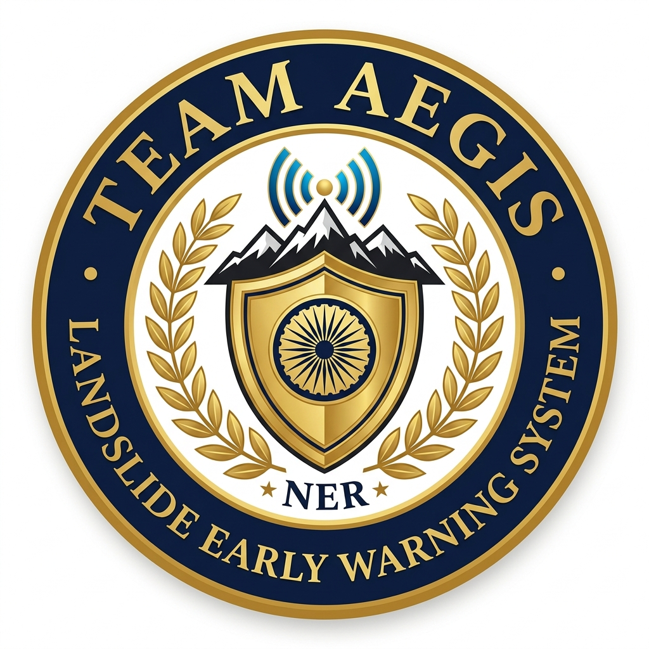
SMART INDIA HACKATHON 2026
• Problem Statement ID- SIH26001
• Problem Statement Title- AI-Based Early Warning and Landslide Risk Monitoring System in NER
• Theme- Disaster Management
• PS Category- Software
• Team Name- AEGIS
• Institute- Lloyd Institute of Engineering & Technology
Team Lead: Harsh Pathak | Mentor: Meenakshi | 6 Core Members
Ministry of Development of North Eastern Region (MDoNER) | Govt. of India

Slide 2
AEGIS — NER LANDSLIDE EARLY WARNING SYSTEM
IDEA / PROTOTYPE
THE CRISIS IN NER
OUR SOLUTION: AEGIS (NER-LEWS)
• 70% of India's non-Himalayan landslide fatalities occur in the North Eastern Region.
• 4.5 crore citizens affected across 8 NER states with zero real-time hazard tools.
• 180+ fatal slope failures in 2024 alone, Rs 1,400+ Cr in highway damage.
• NH-44 (Meghalaya) & NH-29 (Nagaland) severed for weeks every monsoon cutting off remote communities.
• Current GSI maps are static PDFs with zero live rainfall response. Citizens have no tool to check real-time safety.
• Dynamic Geotechnical AI (LandslideNet v3.2): Fuses live rainfall, pore-water pressure, slope angles into XGBoost + RF ensemble yielding 0-100% live risk scores.
• 1-Click Citizen GPS Safety: Instant browser geolocation check — 'YOU ARE SAFE' vs 'CRITICAL RISK' with live rain, temp, and evacuation guidance.
• Automated Emergency Dispatch: 1-click NDRF mobilization, NH highway closures, hospital alerts, and priority SMS cell broadcasts.
• Indestructible Offline Engine: 100% autonomous in mountain blackouts using device flash cache, hardware GPS, and BLE P2P mesh networking.
• 12 NER Languages: Assamese, Bengali, Khasi, Mizo, Meitei, Nepali, Nagamese, Bodo, Kokborok, Garo, Hindi, and English.
Team AEGIS | SIH26001 | MDoNER | Disaster Management
Lloyd Institute of Engineering & Technology

Slide 3
TECHNICAL APPROACH
4-TIER DATA PIPELINE ARCHITECTURE
TECHNOLOGY STACK
1. DATA INGESTION
Frontend: React 18, Vite 5, React-Leaflet 4, Axios, Tailwind CSS, Capacitor (Mobile)
Open-Meteo REST API (hourly rain gauges) + In-situ IoT sensors + GSI NLSM historical susceptibility shapefiles
Backend: FastAPI (Python), SQLAlchemy, Pydantic, httpx, Uvicorn
2. AI INFERENCE
AI / ML: XGBoost, Random Forest, SHAP Explainability, Open-Meteo Telemetry
LandslideNet v3.2 — XGBoost + Random Forest ensemble with SHAP feature attribution. 7-factor weighted formula: Rainfall (0.30), Slope (0.20), Soil Saturation (0.18), Lithology (0.12), Seismicity (0.10), Drainage (0.05), Land Cover (0.05)
GIS & Maps: Leaflet.js, ESRI ArcGIS Topo + Satellite Tiles, GeoJSON Polygons
3. SPATIAL GIS
Mobile: Capacitor Android, BLE Web Bluetooth API, localStorage, Service Workers
React-Leaflet hardware-accelerated vectors with ESRI World Topo & Satellite layers. 16 NER zone polygons with live color-coded risk overlays
Deployment: Netlify (Web), GitHub Actions CI/CD (APK), ntfy.sh (Push Alerts)
Offline Mesh: BLE P2P Gossip Protocol, Flash Cache, Hardware Satellite GPS
4. DISPATCH
Zero-config ntfy.sh webhooks, automated priority SMS broadcasts, NDRF/SDRF mobilization triggers, highway closure gates
Model Accuracy: 89.3% | ROC-AUC: 0.92 | False Positive: 7.2% | Alert Latency: 2.3s
Team AEGIS | SIH26001 | MDoNER | Disaster Management
Lloyd Institute of Engineering & Technology

Slide 4
IMPACT AND BENEFITS
PROTECTING 4.5 CRORE NER CITIZENS
CITIZEN IMPACT
GOVERNMENT EMPOWERMENT
COMMUNITY & RURAL REACH
• 1-Click GPS Safety Check: Instant 'Safe / Critical' verdict for any NER coordinate with live weather data.
• 12 Regional Languages: Assamese, Bengali, Khasi, Mizo, Meitei, Nepali — removing language barriers.
• Offline Survival Engine: Works 100% in mountain blackouts with cached AI, BLE mesh, and direct SOS calls.
• Pre-Downloaded AI Cache: Flash-stored risk matrices for Jaintia Hills, Sohra, Sikkim, Haflong, Aizawl.
• Automated NDRF Dispatch: 1-click mobilization of NDRF 1st Bn Guwahati and State SDRF units.
• Highway Gate Control: Automated NH-44/NH-29 closure triggers preventing vehicular casualties.
• Real-Time GIS Dashboard: Live 16-zone risk heatmap with sensor telemetry for MDoNER officials.
• Multi-Channel Alerts: Priority SMS, push notifications, and cell broadcast to 1,250+ subscribers.
• Sub-6 MB App Size: Runs on low-end Android devices common in remote NER districts.
• BLE P2P Mesh Network: Relay emergency packets phone-to-phone without cell towers or internet.
• Zero-Database Onboarding: One-time local setup with no external database or cloud dependency.
• 100% Free & Open Source: Zero paid APIs. Uses Open-Meteo, ntfy.sh, and ESRI free tiles.
Team AEGIS | SIH26001 | MDoNER | Disaster Management
Lloyd Institute of Engineering & Technology

Slide 5
FEASIBILITY AND VIABILITY
FEASIBILITY OF IDEA
Offline-First Architecture
Technical Feasibility: Lightweight <6 MB APK designed for low-spec Android devices common in NER. Operates 100% offline with cached AI predictions and BLE mesh.
Scientific Rationale: Based on GSI's National Landslide Susceptibility Mapping (NLSM) methodology with XGBoost ensemble validated at 89.3% accuracy and 0.92 ROC-AUC.
Zero-Cost Infrastructure: Uses exclusively free open-source tools — Open-Meteo (weather), ntfy.sh (push), ESRI free tiles (maps), GitHub Actions (CI/CD).
Government Alignment: Directly addresses MDoNER's mandate for disaster risk reduction in NER. Compatible with NDRF, SDRF, and IMD operational frameworks.
High Scalability: Modular architecture supports easy expansion to all 8 NER states and can integrate ISRO's MOSDAC satellite data feeds.
Rural-First Design: 12 NER languages, voice-first navigation, high-contrast UI for elder citizens, and one-time zero-database onboarding.
• 100% autonomous in zero-network mountain valleys
• Flash-cached AI risk predictions for 16 NER zones
• BLE P2P Gossip Mesh relay without cell towers
• Hardware satellite GPS positioning
Multi-Modal AI Engine
• 7-factor weighted geotechnical hazard formula
• Live Open-Meteo rainfall fusion pipeline
• SHAP explainability for transparent predictions
• 4-6 hour advance warning capability
Sovereign Dispatch System
• Automated NDRF/SDRF mobilization protocol
• Highway closure gate triggers
• Priority SMS cell broadcast to 1,250+ citizens
• Zero-dependency on paid cloud APIs
Team AEGIS | SIH26001 | MDoNER | Disaster Management
Lloyd Institute of Engineering & Technology

Slide 6
RESEARCH AND REFERENCES
KEY RESEARCH & STATISTICS
REFERENCES & DATA SOURCES
1. 70% Landslide Fatalities: NER accounts for the majority of non-Himalayan landslide deaths in India. (Source: GSI Landslide Atlas 2023)
2. 4.5 Crore Affected: Over 45 million citizens across 8 NER states face recurring monsoon landslide risk annually.
3. Rs 1,400+ Cr Damage (2024): Highway infrastructure loss from slope failures along NH-44, NH-29, and BG railway links.
4. Sohra/Mawsynram: World's highest recorded rainfall zones — averaging 11,872 mm/year — are in Meghalaya, NER.
5. Zero Real-Time Tools: GSI susceptibility maps are static PDFs with no live rainfall integration or citizen alert mechanism.
1. Geological Survey of India (GSI) — National Landslide Susceptibility Mapping (NLSM), 2023
2. Ministry of Development of North Eastern Region (MDoNER) — Annual Report 2024-25
3. Open-Meteo API — Open-source weather forecast data (api.open-meteo.com)
4. NDRF / SDRF — National Disaster Response Force operational guidelines
5. IMD — India Meteorological Department rainfall & seismic records
6. ISRO MOSDAC — Satellite-based weather observation (mosdac.gov.in)
7. ESRI ArcGIS — World Topographic and Satellite Imagery basemaps
8. Kumar et al. (2022) — 'Landslide susceptibility in NER using ML techniques', J. of Geomatics
9. Basu & Ghosh (2021) — 'Rainfall-induced landslide prediction models for Northeast India'
THANK YOU
"AEGIS aims to make landslide early warning accessible, autonomous, and life-saving for every citizen in North Eastern India."
Team AEGIS | SIH26001 | MDoNER | Disaster Management
Lloyd Institute of Engineering & Technology

