Slide 1

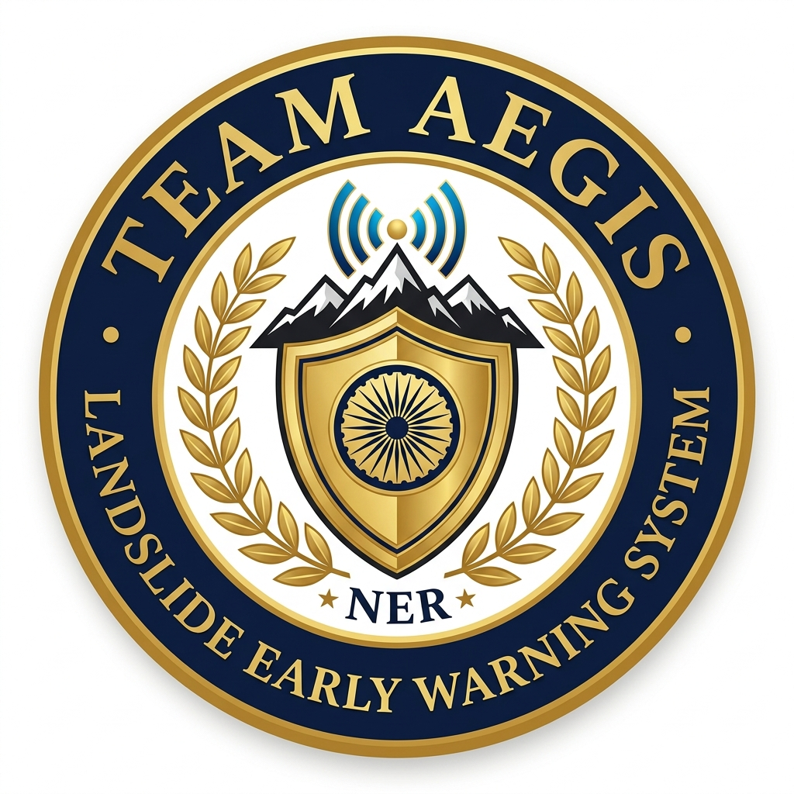
SMART INDIA HACKATHON 2026
• Problem Statement ID- SIH26001
• Problem Statement Title- AI-Based Early Warning and Landslide Risk Monitoring System in NER
• Theme- Disaster Management
• PS Category- Software
• Team ID-
• Team Name- AEGIS
Lloyd Institute of Engineering & Technology | Team Lead: Harsh Pathak + 5 Members | Mentor: Meenakshi
Ministry of Development of North Eastern Region (MDoNER)
Government of India

Slide 2
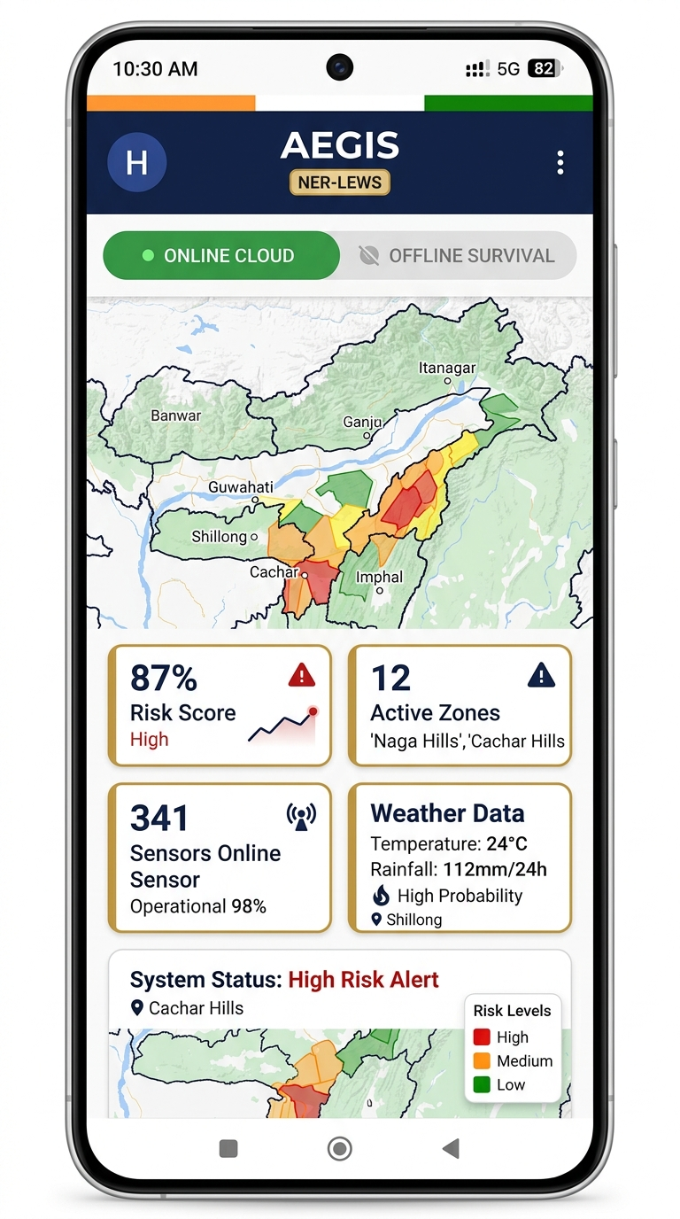
AEGIS
NER Landslide Early Warning System
IDEA / PROTOTYPE:
• Landslides in NER are a recurring catastrophe — 70% of India's non-Himalayan landslide fatalities occur across the 8 North Eastern states. Fragile Disang shale formations, world-record rainfall (Sohra/Mawsynram), and young tectonic slopes trigger rapid debris flows every monsoon.
• AEGIS (NER-LEWS) is an AI-powered, multimodal early warning GIS platform that fuses real-time rainfall telemetry, geotechnical hazard models, and automated multi-channel emergency dispatch specifically engineered for NER.
• The platform tracks and predicts on a continuous basis:
• 1. Dynamic Risk Scoring: Live 0-100% hazard indices across 16 critical NER zones using LandslideNet v3.2 (XGBoost + RF ensemble) fusing 7 geotechnical factors.
• 2. Citizen GPS Safety: Instant 1-click browser geolocation check — tells the user 'YOU ARE SAFE' or 'CRITICAL RISK' with live rainfall, temperature, and evacuation guidance.
• 3. Autonomous Offline Engine: Operates 100% without internet using cached AI predictions, hardware satellite GPS, and Bluetooth Low Energy (BLE) P2P mesh networking to relay hazard alerts.
• 4. Sovereign Emergency Dispatch: 1-click NDRF/SDRF mobilization, highway closure triggers, hospital alerts, and priority SMS cell broadcasts to 1,250+ subscribers.
Team AEGIS | SIH26001 | MDoNER | Disaster Management
Lloyd Institute of Engineering & Technology

Slide 3
TECHNICAL APPROACH
1. DATA INGESTION
App Features
Open-Meteo REST API (hourly rain gauges) In-situ IoT Sensors (soil moisture, displacement) GSI NLSM Historical Susceptibility Shapefiles
CITIZEN
GOVERNMENT
• Instant GPS safety check
• Live risk score 0-100%
• Evacuation route guidance
• 12 NER regional languages
• 16-zone GIS risk dashboard
• 1-click NDRF/SDRF dispatch
• Real-time sensor telemetry
• Highway closure automation
2. AI INFERENCE ENGINE
LandslideNet v3.2 — XGBoost + RF Ensemble 7-Factor Formula: Rainfall(0.30), Slope(0.20), Soil(0.18), Lithology(0.12), Seismicity(0.10), Drainage(0.05), Land Cover(0.05)
OFFLINE ENGINE
COMMUNITY
3. SPATIAL GIS RENDERING
• BLE P2P mesh networking
• Cached AI risk predictions
• Hardware satellite GPS
• Direct SOS calls (no data)
• Sub-6 MB app size
• Zero-database onboarding
• 100% free open-source
• Runs on low-end Android
React-Leaflet Hardware-Accelerated Vectors ESRI ArcGIS Topo + Satellite Layers 16 NER Zone Polygons with Live Risk Overlays
4. ALERT DISPATCH
ntfy.sh Zero-Config Push Webhooks Priority SMS Cell Broadcast (1,250+) NDRF/SDRF Mobilization & Highway Gates
React 18 | FastAPI | XGBoost | Leaflet.js | Capacitor | BLE | ntfy.sh
Team AEGIS | SIH26001 | MDoNER | Disaster Management
Lloyd Institute of Engineering & Technology

Slide 4
IMPACT AND BENEFITS
PROTECTING 4.5 CRORE NER CITIZENS
CITIZEN SAFETY
• 1-Click GPS Safety Check: Instant real-time 'Safe / Critical' verdict for any NER coordinate with live weather data.
• 12 Regional Languages: Assamese, Bengali, Khasi, Mizo, Meitei, Nepali — removing language barriers in remote areas.
• Offline Survival Engine: Works 100% in mountain blackouts with cached AI, BLE mesh, direct SOS calls, and hardware GPS.
GOVERNMENT EMPOWERMENT
• Automated NDRF Dispatch: 1-click mobilization of NDRF 1st Bn Guwahati and State SDRF units with zero manual intervention.
• Real-Time GIS Dashboard: Live 16-zone risk heatmap with sensor telemetry, rainfall overlays for MDoNER officials.
• Highway Gate Control: Automated NH-44/NH-29 closure triggers preventing vehicular casualties during active debris flows.
COMMUNITY & RURAL REACH
• Sub-6 MB App Size: Lightweight enough for low-end Android devices common in remote NER districts.
• BLE P2P Mesh Network: Relay emergency packets phone-to-phone without cell towers or internet in disconnected valleys.
• 100% Free & Open Source: Zero paid APIs used. Built entirely on Open-Meteo, ntfy.sh, ESRI free tiles, and GitHub Actions.
Team AEGIS | SIH26001 | MDoNER | Disaster Management
Lloyd Institute of Engineering & Technology

Slide 5
FEASIBILITY AND VIABILITY
FEASIBILITY OF IDEA
Offline-First Architecture
Multi-Modal AI Engine
Sovereign Dispatch
Technical Feasibility: Lightweight <6 MB APK designed for low-spec Android devices. Works fully offline with cached AI and BLE mesh.
Scientific Rationale: Based on GSI's NLSM methodology with XGBoost ensemble validated at 89.3% accuracy and 0.92 ROC-AUC score.
Zero-Cost Infrastructure: Uses only free open-source tools — Open-Meteo (weather), ntfy.sh (push), ESRI free tiles, GitHub Actions CI/CD.
Government Alignment: Directly addresses MDoNER's disaster risk reduction mandate. Compatible with NDRF, SDRF, and IMD frameworks.
High Scalability: Modular architecture supports expansion to all 8 NER states and integration with ISRO MOSDAC satellite feeds.
Rural-First Design: 12 NER languages, high-contrast UI, voice-first navigation, one-time zero-database local onboarding.
• 100% autonomous in zero-network valleys
• Flash-cached AI risk predictions
• BLE P2P gossip mesh relay protocol
• Hardware satellite GPS positioning
• 7-factor geotechnical hazard formula
• Live Open-Meteo rainfall fusion
• SHAP explainability for transparency
• 4-6 hour advance warning capability
• Automated NDRF/SDRF mobilization
• Highway closure gate triggers
• Priority SMS to 1,250+ citizens
• Zero paid API dependencies
Team AEGIS | SIH26001 | MDoNER | Disaster Management
Lloyd Institute of Engineering & Technology

Slide 6
RESEARCH AND REFERENCES
1. 70% Landslide Fatalities: NER accounts for the majority of non-Himalayan landslide deaths in India. (Source: GSI Landslide Atlas 2023)
2. 4.5 Crore Affected: Over 45 million citizens across 8 NER states face recurring monsoon landslide risk annually.
3. Rs 1,400+ Cr Damage: Highway infrastructure loss from slope failures along NH-44, NH-29, and BG railway. (2024 data)
4. Sohra/Mawsynram Records: World's highest rainfall zones averaging 11,872 mm/year are in Meghalaya, NER.
5. Zero Real-Time Tools: Current GSI susceptibility maps are static PDFs with no live rainfall integration or citizen alerts.
1. Geological Survey of India (GSI) — NLSM 2023
2. MDoNER — Annual Report 2024-25
3. Open-Meteo API — api.open-meteo.com
4. NDRF/SDRF Operational Guidelines
5. IMD — Rainfall & Seismic Records
6. ISRO MOSDAC — mosdac.gov.in
7. ESRI ArcGIS — Topo/Satellite Basemaps
8. Kumar et al. (2022) — ML Susceptibility in NER
9. Basu & Ghosh (2021) — Rainfall-Induced Prediction
"AEGIS aims to make landslide early warning accessible, autonomous, and life-saving for every citizen in North Eastern India."
THANK YOU

