Slide 1
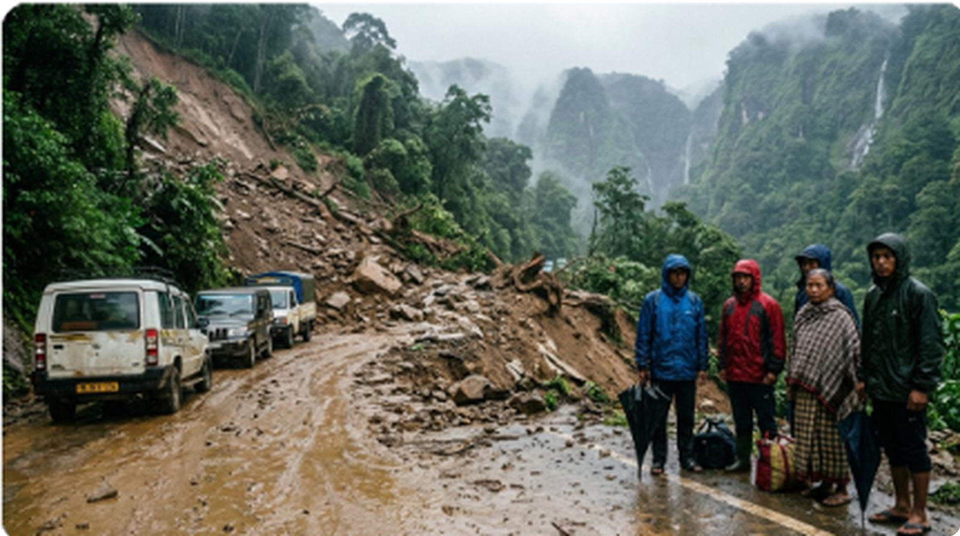








AEGIS
PROPOSED SOLUTION
❖ Ground Reality: The Northeast Crisis
❖ AEGIS Solution: Unified 3-Tier System Architecture
TIER 1: REAL-TIME DATA INGESTION & SATELLITE TELEMETRY
NASA SRTM DEM
IMD AWS & Radar
GSI NLSM Atlas
30m Elevation Grid
Live Doppler Telemetry
1:50k Susceptibility Map
Terrain Slope & Curvature
15-Min Dynamic Rainfall
30,842+ Historical Slips
▼ FastAPI Spatial Core Ingestion Stream ▼
TIER 2: LANDSLIDENET AI & GEOTECHNICAL PHYSICS ENGINE
LandslideNet ML Core
Geotechnical Physics
Severed NH-44 Highway in Meghalaya: Monsoonal debris flows cut off lifeline supply chains & strand mountain commuters.
XGBoost + Random Forest
Dynamic I-D Rainfall Thresholds
89.3% Accuracy
0.92 ROC-AUC
<1.2s API Speed
SHAP Explainability
CRITICAL GROUND STATISTICS & SOURCES
• 70% Non-Himalayan Fatalities: Occur in NER hill tracks annually. (Source: GSI Landslide Atlas 2023)
• 4.5 Crore Citizens At Risk: Vulnerable across all 8 NER states each monsoon. (Source: NDMA National Guidelines)
• 180+ Slips & ₹1,400+ Cr Damage: Recorded in 2024 alone on NH-44 & NH-29. (Source: MDoNER Infrastructure Audit)
▼ Automated Risk Classification & CAP Dispatch ▼
TIER 3: MULTI-AGENCY DISASTER ACTION & LAST-MILE ALERTING
Command Radar
1-Tap CAP Webhook
Offline BLE Mesh
District EOCs & DDMAs
NDRF & SDRF Mobilize
0 KB Internet Needed
16-Zone Live Heatmap
Automated Highway Gates
12 Tribal Voice Sirens

