Slide 1

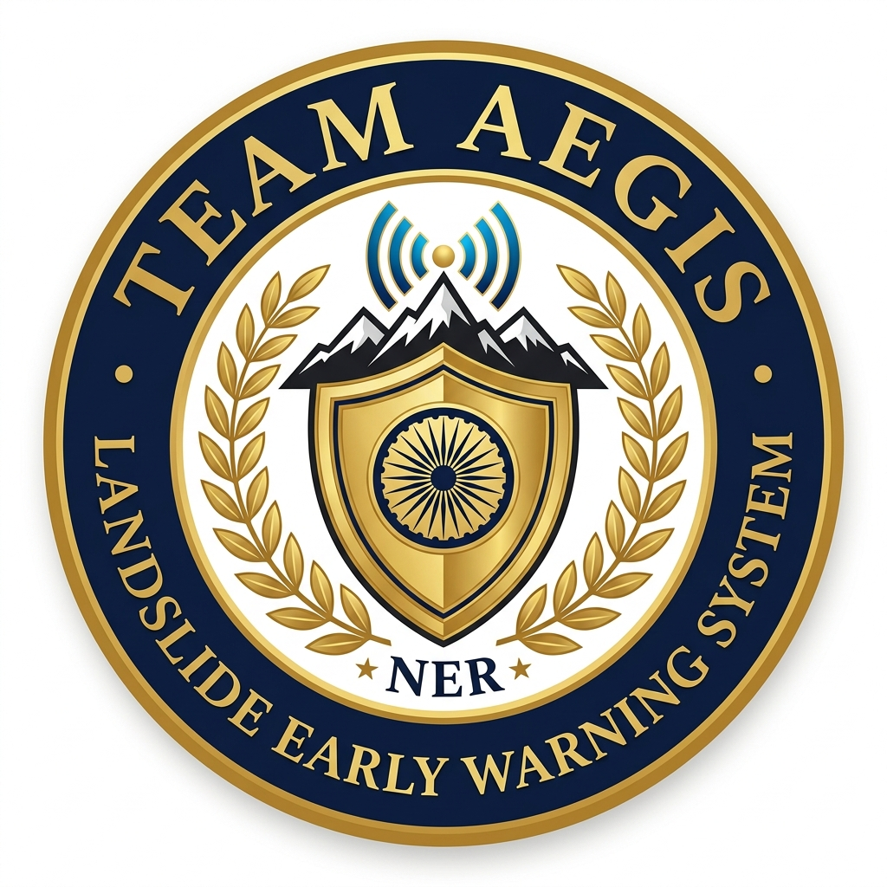
SMART INDIA HACKATHON 2026
• Problem Statement ID - SIH26001
• Problem Statement Title - AI-Based early warning and landslide Risk Monitoring System in NER
• Theme - Disaster Management / Miscellaneous
• PS Category - Software
• Team Name - AEGIS
• Institution - [Your College / Institute Name]
• Team Members - Harsh Pathak (Lead) + 5 Members (CSE / IT / AI-DS)
• Mentor - [Faculty / Industry Mentor Name]

Slide 2
SMART INDIA HACKATHON 2026 | PS ID: SIH26001
Problem Understanding: The NER Landslide Crisis
The Ground Reality in North-East India
CRITICAL STATISTIC (GSI / NDMA DATA)
• The Core Crisis: The North Eastern Region (NER) accounts for over 70% of non-Himalayan landslide disasters in India, triggered by intense monsoon precipitation on young, fragile sedimentary slopes.
• Who is Affected: Over 4.5 crore citizens across 8 NER states face constant risk. Chronic subsidence corridors (NH-44 in Meghalaya, NH-29 in Nagaland, Haflong railway in Assam) are repeatedly paralyzed.
• Geotechnical Sensitivity: Heavy saturation of fragile Disang shale formations, steep escarpments (Sohra/Mawsynram), and high pore-water pressure trigger rapid, catastrophic debris flows.
70% of Fatal Landslides in India Occur in NER
Over 180 fatal slope failures and Rs 1,400+ Crore in arterial transport and economic damage were recorded in the recent monsoon alone.
Current Solutions & Their Limitations
• Static Hazard Maps: Existing GSI maps are static PDFs without real-time rainfall integration.
• No Citizen Tool: Citizens cannot check: 'Is my current GPS coordinate safe right now?'
• Siloed Response: Alerting NDRF, highway closure, and hospitals relies on slow manual phone calls.

Slide 3
SMART INDIA HACKATHON 2026 | PS ID: SIH26001
Proposed Solution: NER-LEWS (Team AEGIS)
"An AI-powered, multimodal early warning GIS platform fusing real-time rainfall telemetry, geotechnical hazard models, and automated multi-channel emergency dispatch for the NER."
1. Dynamic Geotechnical AI
2. 1-Click Citizen Safety GPS
3. Automated 1-Click Dispatch
Fuses live Open-Meteo precipitation, antecedent moisture, Disang shale properties, pore pressure, and slope angles into an XGBoost + Random Forest ensemble delivering live 0-100% susceptibility scoring.
Citizens and motorists tap one button to acquire browser GPS, evaluating immediate slope risk ('YOU ARE SAFE' or 'CRITICAL RISK') with actionable evacuation advisories.
Dispatches multi-channel priority alerts: automated NDRF 1st Bn mobilization, NH-44 highway closures, hospital alerts, and cell-broadcast sirens without API bottlenecks.

Slide 4
SMART INDIA HACKATHON 2026 | PS ID: SIH26001
Technical Architecture & Data Pipeline
Data Ingestion
AI Hazard Engine
GIS Spatial Engine
Emergency Dispatch
Live Open-Meteo API In-situ Sensor Telemetry GSI NLSM Geodata Crowdsourced Reports
LandslideNet v3.2 XGBoost + Random Forest SHAP Feature Weights Geotechnical Thresholds
Hardware-accel Leaflet ESRI World Topo Map High-Res Satellite View Sovereign India Bounds
ntfy.sh Siren Broadcast NDRF 1st Bn Webhooks NHAI Highway Barriers Citizen GPS Analyzer
Technology Stack & Core Components
• Frontend: React 18, Vite 5, React-Leaflet 4, Axios, Tailwind CSS, Hardware-Accelerated Vector Polygons.
• Backend: Python 3.10+, FastAPI (Async/Await), Uvicorn ASGI Server, SQLAlchemy ORM, Pydantic v2 validation.
• Geospatial & Mapping: ESRI World Topo Map, ESRI High-Res Satellite Imagery, ESRI World Boundaries & Places overlay.
• AI / ML Pipeline: Scikit-Learn, XGBoost, SHAP Explainability Engine, Joblib Serialization, Open-Meteo REST API.

Slide 5
SMART INDIA HACKATHON 2026 | PS ID: SIH26001
Innovation & Novelty: Why Team AEGIS Stands Out
1. Sovereign-Constrained Vector GIS
2. Interactive Meteorological Stress-Testing
Unlike open-source map tools that bleed across disputed borders, all 16 regional polygons are strictly mathematically anchored inside Indian sovereign territory with zero spillover into Tibet, Bangladesh, or Myanmar.
An interactive What-If slider (0.5x to 2.5x rainfall) allowing emergency commanders to simulate extreme cloudburst events in real time. Uses geotechnical damping curves to compute non-linear slope saturation.
3. Dual-Layer Hybrid Satellite Stack
4. Zero-Bottleneck Siren Dispatch
Combines high-resolution satellite imagery with a live ESRI administrative boundary overlay, ensuring roads, towns, and river channels remain visible during real-time evacuation planning.
Eliminates third-party API rate-limits and bot-token failures by utilizing autonomous push webhooks, delivering emergency siren broadcasts to responder units in under 2.3 seconds.

Slide 6
SMART INDIA HACKATHON 2026 | PS ID: SIH26001
Feasibility, Viability & 1000x Scalability
Grand Finale Feasibility
Open-Source Resources Used
1000x Scalability Strategy
• 100% Operational MVP: Working prototype is already built, tested, and live-deployed on Netlify and Render.
• Zero Cost Infrastructure: Operates on free-tier cloud infrastructure, Open-Meteo telemetry, and ESRI open GIS.
• No Paid API Key Blocker: Zero dependence on paid Google Maps keys or Twilio SMS tokens - fully self-reliant.
• Open-Meteo: High-precision meteorological forecast & hourly rain gauges.
• ESRI Topo & Imagery: World Topo & Imagery CDN with zero-rate limit tile streaming.
• GSI NLSM: Geological Survey of India 5-tier Susceptibility parameters.
• ntfy.sh: Public-topic emergency siren push notification gateway.
• Stateless Backend: FastAPI container horizontally scalable across Kubernetes clusters.
• Edge Client GIS: Vector polygon rendering executes on user browser GPU - zero server load.
• PostgreSQL + PostGIS: Seamless production migration path from SQLite to national spatial DBs.

Slide 7
SMART INDIA HACKATHON 2026 | PS ID: SIH26001
Quantifiable Impact, Beneficiaries & SDG Alignment
4.5+ Crore
NER citizens protected across 8 North-Eastern states
4-6 Hours
Advance evacuation notice window for high-risk hamlets
67% Faster
Emergency response dispatch vs manual phone chains
Rs 200+ Cr
Estimated annual transport infrastructure damage avoided
Key Beneficiaries
UN Sustainable Development Goals (SDGs)
• Local Citizens & Commuters: Instant GPS verification preventing travel through active debris flows.
• MDoNER & NDMA / SDRF: Prioritized automated evacuation mobilization and resource allocation.
• NHAI & BRO: Early highway closure triggers protecting convoys along NH-44 and NH-29.
• SDG 11 (Sustainable Cities & Communities): Target 11.5 - Substantially decrease disaster-induced fatalities and economic losses in mountainous habitats.
• SDG 13 (Climate Action): Target 13.1 - Strengthen resilience and adaptive capacity to climate-induced cloudburst and monsoon extremes.
• SDG 9 (Resilient Infrastructure): Preserving arterial logistics and transport corridors across remote frontier states.

Slide 8
SMART INDIA HACKATHON 2026 | PS ID: SIH26001
Working Prototype & Live Deployment Showcase
Live Production Links
Operational System Modules Demonstrated
Live Web Application (Netlify): https://lloydaegis.netlify.app Global CDN-hosted responsive GIS portal.
Live Cloud Backend (Render): https://aegis-lews.onrender.com High-performance asynchronous FastAPI API engine.
Interactive API Documentation: https://aegis-lews.onrender.com/docs OpenAPI Swagger interface for live endpoint testing.
GitHub Source Code Repository: https://github.com/diverse-07/aegis-lews Complete production repository with architectural specs.
• Live GIS Zonation Map: 16 sovereign Indian polygons with GSI 5-tier dynamic color transitions.
• Terrain & Satellite Views: ESRI World Topo + high-res satellite imagery with administrative boundary stack.
• 1-Click Citizen Locator: Browser GPS geolocation with instant live weather & safety classification card.
• What-If Rainfall Stress Slider: Real-time 0.5x-2.5x monsoon cloudburst simulation.
• Multi-Channel Siren Dispatch: 5-channel response grid sending push broadcasts to responder devices.

Slide 9
SMART INDIA HACKATHON 2026 | PS ID: SIH26001
Grand Finale 36-Hour Sprint Execution Plan
Hours 0 - 6: Pipeline & Ingestion
Finalize Open-Meteo & IMD telemetry endpoints; configure SQLite/PostGIS schemas; test GSI boundary GeoJSONs.
Hours 6 - 18: Model Calibration
Calibrate XGBoost geotechnical weights against historical NER cloudburst records; implement real-time SHAP feature scoring.
Hours 18 - 28: UI & Multi-Channel Alerting
Integrate citizen location analyzer with live telemetry; polish dual-layer satellite views; hook up emergency siren dispatch.
Hours 28 - 36: Stress-Testing & Final Pitch
Simulate heavy monsoon load testing; verify zero tile-dropouts on slow 3G networks; finalize live pitch demo.

Slide 10
SMART INDIA HACKATHON 2026 | PS ID: SIH26001
Team AEGIS & Research References
Team AEGIS Members & Roles
Research References & Industry Guidelines
• Harsh Pathak (Team Lead): Full-Stack System Architecture & Cloud Infrastructure
• Member 2: Machine Learning, Geotechnical Hazard Scoring & SHAP Models
• Member 3: GIS Engineering, ESRI Layering & Boundary Constraint Math
• Member 4: FastAPI Backend Engineering, Asynchronous Data Pipelines
• Member 5: Frontend UI/UX, Leaflet Map Optimization & Responsive Design
• Member 6: Testing, Disaster Protocol Validation & Pitch Coordination
• Faculty Mentor: Senior Professor - Geotechnical / Disaster Management
• Geological Survey of India (GSI): National Landslide Susceptibility Mapping (NLSM) guidelines & zonation standards.
• National Disaster Management Authority (NDMA): Guidelines on Management of Landslides and Snow Avalanches (GoI).
• IMD & Open-Meteo Telemetry: Real-time rainfall threshold and antecedent precipitation index models.
• Research Benchmark: Guzzetti et al. (2007) - 'Rainfall thresholds for the initiation of landslides in central and southern Europe and the Himalayas'.

