Slide 1
Kermeta Days'09
ModelType
generic refactoring usecase
  Vincent MAHÉ
  IRISA Lab / INRIA Rennes, France
  Triskell Team
  vmahe@irisa.fr
Kermeta Days

Slide 2
ModelType
Jim STEEL PhD thesis
Type = set of values on which a set of operations can be performed successfully
Conformance = weakest substitutability relation that guarantees type safety
ModelType = a given metamodel as nominal input/output of a model processing program
ModelType

Slide 3
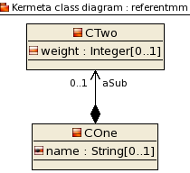
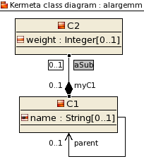
ModelType
We define a
referent model
and its model type
We want to find “it”
in a larger model
//// ReferentMT.kmt file ////
// same root as the .km file
package referentmm;
require kermeta
require "ReferentMM.km"
modeltype ReferentMT
{
COne,
CTwo
}
ModelType
//// ALargeMT.kmt file ////
package alargemm;
require kermeta
require "ALargeMM.km"
// we aim for it to correspond
// referent model type
modeltype ALargeMT
{
C1,
C2
}

Slide 4
ModelType
We write a program
on ReferentMT
  We use it
  on ALargeMT
//// ReferentCode.kmt ////
package referentmm;
require kermeta
require "ReferentMT.kmt"
using kermeta::standard
// we define a generic class typed with ReferentMT
class Code<MT : ReferentMT>
{
operation createNewCOne(name : String) : MT::COne is do
// We are manipulating ReferentMM elements
result := MT::COne.new
result.name := name
stdio.writeln("ReferentCode.kmt ----------")
stdio.writeln(" createNewCOne() - instance = "
+ result.toString + "\n")
end
}
//// UseOnALargeMM.kmt ////
@mainClass "alargemm::Main"
@mainOperation "main"
package alargemm;
require kermeta
require "ALargeMT.kmt"
require "ReferentCode.kmt"
class Main
{
operation main() : Void is do
stdio.writeln("UseOnALargeMM.kmt ----------\n main() - start\n")
// we use referent code through targeted modeltype
var code : referentmm::Code<alargemm::ALargeMT>
init referentmm::Code<alargemm::ALargeMT>.new
// we try to create a new C1 class using the referent code
var newClass : alargemm::C1 init code.createNewCOne("MyC1Class")
// we obtain an effective C1 class
stdio.writeln("UseOnALargeMM.kmt ----------")
stdio.writeln(" main() - newClass = " + newClass.toString)
end
}
ModelType

Slide 5
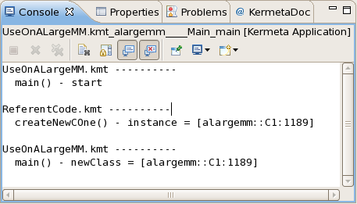
ModelType
Even the referent code manipulate
the targeted metamodel elements
ModelType

Slide 6
Conformance Toughness
Targeted metamodels must comply to ModelType enough to typecheck
  Be similar is not sufficient, as ModelType is considered like any other Type in compiling domain
  The ModelType theory has defined rules of compliance between a top metamodel and variants
  The Kermeta typechecker implements the corresponding matching algorithm
  There is cycles between elements of a metamodel so the match of others elements may depend on an element with circularity
  Two similar elements of the targeted metamodel may compete for one element of generic metamodel, forbidding global match
ModelType

Slide 7
Generic Refactoring Usecase
Our goal
  Define a library of generic refactorings
  Apply it on many similar metamodels
      UML class diagrams
      Kermeta program models
      Java program models
A huge difficulty
  Find a modeltype that match all of them
An effective solution
the NonMatching Strategy
Generic Refactoring Usecase

Slide 8
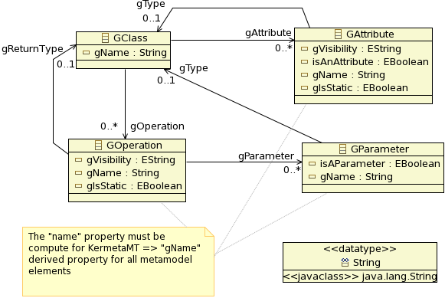
NonMatching Strategy
The generic metamodel
  obvious names are prefixed by a “g” to avoid matching in original targeted metamodels
Generic Refactoring Usecase

Slide 9
NonMatching Strategy
Generic refactoring code
package refactor;
require kermeta
require "GenericMT.kmt"
class Refactor<MT : GenericMT>
{
operation encapsulateField(field : MT::GAttribute,
fieldClass : MT::GClass,
getterName : kermeta::standard::String,
setterName : kermeta::standard::String) : Void is do
///////// manage the setter /////////
if not fieldClass.gOperation.exists{ op | op.gName == setterName } then
// no setter so we must add it
var op1 : MT::GOperation init MT::GOperation.new
op1.gName := setterName
fieldClass.gOperation.add(op1)
// it is a setter so we have input parameter)
var par : MT::GParameter init MT::GParameter.new
par.gName := field.gName
par.gType := field.gType
op1.gParameter.add(par)
end
///////// manage the getter /////////
if not fieldClass.gOperation.exists{ op | op.gName == getterName } then
// no getter so we must add it
var op : MT::GOperation init MT::GOperation.new
op.gName := getterName
fieldClass.gOperation.add(op)
// it is a getter so we have a return type
op.gType := field.gType
end
end
}
Generic Refactoring Usecase

Slide 10
NonMatching Strategy
We then adapt UML metamodel to add the generic elements through derived properties
// "UmlPlus.kmt" file
package uml;
require "UmlHelper.kmt"
aspect class Class
{
property gOperation : Operation[0..*]
getter is do
var coll : kermeta::standard::ClassOperationsOSet<Operation>
init kermeta::standard::ClassOperationsOSet<Operation>.new
coll.owner := self
// we must duplicate data in the wrapping collection
coll.addAll(self.ownedOperation)
// we pass the wrapper as derived property value
result := coll
end
property gAttribute : Property[0..*]
[.. idem ..]
end
property gName : kermeta::standard::String
getter is do
result := self.name
end
property isAClass : kermeta::standard::Boolean
}
[.. other properties ..]
Generic Refactoring Usecase

Slide 11
NonMatching Strategy
We then adapt UML metamodel to add the generic elements through derived properties
// "UmlPlus.kmt" file
package uml;
require "UmlHelper.kmt"
aspect class Class
{
property gOperation : Operation[0..*]
getter is do
var coll : kermeta::standard::ClassOperationsOSet<Operation>
init kermeta::standard::ClassOperationsOSet<Operation>.new
coll.owner := self
// we must duplicate data in the wrapping collection
coll.addAll(self.ownedOperation)
// we pass the wrapper as derived property value
result := coll
end
property gAttribute : Property[0..*]
[.. idem ..]
end
property gName : kermeta::standard::String
getter is do
result := self.name
end
property isAClass : kermeta::standard::Boolean
}
[.. other properties ..]
    managing multiplicity > 1
Generic Refactoring Usecase
    managing multiplicity = 1
    managing similarity

Slide 12
NonMatching Strategy
Final steps: ModelType + call of refactoring
// "UmlMT.kmt" file
package uml;
require kermeta
require "UmlPlus.kmt"
modeltype UmlMT
{
Class,
Property,
Operation,
Parameter
}
// "UmlGenericRefactoring.kmt" file
@mainClass "refactor::Main"
@mainOperation "main"
package refactor;
require kermeta
require "../../metamodels/UmlMT.kmt"
require "GenericRefactor.kmt"
class Main
{
operation main() : Void is do
// initialization
[.. loading model ..]
var node : uml::Class
var nameField : uml::Property
[.. retrieving elements ..]
refactor.encapsulateField(nameField, node, "getName", "setName", false)
// we save the refactored UML model
[.. saving result ..]
end
}
Generic Refactoring Usecase

Slide 13
NonMatching Strategy
As we derive all generic features, we must include management of [0..*] multiplicities
  We extend Kermeta collections to derived the generic references with multiplicity > 1
// "UmlHelper.kmt" file
package kermeta;
require kermeta
require "http://www.eclipse.org/uml2/2.1.0/UML"
package standard {
/** dedicated class for derived property on 'uml::Class' 'ownedOperation' attribute,
because of its [0..*] multiplicity */
aspect class ClassOperationsOSet<O : uml::Operation>
inherits kermeta::standard::OrderedSet<uml::Operation> {
reference owner : uml::Class
method add(element : uml::Operation) is do
owner.ownedOperation.add(element)
// we must maintain equivalence between real collection and the wrapping one
super(element)
end
}
Generic Refactoring Usecase

Slide 14
NonMatching Strategy
General scheme of the system
Generic
metamodel
require
Refactoring
ModelType
conformance
Generic Refactoring Usecase
ModelType
types
translation
Full UML2
metamodel
Kermeta
adhoc
collections
Adhoc
extended
UML
UML generic refactoring
require
require
require

Slide 15
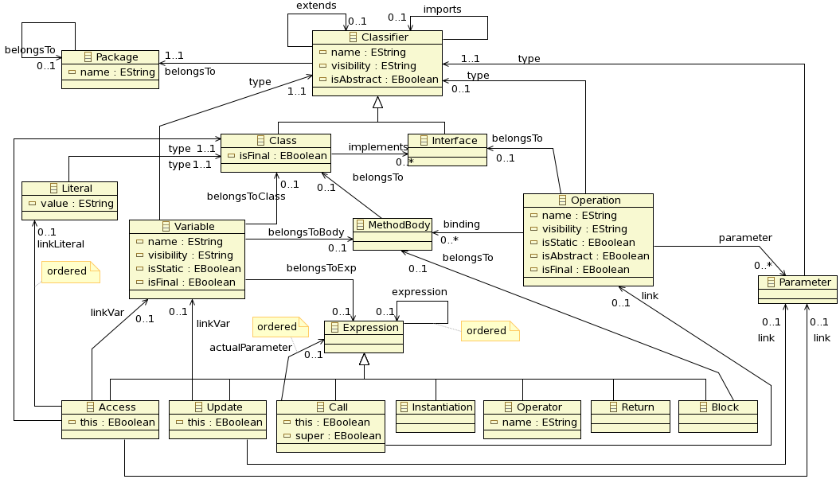
NonMatching Strategy
We want to refactor non UML models
    Example: java program models
    A given JavaProgram metamodel
    Different semantic
        classes do not know operations
        ...
Generic Refactoring Usecase

Slide 16
NonMatching Strategy
We need
    Adhoc collections => JavaProgramHelper.kmt
    Derived properties => JavaProgramPlus.kmt
    ModelType => JavaProgramMT.kmt
    Launcher => JavaProgramGenericRefactoring.kmt
Main toughness: add lacking semantic
    Access to operations from class
      => add opposites to metamodel at runtime: as it is not working currently for model loading, we replace them by adhoc computing in derived properties
    JavaProgram metamodel implies flat models (all model elements are stored at the resource root)
      => manipulate the resource when adding elements
Generic Refactoring Usecase

Slide 17
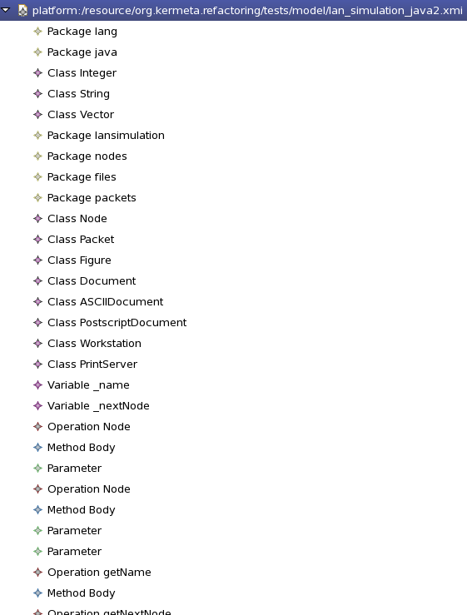
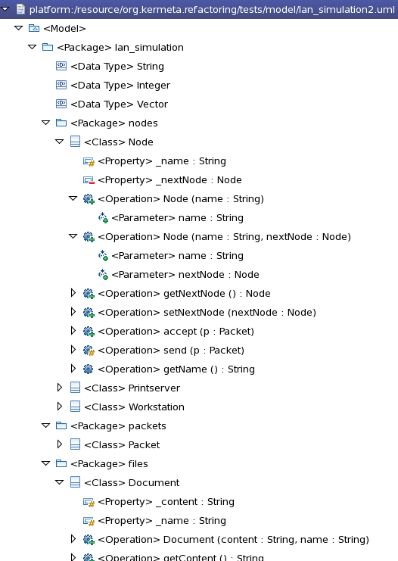
NonMatching Strategy
A flat model example
Similar UML model
Generic Refactoring Usecase

Slide 18
NonMatching Strategy
Managing flat model structure
    Adding a new element in model (adhoc collection)
// "JavaProgramHelper.kmt" file
package kermeta;
package standard {
/** dedicated class for derived property on 'uml::Class' 'ownedOperation'
attribute, because of its [0..*] multiplicity */
aspect class ClassOperationsOSet<O : javaprogram::Operation> inherits
kermeta::standard::OrderedSet<javaprogram::Operation> {
reference owner : javaprogram::Class
operation initialize(ownerColl : javaprogram::Operation[0..*]) is do
self.addAll(ownerColl)
end
method add(element : javaprogram::Operation) is do
// we must create a body if the operation have no body corresponding to the class
var opBody : javaprogram::MethodBody init element.binding.detect{ body |
body.belongsTo == owner or body.belongsTo.isVoid
}
if opBody == void then
opBody := javaprogram::MethodBody.new
element.binding.add(opBody)
owner.containingResource.add(opBody)
// we expect the operation is a new one and needs to be inserted in the resource
owner.containingResource.add(element)
end
opBody.belongsTo := owner
// we must maintain equivalence between real collection and the wrapping one
super(element)
end
} }
Generic Refactoring Usecase

Slide 19
NonMatching Strategy
Managing flat model structure
    Adding a new element in model (derived property)
// "JavaProgramPlus.kmt" file
package javaprogram;
require kermeta
require "JavaProgramHelper.kmt"
aspect class Class
{
property gOperation : Operation[0..*]
getter is do
var coll : kermeta::standard::ClassOperationsOSet<Operation>
init kermeta::standard::ClassOperationsOSet<Operation>.new
coll.owner := self
// we must duplicate data in the wrapping collection
self.containingResource.each{ o |
var op : Operation
op ?= o
if op != void then
op.binding.each{ body |
if body.belongsTo == self then
coll.add(op)
end
}
end
}
// we pass the wrapper as derived property value
result := coll
end
[.. other derived properties ..]
}
Generic Refactoring Usecase

