Slide 1

OpenEmbeDD lectures
Kermeta 1.3
  ModelType for Generic Model Engineering

Slide 2
Contents
Introduction
Generic MM / transformation
“Model Type”
ModelType conformance toughness
NonMatching strategy
Apply refactoring to new metamodels
Adaptation recurrent patterns
... what is ModelType?
Notes:
This course is adressed to people familiar with Kermeta features.
We present advanced principles, based upon Kermeta, for main MDE relative tasks.
The list will be extended in the future.
The Aspects oriented approach makes manipulation of models easier through a natural writing of processes onto the metamodel itself. Aspects infer the models behave as desired, their elements doing themselves the changes.

Slide 3
Introduction
What is the goal of this presentation?
  Present the Kermeta “ModelType” feature
  Use ModelType translation to build generic Model transformations:
    Define the transformation on a generic metamodel
    Define the ModelType on this generic metamodel
    Declare corresponding ModelType on targetted metamodels
    Complete those metamodels to adapt them to the ModelType, using Kermeta aspects
    Run the transformation on instance models of those metamodels
  Discuss some theoretic concerns about ModelType

Slide 4
Generic transformation
Generic transformation
and its metamodel

Slide 5
Generic transformation
Our goal:
  Write once a refactoring using a generic metamodel
  Easily apply it to equivalent real metamodels instances (like UML models,...)
It implies:
  Define the generic metamodel
  Use it for typing in our refactoring
  Use the code as-is on targeted metamodels
  Easily adapt those metamodels to the generic one
  Translate generic types in the corresponding types in the targeted metamodels
  Typecheck statically and at execution time

Slide 6
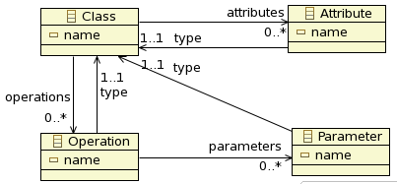
Generic transformation
A expected transformation: setter refactoring
  A Class
  An Attribute of this class
  The program adds a setter Operation on attribute with the type of attribute as Parameter
  The program adds a getter operation on attribute
First draft of a metamodel GenericMM.ecore about elements implied in transformation:

Slide 7
Generic transformation
package refactor;
require kermeta
require "GenericMT.kmt"
class Refactor<MT : GenericMT>
{
The refactoring code
operation encapsulateField(field : MT::Attribute,
fieldClass : MT::Class,
getterName : kermeta::standard::String,
setterName : kermeta::standard::String) : Void is do
///////// manage the setter /////////
if not fieldClass.operations.exists{ op | op.name == setterName } then
// no setter so we must add it
var op1 : MT::Operation init MT::Operation.new
op1.name := setterName
fieldClass.operations.add(op1)
// it is a setter so we have input parameter)
var par : MT::Parameter init MT::Parameter.new
par.name := field.name
par.type := field.type
op1.parameters.add(par)
end
///////// manage the getter /////////
if not fieldClass.operations.exists{ op | op.name == getterName } then
// no getter so we must add it
var op : MT::Operation init MT::Operation.new
op.name := getterName
fieldClass.operations.add(op)
// it is a getter so we have a return type
op.type := field.type
end
end
}

Slide 8
Model Type
Model Type

Slide 9
Model Type
Jim STEEL PhD thesis
Type = set of values on which a set of operations can be performed successfully
Conformance = weakest substitutability relation that guarantees type safety
ModelType = a given metamodel as nominal input/output of a model processing program
  There could be metamodel variants which can conformed to this given metamodel
  A program written on the ModelType can be executed on instances of ModelType conformed variants
  Any metamodel (not a variant) which conforms to the ModelType can run the program on its instances

Slide 10
ModelType on generic Metamodel
“ModelType” is a simple declaration:
//// “GenericMT.kmt” file ////
// same root as the Ecore metamodel above
package genericmm;
require kermeta
require "GenericMM.ecore"
modeltype GenericMT
{
Class,
Attribute,
Operation,
Parameter
}
But it implies deeper concerns:
  The ModelType is based on the 4 declared elements
  The “package genericmm;” declaration links the ModelType with the root of the Ecore metamodel

Slide 11
ModelType on generic Metamodel
“ModelType” is a simple declaration:
//// “GenericMT.kmt” file ////
// same root as the Ecore metamodel above
package genericmm;
require kermeta
require "GenericMM.ecore"
modeltype GenericMT
{
Class,
Attribute,
Operation,
Parameter
}
But it implies deeper concerns:
  The ModelType is based on the 4 declared elements
  The “package genericmm;” declaration links the ModelType with the root of the Ecore metamodel
  The ModelType includes all the features of each element as designed in the Ecore metamodel
  Details of relations in the Ecore are part of ModelType

Slide 12
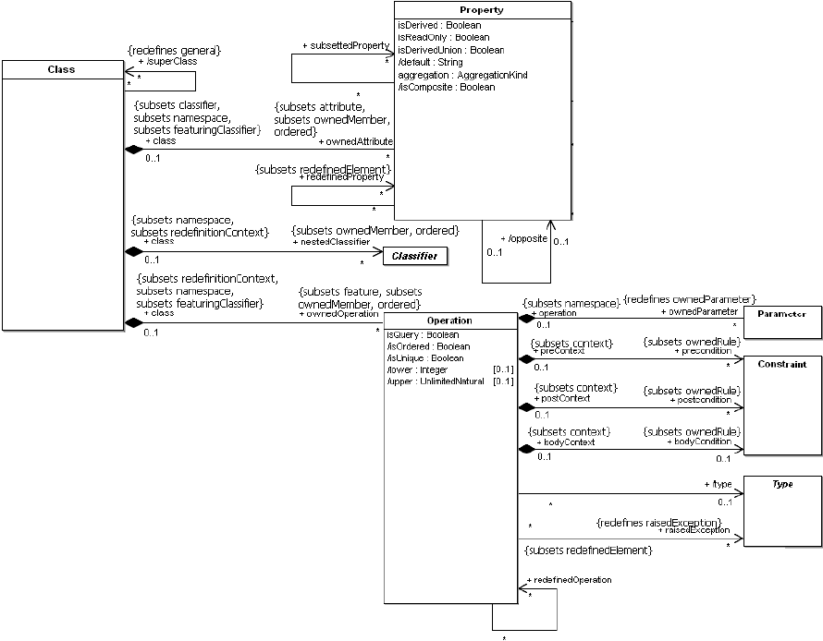
Using ModelType with UML2
Applying ModelType on UML:
//// “UmlMT.kmt” file ////
// same root as the UML2 metamodel above
package uml;
require kermeta
require "http://www.eclipse.org/uml2/2.1.0/UML"
modeltype umlMT
{
Class,
Property,
Operation,
Parameter
}
UML equivalent
of GenericMM
  The typechecker translates elements:
  genericmm::Class → uml::Class
  genericmm::Attribute → uml::Property

Slide 13
Using ModelType with UML2
Using generic transformation method on UML
  Call of the method with ModelType typing
@mainClass "refactor::Main"
@mainOperation "main"
package refactor;
require kermeta
require "../../metamodels/UmlMT.kmt"
require "GenericRefactor.kmt"
class Main
{
operation main() : Void is do
// initialization
[....]
var refactor : refactor::Refactor<uml::UmlMT> init refactor::Refactor<uml::UmlMT>.new
// retrieving class and attribute to be refactored
var node : uml::Class
var nameField : uml::Property
[....]
// using the generic refactoring code
refactor.encapsulateField(nameField, node, "getName", "setName")
// we save the refactored UML model
[....]
end
}

Slide 14
ModelType conformance toughness
ModelType conformance
The critical toughness of ModelType

Slide 15
ModelType conformance toughness
Targeted metamodels must comply to ModelType enough to typecheck
  Be similar is not sufficient, as ModelType is considered like any other Type in compiling domain
  The ModelType theory has defined rules of compliance between a top metamodel and variants
  The Kermeta typechecker implements the corresponding matching algorithm
  There is cycles between elements of a metamodel so the match of others elements may depend on an element with circularity
  Two similar elements of the targeted metamodel may compete for one element of generic metamodel, forbidding global match

Slide 16
ModelType conformance toughness
Matching rules (on Ecore properties)
  req: generic metamodel element (required properties)
  prov: targeted metamodel element (as provided)
  On multiplicity
    req.upper = 1 implies prov.upper = 1
    req.upper >= prov.upper
    req.lower <= prov.lower
    req.isOrdered implies prov.isOrdered
    req.isUnique implies prov.isUnique
  On EClass
    (not req.isAbstract) implies (not prov.isAbstract)
    all req attributes are matched by prov attributes
    all req operations are matched by prov operations

Slide 17
ModelType conformance toughness
  On EProperty
    prov.name = req.name (annotations are planned to weak it)
    prov multiplicity matches with req multiplicity
    req.isReadOnly implies prov.isReadOnly
    req.isComposite implies prov.isComposite
    (req.opposite->isOclUndefined) implies
    (prov.opposite->isOclUndefined)
    prov.opposite.name = req.opposite.name
  On EOperation
    prov.name = req.name (annotations are planned to weak it)
    prov multiplicity matches with req multiplicity
    prov.ownedParameter.size = req.ownedParameter.size
    all req parameters are matched by prov parameters

Slide 18
ModelType conformance toughness
As seen in previous slides, many features are verified by model typechecker
It is an AND statement
  If one feature does not match, the ModelType does not match at all
The less restrictive the generic metamodel is, the easier targeted metamodels conform to it
  Do not use strict requirements which are not needed
    Prefer Set to OrderedSet, [0..1] to [1..1],...
  Do not add elements which program does not use
    There is no “Package” in our example
Ecore may implies restrictive default values
  Those properties should be relaxed as possible

Slide 19
ModelType conformance toughness
Main problem comes from name of attributes and operations of ModelType elements
  Generic metamodel elements' features must have same name as the targeted metamodel, which becomes impossible with multiple different targets
Sometimes the targeted metamodel semantic may also differ from the generic one
  It implies to derived the correct semantic in the targeted metamodel where it lacks
One possible strategy is to use non matching names in the generic metamodel
  Then we adapt the targeted metamodels with derived properties to conform it to the generic one
  We generalize derived properties implementing generic

Slide 20
NonMatching strategy

Slide 21
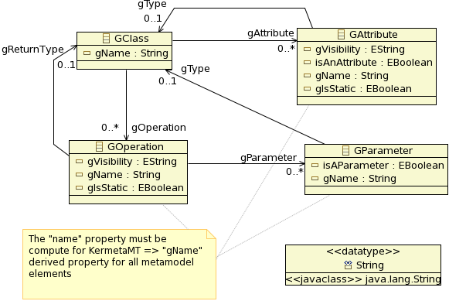
NonMatch conformance strategy
The generic metamodel
  obvious names are prefixed by a “g” (as generic) to avoid matching in original targeted metamodels

Slide 22
NonMatch conformance strategy
package refactor;
require kermeta
require "GenericMT.kmt"
class Refactor<MT : GenericMT>
{
generic refactoring code
operation encapsulateField(field : MT::GAttribute,
fieldClass : MT::GClass,
getterName : kermeta::standard::String,
setterName : kermeta::standard::String) : Void is do
///////// manage the setter /////////
if not fieldClass.gOperation.exists{ op | op.gName == setterName } then
// no setter so we must add it
var op1 : MT::GOperation init MT::GOperation.new
op1.gName := setterName
fieldClass.gOperation.add(op1)
// it is a setter so we have input parameter)
var par : MT::GParameter init MT::GParameter.new
par.gName := field.gName
par.gType := field.gType
op1.gParameter.add(par)
end
///////// manage the getter /////////
if not fieldClass.gOperation.exists{ op | op.gName == getterName } then
// no getter so we must add it
var op : MT::GOperation init MT::GOperation.new
op.gName := getterName
fieldClass.gOperation.add(op)
// it is a getter so we have a return type
op.gType := field.gType
end
end
}

Slide 23
NonMatch conformance strategy
As we derive all generic features, we must include management of [0..*] multiplicities
  We extend Kermeta collections to derived the references of generic metamodel with multiplicity > 1
// "UmlHelper.kmt" file
package kermeta;
require kermeta
require "http://www.eclipse.org/uml2/2.1.0/UML"
package standard {
/** dedicated class for derived property on 'uml::Class' 'ownedOperation' attribute,
because of its [0..*] multiplicity */
aspect class ClassOperationsOSet<O : uml::Operation>
inherits kermeta::standard::OrderedSet<uml::Operation> {
reference owner : uml::Class
method add(element : uml::Operation) is do
owner.ownedOperation.add(element)
// we must maintain equivalence between real collection and the wrapping one
super(element)
end
}
    Rem: we plan to make collections observable

Slide 24
NonMatch conformance strategy
We then add the generic metamodel elements through derived properties in UML
// "UmlPlus.kmt" file
package uml;
require "UmlHelper.kmt"
aspect class Class
{
property gOperation : Operation[0..*]
getter is do
var coll : kermeta::standard::ClassOperationsOSet<Operation>
init kermeta::standard::ClassOperationsOSet<Operation>.new
coll.owner := self
// we must duplicate data in the wrapping collection
coll.addAll(self.ownedOperation)
// we pass the wrapper as derived property value
result := coll
end
property gAttribute : Property[0..*]
[.. idem ..]
end
property gName : kermeta::standard::String
getter is do
result := self.name
end
property isAClass : kermeta::standard::Boolean
}
[.. other properties ..]
    managing multiplicity > 1
    managing multiplicity = 1
    managing similarity

Slide 25
NonMatch conformance strategy
Final steps: ModelType + call of refactoring
// "UmlMT.kmt" file
package uml;
require kermeta
require "UmlPlus.kmt"
modeltype UmlMT
{
Class,
Property,
Operation,
Parameter
}
// "UmlGenericRefactoring.kmt" file
@mainClass "refactor::Main"
@mainOperation "main"
package refactor;
require kermeta
require "../../metamodels/UmlMT.kmt"
require "GenericRefactor.kmt"
class Main
{
operation main() : Void is do
// initialization
[.. loading model ..]
var node : uml::Class
var nameField : uml::Property
[.. retrieving elements ..]
refactor.encapsulateField(nameField, node, "getName", "setName", false)
// we save the refactored UML model
[.. saving result ..]
end
}

Slide 26
NonMatch conformance strategy
General scheme of the system
Generic
metamodel
include
Refactoring
ModelType
conformance
ModelType
types
translation
Full UML2
metamodel
Kermeta
adhoc
collections
Adhoc
extended
UML
UML generic refactoring
include
include
include

Slide 27
Apply to new metamodels

Slide 28
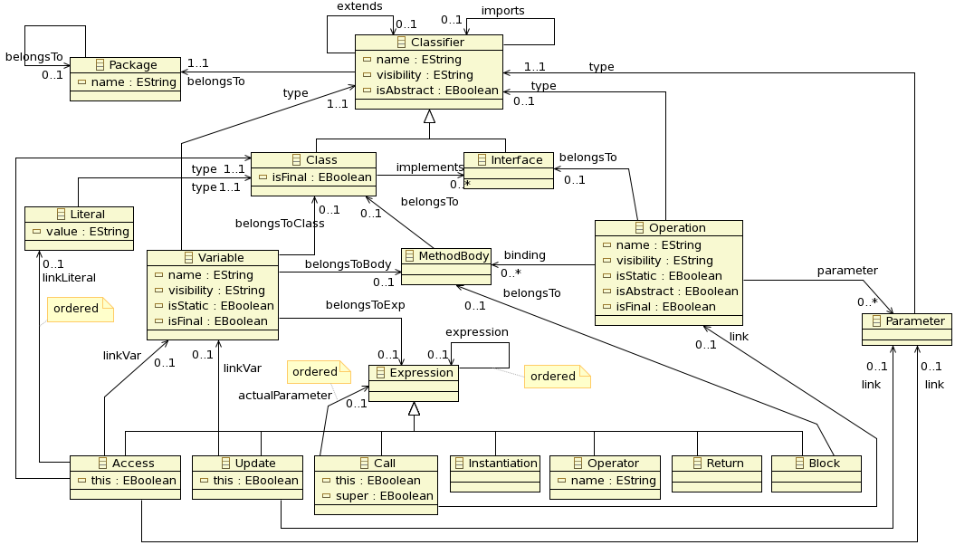
Apply to new metamodels
We want to refactor non UML models
  Example: java program models
  A given JavaProgram metamodel
  Different semantic
    classes do not know operations
    ...

Slide 29
Apply to new metamodels
We need
  Adhoc collections => JavaProgramHelper.kmt
  Derived properties => JavaProgramPlus.kmt
  ModelType => JavaProgramMT.kmt
  Launcher => JavaProgramGenericRefactoring.kmt
Main toughness: add lacking semantic
  Access to operations from class
    => add opposites to metamodel at runtime: as it is not working currently for model loading, we replace them by adhoc computing in derived properties
  JavaProgram metamodel implies flat models (all model elements are stored at the resource root)
    => manipulate the resource when adding elements

Slide 30
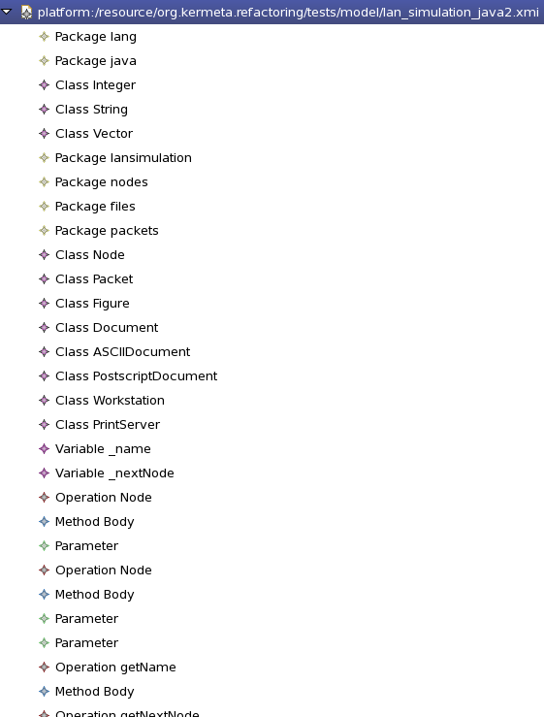
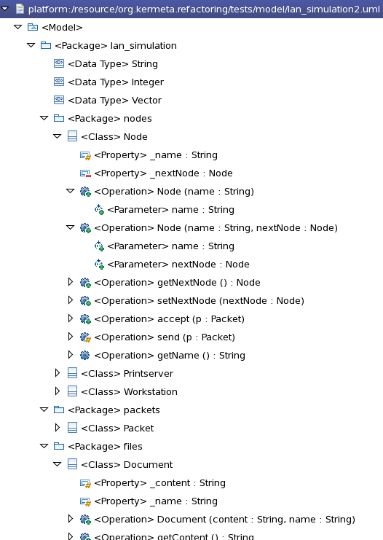
Apply to new metamodels
A flat model example
Similar UML model

Slide 31
Apply to new metamodels
Managing flat model structure
  Adding a new element in model (adhoc collection)
// "JavaProgramHelper.kmt" file
package kermeta;
package standard {
/** dedicated class for derived property on 'uml::Class' 'ownedOperation'
attribute, because of its [0..*] multiplicity */
aspect class ClassOperationsOSet<O : javaprogram::Operation> inherits
kermeta::standard::OrderedSet<javaprogram::Operation> {
reference owner : javaprogram::Class
operation initialize(ownerColl : javaprogram::Operation[0..*]) is do
self.addAll(ownerColl)
end
method add(element : javaprogram::Operation) is do
// we must create a body if the operation have no body corresponding to the class
var opBody : javaprogram::MethodBody init element.binding.detect{ body |
body.belongsTo == owner or body.belongsTo.isVoid
}
if opBody == void then
opBody := javaprogram::MethodBody.new
element.binding.add(opBody)
owner.containingResource.add(opBody)
// we expect the operation is a new one and needs to be inserted in the resource
owner.containingResource.add(element)
end
opBody.belongsTo := owner
// we must maintain equivalence between real collection and the wrapping one
super(element)
end
} }

Slide 32
Apply to new metamodels
Managing flat model structure
  Adding a new element in model (derived property)
// "JavaProgramPlus.kmt" file
package javaprogram;
require kermeta
require "JavaProgramHelper.kmt"
aspect class Class
{
property gOperation : Operation[0..*]
getter is do
var coll : kermeta::standard::ClassOperationsOSet<Operation>
init kermeta::standard::ClassOperationsOSet<Operation>.new
coll.owner := self
// we must duplicate data in the wrapping collection
self.containingResource.each{ o |
var op : Operation
op ?= o
if op != void then
op.binding.each{ body |
if body.belongsTo == self then
coll.add(op)
end
}
end
}
// we pass the wrapper as derived property value
result := coll
end
[.. other derived properties ..]
}

Slide 33
Apply to new metamodels
// "JavaGenericRefactor.kmt" file
@mainClass "refactor::Main"
@mainOperation "main"
package refactor;
require "../../metamodels/JavaProgramMT.kmt"
require "GenericRefactor.kmt"
class Main
{
operation main() : Void is do
// initialization
[.. loading model ..]
var refactor : refactor::Refactor<javaprogram::JavaProgramMT>
init refactor::Refactor<javaprogram::JavaProgramMT>.new
var node : javaprogram::Class
var nameField : javaprogram::Variable
[.. retrieving elements ..]
// MODEL TYPE use
refactor.encapsulateField(nameField, node, "getName", "setName", false)
[.. saving result..]
end
}
Define ModelType and use it
// "JavaProgramMT.kmt" file
package javaprogram;
require kermeta
require "JavaProgramPlus.kmt"
modeltype JavaProgramMT
{
Class,
Variable,
Operation,
Parameter
}

