Slide 1
Product line architecture: Behavioural model manipulation
Jean-Marc Jézéquel

Slide 2
Auction system example
Auction
Commission
Acc
Robot
fonctionnement
Nulle
%
CB
Monnaie
P_resev
S_P_reseve
« mutex »
« mutex »
« mutex »

Slide 3
DePLiS (Derivation Product Line Scenarios)
Derivation
Generic MSC
msc_pl.msc
Specific MSC
msc_product.msc
DePLiS
Variation points instiatiation.
PL constructs : virtual, optional_instance , optional_behavior,
variation
Notes:
DePLiS (Derivation Product Line Scenarios)
Presentation
DePLiS (Derivation Product Line Scenarios) is a prototype developed in JAVA to derive from generic scenarios which represent PL behaviors, specific scenarios for each product. The DePLiS is implemented to validate our ideas about the modeling of variability in scenarios, as proposed in [Ziadi et al, 02]. It takes as input, files which specified PL behaviors and it generate output files, specified product behaviors. The derivation is based on files processing and in this stage of the work only syntaxic processing is ensured.
DePLiS uses the ITU-T (Z120) textual specification (Event oriented textual syntax) [ITU-Z120, 99] with some variability constructs as input and output files.
Input files
The input file represent a textual representation of a generic scenario. A generic scenario is identified by a set of variation points, in this context
we use three mechanisms, as prposed in [Ziadi et al, 02]:
Optionality. Optionality can be associated to instances and behavior part:
Optional instances are tagged in the input file by the <<Optional>> key word, in the declaration header:
<<Optional>> inst I2
Optional behaviors are defined between optionalbegin and optionalend key words:
optionalbegin <optional_part_name>
<msc_message>*
optionalend
Virtual. A generic scenario can contains virtual parts which be refined by another MSC. Virtual pars are specifed between virtualbegin and virtualend key words:
virtualbegin <virtual_point_name>
<msc_message>*
virtualend
Variation. A last variation point in PL scenario sonsists in defining a choice between a set of behaviors variants. Each product use only one variant. It is specified between variationbegin and variationend, the variation key word is used to separate a different variants:
variationbegin <variation_point_name>
<msc_message_V1>*
variation
<msc_message_V2>*
variation
<msc_message_V3>*
….
variationend
Output files
The output file contains a textual specification of MSC obtained after the derivation process.
DePLiS ensure the derivation through a set of line commands, the main command is PL_DERIVE which derive a product scenario from a generic one, the general syntax of this command:
PL_DERIVE <msc_pl_name> [REFINE] [<virtual_part_name>] [BY] [<reffinement_msc_name>]
[PRESENCE_OPTIONAL_BEHAVIOR] [<optional_behavior_name>] [<Presence_Desicion>]
[PRESENCE_OPTIONAL_INSTANCE] [<optional_instance_name>] [<Presence_Desicion>]
[VARIATION] [<variation_part_name>] [<variation_choice>]
With:
<msc_pl_name>: a name of the file contains a textual specification of a PL scenario
<virtual_part_name>: a name of a virtual part in PL scenario (defined after the key word virtualbegin)
<reffinement_msc_name>: a name of the file contain atextual specification of a refinement scenario.
<optional_behavior_name> :a name of an optional part in PL scenario (defined after the key word optionalbegin)
<optional_instance_name>: a name of an optional instance in the PL scenario (instance with the key word « Optional »)
<Presence_Desicion>: FALSE / TRUE
<variation_part_name>: a name o th variation point (defined after the key word variationbegin)
<variation_choice>: a choise betwwen all the possible variants.

Slide 4
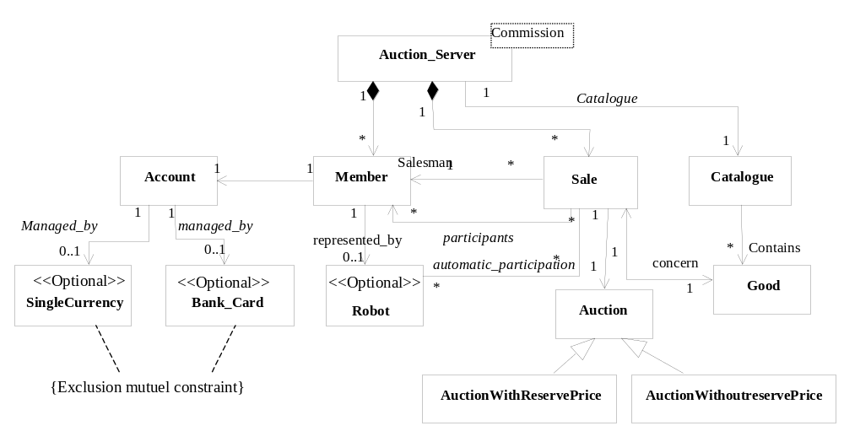
UML class diagram
E-Auction
Notes:
The following UML class diagram shows the auction PL architecture. An auction is associated to the particular sale. A Member can be a seller or an auction participant. The automatic particpation is represented by the Robot class which is defined as optional (only some products support automatic participation).
Accounts of members can be managed directly by bank card or by a single currency.

Slide 5
HMSC
HMSC Sale management
HMSC Saler_hmsc
Enter
Initiate a sale
cancel a sale
Sal management
Catalog consultation
HMSC Visitor_hmsc
HMSC administrateur_hmsc
Enter
PV
Close bidding
PV
PV
Place Bidding
Catalog consultation
Robot program

Slide 6
HMSC
HMSC Auction
Enter
PV
PV
PV
Sal management
Place Bidding
Catalog consultation
Robot program
Close bidding

Slide 7
MSC Enter
msc Enter
Member
Server
Enter(login, pwd)
Alt
When login, pwd in listMember
Enter_Autorization
When login, pwd not in listMember
Enter_Refuse

Slide 8
MSC PlaceBidding
msc PlaceBidding
« Optional »
Robot
Member
Server
Sale
Auction
Virtual P1
placeBidding(Good, price)
passOffer(price)
getCurrentPrice()
Return(CurrentPrice)
alt
When price > CurrentPrice
Accept
Accept
setPrice(price)
When price <= CurrentPrice
Reject
Reject
Notes:
MSC: PlaceBidding
The PlaceBidding message sequence chart is a generic scenario that describe the collaboration of the different objects to realize a bidding operation. Any client can place a bidding with a price for a specific good. The bidding is accepted if the proposed price is greater than the current price. The part P1 which contain the bidding verification is defined as virtual because the verification depends on each product (some product define a arise to accept each auction augmentation). In products which support automatic participation a Robot plays the role of client.

Slide 9
MSC PlaceBidding – Textual form
File: PlaceBidding.msc
msc PlaceBidding;
optional inst Robot
inst User;
inst Server;
inst Sale;
inst Auction;
virtualbegin P1
User: out placeAuction() to Server;
Server: in placeAuction from User;
out passOffer() to Sale;
Sale: in passOffer() from Server;
out getPrice() to Auction;
Auction: in getPrice() from Server;
alt begin
condition when shared Server,Sale;
Sale: out setPrice() to Auction;
endinstance
Auction: in setPrice() from Sale;
endinstance
Server: out Accept to User;
User: in Accept from Server;
alt
condition when shared Server,Sale;
Server: out Reject to User;
endinstance
User: in Reject from Server; alt end
endinstance
virtualend
endmsc
Notes:
The above file describe the textual specification of the PlaceBidding scenario. It define one optional instance and one virtual part.

Slide 10
Deriving PlaceBiding behaviour
PL_DERIVE PlaceBidding.msc REFINE P1 BY WithArise.msc
PRESENCE_OPTIONAL_INSTANCE Robot=FALSE
command
DePLiS
PlaceBidding.msc
PlaceBiddingWithArise.msc
derivation
Notes:
The derivation process
We use the DePLiS ( Derivatiing Product Lline Scenarios) with the command:
PL_DERIVE PlaceBidding.msc REFINE P1 BY WithArise.msc
PRESENCE_OPTIONAL_INSTANCE Robot FALSE
The derivation consists in deleting from the input file (PlaceBidding.msc) all messages related the optional class Rebot and to replace the virtual par by the contents of the refinement file (WithArise.msc).
PlaceBiddingWithArise.msc is the output file.

Slide 11
MSC WithArise as a replacement for region P1
Client
Server
Sale
Auction
placeBidding(Good, price)
passOffer(price)
getCurrentPrice()
Return(CurrentPrice)
alt
When price > CurrentPrice+raise
Accept
setPrice(price)
Accept
When price <= CurrentPrice+raise
Reject
Reject

Slide 12
MSC WithArise as a replacement for region P1 Textual form
File: WithArise.msc
msc place_auction_product1;
inst User;
inst Server;
inst Sale;
inst Auction;
User: out placeAuction() to Server;
Server: in placeAuction from User;
out passOffer() to Sale;
Sale: in passOffer() from Server;
out getPrice() to Auction;
Auction: in getPrice() from Server;
alt begin
condition when shared Server,Sale;
Sale: out setPrice() to Auction;
Auction: in setPrice() from Sale;
Server: out Accept to User;
User: in Accept from Server;
alt
condition when shared Server,Sale;
Server: out Reject to User;
User: in Reject from Server; alt end
endmsc

Slide 13
The derived PlaceBidding
Client
Server
Sale
Auction
placeBidding(Good, price)
passOffer(price)
getCurrentPrice()
Return(CurrentPrice)
alt
When price > CurrentPrice+raise
Accept
setPrice(price)
Accept
When price <= CurrentPrice+raise
Reject
Reject

Slide 14
The derived PlaceBidding – Textual form
File: PlaceBiddingWithArise.msc
msc PaceBiddingWithArise;
inst User;
inst Server;
inst SingleCurrency;
inst Auction;
User: out placeAuction() to Server;
Server: in placeAuction from User;
out passOffer() to Sale;
Sale: in passOffer() from Server;
out getPrice() to Auction;
Auction: in getPrice() from Server;
alt begin
condition when shared Server,Sale;
Sale: out setPrice() to Auction;
Auction: in setPrice() from Sale;
Server: out Accept to User;
User: in Accept from Server;
alt
condition when shared Server,Sale;
Server: out Reject to User;
User: in Reject from Server;
alt end
ebdmsc

Slide 15
MSC DepositAmount
msc DepositAmount
« Optional »
« Optional »
Server
SellerAccount
SingleCurrency
SellerBankCard
DepositAccount(Amount)
Variation P2
(V1)
Decrease(Amount)
(V2)
DepositBankeCard(Amount)
Notes:
MSC: DepositAmount
The « DepositAmount » scenario describe how the auction server deposits amounts to clients accounts. We use the variation mechanisms to specify two variants to realize the deposit function. Products support bank cards operation instantiate the second variants, otherwise the first one.

Slide 16
MSC DepositAmount – Textual form
File: DepositAmount.msc
msc DeposiAmount;
inst Server;
inst SellerAccount;
« Optional » inst SingleCurrency;
« Optional » inst SellerBankCard;
Server: out DepositAccount(Amount) to SellerAccount;
SellerAccount : in DepositAccount from Server;
Variationbegin P2
SellerAccount : out Decrease(Amount) to SingleCurrency;
SingleCurrency: in Decrease(Amount) fromSellerAccount ;
Variation
SellerAccount : out DepositBankeCard(Amount) to SellerBankCard;
SellerBankCard : in DepositBankeCard(Amount) from SellerAccount;
Variationend
endmsc

Slide 17
Deriving DepositAmount
PL_DERIVE DepositAmount.msc
VARIATION P2 V2
PRESENCE_OPTIONAL_INSTANCE SingleCurrency FALSE
PRESENCE_OPTIONAL_INSTANCE SellerBankCard TRUE
command
DePLiS
DepositAmount.msc
DepositAmountWithCardBank.msc
Derivaion
Notes:
The derivation process
We use the DePLiS ( Derivatiing Product Lline Scenarios) with the command:
PL_DERIVE DepositAmount.msc VARIATION P2 V2
PRESENCE_OPTIONAL_INSTANCE SingleCurrency FALSE
PRESENCE_OPTIONAL_INSTANCE SellerBankCard TRUE
The derivation consists in deleting from the input file (PlaceBidding.msc) all messages related the first variant (V1).
P.S: The same derivation can be used from by deleting messages related the optional instance SingleCurrency.
Ageneric constrain should be ass the PL behaviors to specify that :
- The present of the SingleCurrency class implies the choice of the first variant (V1)
- The present of the SellerBankCard class implies the choice of the first variant (V2)

Slide 18
The derived DepositAmount
msc DepositAmountWithCardBank
Server
SellerAccount
SellerBankCard
DepositAccount(Amount)
DepositBankeCard(Amount)

Slide 19
The derived DepositAmount – Textual form
File: DepositAmountWithCardBank.msc
msc DeposiAmount;
inst Server;
inst SellerAccount;
inst SellerBankCard;
Server: out DepositAccount(Amount) to SellerAccount;
SellerAccount : in DepositAccount from Server;
SellerAccount : out DepositBankeCard(Amount) to SellerBankCard;
SellerBankCard : in DepositBankeCard(Amount) from SellerAccount;
endmsc

