Slide 1




The Importance of Software Quality
Developing a robust software system that is integral to the success of a new product launch
by Team Super Bots

Slide 2


Overview
1
Business Problem
There is a growing concern about the overall quality of the software codebase. The project is reaching a crucial milestone, there is a need to ensure that the software meets the highest quality standards to minimize the risk of defects and ensure long-term maintainability.
2
Problem Analysis
The quality team has decided to conduct software quality assessment, to initiate analysis, the team has gathered a dataset containing various metrics related to the software's complexity, size, structure, and potential defects
3
Role of the Super Bot Team
To leverage the dataset and perform a comprehensive software quality assessment. The goal is to analyze the provided metrics and identify key insights regarding the overall quality of the software

Slide 3

Project Overview
Deep understanding of the
Problem & Data
Modeling
Thoroughly understand the
project requirements and expected goals of the project
Use different ML algorithms to predict if software will produce defects basis certain features
1
2
3
4
Discovery
Testing
Leverage existing data and
perform data wrangling & exploratory data analysis(EDA) to
Generate actionable insights
Test the ML model on a new dataset
Before deployment

Slide 4
Part 1- Deep understanding of the Problem & Data

Slide 5


Metadata
Database
Training data
(~75k rows, 37 columns)
35 features
1 class
label
Test
Data
(~32k rows, 36 columns)
34 features

Slide 6

Features in the training dataset for evaluating Software Quality
1 | id: Unique identifier for the code module.
2 | McCabeLineCount: Number of lines in the code.
3 | McCabeCyclomaticComplexity: Measure of the complexity of the code based on control flow.
4 | McCabeEssentialComplexity: Complexity of the code after removing structured programming constructs.
5 | McCabeDesignComplexity: Complexity of the code based on the design structure.
6 | HalsteadTotalOperatorsOperands: Total count of operators and operands in the code.
7 | HalsteadVolume: Size of the implementation in terms of code length.
8 | HalsteadProgramLength: Total number of operators and operands.
9 | HalsteadDifficulty: Difficulty to understand the code.
10 | HalsteadIntelligence: Effort required to write the code.
11 | HalsteadEffort: Effort required to implement or understand the code.
12 | HalsteadB: Calculated as VolumeIntelligence\frac{Volume}{Intelligence}IntelligenceVolume​.
13 | HalsteadTimeEstimator: Estimated time to understand the code in seconds.
14 | HalsteadLineCountCode: Number of lines of actual code.
15 | HalsteadLineCountComment: Number of lines containing comments.
16 | HalsteadLineCountBlank: Number of blank lines.
17 | HalsteadLineCountCodeAndComment: Total number of lines of code and comments.
18 | UniqueOperators: Number of unique operators in the code.
19 | UniqueOperands: Number of unique operands in the code.
20 | TotalOperators: Total number of operators in the code.
21 | TotalOperands: Total number of operands in the code.
22 | BranchCount: Number of branches in the control flow.
23 | Defects: Number of defects found in the code.
24 | CodeDensity: Density of the code based on its size.
25 | OperatorToOperandRatio: Ratio of operators to operands.
26 | CommentDensity: Density of comments in the code.
27 | ComplexityEfficiency: Measure of how efficiently the complexity is managed.
28 | OperandsPerOperator: Average number of operands per operator.
29 | CodeAndCommentRatio: Ratio of code to comments.
30 | CodeAge: Age of the code since creation or last modification.
31 | CodeLanguage: Programming language used in the code.
32 | CodeSizeCategory: Size category of the code (e.g., small, medium, large).
33 | CodeType: Type of code (e.g., application, library).
34 | CodeQuality: Quality rating of the code.
35 | QualityScore: Numerical score representing code quality.
36 | IsDeprecated: Indicates if the code is deprecated.
37 | TeamSize: Size of the team that worked on the code
Categorical Features
Label Class

Slide 7
Part 2- Data Wrangling & EDA

Slide 8
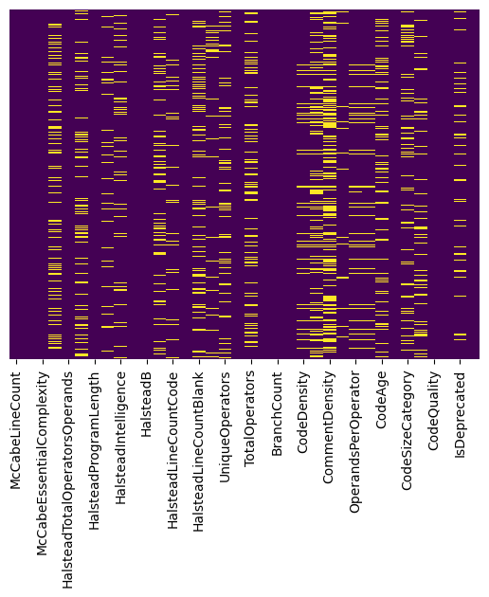
Identifying missing values
McCabeLineCount 0
McCabeCyclomaticComplexity 0
McCabeEssentialComplexity 0
McCabeDesignComplexity 16328
HalsteadTotalOperatorsOperands 0
HalsteadVolume 13718
HalsteadProgramLength 0
HalsteadDifficulty 7542
HalsteadIntelligence 5441
HalsteadEffort 0
HalsteadB 0
HalsteadTimeEstimator 13856
HalsteadLineCountCode 6229
HalsteadLineCountComment 0
HalsteadLineCountBlank 14139
HalsteadLineCountCodeAndComment 4537
UniqueOperators 10698
UniqueOperands 0
TotalOperators 12735
TotalOperands 0
BranchCount 0
defects 0
CodeDensity 5712
OperatorToOperandRatio 17436
CommentDensity 23845
ComplexityEfficiency 3645
OperandsPerOperator 5777
CodeAndCommentRatio 5746
CodeAge 13761
CodeLanguage 0
CodeSizeCategory 14632
CodeType 9782
CodeQuality 0
QualityScore 0
IsDeprecated 6517
TeamSize 0

Slide 9
Treating missing values

Slide 10
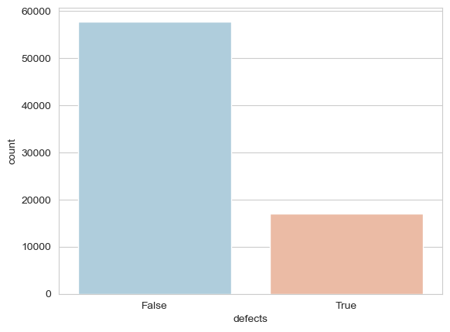
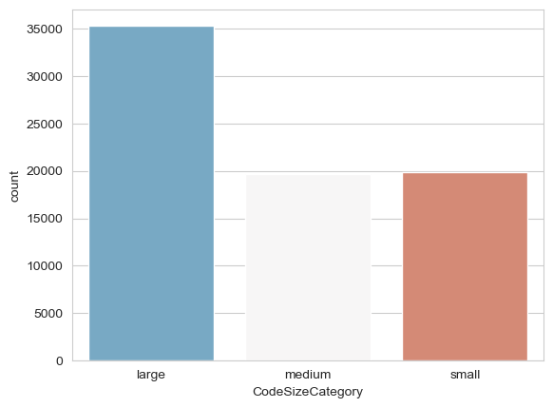
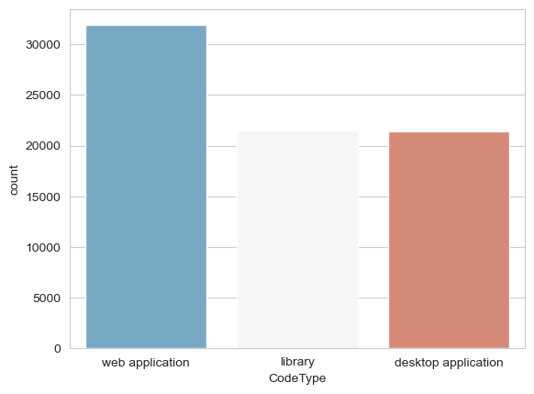
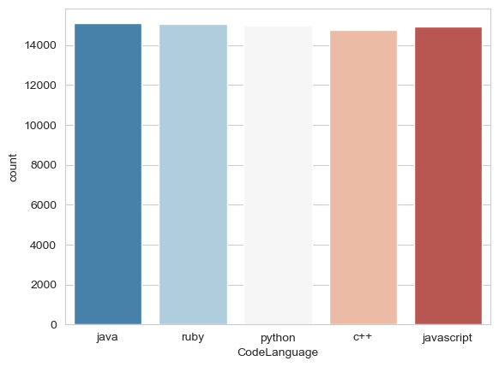
Univariate Analysis- Categorical label & Features

Slide 11
Multivariate Analysis

