Slide 1
Git
SA² team (Software Automation Architecture)
February 2019

Slide 2
Introduction
A little vocabulary
Basic usage
A bit further
00’20
00’40
02’30
00’30

Slide 3
Git
Introduction

Slide 4
Git
is a revision control system
Created in 2005 by Linus Torvalds to develop the Linux kernel
Free and open source
Source code available at https://github.com/git/git
Possible to contribute !

Slide 5
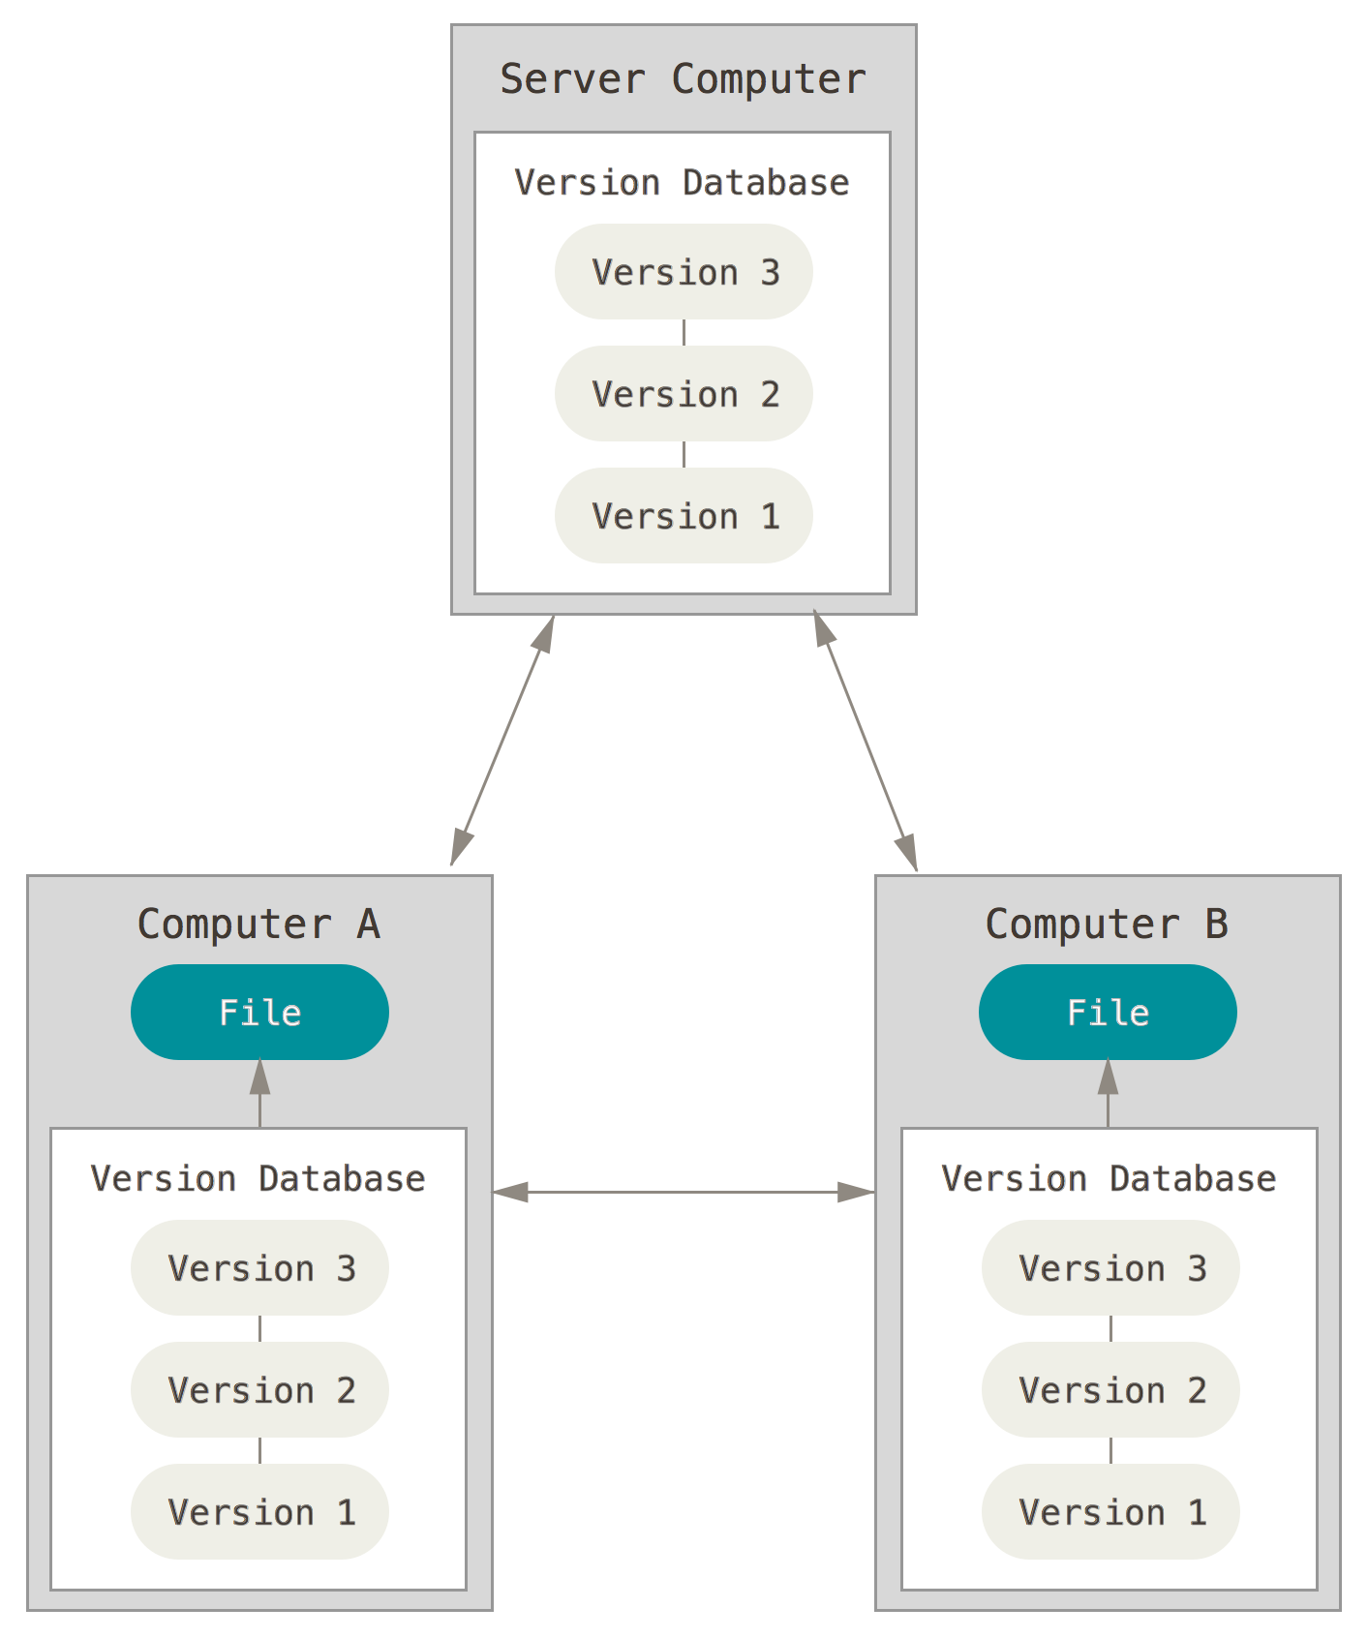
Git
is distributed
You clone an entire repository
Your local repo is a full copy of the original repo
There is no single point of failure (as long as there is at least two copies of a repository)
Notes:
Local repo can also be seen as a backup of the original repo

Slide 6
Git
operations are mostly local
Any repo is self-sufficient
All the information, files and history are stored locally
As a consequence operations are local… and fast
Commit and checkout are local too !

Slide 7
Git
branching is flexible
Git encourages you to have multiple local branches
Creation / merging / deletion of branches take seconds
If you have a new idea, switch to a new branch and code
Notes:
When you push to a remote repository, you do not have to push all of your branches.
You can choose to share just one of your branches, a few of them, or all of them.

Slide 8
Git
is about snapshots
Git stores state of the repo after each operation
Git generally only adds data
Almost any change on a branch can be recovered
Notes:
See command git reflog (records when tips of branches and other refs are updated in the local repository)

Slide 9

Git
is not GitLab / GitHub / …
Git is a tool for version control
GitLab and GitHub are hosting services for Git repositories with additional collaboration features
GitLab and GitHub concepts (Merge/Pull Request, fork, code review, etc) will be described in another presentation
Notes:
« Git replaces SVN, GitLab replaces the Forge »

Slide 10
Git
A little vocabulary

Slide 11
Git
The three zones
Working Directory
Staging area
.git directory (Repository)
Checkout a branch
Stage (add) changes
Commit
Notes:
--> All 3 states are local
Git doesn’t track modified file in working directory
When you commit, Git only looks for the files present in the staging area (= index)
So it’s a 2-steps operation: add changes to the staging area and then commit
Modified means that you have changed the file but have not staged or committed it yet.
Staged means that you have marked a modified file in its current version to go into your next commit snapshot.
Committed means that the data is safely stored in your local database.
Questions ?

Slide 12
Git
The fourth states
untracked
modified
staged
unmodified
add
add
commit
edit file
Notes:
--> All 3 states are local
Git doesn’t track modified file in working directory
When you commit, Git only looks for the files present in the staging area (= index)
So it’s a 2-steps operation: add changes to the staging area and then commit
Modified means that you have changed the file but have not staged or committed it yet.
Staged means that you have marked a modified file in its current version to go into your next commit snapshot.
Committed means that the data is safely stored in your local database.
Questions ?

Slide 13
Git
.gitignore
Specifies intentionally untracked files that Git should ignore
# Eclipse
.classpath
.project
.settings/
target/
bin/
# Archives
*.7z
*.jar
*.rar
*.tar
*.zip
Useful .gitignore files for your project - https://www.gitignore.io/
Notes:
.gitignore file:
is part of the project files
is present in root directory + potentially in subfolders

Slide 14
Git
Commit
Holds one state of the repository
Identified by a SHA1 hash like
The SHA is globally unique
Every commit has a parent commit
A merge commit as two parent commits
af12b073
master
w5462bfe
Time
368f3565
1033177f
99bfc288
Notes:
Git commit SHA = SVN revision number
(Git cannot have simple number due to decentralized nature)
Commit =
SHA of the tree of files and directories in the commit
SHA of the parent commit(s)
commit message
author name/email/timestamp
committer name/email/timestamp

Slide 15
Git
master
af12b073
325rt558
FEATURE_1
w5462bfe
dd409122
368f3565
Branch
1033177f
99bfc288
A linked list of commits with a name
Default branch is master
Usually a branch is created to work on a new feature
A branch is easy to create and delete
This is the basis of Feature Branch workflow
Notes:
A branch does not really « contains » commits
A branch is just a name for a particular list of commits
Commits can appear in several branches

Slide 16
Git
HEAD
Symbolic ref to the latest commit
Only on currently checked out branch
HEAD
master
af12b073
325rt558
FEATURE_1
w5462bfe
dd409122
af12b073
368f3565
w5462bfe
1033177f
368f3565
99bfc288
1033177f
$ git show HEAD~3
99bfc288

Slide 17
Git
Tag
Same semantic as in SVN
« branches move, tags don't »
Usually created for releases

Slide 18
Git
Stashes
Working Directory
Staging area
Stash
Stash
Unstash
Like a « fourth zone »
Save changes from your working directory + staging area on a stack away from any branch
Number of stashes not limited
You can reapply any of your stashes at any time on any of your local branches
Notes:
All saved stashes are available from all local branches

Slide 19
Git
Remote
Alias + URL that refers to another repository
In URL protocol can be ssh / http(s) / git / local file
Several remotes can be configured in a repository
$ git remote -v
origin git@innersource.soprasteria.com:software-automation-architecture/git-training.git (fetch)
origin git@innersource.soprasteria.com:software-automation-architecture/git-training.git (push)
evrignaud https://innersource.soprasteria.com/etienne.vrignaud/git-training.git (fetch)
evrignaud https://innersource.soprasteria.com/etienne.vrignaud/git-training.git (push)
Notes:
A remote called origin is automatically created when you clone a repo, pointing to the repo you cloned from.

Slide 20
Git
Working Directory
Staging area
.git directory (Repository)
Remote repository
Pull
Merge / Rebase
Fetch
Incorporates changes from a branch on a remote repo into the current local branch
Shortcut for fetch + (merge or rebase)
Pull will not work if you have unsaved local changes
--> stash, commit or reset

Slide 21
Git
Merge Rebase
master
af12b073
325rt558
FEATURE_1
master
af12b073
325rt558
FEATURE_1
w5462bfe
dd409122
w5462bfe
dd409122
Time
368f3565
Time
368f3565
1033177f
1033177f
99bfc288
99bfc288
$ git checkout master
$ git merge FEATURE_1
$ git checkout FEATURE_1
$ git rebase master
c769fc41
FEATURE_1
master
1cbf5873
57387afd
af12b073
325rt558
FEATURE_1
master
af12b073
w5462bfe
dd409122
w5462bfe
368f3565
368f3565
1033177f
1033177f
99bfc288
99bfc288
Notes:
Merge operation creates an additional ‘merge commit’ --> rollback easy
Rebase does not need a ‘merge commit’ but as parent of commits change commit SHA’s change too
On your feature branch use rebase
--> you rebase your feature branch on top of master
On origin/master GitLab uses merge

Slide 22
Git
Working Directory
Staging area
.git directory (Repository)
Remote repository
Push
Add
Commit
Push
Updates a remote branch from your local branch
Sends objects (commits) necessary to complete the given branch

Slide 23
Git
Basic usage
Notes:
Mix presentations of basic commands and practical training
Training menu:
Install and configure your Git client
Clone a repository
Create a new feature branch
Make some changes
Add changes to index
Commit changes
Push branch to a remote repository
Create another feature branch
Stash
Apply changes from another branch
Unstash
Clean changes
(+ additional exercises)

Slide 24
Git
Notice
Git offers tens of commands for all usage
Only the most common commands and options are presented in this section
For a comprehensive list of Git commands visit Git official page: https://git-scm.com/docs
Git Cheat Sheet https://gitlab.com/gitlab-com/marketing/raw/master/design/print/git-cheatsheet/print-pdf/git-cheatsheet.pdf
Stack overflow - https://stackoverflow.com/questions/tagged/git
Notes:
Build your own way to work with Git !

Slide 25
Stash
Working Directory
Staging area
.git directory (Repository)
Remote repository
Clone
Checkout branch
Add
Commit
Reset
Checkout path(s)
Reset --hard
Push
Fetch
Merge / Rebase
Stash
Unstash

Slide 26

Git
Install a Git client
Create a HOME env variable in Windows with value D:\Profiles\<user> (HOME is the location where Git stores its configuration by default)
Install Git for Windows https://gitforwindows.org/ (includes also Git Bash)
You can then access Git Bash from Eclipse (right click on project > Show in > Git Bash)

Slide 27
Git
Configure SSH connection to Innersource
Generate a key pair
$ ssh-keygen -t rsa
Add the SSH key to your Innersource account
$ cat ~/.ssh/id_rsa.pub
Copy your SSH public key and open https://innersource.soprasteria.com/profile/keys
Paste your SSH public key in the Key field, fill the Title field & click on Add

Slide 28
Git
Configure SSH connection to Innersource
Active your SSH key when a new Git Bash window is opened
$ vi ~/.bash_profile
eval "$(ssh-agent -s)"
ssh-add ~/.ssh/id_rsa.pub
$ source ~/.bash_profile

Slide 29
Git
Test your connection to Innersource
$ git clone git@innersource.soprasteria.com:Innersource-meta/Welcome.git
$ rm -rf Welcome
see Innersource-meta wiki for more details

Slide 30
Git
config : manage global and repository configuration
List properties
$ git config --list
Configure your author name
$ git config --global user.name "Jean Dupont"
Configure your email address
$ git config --global user.email jdu@sopra.com
Notes:
Different property scopes: global and repository

Slide 31
Git
config : specific for Windows
Allow to create a file or directory with a long path
$ git config --global core.longpaths true
(for HTTPS connection) Store user / password inside the Git Credential Manager for Windows
$ git config --global credential.helper manager
(if needed go into the Windows credential manager to change your password: https://support.microsoft.com/en-us/help/4026814/windows-accessing-credential-manager)
Notes:
Different property scopes: global and repository

Slide 32
Git
init : create a new empty repository
$ git init [<directory>]
Notes:
Start a new Git repository for an existing code base:
$ cd /path/to/project
$ git init
$ git add .
$ git commit

Slide 33
Git
clone : copy an existing repository into a new directory
$ git clone [-b <branch>] <repo-url> [<directory>]
Notes:
A remote named origin and with the URL used for cloning is automatically configured in the repository
-b <name> : point to <branch> instead of pointing the newly created HEAD to the branch pointed to by the cloned repository’s HEAD.

Slide 34
Git
Clone a repository
Clone https://innersource.soprasteria.com/software-automation-architecture/git-training
Tips:
Get the SSH URL of the repository to clone on Innersource
Notes:
A remote named origin and with the URL used for cloning is automatically configured in the repository

Slide 35

Git
Clone a repository
Clone https://innersource.soprasteria.com/software-automation-architecture/git-training
$ cd /your/projects/folder
$ git clone git@innersource.soprasteria.com:software-automation-architecture/training/git-training.git
$ cd git-training

Slide 36
Git
branch : manage branches
List branches
$ git branch
Create a new branch
$ git branch <branch-name> [<start-point>]
Delete a branch
$ git branch -d <branch-name>

Slide 37
Git
Working Directory
Staging area
.git directory (Repository)
Checkout <branch>
checkout : switch branches or restore working tree files
Checkout <path>
Switch to a branch
$ git checkout <branch>
Create a new branch and switch to it
$ git checkout –b <new-branch> [<start-point>]
Update given path in working tree to match the index
$ git checkout -- <path> # Local modifications are lost
Notes:
git checkout != svn checkout
‘--’ to disambiguate branch/path

Slide 38
Git
Create a new feature branch
Now you have a local Git repository which is a copy of software-automation-architecture/git-training
Create a new local branch with a name that respects the convention on your project and switch to it

Slide 39
Git
Create a new feature branch
Now you have a local Git repository which is a copy of software-automation-architecture/git-training
Create a new local branch with a name that respects the convention on your project and switch to it
$ git checkout –b SA2_BLM1
(or $ git branch SA2_BLM1 $ git checkout SA2_BLM1)

Slide 40
Git
Make some changes in working directory
Make some local changes in existing files
Create a new file
Delete an existing file
Notes:
Make several changes in at least in an existing file

Slide 41
Git
status : show the working tree status
$ git status
MINGW64 /d/projects/git-training (<branch-name>)
$ git status
On branch <branch-name>
Changes to be committed:
(use "git reset HEAD <file>..." to unstage)
new file: src/main/java/com/example/Test.java
deleted: src/site/apt/index.apt
modified: src/test/java/com/example/TestGreeter.java
Changes not staged for commit:
(use "git add <file>..." to update what will be committed)
(use "git checkout -- <file>..." to discard changes in working directory)
modified: src/test/java/com/example/TestGreeter.java

Slide 42
Git
diff : show changes between states or commits
View the diff between working directory and index
$ git diff
View the changes you added to the index (staging area)
$ git diff --staged
View the changes between two commits
$ git diff <commit> <commit>

Slide 43
Git
Working Directory
Staging area
.git directory (Repository)
Add
add : add file contents to the index
Interactively choose changes to add to the index
$ git add -p
Add all changes at given path to the index
$ git add <path>

Slide 44
Git
Working Directory
Staging area
.git directory (Repository)
Reset
reset : reset current HEAD to the specified state
Reset --hard
Unstage changes
$ git reset HEAD
Interactively choose changes to unstage
$ git reset –p HEAD
Reset current branch head to a commit / branch / tag
$ git reset --hard <tree-ish>
Notes:
step 1: Move HEAD (--soft)
+ step 2: Update the Index (--mixed)
+ step 3: Update the Working Directory (--hard)

Slide 45
Git
Working Directory
Staging area
.git directory (Repository)
Commit
commit : record changes to the local repository
Stores the contents of the index in a new commit
$ git commit –m <message>
Amend the previous commit with the contents of the index
$ git commit --amend

Slide 46
Git
log : show commit logs
Show the commit logs
$ git log
Shows commits and diffs that touch the given path
$ git log –p <path>
Shows the commits difference between two branches
$ git log <branch1>..<branch2>

Slide 47
Git
log : show commit logs
Visualize the branches, merges, etc.
$ git log --graph
Visualize all branches decorated
$ git log --graph --oneline --all --decorate
Filter by author
$ git log --author=...

Slide 48
Git
push : update remote refs along with associated objects
Update given repository and branch using local branch
$ git push <remote> <branch>
Notes:
if you reworked some commits that were already pushed and try to push your branch
then you’ll get an error (because modified commits differ from existing ones)

Slide 49
Git
Add changes to index
Add new file and deleted file to the index
Interactively choose files content to add

Slide 50
Git
Add changes to index
Add new file and deleted file to the index
Interactively choose files content to add
$ git add <new file> <deleted file>
$ git add -p

Slide 51
Git
Unstage some changes
Unstage some of the changes you just added to index
Notes:
Unstage part of changes made in a file (for training purpose)

Slide 52
Git
Unstage some changes
Unstage some of the changes you just added to index
$ git reset -p HEAD
Notes:
Unstage only part of changes made in a file (for training purpose)

Slide 53
Git
Commit changes
Commit staged changes with a message
remark: You may have to respect a commit message convention on your project

Slide 54
Git
Commit changes
Commit staged changes with a message
$ git commit –m "Doing something"
remark: You may have to respect a commit message convention on your project

Slide 55
Git
Push branch to a remote repository
Push will create a branch with same name as your local branch on remote repository
Tip:
Push operation takes two parameters remote and branch

Slide 56
Git
Push branch to a remote repository
Push will create a branch with same name as your local branch on remote repository
$ git push origin <your branch name>

Slide 57

Git
Stashes
Working Directory
Staging area
Stash
stash : stash changes in working directory away
stash current state of the working directory and index
$ git stash [-p save <message>]
List the stashes that you currently have
$ git stash list
Apply a stash on top of the current working tree state
$ git stash pop [<stash>]
https://dev.to/srebalaji/useful-tricks-you-might-not-know-about-git-stash-117e
Notes:
apply = like pop, but do not remove the state from the stash list

Slide 58
Git
Create another feature branch
Create another branch from master (still respecting naming convention) + switch to it
Tip:
Pay attention to use master as starting point and not your currently checked out branch

Slide 59
Git
Create another feature branch
Create another branch from master (still respecting naming convention) + switch to it
$ git checkout –b SA2_BLM2 master
[error: Your local changes to the following files would be overwritten by checkout:
<your modified file>
Please commit your changes or stash them before you can switch branches.]
Notes:
Here on the same file:
local modifications
file is different between current branch & branch to which we are switching
Git refuse to switch because it cannot preserve modifs in context
Need to:
stash
or git checkout --merge (three-way merge between current branch, working tree contents & new branch)

Slide 60
Git
Stash your local changes
Stash
Check content of your stash

Slide 61
Git
Stash your local changes
Stash
Check content of your stash
$ git stash
$ git stash list
$ git stash show –p stash@{0}

Slide 62
Git
Retry to create your branch
Now your working directory is clean ☺
$ git checkout –b SA2_BLM2 master

Slide 63
Git
.git directory (Repository)
Remote repository
Fetch
fetch : download objects and refs from another repository
Fetch branches and tags from a given remote repo
$ git fetch <remote>
Fetch from all configured remotes
$ git fetch --all

Slide 64

Git
rebase : apply commits on top of another branch
Apply commits of current branch on top of given branch
$ git rebase <branch>
Edit the list of commits which are about to be rebased
$ git rebase –i <branch>
This operation may have consequences for other contributors on the project
Notes:
Always rebase your feature branch on master, the opposite would modify commits on master branch
The golden rule of git rebase is to never use it on public branches

Slide 65
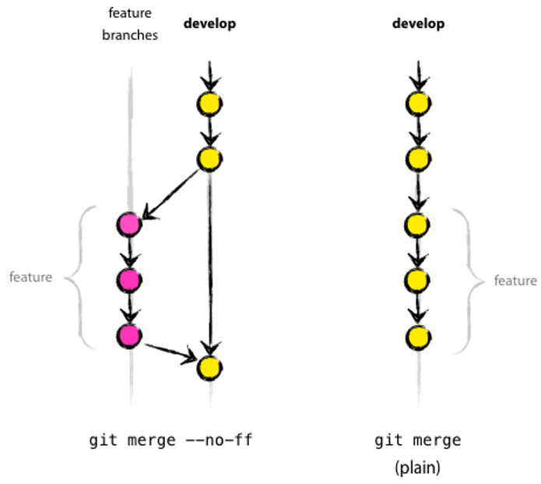
Git
master
master
merge : join several development histories together
Two strategies:
Create a merge commit
Fast forward
--ff
Notes:
fast-forward merge = Move (i.e., “fast forward”) the current branch tip up to the target branch tip. This is only possible when path to target branch tip is linear (when branches have not diverged).
Disabling fast-forward is useful in order to keep history of all merges that occur in the branch.

Slide 66
Git
merge : join several development histories together
Merge branch FEATURE-1 with current branch
$ git merge FEATURE-1
Abort the merge process and reconstruct the pre-merge state
$ git merge --abort
Notes:
fast-forward merge = Move (i.e., “fast forward”) the current branch tip up to the target branch tip. This is only possible when path to target branch tip is linear (when branches have not diverged).
Disabling fast-forward is useful in order to keep history of all merges that occur in the branch.

Slide 67
Git
pull : fetch from and integrate with another repository
Shorthand for git fetch && git merge
$ git pull <remote> <branch>
Shorthand for git fetch followed by git rebase
$ git pull --rebase <remote> <branch>
Rebase by default when doing git pull without --rebase
$ git config --global pull.rebase true
Recommended way of pulling

Slide 68
Git
remote : manage remotes
List remotes
$ git remote [-v]
Add a new remote
$ git remote add <alias> <repository URL>
Remove a given remote
$ git remote remove <alias>
Notes:
-v shows remote URLs
git remote will be used during the GitLab training

Slide 69
Git
Apply changes from another branch
Apply the changes from your first branch on the second branch using the rebase strategy
Tip:
You can use either the local or the remote branch to get the changes

Slide 70
Git
Apply changes from another branch
Apply the changes from your first branch on the second branch using the rebase strategy
$ git rebase <branch>
(or $ git pull --rebase origin <branch>)
Notes:
--> same as checkout, it will not work if you have unstaged changes (if you unstashed)

Slide 71
Git
Unstash your local changes
Unstash the local changes that we staged earlier

Slide 72
Git
Unstash your local changes
Unstash the local changes that we staged earlier
$ git stash pop
or $ git stash apply [stash{0}]

Slide 73
Git
Clean your local changes
Clean your local changes from the working directory
Tip:
Revert changes on working directory = update given paths in the working tree from the index file

Slide 74
Git
Clean your local changes
Clean your local changes from the working directory
$ git checkout -- <path>
Notes:
‘--’ for disambiguating between branches and paths

Slide 75
Git
revert : Revert some existing commits
Revert the changes that given commit(s) introduced
$ git revert <commit>..
Edit the commit message prior to committing the revert
$ git revert -e <commit>..
Notes:
Clean way to undo changes that were already committed and pushed

Slide 76
Git
A bit further
Notes:
Mix presentations of basic commands and practical training
Training menu:
Install and configure your Git client
Clone a repository
Create a new feature branch
Make some changes
Add changes to index
Commit changes
Push branch to a remote repository
Create another feature branch
Stash
Apply changes from another branch
Unstash
Clean changes
(+ additional exercises)

Slide 77
Git Aliases
Aliases are shortcuts to Git commands
You can define some useful aliases
Using one of them
$ git config --global alias.st status
$ git config --global alias.ci commit
$ git config --global alias.lg "log --graph --oneline --all --decorate"
$ git config --global alias.oops "commit --amend --no-edit"
$ git lg

Slide 78
Cherry picking
Just pick a single commit
Pick a commit
$ git cherry-pick <commit-sha>
If it goes wrong you can abort cherry pick
$ git cherry-pick --abort

Slide 79
Cherry picking
$ git log --graph --oneline --all --decorate
* 9a050ca (evrignaud) After some work
* 44e18fb (master) Modif #2
* b736445 Modified two files
* f46a1cd (HEAD -> dev) Add some content
* 1db511c Add readme
$ git cherry-pick b736445
[dev e87b4a5] Modified two files
Date: Wed Jan 31 22:52:20 2018 +0100
2 files changed, 0 insertions(+), 0 deletions(-)
create mode 100644 src/site/apt/index.apt
create mode 100644 src/test/java/com/example/TestGreeter.java
$ git log --graph --oneline --all --decorate
* e87b4a5 (HEAD -> dev) Modified two files
| * 9a050ca (evrignaud) After some work
| * 44e18fb (master) Modif #2
| * b736445 Modified two files
|/
* f46a1cd Add some content
* 1db511c Add readme

Slide 80
Cleanup your history
Rewriting History
Changing Multiple Commit Messages
Reordering Commits
Squashing Commits
Splitting a Commit
https://git-scm.com/book/en/v2/Git-Tools-Rewriting-History
https://delicious-insights.com/en/posts/getting-solid-at-git-rebase-vs-merge/
For example using: $ git rebase -i HEAD~3

Slide 81
Merge Conflicts
Merge conflicts may occur if competing changes are made to the same line of a file or when a file is deleted that another person is attempting to edit.
https://git-scm.com/book/en/v2/Git-Branching-Basic-Branching-and-Merging#_basic_merge_conflicts
https://help.github.com/articles/resolving-a-merge-conflict-using-the-command-line/
Using GitLab’s Merge Request you don’t merge manually. To ease GitLab’s Merge you need to rebase on the master’s HEAD.

Slide 82
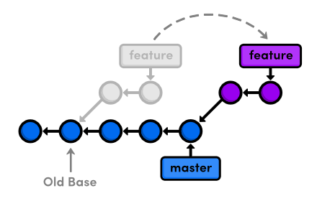
Force push needed after rebase
origin/feature
After a rebase the remote branch cannot be « fast-forwarded » to your local branch
https://stackoverflow.com/a/8940299
https://stackoverflow.com/a/15144275

Slide 83
Git
More exercises
Display commits difference between a local branch and origin/master
Reset HEAD to previous commit
Apply one commit from another branch to your branch
Edit last commit (content, message and author)
Delete a branch both locally and on remote repository

Slide 84
Git
More exercises
git log origin/master..<my-branch>
git reset [mode] HEAD~1
git cherry-pick <commit SHA>
git commit --amend [--author “Author <a@a.a>”]
git branch –d (or -D) <branch> && git push <remote> :<branch>

Slide 85
Going further
Learn Git Branching https://learngitbranching.js.org/
Git book available online for free
EN https://git-scm.com/book
FR https://git-scm.com/book/fr/v2
Introduction to Git with Scott Chacon of GitHub https://www.youtube.com/watch?v=ZDR433b0HJY
Git GUI Clients https://git-scm.com/download/gui/windows

Slide 86
.gitconfig minimal content
# File: ~/.gitconfig
[core]
longpaths = true
autocrlf = true
excludesfile = D:/Profiles/<username>/.gitignore
fscache = true
[push]
default = matching
[user]
name = <name>
email = <email>
[pull]
rebase = true
[merge]
ff = false
[credential]
helper = manager
[help]
autocorrect = 1
Details here: https://git-scm.com/docs/git-config
[alias]
st = status
ci = commit
oops = commit --amend --no-edit
lg = log --graph --oneline --all --decorate

