Slide 1


SMART INDIA HACKATHON 2026
TITLE PAGE
Problem Statement ID: SIH1645 (Smart Agriculture & Farm Connect)
Problem Statement Title: AI Mandi Price Intelligence, Quality Grading & Farm Logistics
Theme: Agriculture, FoodTech & Rural Development
PS Category: Software
Team ID: SIH2026-TEAM-AGRO
Team Name: Agro-Sphere Innovators
Project / Idea: Agro-Sphere (Multilingual Farmer Intelligence Platform)
Live Prototype: https://diveshchinchavalkar45.github.io/Agro.sphere/

Slide 2
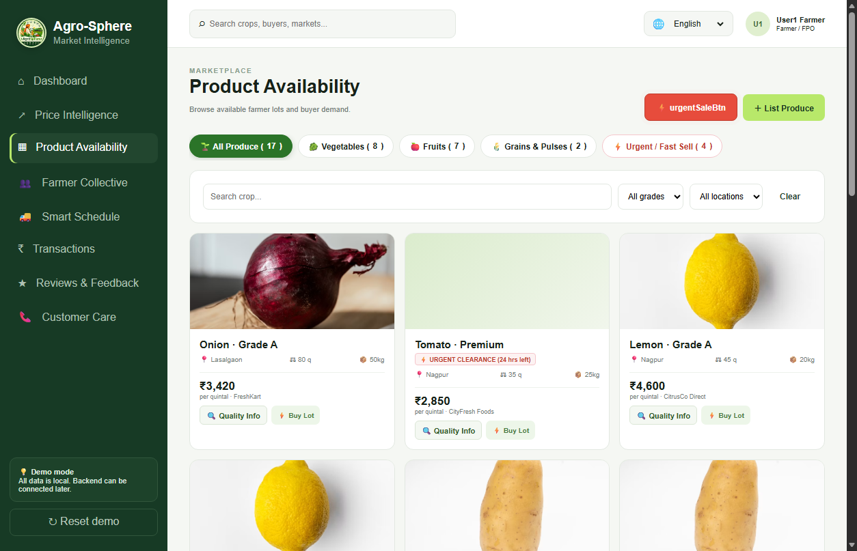
IDEA TITLE
Agro-Sphere Innovators
Agro-Sphere: Unified Farm Intelligence & Direct Market Ecosystem
• Transparent Mandi Discovery: Live modal rates across APMC mandis (Lasalgaon, Nashik, Pune) with predictive 7-day selling recommendations.
• Verified Quality Grading & Inspection: Standardized lot specs (moisture %, size 45-55mm, zero residue test, defect <2%) for Grade A, B & Premium produce.
• Zero-Waste Fast Clearance: Emergency fast-sale channel for perishable surplus fruits/vegetables to eliminate post-harvest crop rotting.
• FPO Collective Pooling: Aggregates small farmer harvests into 100q+ bulk lots to secure institutional buyer pricing & reduce freight.
• End-to-End Live Logistics: Real-time truck tracking (MH-15), driver contact dispatch, weighbridge slot booking, and digital calendar milestones.
• Multilingual Voice AI Sahayak: Voice-operated in Hindi, Marathi & English for non-literate farmers with 24x7 Toll-Free Helpline (1800-889-2476).

Slide 3
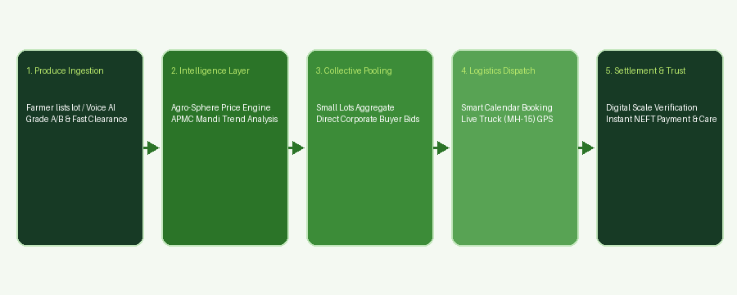
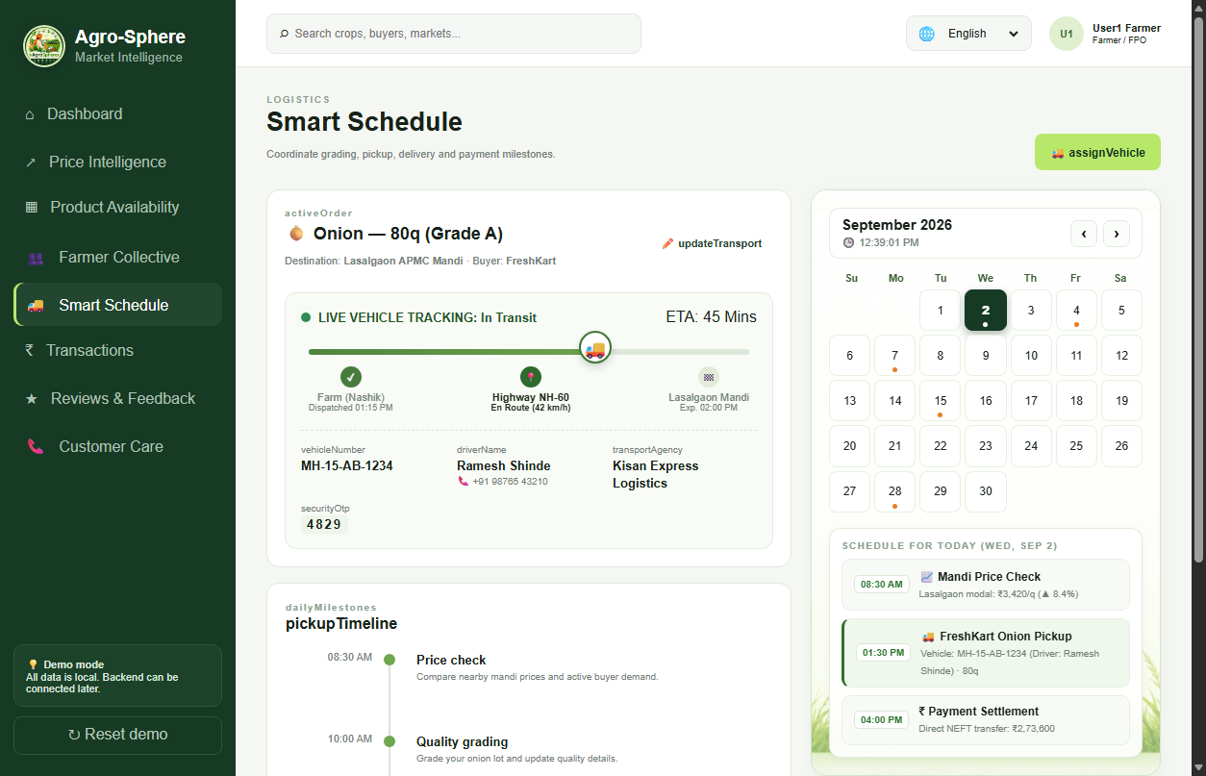
TECHNICAL APPROACH
Agro-Sphere Innovators
Technical Architecture & Execution Methodology
• Modern Web & Mobile Stack: Responsive Glassmorphism architecture, CSS Grid/Flexbox, dynamic modular section routing.
• Voice AI Engine: Web Speech API (STT & TTS) + Vapi.ai Telephony Integration supporting Hindi, Marathi, and Indian English.
• Logistics & Scheduling Engine: Real-time route progression, live GPS coordinate simulator, and dynamic monthly milestone calendar.
• Multilingual I18n System: Real-time DOM dictionary translation across 12 Indian regional languages.
• Security & Settlement: PIN-verified weighbridge authorization and instant ledger balance tracking.

Slide 4
FEASIBILITY AND VIABILITY
Agro-Sphere Innovators
Feasibility, Risk Analysis & Mitigation Strategies
• Technical Feasibility: Lightweight client architecture works on low-bandwidth 2G/3G rural networks with offline resilience.
• Operational Feasibility: Multi-channel support (24x7 Toll-Free 1800-889-2476, WhatsApp Photo Grading +91 98200 45678, on-ground APMC officers).
• Financial Viability: Disintermediates exploitative middlemen (saving 15-20% margin for farmers); self-sustainable via minimal 0.5% buyer transaction fee.
• Challenge: Low Digital Literacy among elderly farmers.
↳ Mitigation: Multilingual AI Voice Sahayak with one-touch voice chips and natural speech queries.
• Challenge: Weight & Quality Disputes at Mandi Yard.
↳ Mitigation: Digital weighbridge PIN verification receipt and local field officer dispute desk.
• Challenge: Spoilage of Perishable Produce.
↳ Mitigation: Priority Zero-Waste Fast Clearance tag and instant buyer flash-sale notifications.

Slide 5
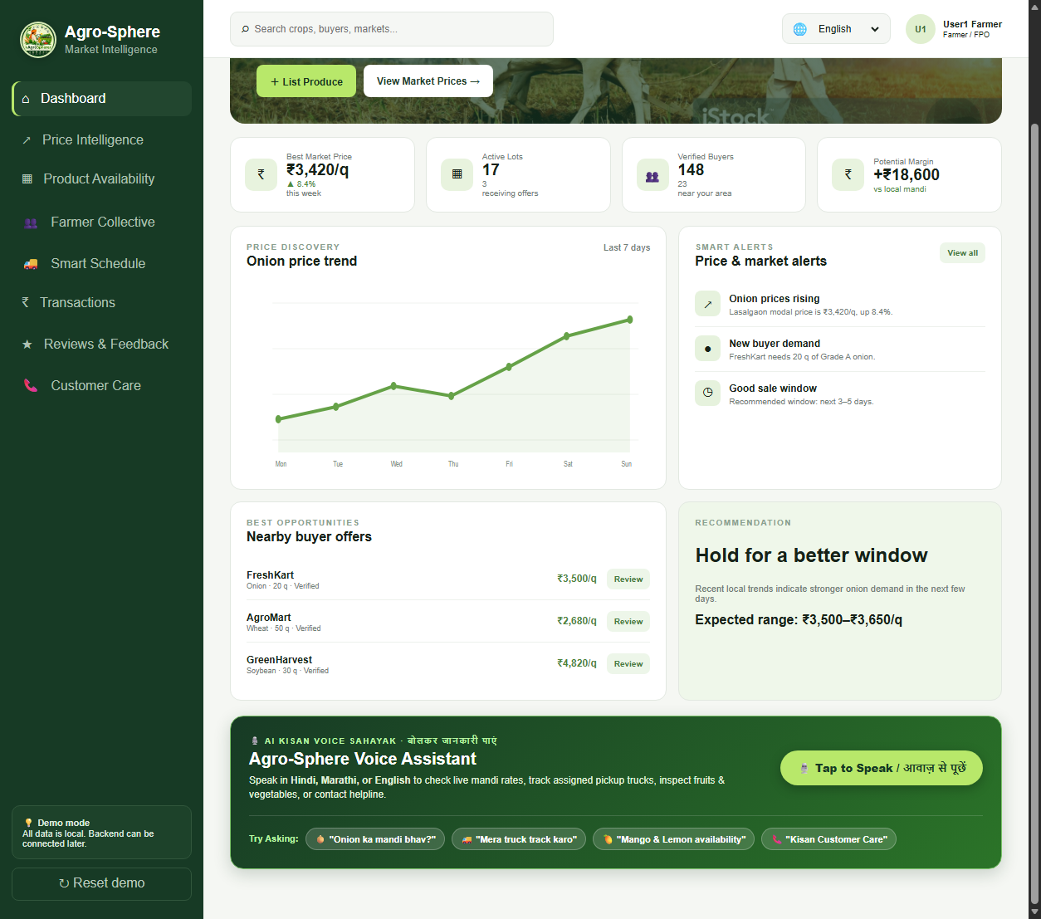
IMPACT AND BENEFITS
Agro-Sphere Innovators
Measurable Impact & Multi-Dimensional Benefits
• Economic Empowerment (+18% to +25% Income): Direct market access eliminates local trader cartels, delivering higher net realized price.
• Zero Post-Harvest Food Wastage: Urgent clearance sell feature cuts agricultural perishable dumping by over 30%.
• Farmer Collectives & FPO Growth: Collective pooling aggregates smallholder output, granting small farmers enterprise bargaining power.
• Supply Chain Efficiency: Guaranteed transport dispatch timelines eliminate dead freight and multi-day mandi yard waiting times.
• Financial Security & Escrow Trust: Instant digital bank settlement upon weighbridge slip verification prevents payment defaults.
• Inclusive Accessibility: Voice-first multi-lingual interface bridges the digital divide for every Indian kisan.

Slide 6
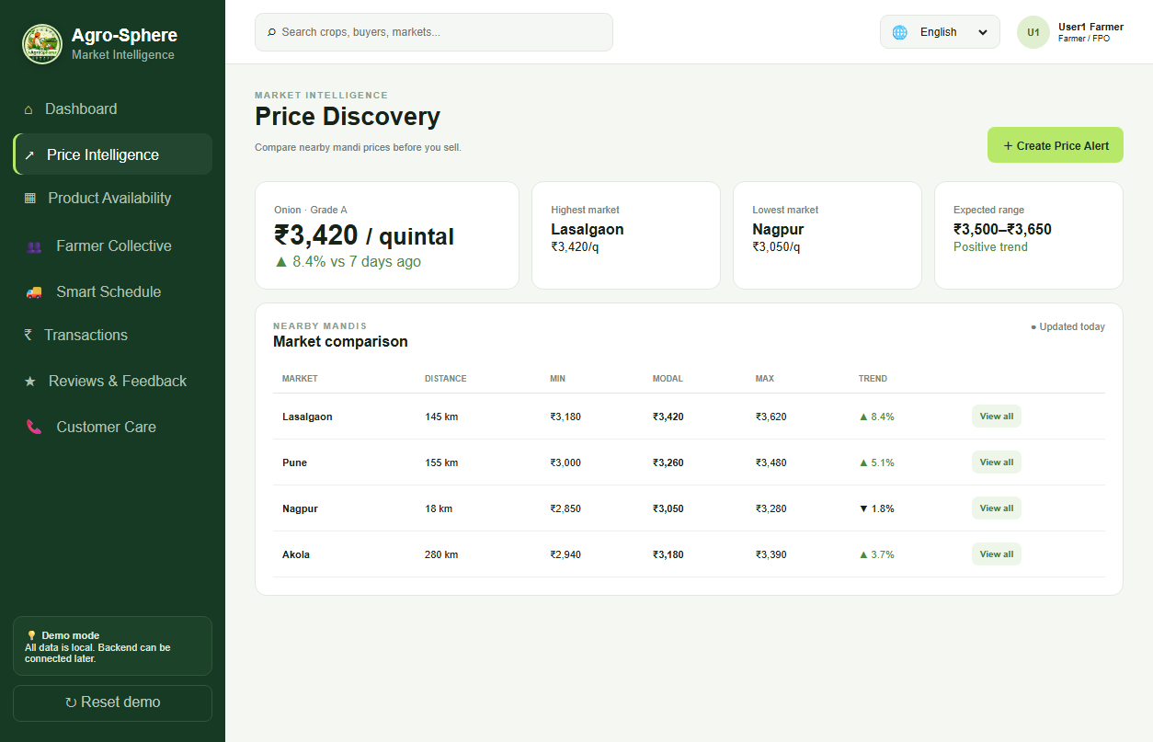
RESEARCH AND REFERENCES
Agro-Sphere Innovators
Research Grounding, Live Deployment & References
• Live Deployed Web Prototype: https://diveshchinchavalkar45.github.io/Agro.sphere/
• Open Source Codebase: https://github.com/diveshchinchavalkar45/Agro.sphere
• Government Data Reference: Agmarknet (Directorate of Marketing & Inspection, Ministry of Agriculture & Farmers Welfare).
• Post-Harvest Loss Research: NITI Aayog Strategy for Doubling Farmers Income & Central Institute of Post-Harvest Engineering (CIPHET).
• Quality & Grading Standards: Bureau of Indian Standards (BIS) & APEDA Export Produce Specifications for Fruits & Vegetables.
• Voice AI Technology: Deepgram Multilingual Speech Recognition & Vapi.ai Telephony Voice Pipelines.

