Slide 1
[ The Manor & Main ]
- A Clothing Brand
Team Members –
Divesh Singh – 2401201065
Gauransh Pawar - 2401201120
Ajay Singh - 2401201158

Slide 2
Introduction
Overview:
The Manor & Main is a new clothing brand aiming to bridge the gap between classic "old money" elegance and "contemporary streetwear cool".
Relevance:
Fashion is a powerful form of self-expression, and a blended aesthetic like this caters to a modern consumer with diverse tastes. There's a growing demand for versatile, high-quality apparel that transcends fleeting trends.

Slide 3
Objectives
Develop a cohesive brand identity that resonates with the target audience.
Design and produce high-quality apparel that embodies the blended aesthetic.
Establish a strong online and potentially physical presence.
Build a loyal customer base and achieve sustainable growth.

Slide 4
Problem Statement
Blend: Shoppers seeking a blend of classic and streetwear styles struggle to find a single source.
Experience: Many clothing websites offer a cluttered and frustrating user experience.
Story: Most sites lack compelling brand storytelling, missing a deeper customer connection.
Differentiation: In a crowded market, many sites fail to stand out with a unique offering.
Community: Online clothing shopping often lacks a sense of community.

Slide 5
The Fashion Landscape
Old Money Style
Street-Wear Style
Urban Edge
Relaxed Silhouettes
Bold Graphics
Casual Everyday Wear
Classic Elegance
Tailored Fits
Luxury Materials
Formal Occasion
A significant gap exists for a brand that seamlessly blends these styles.
[ The Manor & Main ]
( The Mainor & Main Bridging the Gap. )
Blending Classic Elegance with Urban Edge.
Creating a Unique Aesthetic for the Modern Individual.

Slide 6

Methodology
Market Research:
Analyze current fashion trends, competitor offerings, and target consumer preferences.
Brand Development:
Define brand values, mission, and unique selling proposition. Create a compelling brand story and visual identity.

Slide 7
Product Design & Development:
Design and produce apparel collections that reflect the blended aesthetic, using high-quality materials and construction.
Marketing & Sales:
Develop a marketing strategy to reach the target audience and establish sales channels (e.g., e-commerce website, retail partnerships).

Slide 8
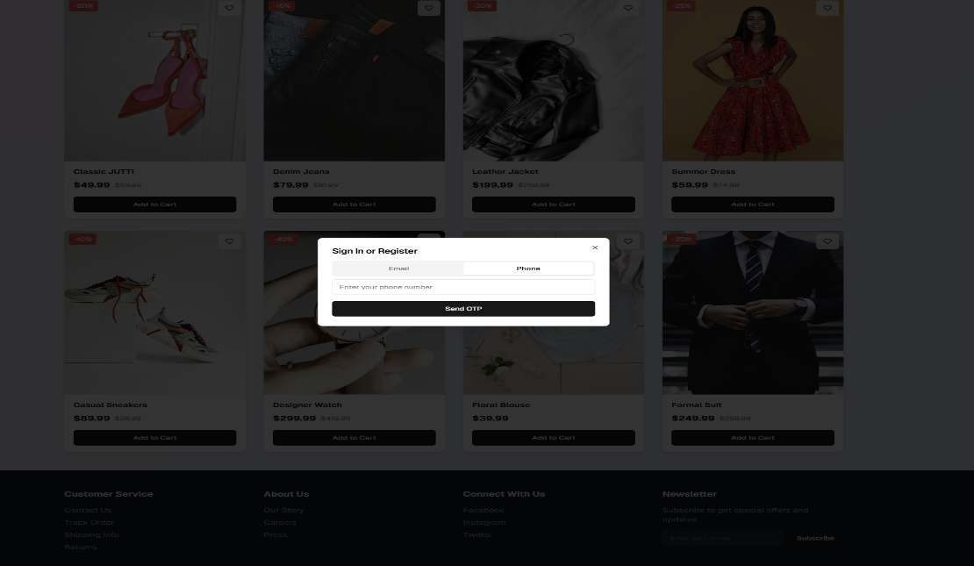

Slide 9
Tools & Techniques
Frontend Development ​
​
HTML, CSS, JavaScript – Core building blocks of the website.​
React.js – For a modern, dynamic frontend experience.​
​
Backend Development​
​
Node.js (JavaScript) – Lightweight and scalable.​
Python – Secure and good for data-heavy applications.​
PHP – Popular for e-Commerce backends.

Slide 10
Databases:​ MySQL – Relational databases for structured data.
eCommerce Features :​
​
Product Pages – High-quality images, size guides, and customer reviews.​
Shopping Cart & Checkout –​Integrated with PayPal, Razor pay for seamless payments.
Inventory Management – It has built-in tools​.
​

Slide 11
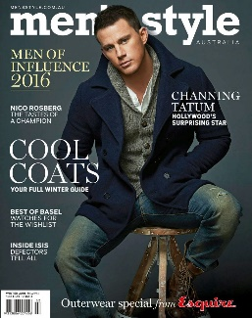
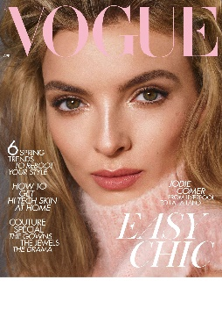
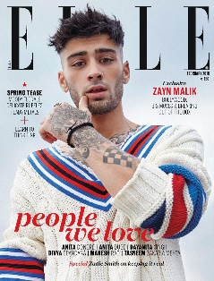
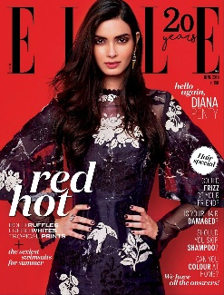
Key References
Vogue India: Known for its high-fashion spreads and trendsetting content.
Elle India: Celebrates global fashion trends while promoting local talent.
Harper's Bazaar India: Offers a blend of luxury fashion, beauty, and lifestyle.
Cosmopolitan India: Mixes fashion with lifestyle advice and empowering content.

Slide 12
Expected Outcomes
Establish a recognizable and respected brand within the target market.
Achieve sales targets and build a profitable business.
Cultivate a loyal customer base who appreciate the brand's unique style and values.
Become a leading brand in the blended "old money"/streetwear segment.

Slide 13
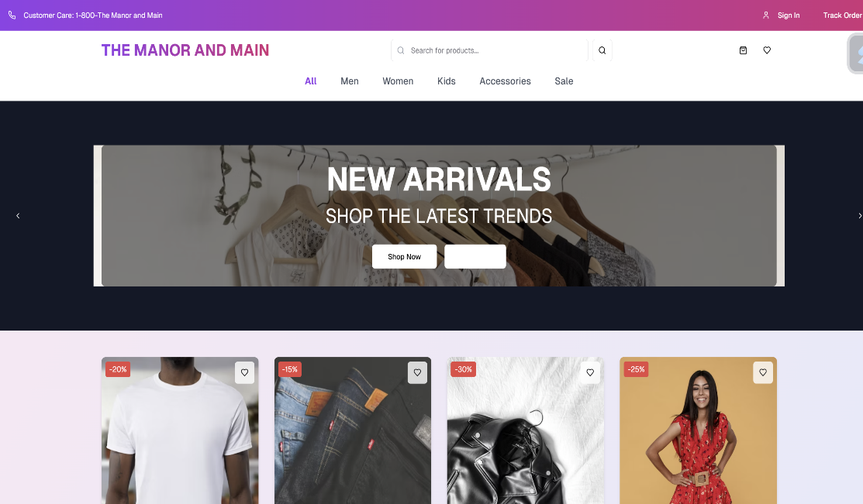

Slide 14
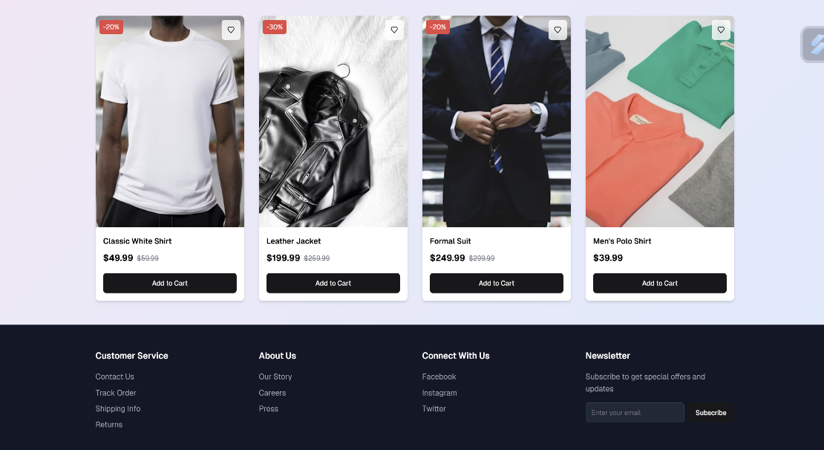

Slide 15
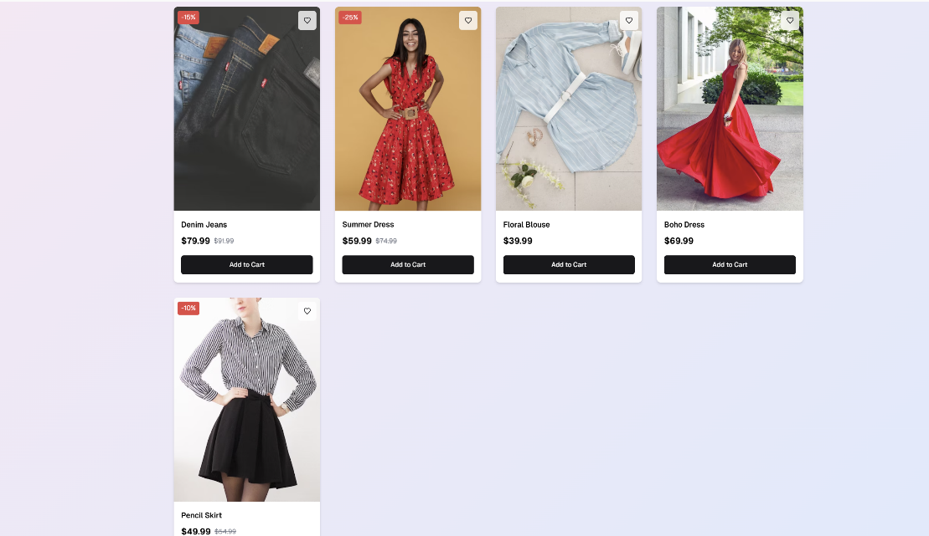

Slide 16
Conclusion
Summary:
The Manor & Main aims to fill a gap in the fashion market by offering a unique blend of classic elegance and streetwear cool. Through careful market research, brand development, and product design, the brand seeks to create high-quality, versatile apparel that empowers individuals to express their multifaceted style.

Slide 17
Importance of Outcomes:
Success in this venture will provide consumers with a new and exciting fashion option, while also establishing a sustainable and impactful brand that contributes to the evolution of modern style.

Slide 18
THANK YOU !

