Slide 1
Internship Report Presentation
Research & Analytics Internship – Satvify
Customer Loyalty, Retention & Early-Stage Customer Acquisition
Prepared by Diveshika Yadav
IILM University, Greater Noida | 2025–26

Slide 2
Project Overview
Research & Analytics Internship – Satvify
Primary customer data collected through Google Forms
Focus: loyalty, retention and early-stage acquisition
Responses converted into percentage-based pie charts
Objective: validate research observations and derive actionable recommendations

Slide 3
Survey Methodology
Customer Loyalty survey – 22 responses
Customer Retention survey – 15 responses
Early-Stage Customer Acquisition survey – 23 responses
Each survey set is analysed separately because sample sizes differ
Results are directional insights from small convenience samples

Slide 4
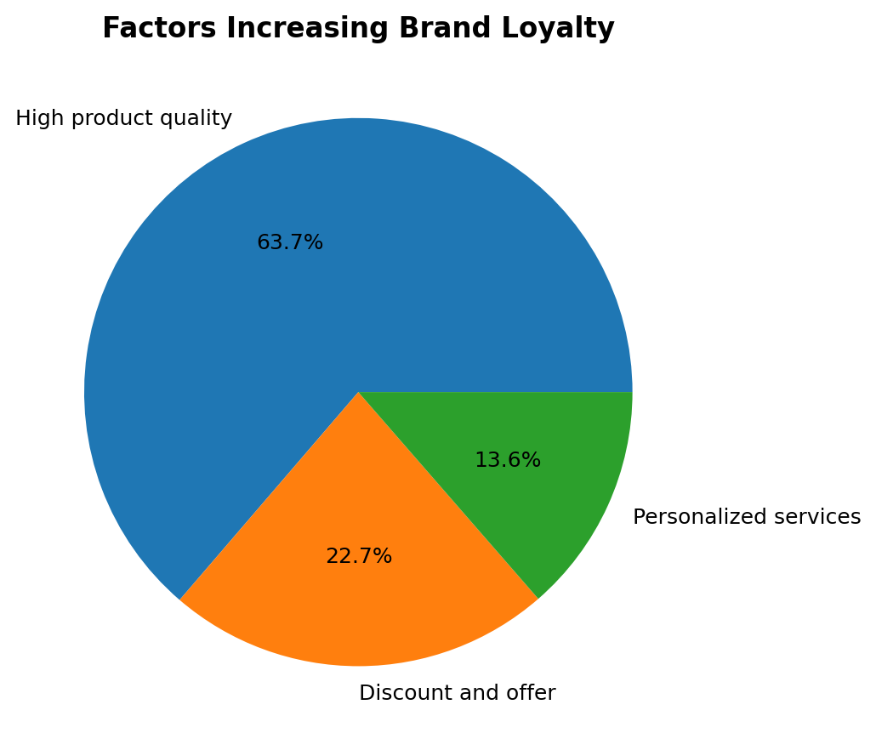
Customer Loyalty – Strongest Loyalty Driver
Key interpretation
High product quality was selected by 63.7%, making it the strongest loyalty driver.

Slide 5
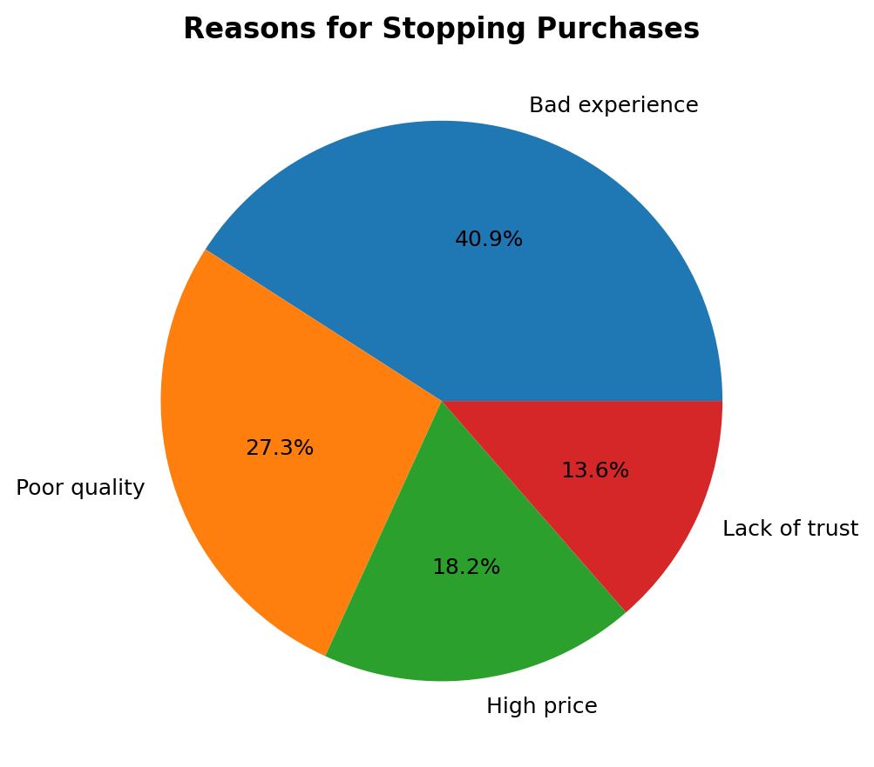
Customer Loyalty – Why Customers Stop Buying
Key interpretation
Bad experience was the leading reason at 40.9%.

Slide 6
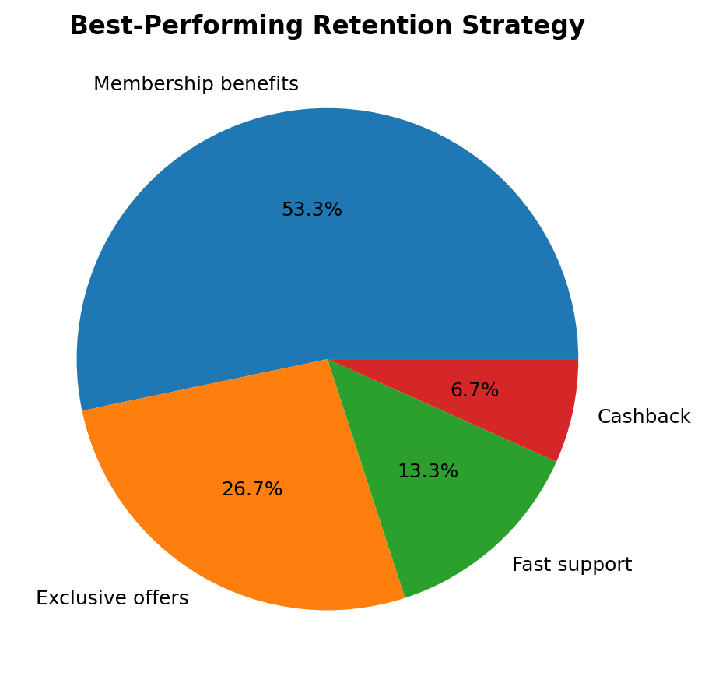
Customer Retention – Best Strategy
Key interpretation
Membership benefits were the most preferred retention strategy at 53.3%.

Slide 7
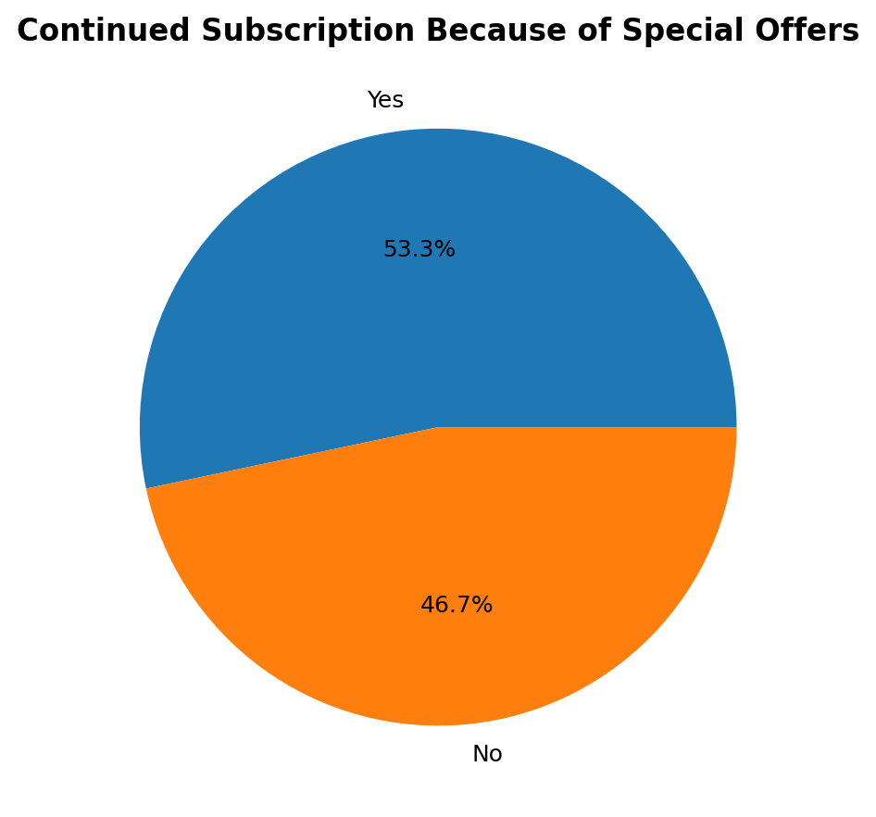
Customer Retention – Special Offers
Key interpretation
53.3% reported continuing a subscription because of special offers.

Slide 8
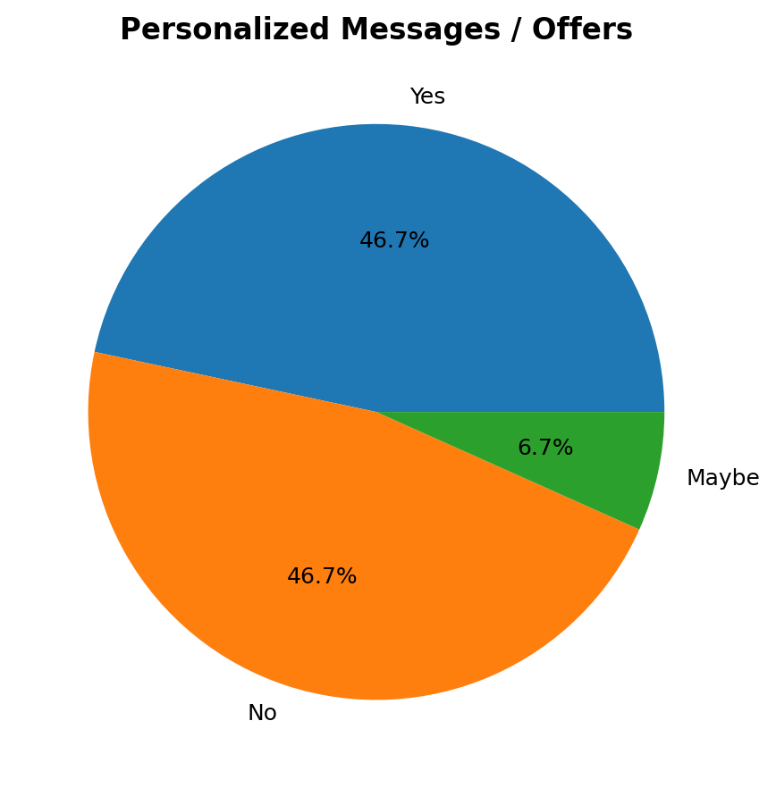
Customer Retention – Personalization
Key interpretation
Responses were split: 46.7% Yes and 46.7% No, showing mixed reactions.

Slide 9
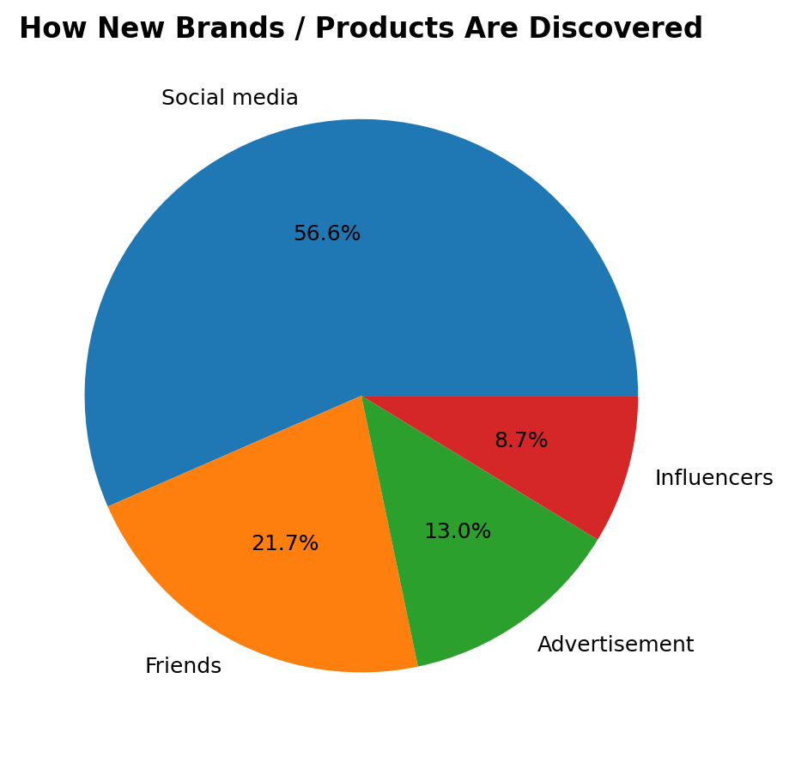
Acquisition – Brand Discovery
Key interpretation
Social media was the leading discovery channel at 56.5%.

Slide 10
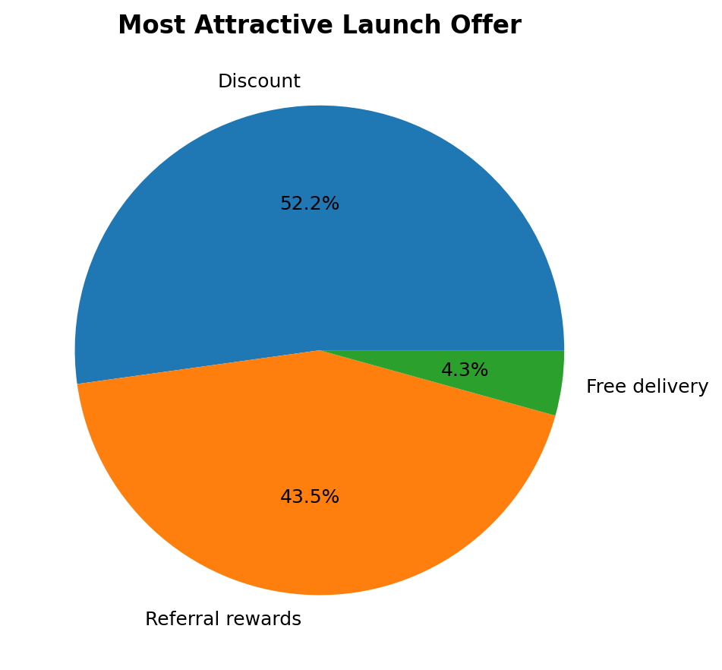
Acquisition – Launch Offer
Key interpretation
Discounts led at 52.2%, followed by referral rewards at 43.5%.

Slide 11
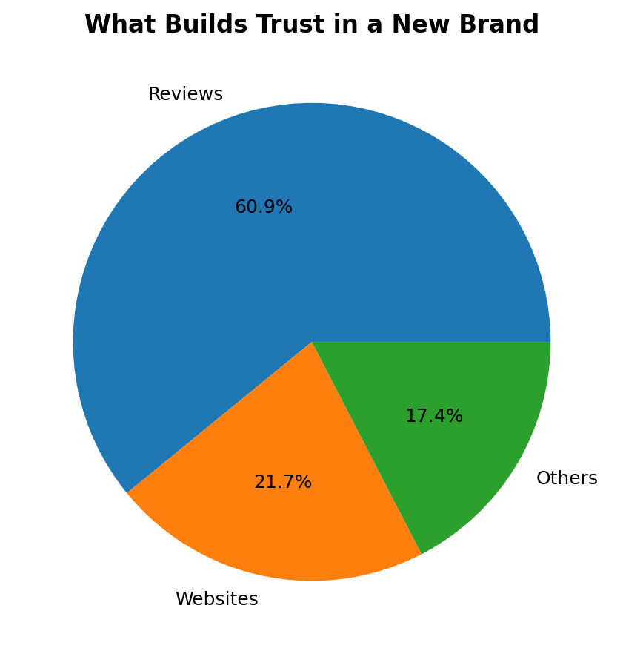
Acquisition – Trust
Key interpretation
Reviews were the strongest trust-building factor at 60.9%.

Slide 12
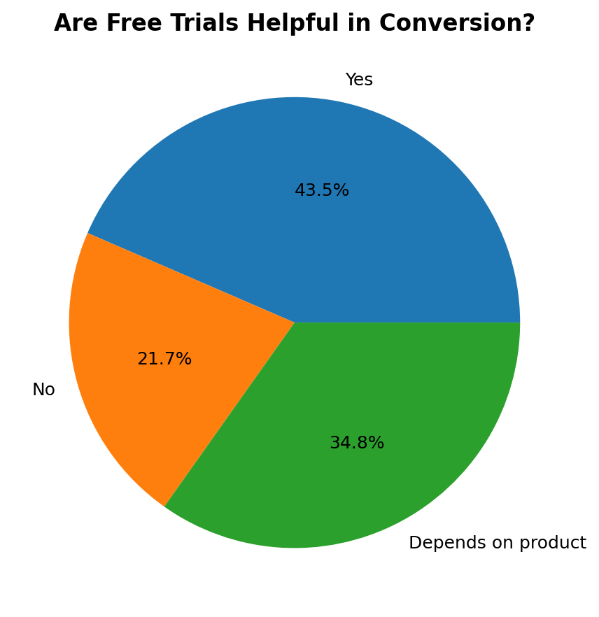
Acquisition – Free Trials
Key interpretation
43.5% said trials help conversion, while 34.8% said effectiveness depends on the product.

Slide 13
Consolidated Findings
Quality and customer experience are central to loyalty.
Membership benefits and special offers can support retention.
Social media is the strongest discovery channel in the acquisition survey.
Reviews are a major trust-building mechanism.
Discounts and referral rewards can support launch campaigns.
Personalization should be relevant rather than simply frequent.

Slide 14
Recommendations
Prioritise consistent product quality and customer experience.
Use membership benefits and carefully designed offers for retention.
Build acquisition around social media, reviews and customer proof.
Use discounts and referral rewards strategically.
Offer trials where value can be demonstrated quickly.
Keep personalization relevant and customer-focused.

Slide 15
Satvify Subscription-Plan FAQs
20 customer-facing FAQs were documented.
Topics include: Satvify overview, Satvic/vegan positioning, ordering and subscription plans.
Also covers customization, best-selling items, delivery, payment methods and contact.
FAQ content is based on the supplied Satvify FAQ document.

Slide 16
Internship Learning Outcomes
Primary-data collection and survey interpretation
Percentage-based data presentation
Customer behaviour analysis
Turning findings into business recommendations
Professional documentation and presentation
Customer-focused communication through FAQs

Slide 17
Limitations
Small samples of 15–23 respondents
Convenience sampling
Findings are directional rather than population-representative
Different survey sets should not be artificially merged into one respondent count

Slide 18
Conclusion
Survey evidence supports the major research themes covered during the internship.
Quality, experience, membership benefits, social media, reviews and offers emerged as important customer factors.
The findings provide a practical base for loyalty, retention and early-stage acquisition recommendations.

Slide 19
Thank You
Questions & Discussion

