Slide 1
Power BI Dashboard Summary
Call Center Product Sales Analysis

Slide 2
Project Overview
Goal:
To design an interactive dashboard that enables stakeholders to:
- Monitor agent-wise performance
- Track call pickup efficiency
- Understand sales productivity patterns
Dataset: Product Sales & Call Duration records

Slide 3
Key KPIs
| KPI | Value |
|----------------------|-------------|
| Total Agents | 11 |
| Total Calls | 9,939 |
| Total Products Sold | 2,089 |
| Avg. Call Duration | 125.16 sec |
These figures offer a quick snapshot of call center scale and efficiency.

Slide 4
Agent Performance
Top Agents by Product Sold: Gloria Singh, Todd Morrow, Lisa Cordova
Highest Average Call Duration: Jocelyn Parker, Gloria Singh
Visuals Included:
- Horizontal bar chart for Product Sold by Agent
- Bar chart for Average Call Duration
Insight: Indicates which agents are both persuasive and patient during calls.

Slide 5
Call Activity Insights
Pickup Rate: ~30% picked up, ~70% missed
Total Calls by Agent: Highest by Michele Williams & Gloria Singh
Visuals Included:
- Pie Chart for Pickup Rate
- Bar Chart for Total Calls by Agent
Insight: High call volume doesn’t always equate to high sales—quality matters.

Slide 6
Call Duration Distribution
Histogram shows how call durations are distributed (binned).
Most calls are around 100–130 seconds.
Used to analyze customer engagement and agent handling efficiency.

Slide 7
Interactive Features
Slicers: Filter by Agent Name
Consistent Theme: Clean blue and white
Buttons: Navigate between sections easily
Designed for clarity and executive decision-making.

Slide 8
Recommendations
- Train underperforming agents with high call volumes but low conversions.
- Explore reasons for low pickup rate—invest in better call timing or auto-dialing strategies.
- Reward top performers to boost morale and retention.

Slide 9
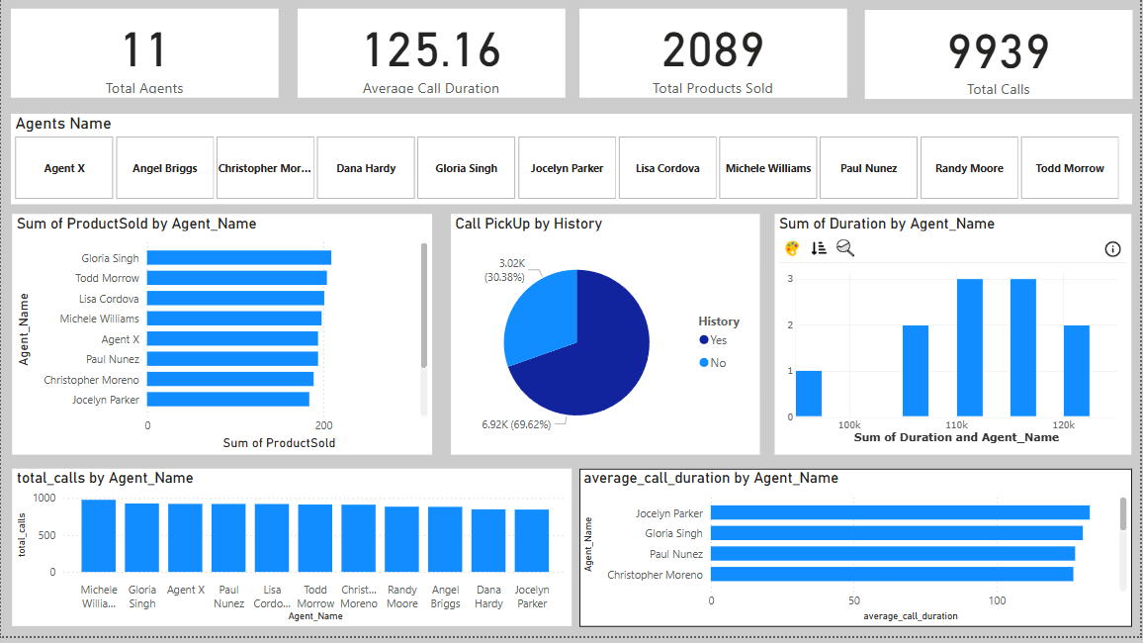
Dashboard Overview

