Slide 1

Humber Parts Crib
Presented by Divesh Oree
Members:
Rafel Yashooa
Masoud Raghuzar
Gurpreet Jia

Slide 2
Introduction [Proposal]
What is Humber Parts Crib?
This project is a collaboration of the Humber Parts Crib which will allows students to sign off items for their labs on regular basis. In short, the main purpose of this whole project is to make the Humber Part Cribs more effective to deal with a large number of students.
2. How is it going to work?
So basically, I will have a camera which I will use in order to scan the barcode strip on the student card and that barcode will get input electronically in the system. I will be using the LED on the PCB to show if the barcode was scanned successfully. Once it is scanned, that barcode information is sent on a txt file where the user can see and have access to it.

Slide 3
Introduction [Proposal]
3. Benefit of doing this project?
It is a project for Humber College, beneficial for the faculty and students
More effective and less time consuming – Easy to keep track of items
Save paper – Instead of using paper to sign off, everything is done electronically

Slide 4
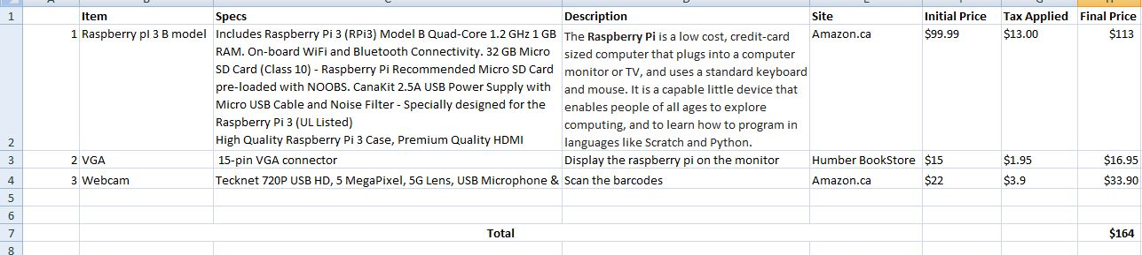
Budget

Slide 5
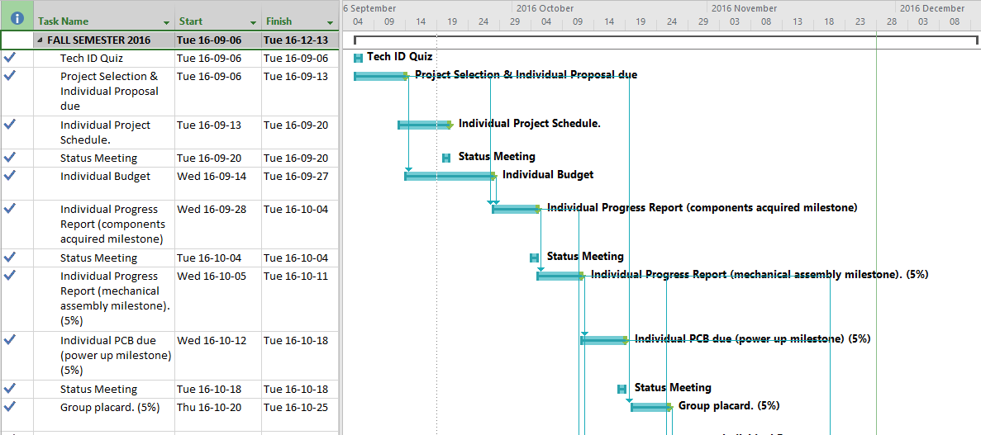
Schedule [continued...]

Slide 6
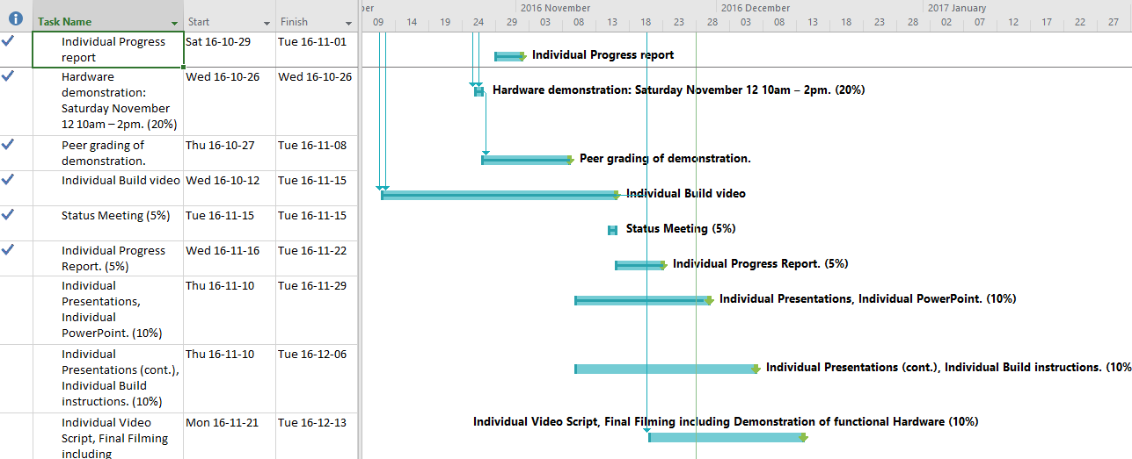
Schedule

Slide 7
Build Video
http://magis.to/xLtLrxEL

Slide 8
Course knowledge utilized from previous courses:
Construction of circuits from CENG 215 Digital And Interfacing Systems,
Soldering of the PCB from TECH 150 Electronic Devices & Circuits
3. Rapid application development and Gantt charts from CENG 216 Intro to Software Engineering,
Connecting and creating database CENG 319 Software Project
Programming courses: CENG 251(Unix Internal); Python (Google)

Slide 9
Thank you! ☺
DEMO

