Slide 1
Project Presentation of CO-OP Project at Industry (Module-2) (22CS421)
On
Context-Forge
Divesh Saini
2210991527
Supervised By
Lalit K Sharma
Department of Computer Science and Engineering,
Chitkara University, Punjab

Slide 2
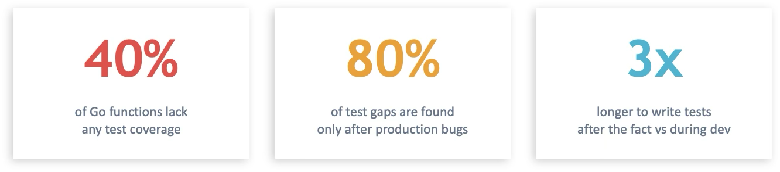

Introduction
The Problem
Writing tests is tedious — developers skip them under deadline pressure
No visibility into which functions are tested vs untested
Manual test gap analysis doesn't scale across large codebases
‹#›

Slide 3
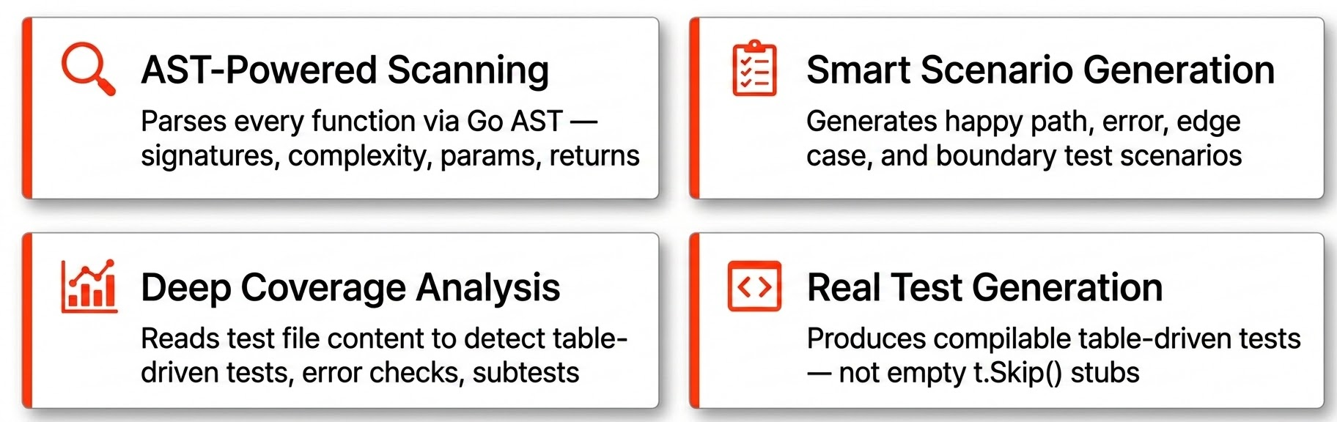
Introduction
The Solution
ContextForge is an MCP server that plugs into your editor and automates test coverage analysis and test generation for Go repositories.
‹#›

Slide 4
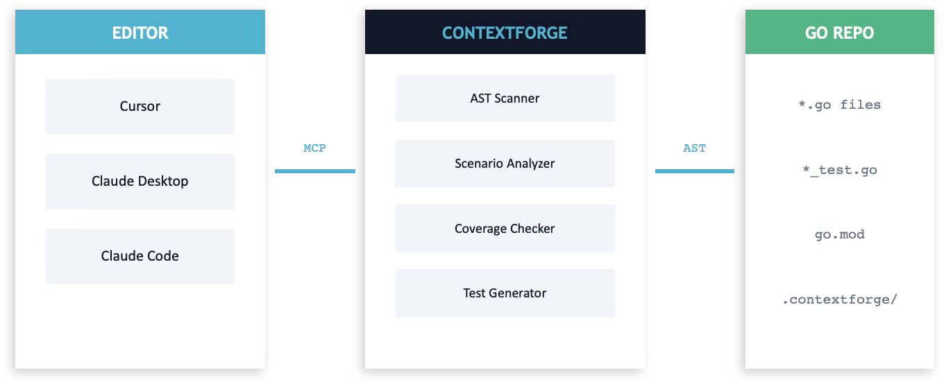
Architecture
‹#›

Slide 5
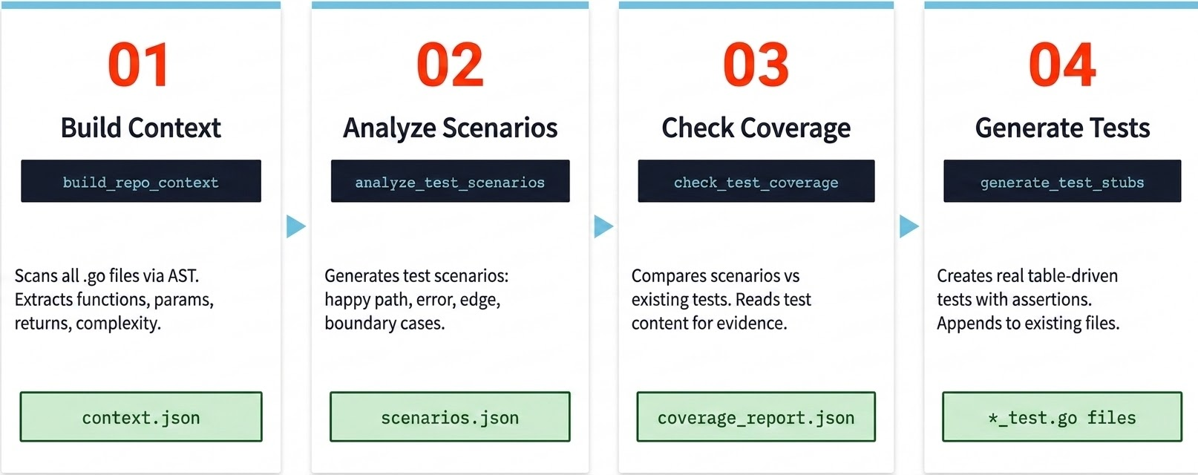
4-Step Workflow
‹#›

Slide 6



Quick Start
1. Install
go install github.com/diveshsaini1991/contextforge-2210991527/cmd/contextforge@latest
2. Add to Your Editor
{
"mcpServers": {
"contextforge": {
"command": "/Users/<user>/go/bin/contextforge"
}
}
}
3. Ask Your AI
"Analyze test coverage for my Go project at /path/to/repo"
‹#›

Slide 7
Thank You
‹#›

