Slide 1

Brain inspired computing
using a FPAA Board
10/09/2019
Try to understand the way of using the HHN model block
Matthieu Divet
Jonathan Gomis
Annie Luo
Anonto Zaman
Special problem
ECE 8903
Dr. Alexandre Locquet
Dr. Damien Rontani

Slide 2
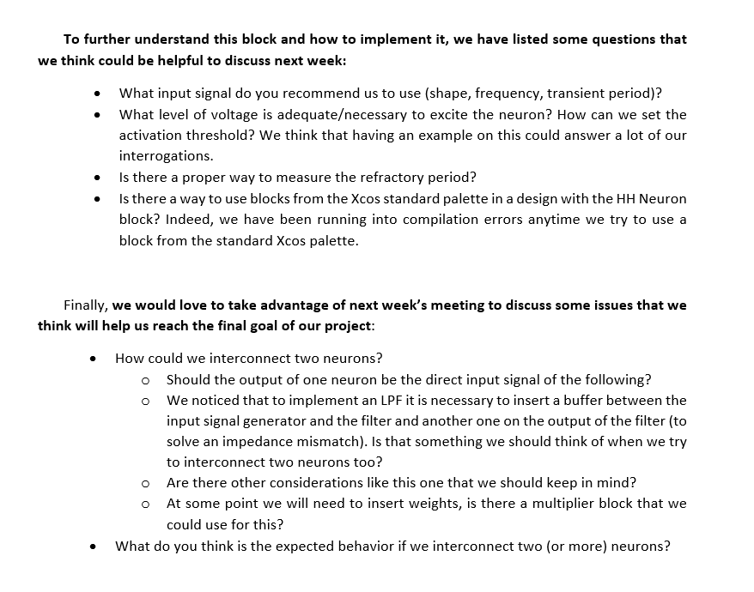
Test the process indicated by Pr.Hassler with the ‘Examples’ tab on the blue GUI:
Wrong location
Same design we have been using for the past weeks
Try to update ‘RASP Tools’ but nothing has changed
Prepare a set of questions for the meeting with Pr.Hassler :
Watch the videos
Interrogations about:
The current design we’re trying to implement (version of the HHN block we use, how to improve it...)
Possible ideas for the next steps to reach our final goal

Slide 3
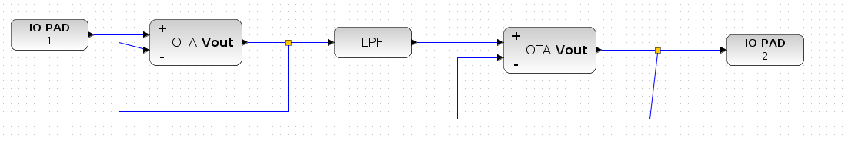
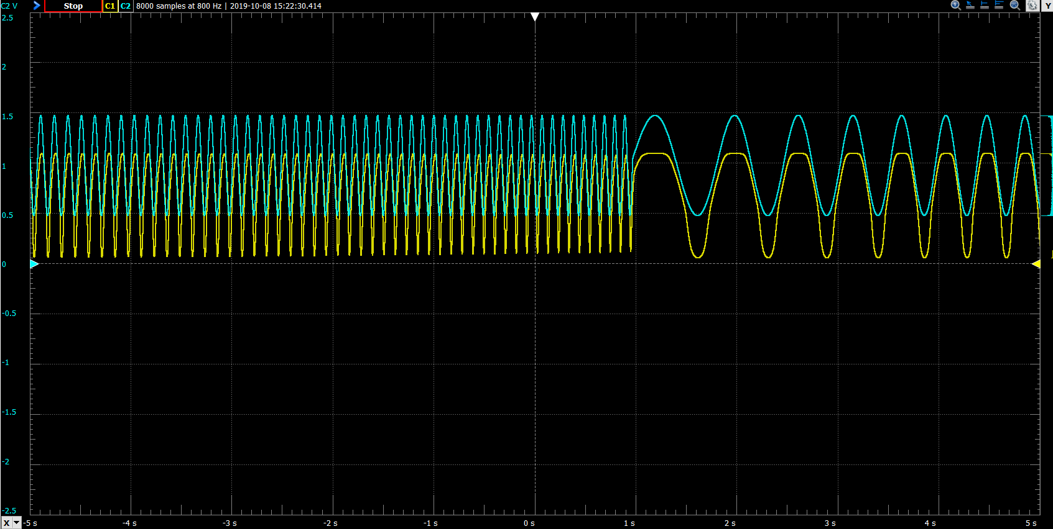
Determination of the LPF real cut-off frequency:
Last time: cut-off frequency = 150Hz but cut far below.
Tested more values:
Sometimes higher, sometimes lower
No regular shift of the cut-off frequency
Possibly linear shift ?
Still an amplitude offset.

