Slide 1

Brain inspired computing
using a FPAA Board
11/20 catch-up session
New tests on the HHN block design
Matthieu Divet
Jonathan Gomis
Annie Luo
Anonto Zaman
Special problem
ECE 8903
Dr. Alexandre Locquet
Dr. Damien Rontani

Slide 2
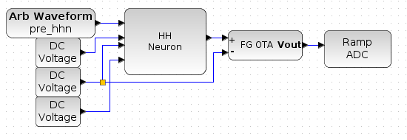
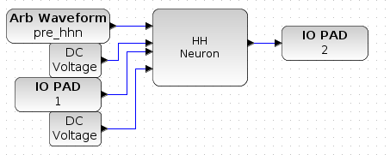
Directions given by Aishwarya:
Remove the RAMP_ADC and the FG_OTA
Keep the given input signal
Modulate the sodium Vref until we get something
Can then play a bit with the other reference voltages
Already implemented example design
Design used to test the parameters

Slide 3
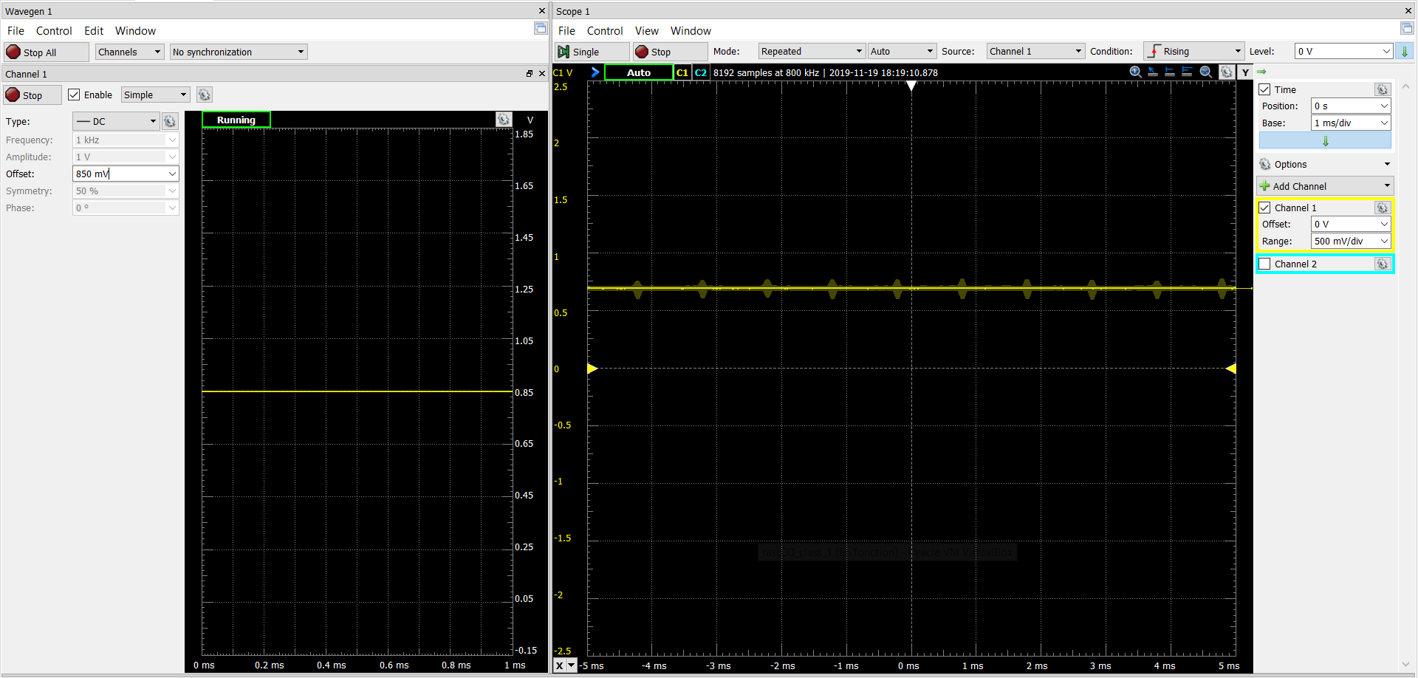
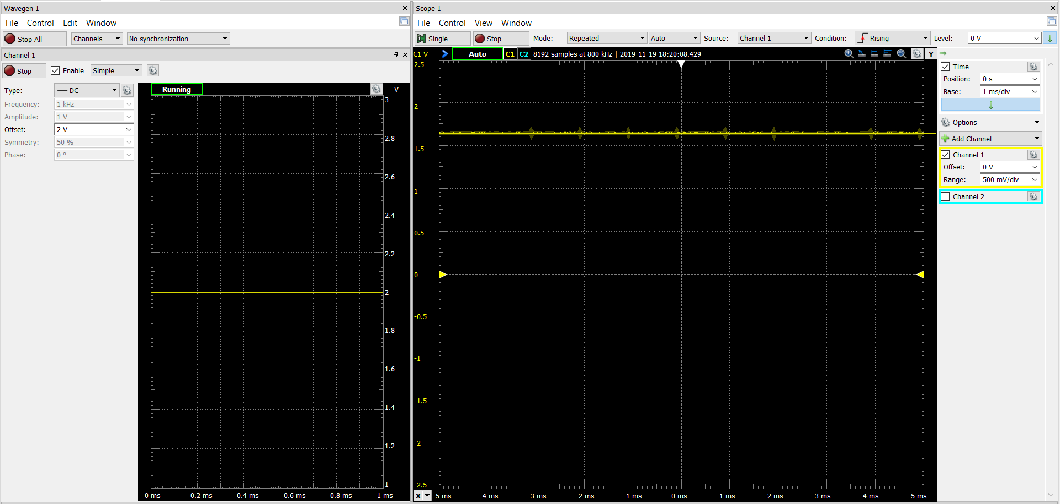
Results:
A constant signal as answer
Amplitude changes with variations of the sodium reference voltage
Tried with other reference voltages, same result
Direct follow of the variations, doesn’t wait for us to press ‘Take data’ again.

