Slide 1

Brain inspired computing
using a FPAA Board
12/04 catch-up session
Characterizing the
HHN block
Matthieu Divet
Jonathan Gomis
Annie Luo
Anonto Zaman
Special problem
ECE 8903
Dr. Alexandre Locquet
Dr. Damien Rontani

Slide 2
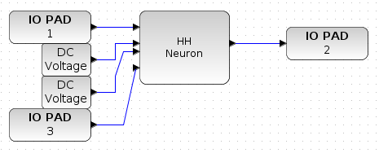
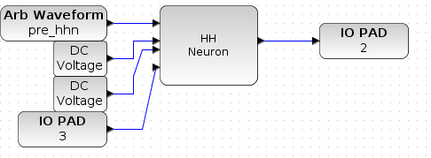
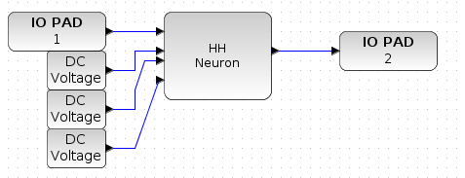
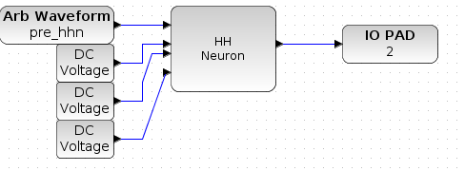
Finally get a design that works the way we want:
IO PAD instead of Waveform generator
IO PAD instead of ‘DC Voltage’ block for the Na channel
IO PAD to read the output
Remove the ‘FG OTA’ block (not necessary)
Connect the ground of the digilent module to a ground pin on the board
→ Try out other designs but didn’t get the same answer with another one.

Slide 3
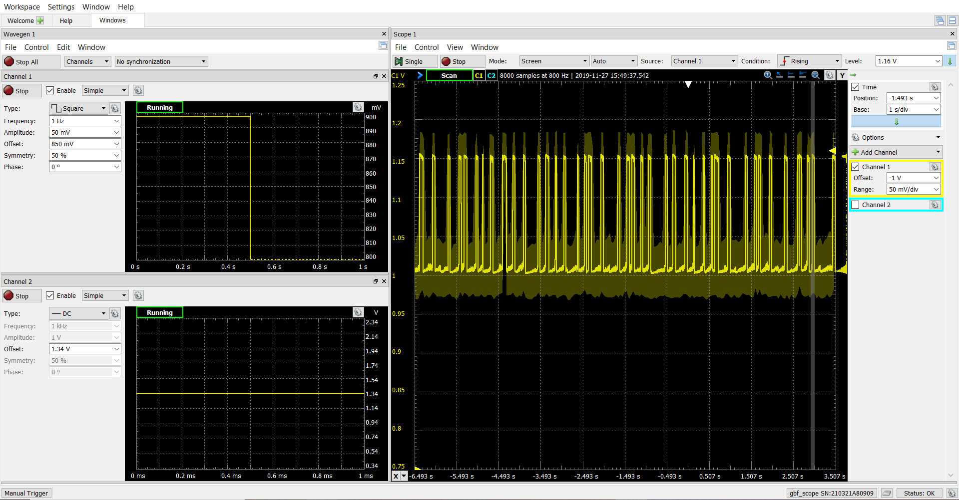
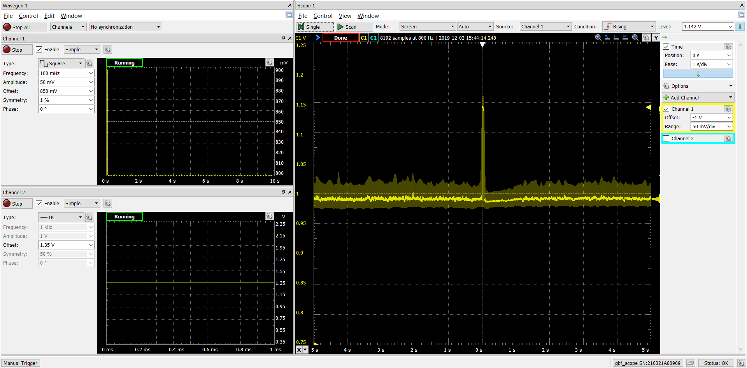
Characterization:
Send the same signal and values as in the example:
Square signal, frequency = 1Hz, amplitude = 50mV, offset = 850mV
DC value, offset = 1,34V
Determine characteristics of the neuron:
Mean refractory period (calculated over 13 periods) = 186ms
Amplitude of spikes = 154mV
Influence of Na channel:
1.35V: almost no excitation
1,33: almost always excited → overlapping of spikes ?
No evident influence of the input signal on the answer (falling fronts inhibit spikes?)
Difficult reproducibility: wires/contact involved, shift in amplitude, change of the optimal Na channel value…

