Slide 1

Brain inspired computing
using a FPAA Board
10/23 catch-up session
Further testing of the HHN block design
Matthieu Divet
Jonathan Gomis
Annie Luo
Anonto Zaman
Special problem
ECE 8903
Dr. Alexandre Locquet
Dr. Damien Rontani

Slide 2
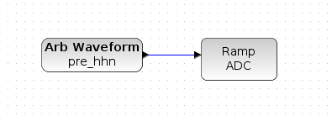
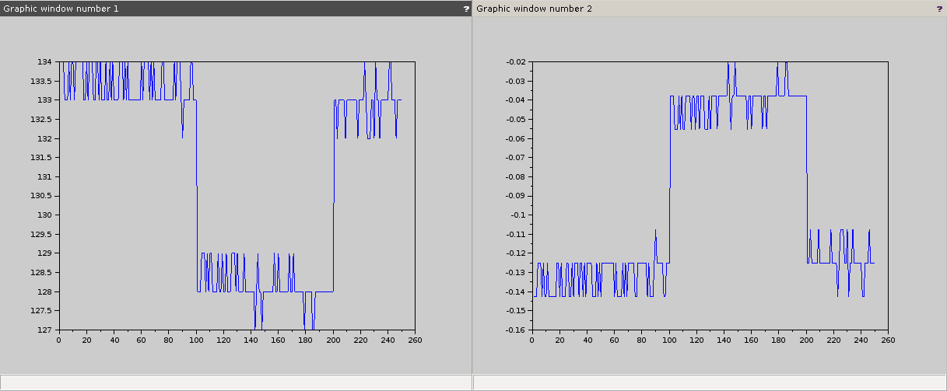
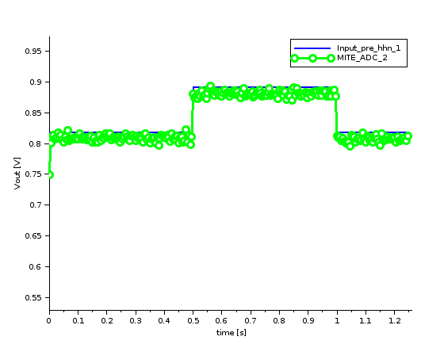
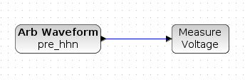
Test different blocks separately to try finding out which one the problem may come from:
Arb Waveform:
Tested with both ‘Ramp ADC’ and ‘Measure Voltage’ blocks
No problem
DC Voltage:
Send a single value
FG OTA:
No problem
Already used when implementing LPF off-chip
Ramp ADC:
Tested with only a simple square input
Still 2 windows
Expected time length and amplitude difference on the second
Still interrogations about the first one
Expected amplitude
Expected time length
Looks like the opposite, but different amplitude

Slide 3
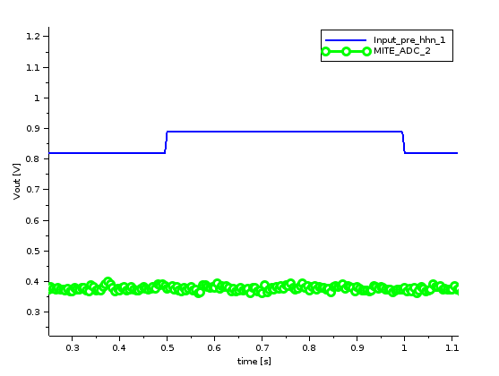
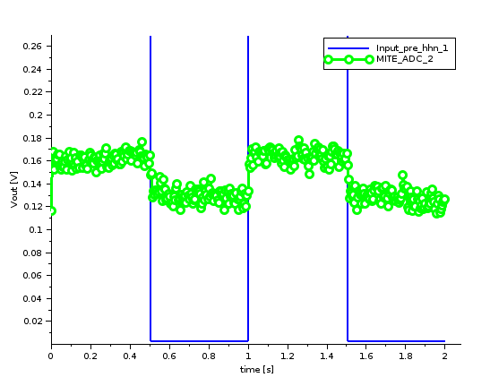
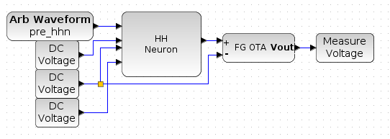
Same design with just ‘Measure Voltage’ block instead of ‘Ramp ADC’:
Compile and program without trouble
The input is in blue and the output in green
Tested with two different signals:
The one already implemented by Pr.Hasler on the left
No spike
f = 1Hz, amplitude = 1.25V, offset = 1.25V
No spike but looks like it follows the input if we zoom on the output

Slide 4
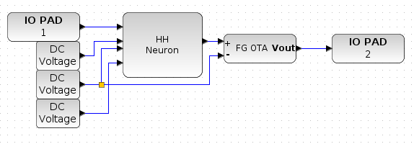
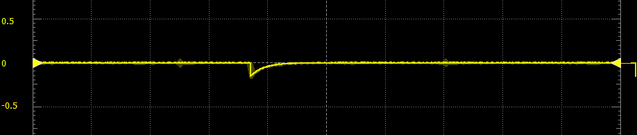
Test the design with an off-chip input:
f = 1Hz, amplitude = 1.25V, offset = 1.25V
Get an answer
Depends on the amplitude:
<800V : nothing
>900V : answser
HYPOTHESIS : Pr.Hasler’s input isn’t the signal but the step values
Same result for a sweep of amplitude between 800mV and 900mV in 1ms.

