Slide 1

Brain inspired computing
using a FPAA Board
2nd week catch-up session
Collective work on the chip to continue getting familiar with it and explore its boundaries
Matthieu Divet
Jonathan Gomis
Annie Luo
Anonto Zaman
Special problem
ECE 8903
Dr. Alexandre Locquet
Dr. Damien Rontani

Slide 2
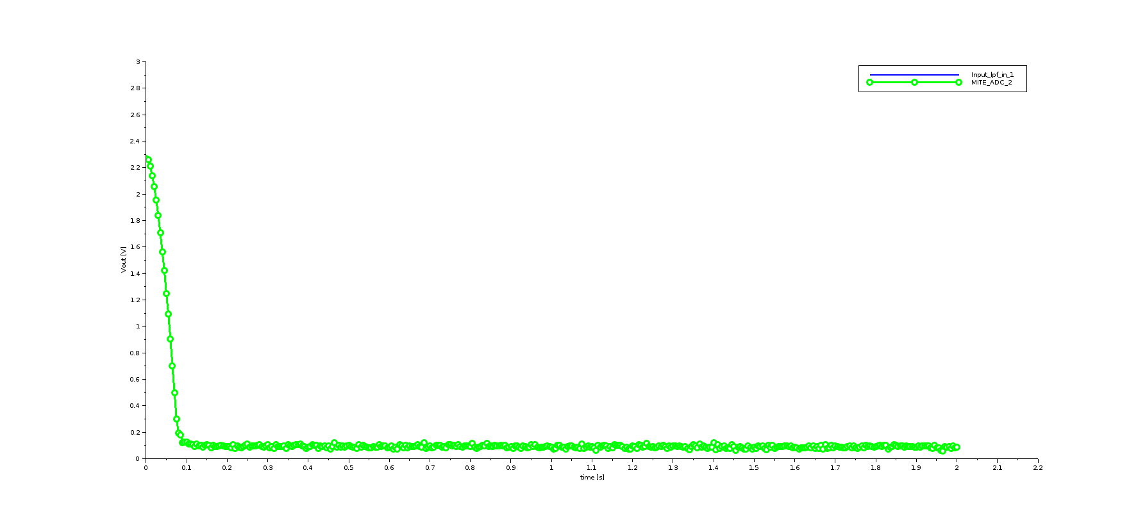
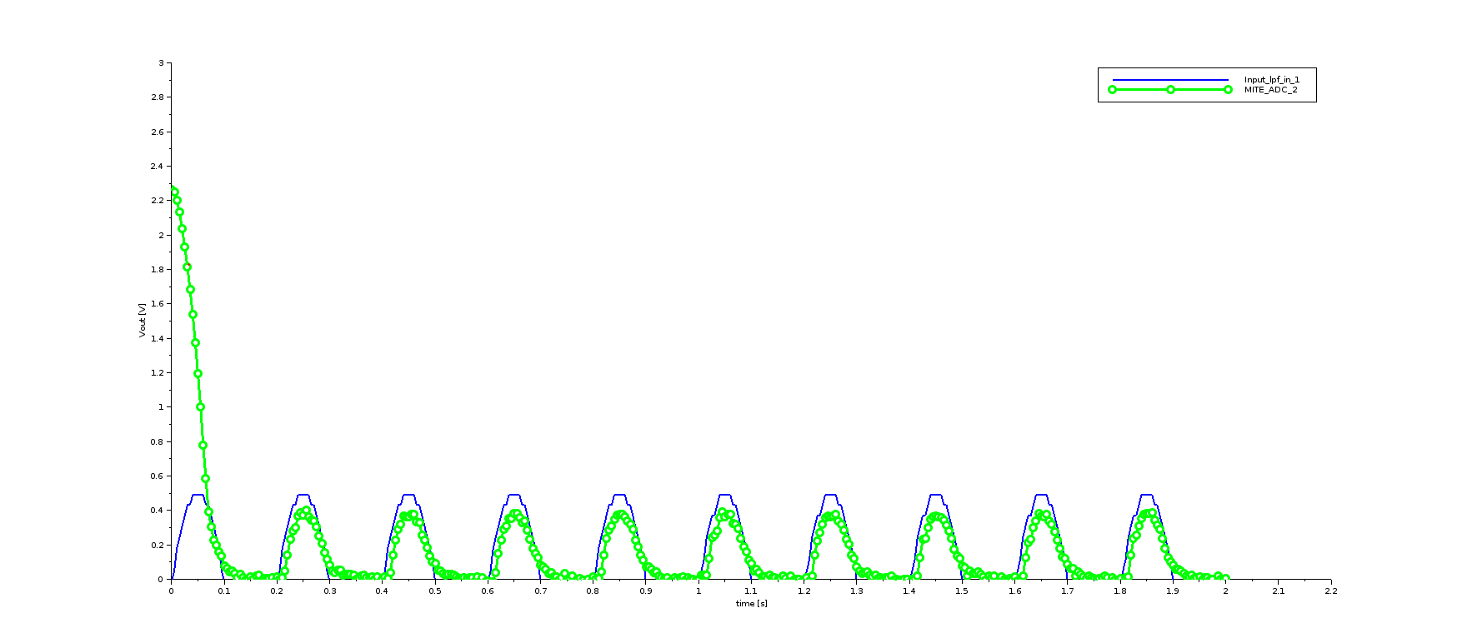
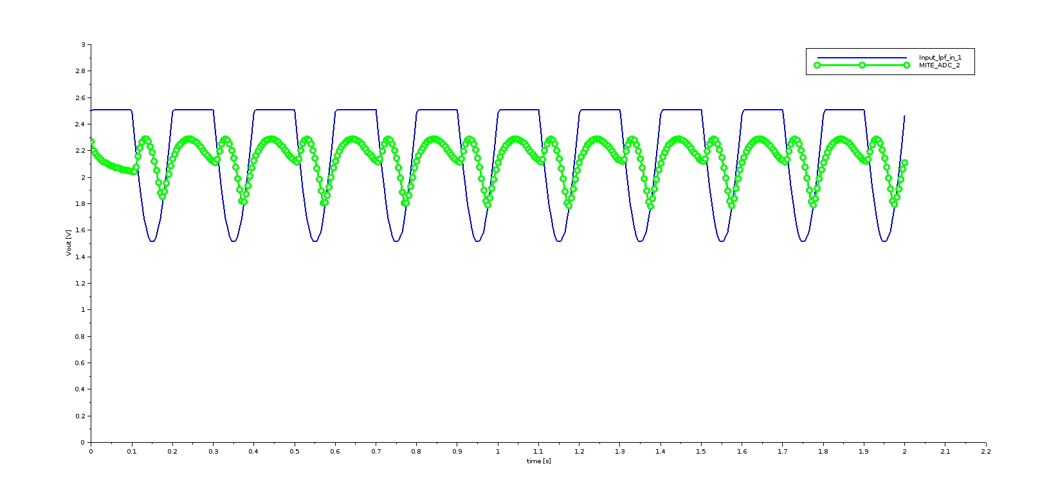
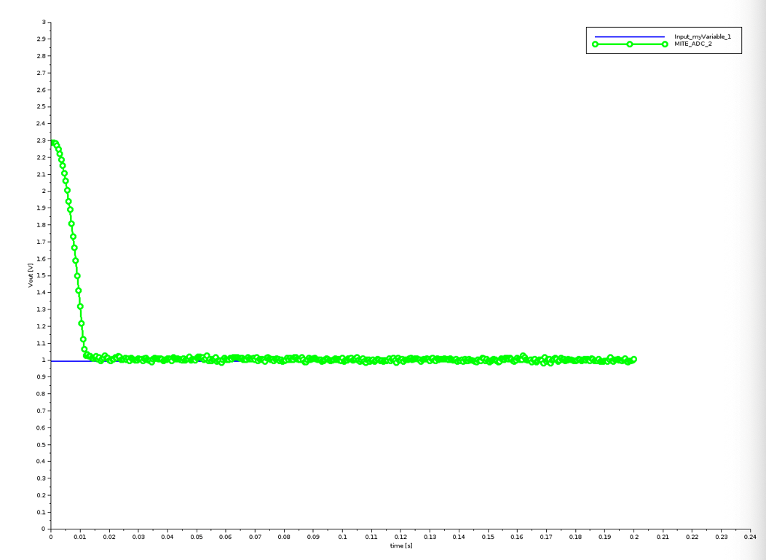
Redoing the tutorial with the undergraduate students:
Test the limits in terms of offset and amplitude
Amplitude between 0 and 2.5
No negative signal
Testing with a higher frequency
Try with f = 100Hz
The sample rate needs to be higher than 200Hz, however it’s written “(0-200Hz)”
We chose a sample rate of 2000Hz
Still no signal: sample rate automatically set to 200Hz if higher ?
How can we reach kHz frequencies ?

Slide 3
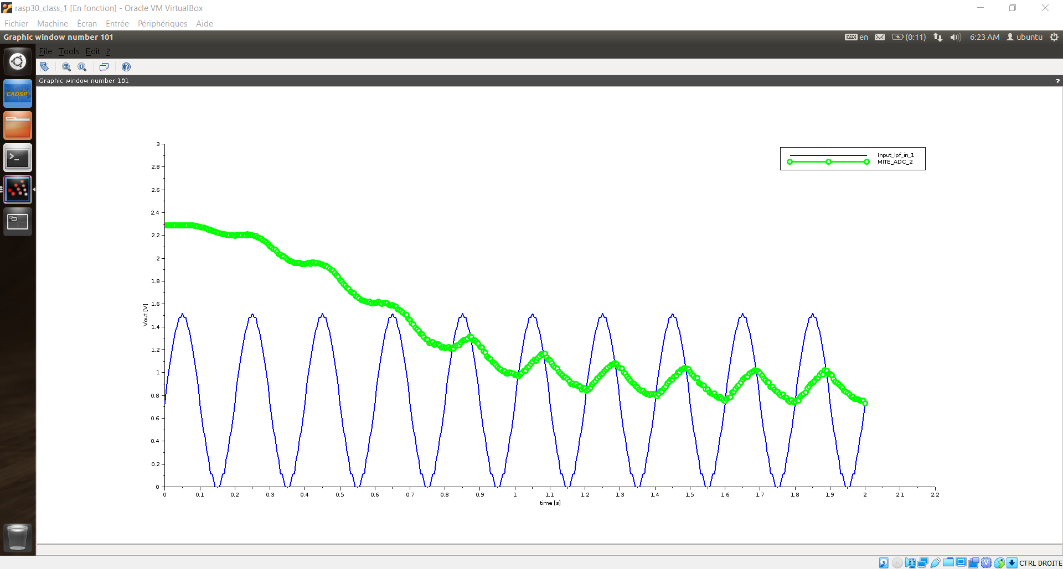
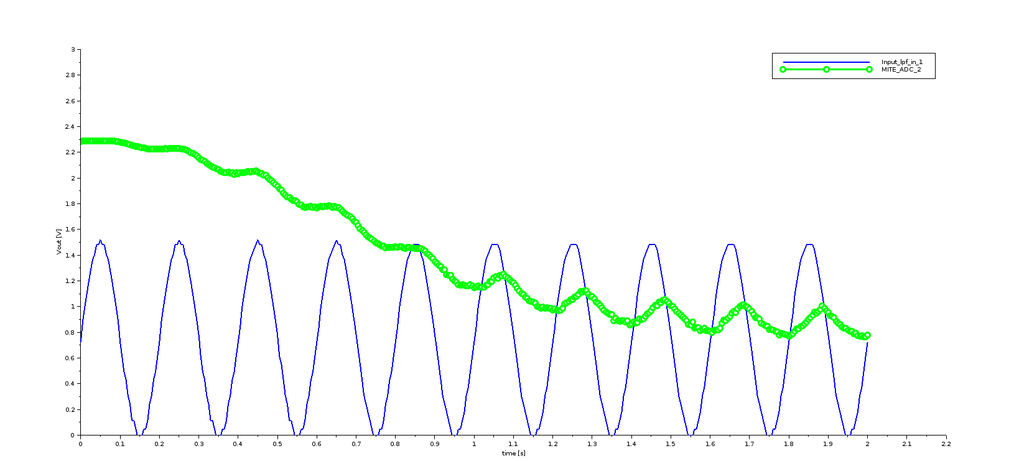
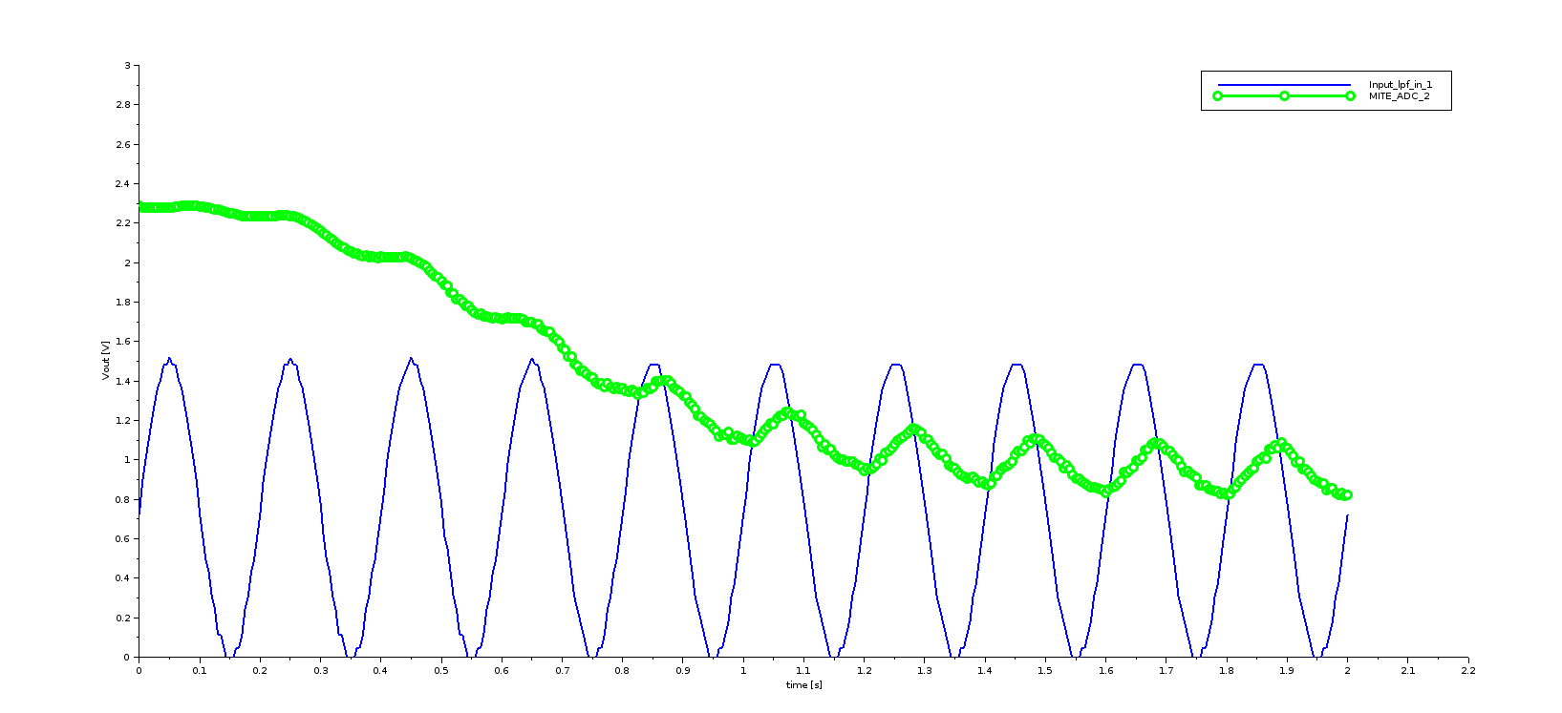
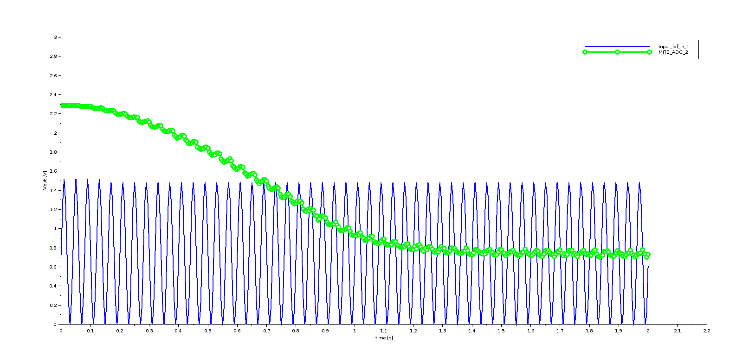
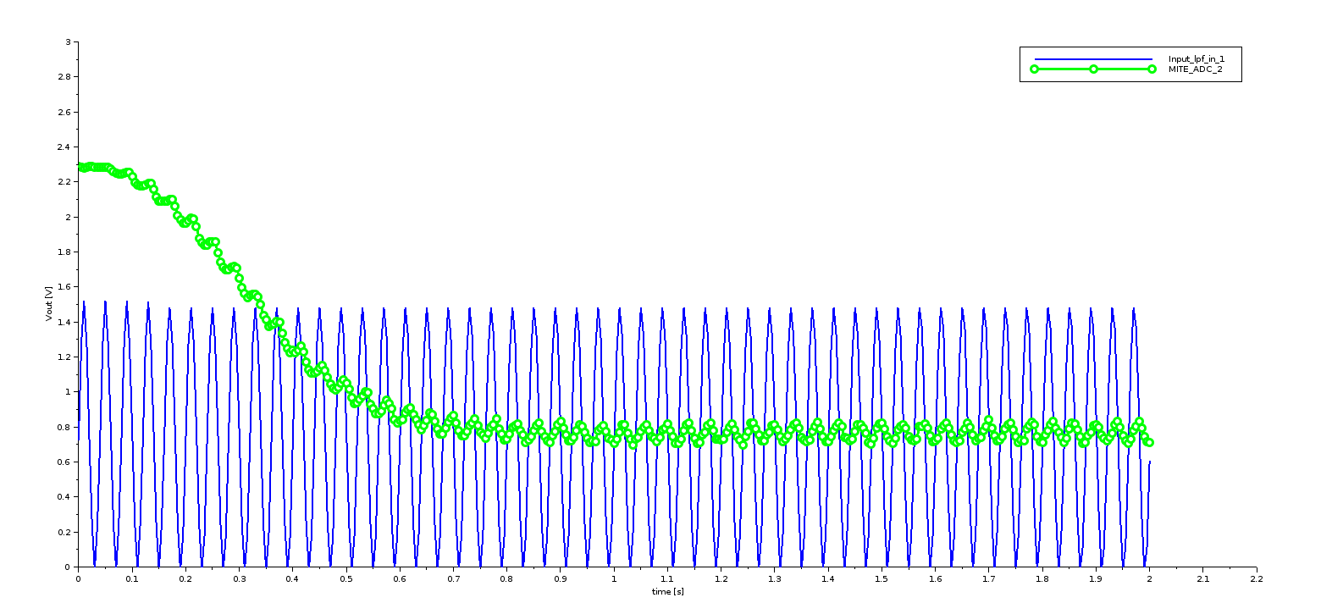
Testing the influence of the cut-off frequency on the convergence speed
After having seen the result for a signal with a frequency of 5Hz and a cut-off frequency of 2.5Hz, we wanted to test how the convergence time is affected by the cut-off frequency.
Keep all other parameters : sample rate = 200Hz, signal offset = 0,75V, signal amplitude = 0,75V
Performed several tests with different cut-off frequencies values:
Signal_freq = 5Hz; Cut-off_freq = 1Hz
Signal_freq = 5Hz; Cut-off_freq = 4Hz
To make the difference even more obvious, we tried with higher values of frequency:
Signal_freq = 25Hz; Cut-off_freq = 10Hz
Signal_freq = 25Hz; Cut-off_freq = 20Hz
Last week result:
This week results:
1)
2)
3)
4)

Slide 4
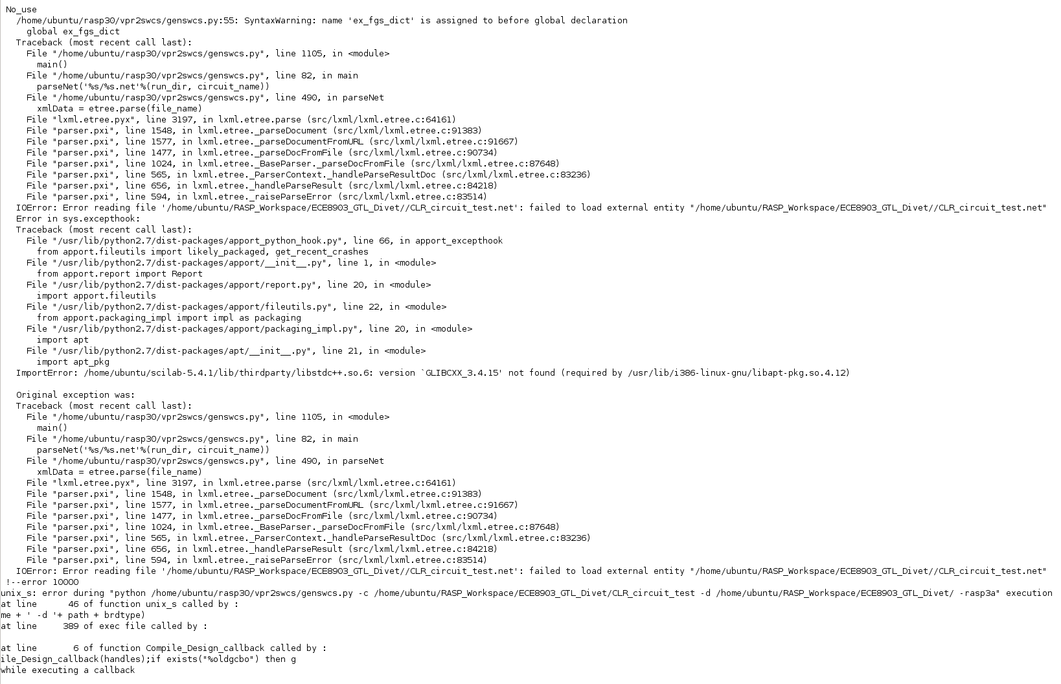
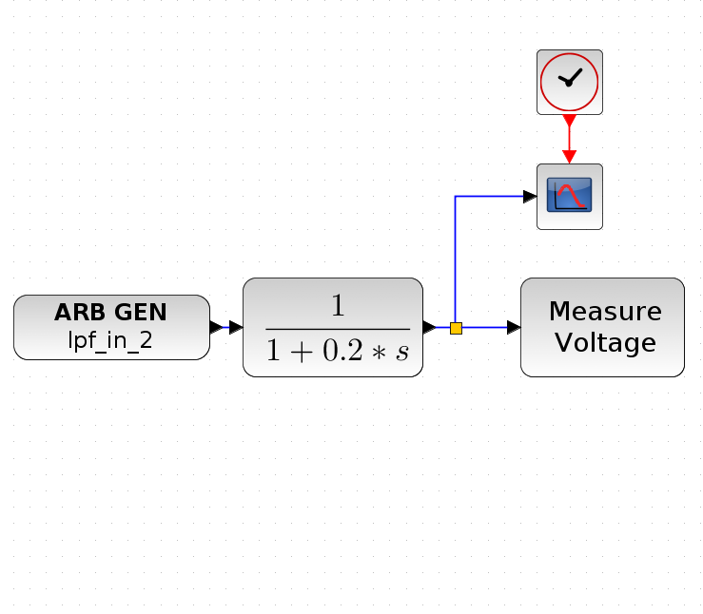
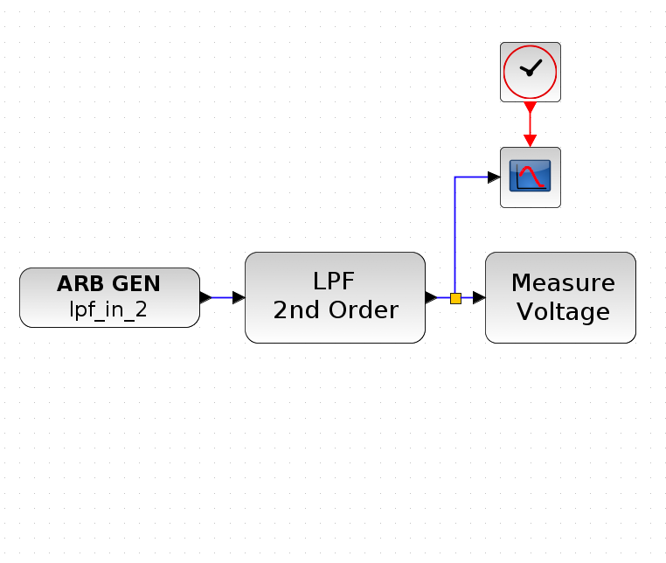
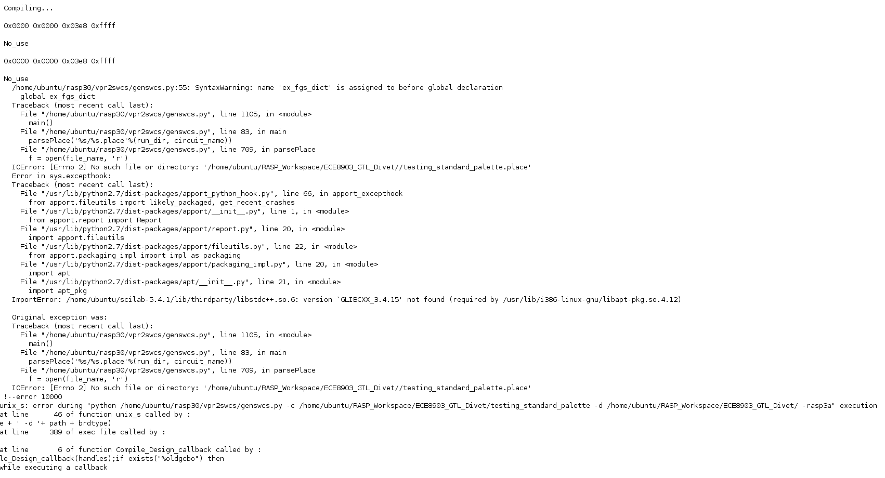
Trying again a different on-chip LPF design on our FPAA Board
Last week, we tried implementing blocks from the traditional Xcos palette for the CLR model:
Unsuccessful: the design couldn’t compile
We tried now mixing both traditional Xcos and FPAA palettes blocks:
Unsuccessful: none of the designs compiled
Questions:
The demo LPF design uses blocks from the Xcos palette
We tried to implement Xcos blocks in the working design (replacing the source with a standard source or the LPF block with a transfer function block) but nothing worked (Reading error)
The design will not compile if does not contain the “Measure voltage” block (No such directory error)

