Slide 1

Brain inspired computing
using a FPAA Board
5th week catch-up session
Work on the Hodgkin Huxley neuron block
Matthieu Divet
Jonathan Gomis
Annie Luo
Anonto Zaman
Special problem
ECE 8903
Dr. Alexandre Locquet
Dr. Damien Rontani

Slide 2
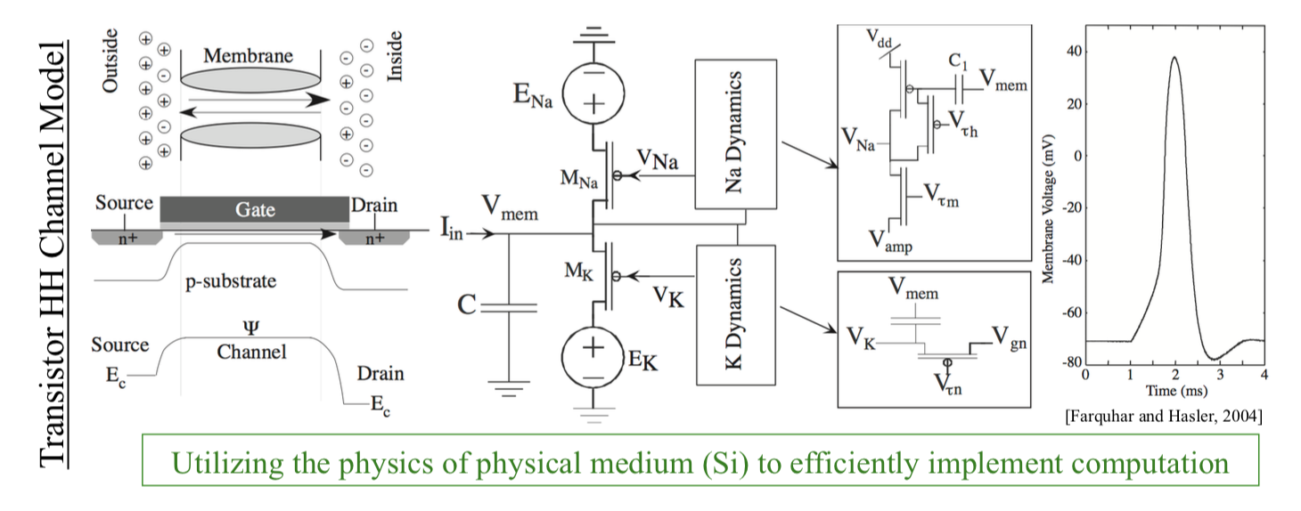
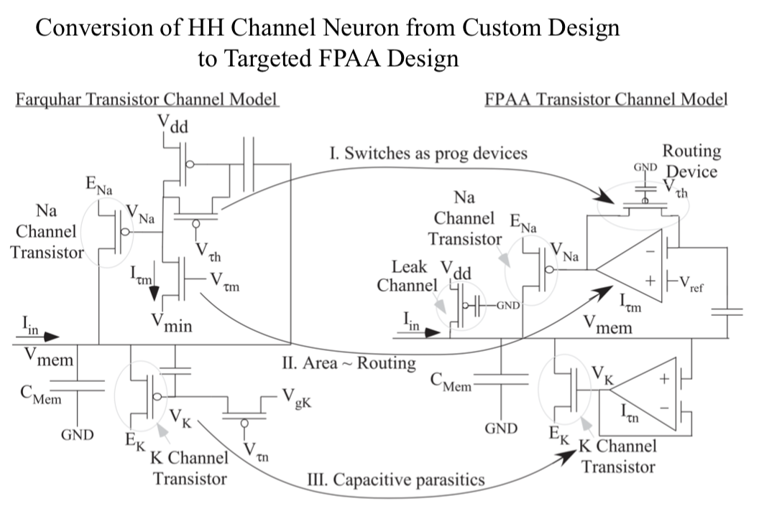
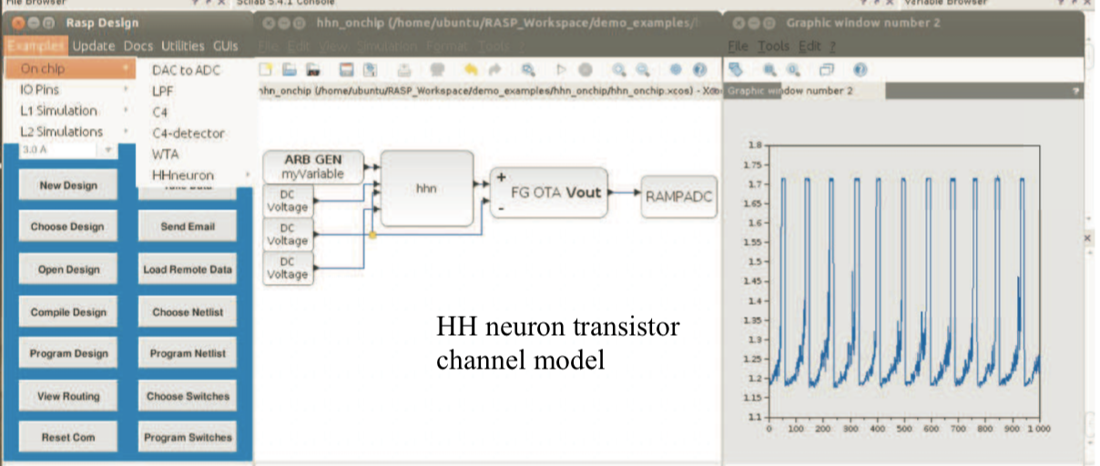
Extract from the document sent to Pr. Hasler
Extract from Pr. Hasler’s FPAA Workshop video on the HH neuron
“
Parameters used during these first tests and assumptions that we believe to be true:
we think the ‘pre_hhn’ is the input signal. Is that the case? We generated it on-chip (we tried different wave forms – sinusoidal and square, frequencies and amplitudes).
We assumed the “DC Voltage” blocks are three constant input values that set the Na and K electrochemical potentials and the excitement threshold. Is V_{ref} really this threshold?
We added a ‘clock’ block and a ‘scope’ block to read the output from the wire between the block circled in green on the picture above and the ‘Measure Voltage’ block. Is that what we are supposed to read as an output of the neuron?
Other questions we have still not figured out:
what are we supposed to use the “IO PAD” blocks for? During the tests we had nothing connected to the board. Are we supposed to apply some kind of voltage or signal to the physical pins on the board represented by these blocks? Are pins 40, 41 and 42 particular in any way?
What the block circled in green does and what are the different inputs it takes and outputs it produces? This is probably the main question that has been blocking us from fully understanding the design, it would be very helpful to be taken through the process of this block diagram.
✅
❌
✅
❓
❓
“

Slide 3
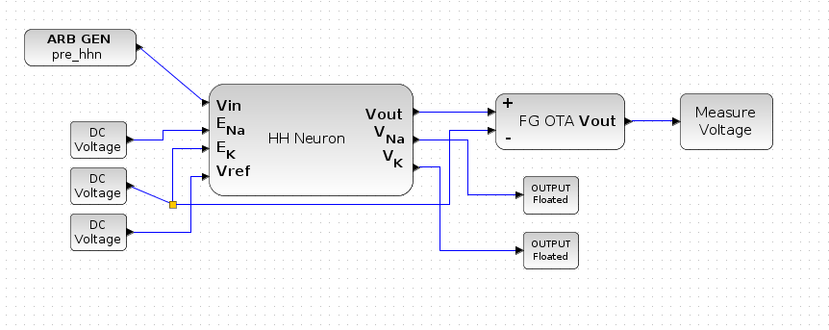
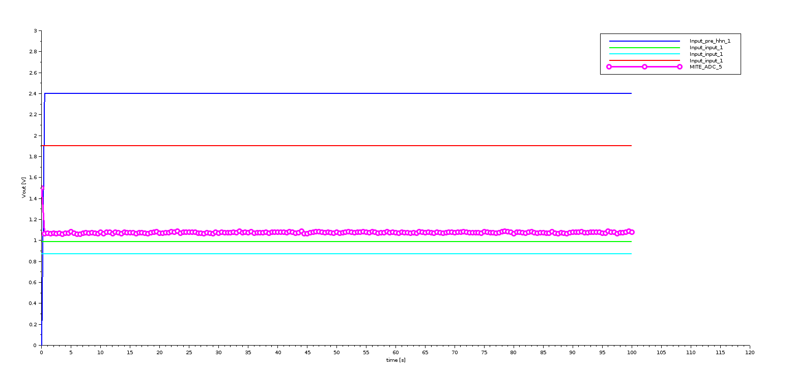
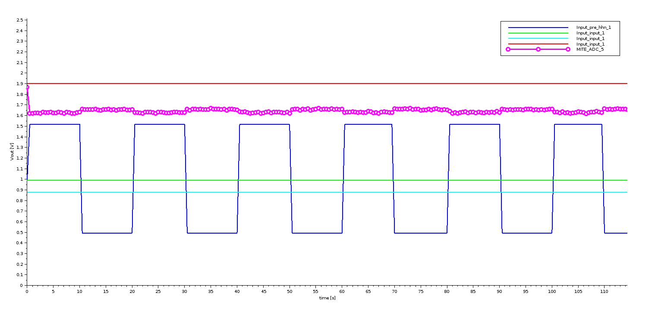
Testing the new HH neuron design
It is exactly the same design as tested last week, but we added an amplifier on the output of the neuron as Dr. Hasler did on her design
Just like last week, we obtained unexpected results for different signals
We would still like to ask some questions to Dr. Hasler
Starting with the fact that our block is different from Dr. Hasler’s (we have 3 outputs she only has 1):
Is the big block that appears in the default design included in Dr. Hasler’s version of the HH neuron block?
Are we supposed to use the V_{Na} and the V_{K} in some kind of retroactive loop (see electronic implementation schematics)

