Slide 1
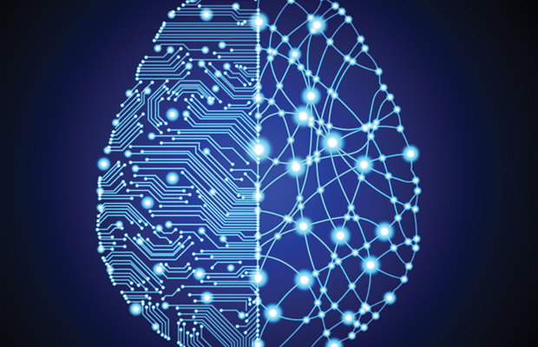
Brain inspired computing
using a FPAA Board
11/13 catch-up session
Further testing of the HHN block design
Matthieu Divet
Jonathan Gomis
Annie Luo
Anonto Zaman
Special problem
ECE 8903
Dr. Alexandre Locquet
Dr. Damien Rontani

Slide 2
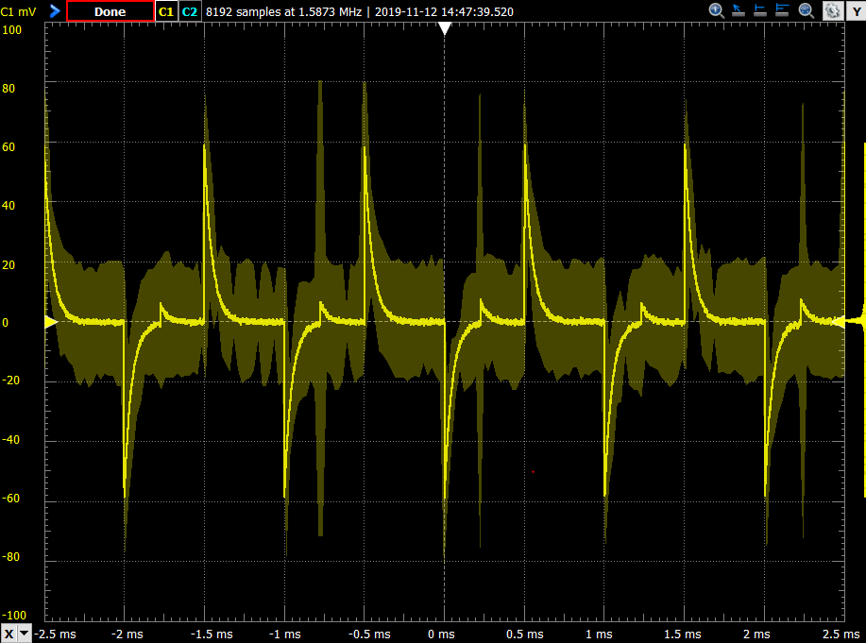
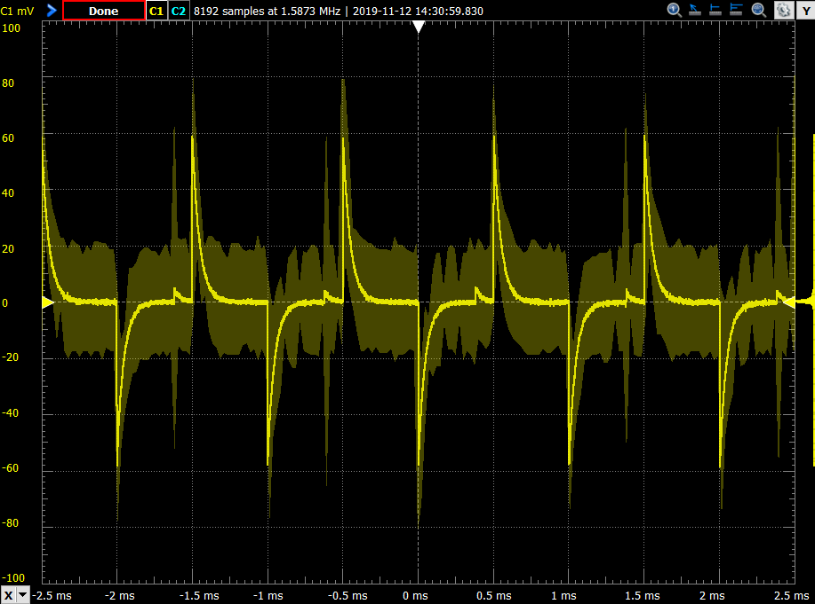
Playing with the parameters while still using an external signal:
Modulate different parameters from both HHN block and OTA block
Change the order of magnitude
No apparent influence, similar answer
A small spike appears and move constantly on the left
No indication on the parameter role
Playing with the parameters of the HHN block
Playing with the parameters of the OTA block

Slide 3
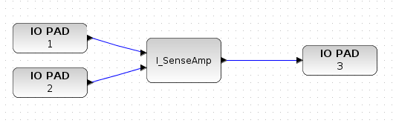
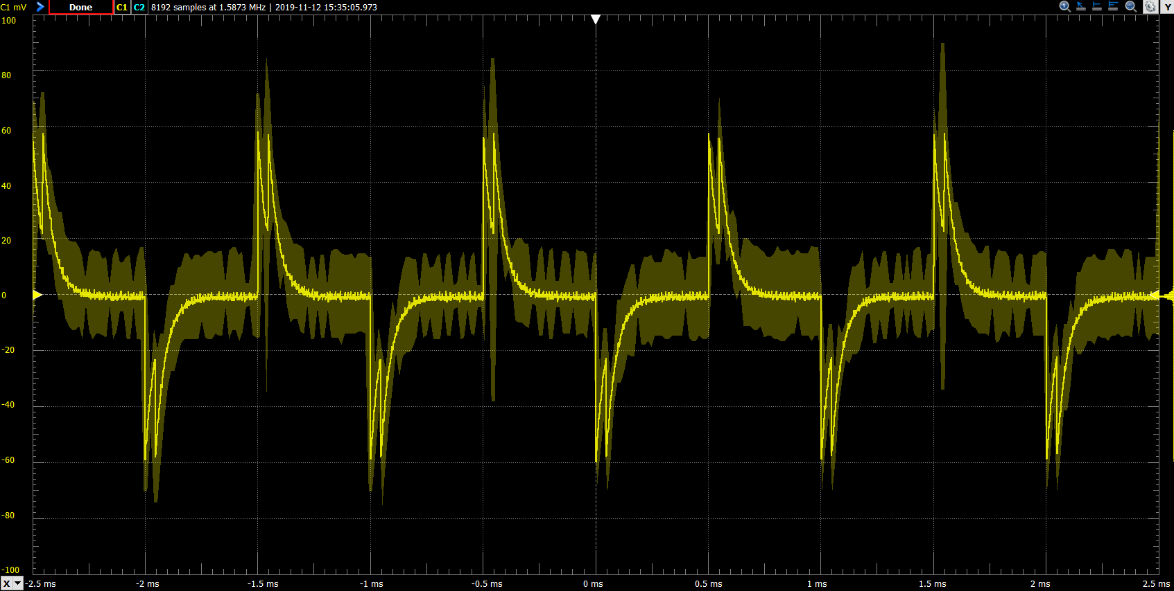
Test different blocks with several inputs and only one output:
I_SenseAmp:
Two ‘spikes’ close to each other, the space between them is modulated by the phase shift between the two signals
ota:
Same answer as for the ‘I_SenseAmp’ block
signalmult:
Doesn’t compile because it requires 4 inputs and 2 outputs exactly
join:
Not interesting here because can have several output but only one input
Try to join ‘IO PAD 1’ to ‘IO PAD 3’ directly but compilation never ends…

Slide 4
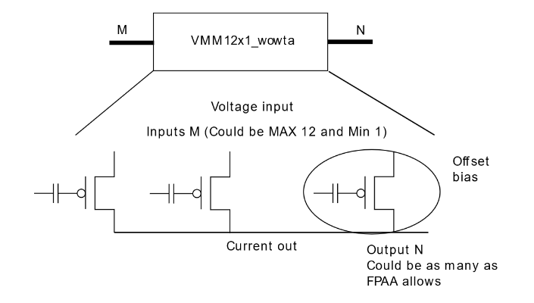
About the Figure 2 in the synapse paper, we need more explanations to fully understand the model:
Is the ‘Ramp generator’ represented by the ‘Ramp ADC’ block ?
What is the bottom right corner block’s purpose ?
How to join the outputs of several FG switches ?
"vmm12x1_wowta“ block looks like 12 FG switches in parallel and should operate the join operation according to the documentation
It looks as if we need to join the signals before sending them into the bock (the input is an array)
Is the Figure 2 the representation of the mentioned block, which is not published yet (neuron + synapse already combined) ?
If so, how to build a network from it ?
What is the "synaptic cleft" in the xcos model ?
About the HHN block, we still don't have the desired behavior:
Is our set of parameters correct ?
What are their influence on the system ?
Went through the papers:
Didn’t understand everything
No new idea since last week
Wrote up some questions

