Slide 1

Brain inspired computing
using a FPAA Board
4th week catch-up session
Try to understand the way of using the HHN model block
Matthieu Divet
Jonathan Gomis
Special problem
ECE 8903
Dr. Alexandre Locquet
Dr. Damien Rontani

Slide 2
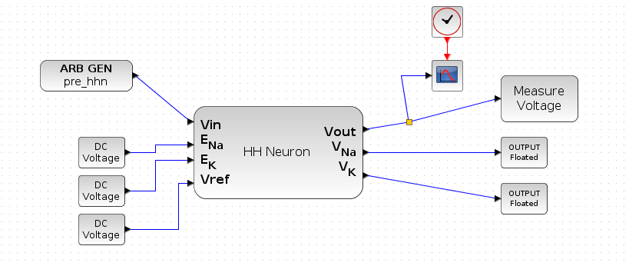
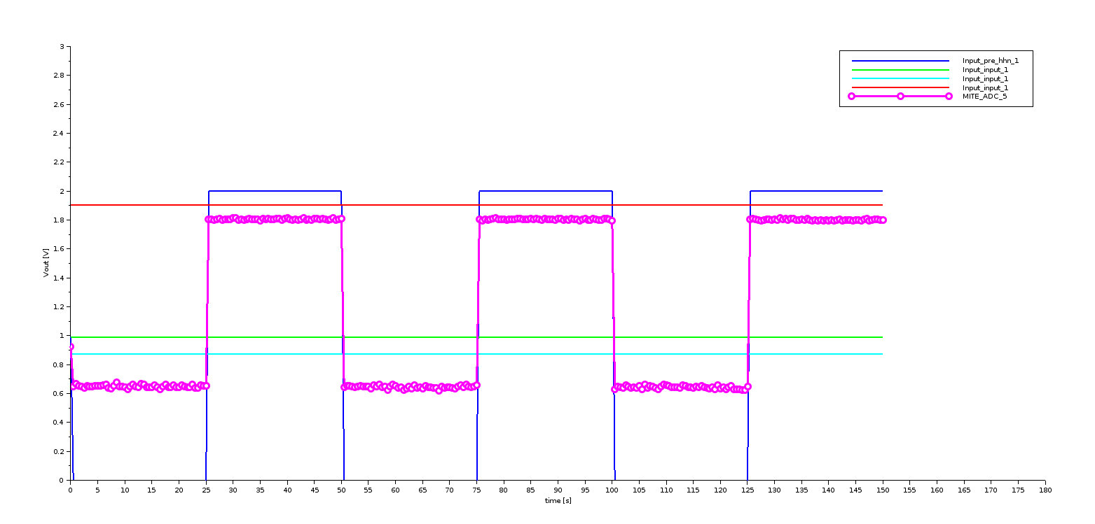
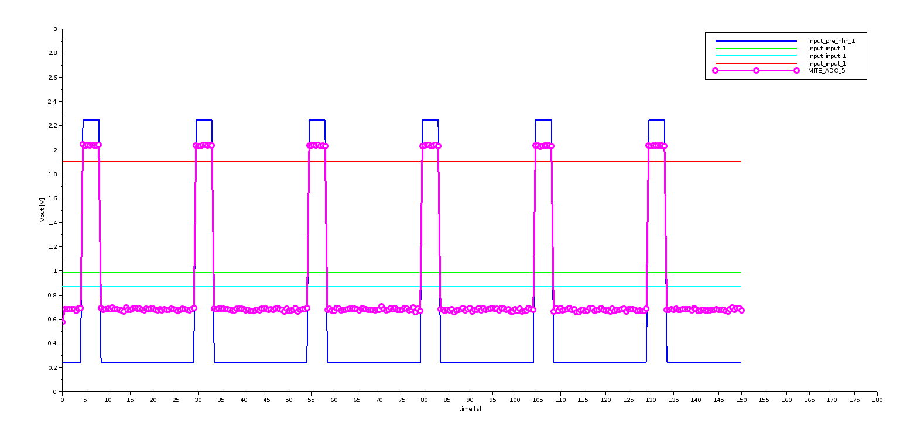
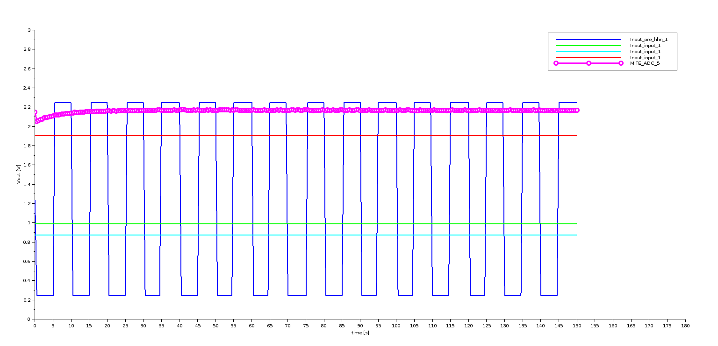
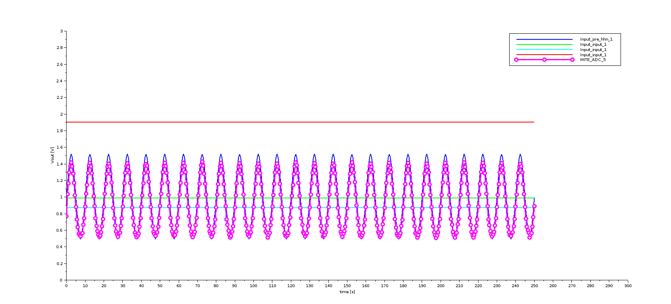
Test the HHN block on-chip:
Create a new design:
Input : the signal ‘pre_hhn’ and the tree DC Voltage boxes
We read the V_{out} (in pink on the graphs) which is our interesting value
Generate answers for various signals to understand how it works:
What we supposed about this block:
Peaks when excitation
In red line is the threshold to generate an excitation
There may be a recovery time between two excitations

Slide 3
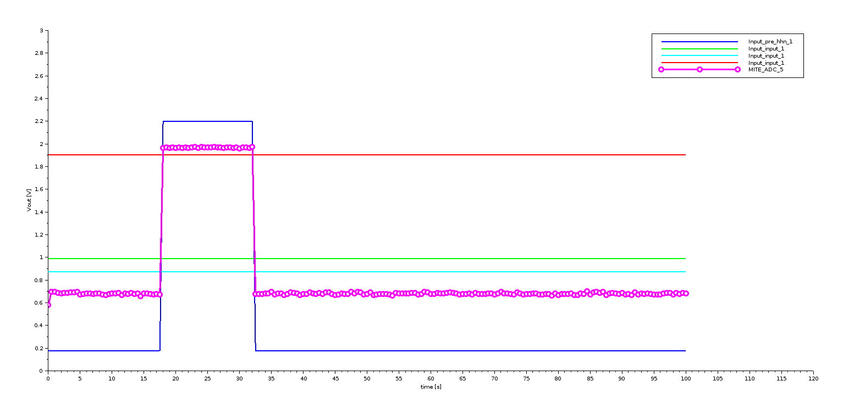
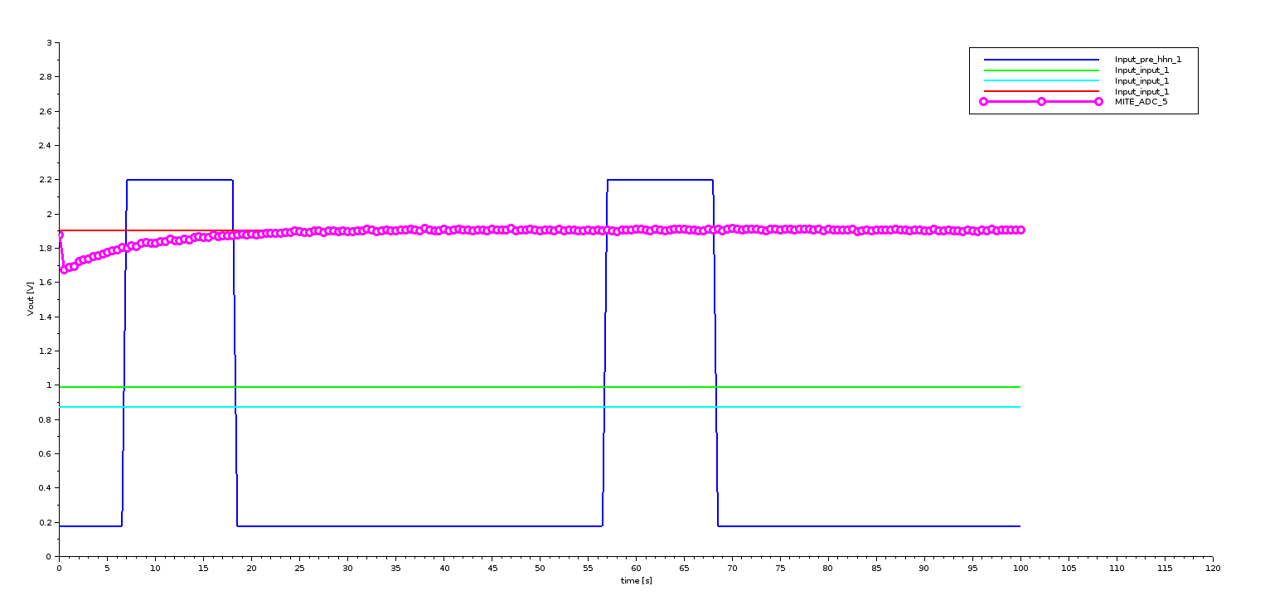
We still have a lot of interrogations:
Sometimes it follows the blue curve and sometimes not
We thought it was because of a ‘recovery time’ but apparently not…
Sometimes it starts from a low value and sometimes it doesn’t
It may go higher than the red line but sometimes not (maximum value ?)
It looks as if each result is a bit uncertain, not ‘plug and play’

