Slide 1

Brain inspired computing
using a FPAA Board
4th week catch-up session
Writing the FPAA/Digilent guide and implementing the lowpass filter using Digilent
Matthieu Divet
Jonathan Gomis
Annie Luo
Anonto Zaman
Special problem
ECE 8903
Dr. Alexandre Locquet
Dr. Damien Rontani

Slide 2
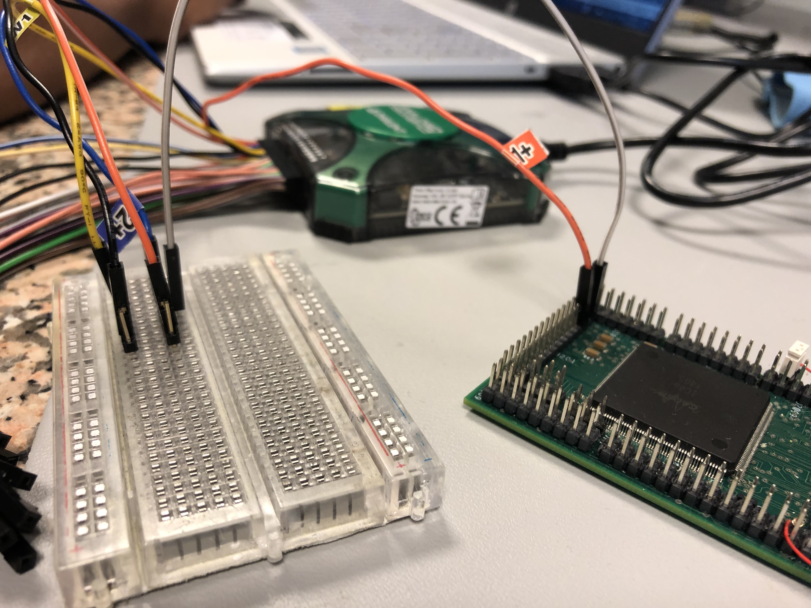
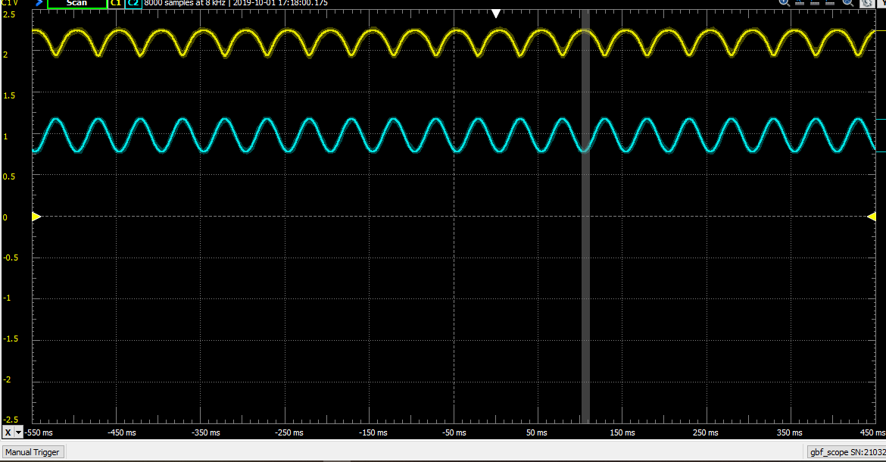
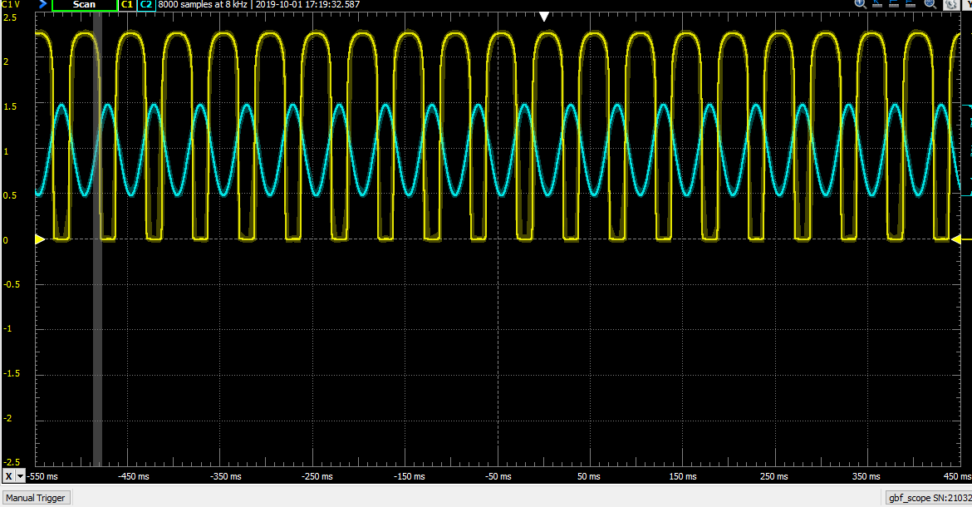
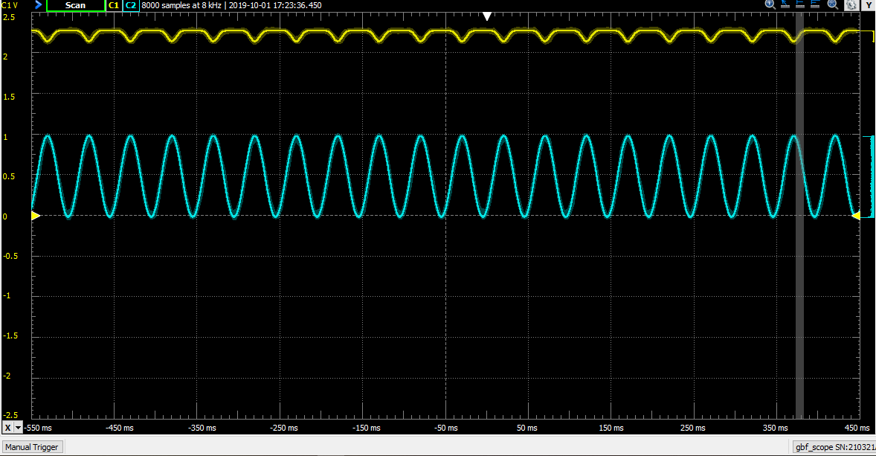
Continued off-chip tests on FPAA using Digilent Analog Discovery
Initially had some trouble with the LPF
Signal would not properly attenuate at different frequencies
Some success using an inverter
Successfully fed signals to FPAA and measured output signals from IO pins
Results were consistent across frequencies and amplitudes
20Hz, 400mVpp
1V Offset
20 Hz, 1Vpp
1V Offset
20 Hz, 1Vpp
500mV Offset

Slide 3
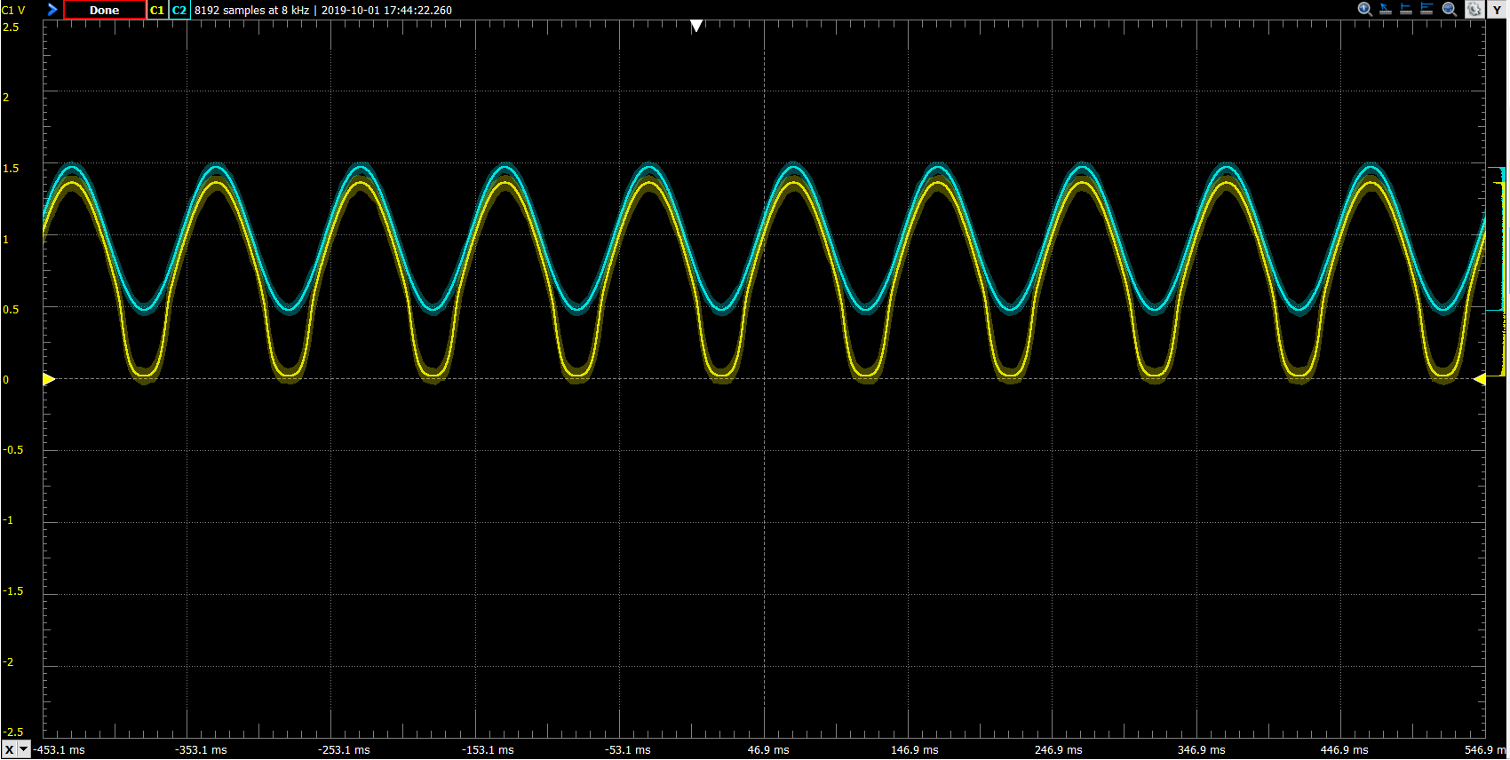
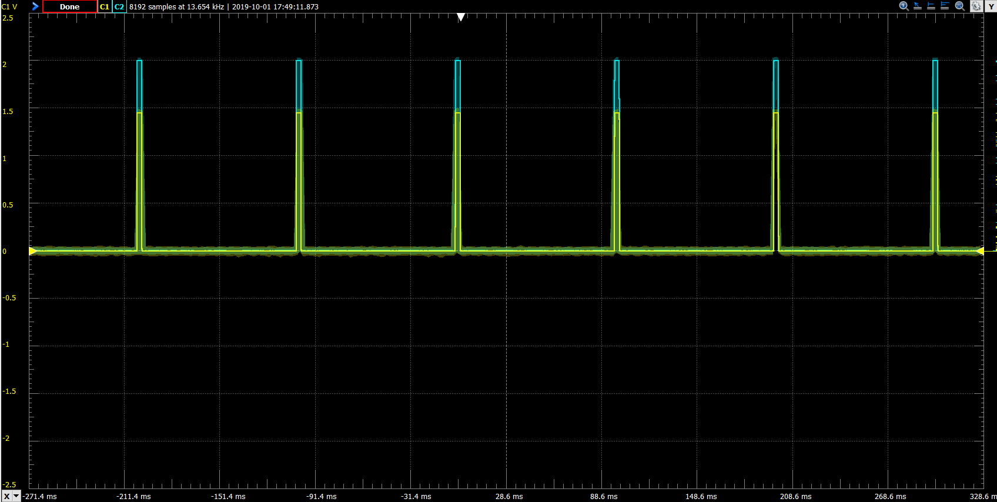
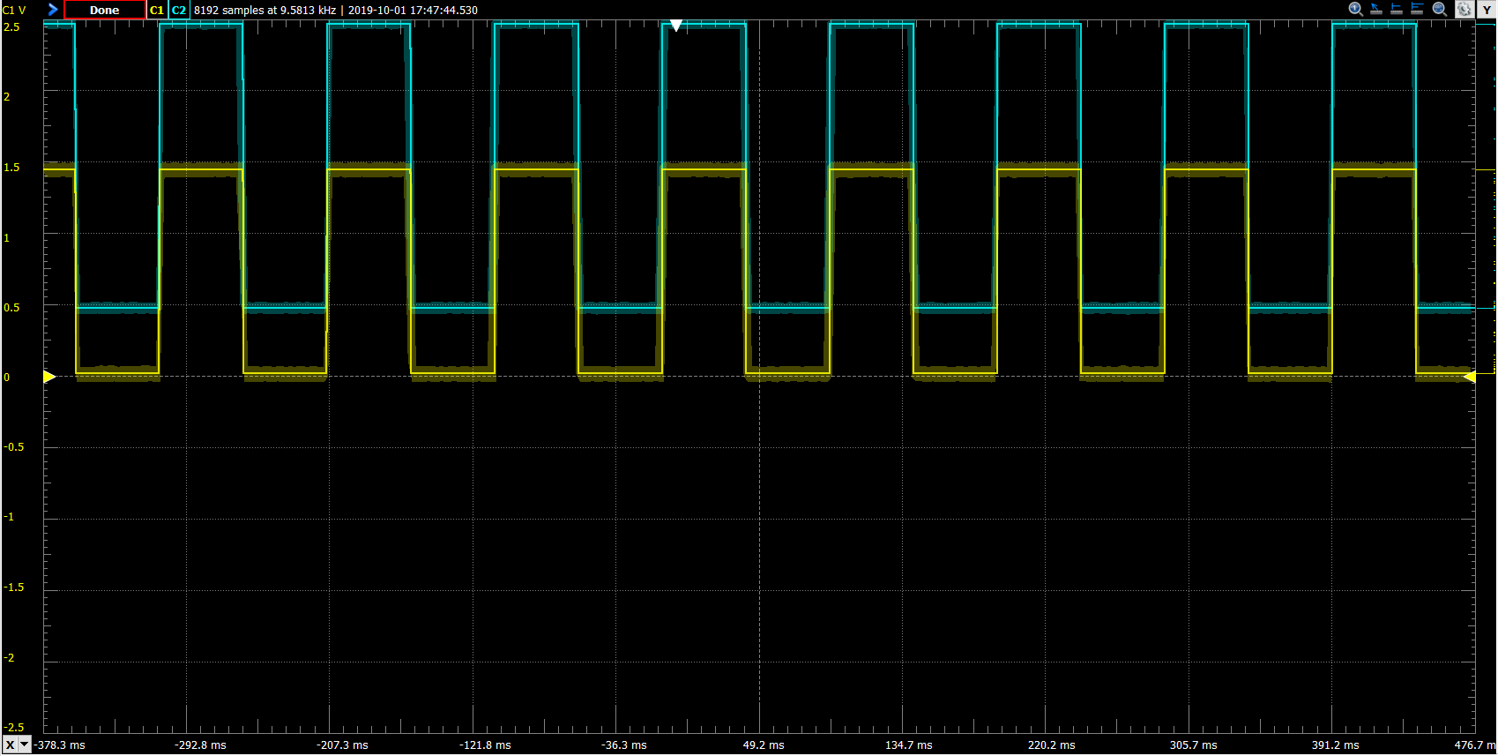
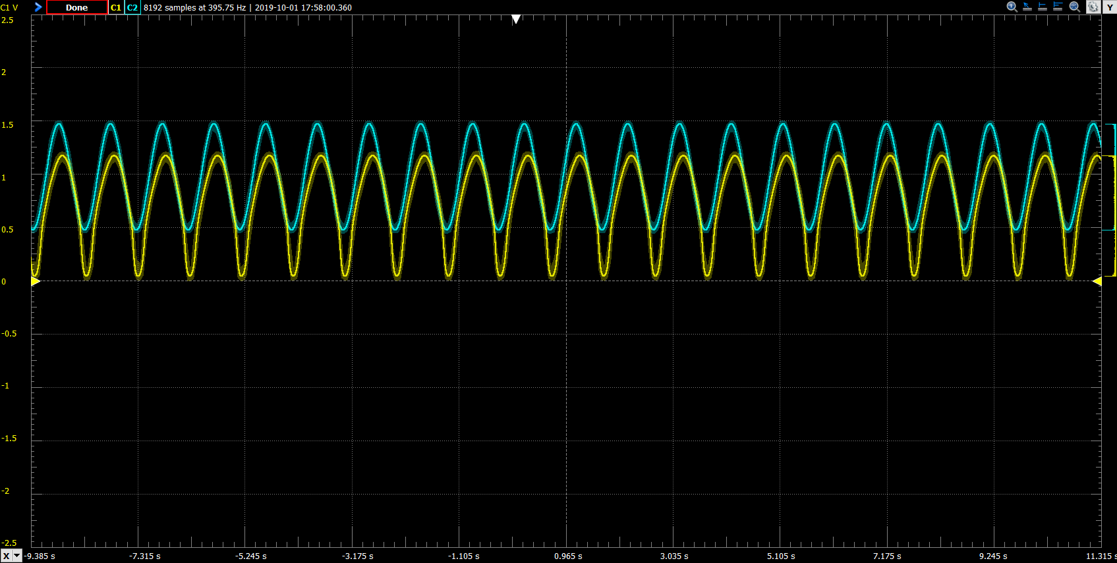
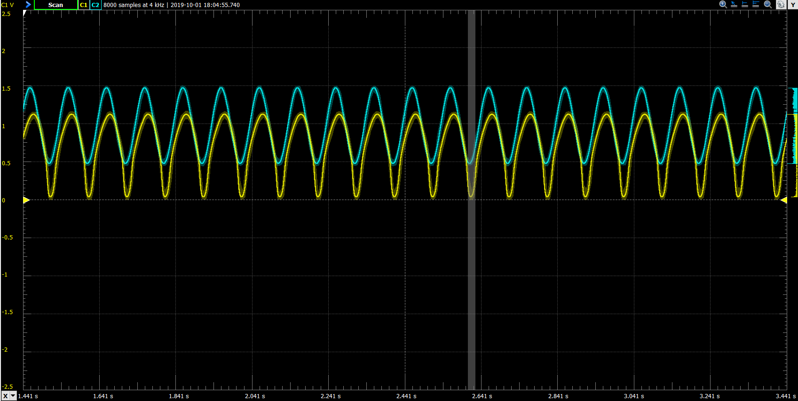
Max-Detect Captures
Further off-chip tests
Successfully demonstrated the max-detect block
Functional at different frequencies, wave shapes, and amplitudes
Successfully ran LPF test
Added a block at the input and output to make it work
LPF Captures
1Hz
10Hz

