Slide 1

Brain inspired computing
using a FPAA Board
10th week catch-up session
Work on the Hodgkin Huxley neuron block
Matthieu Divet
Jonathan Gomis
Annie Luo
Anonto Zaman
Special problem
ECE 8903
Dr. Alexandre Locquet
Dr. Damien Rontani

Slide 2
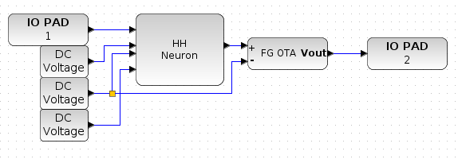
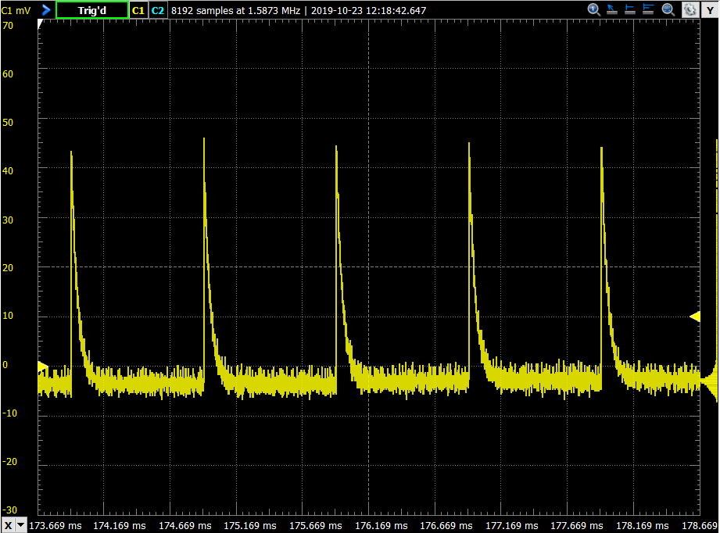
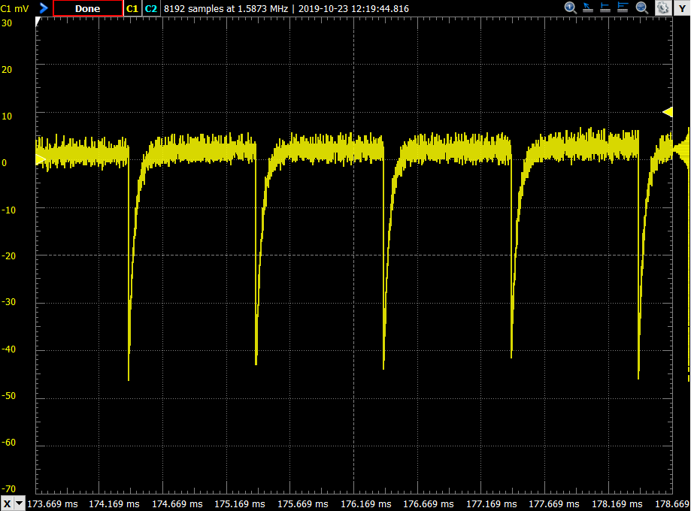
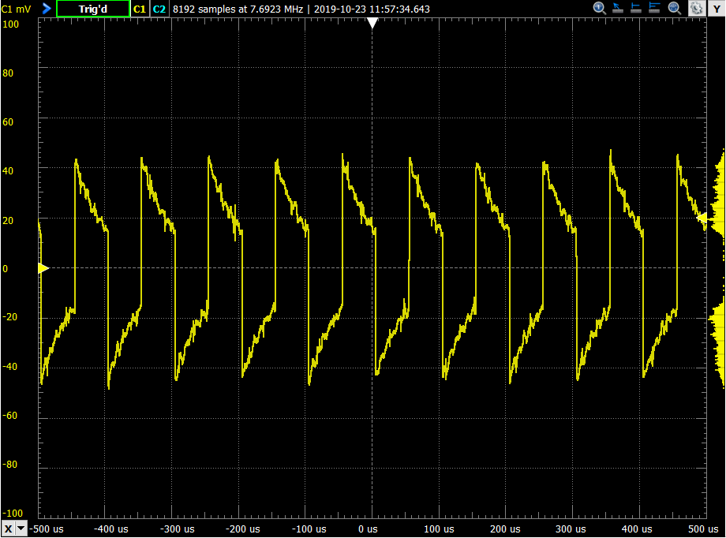
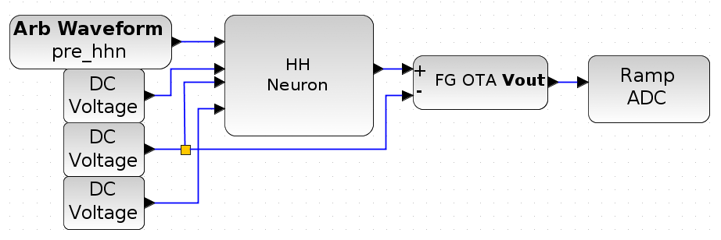
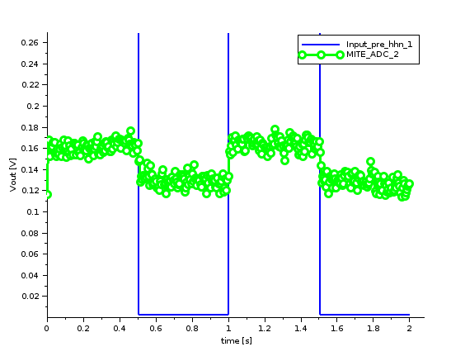
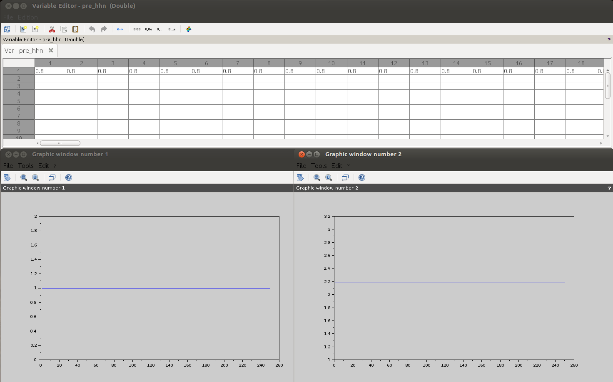
Further testing of Dr. Hasler’s HH neuron design
The default design (pre-loaded example on the blue GUI) doesn’t give the expected results. Replacing ”Ramp ADC” block with “Measure Voltage” block doesn’t seem to help either
We decided to take a direct look at the HHN behavior by using the Digilent module. So we replaced the input block (“Arb Waveform”) and the output block (“Ramp ADC”) with two “IO PAD” blocks: we now have complete control over the input signal and can study the output on an oscilloscope. These tests gave what looks like a spike, for the first time! And they allowed us to confirm that:
The neuron produces spikes when the input signal presents steps of amplitudes bigger than ~900mV (spikes of ~40mV, smaller for smaller amplitudes);
If the step is a rising step, we will observe a rising spike; conversely, if it is a falling step, we will observe a falling spike;
If the slope of the step in the input signal is too small (i.e. the input signal varies too slowly), no spike will be produced;
The refractory period of the neuron is ~0.5 ms.

Slide 3
« Looking over the measurements, the "negative" spike is certainly showing dynamics, but more a high-pass type response in a different direction. This is not really the spiking that you would expect. »
As instructed, we have sent the parameter set that we are using to Dr. Hasler. This parameter set is the pre-loaded one, so it should be working, she just wants to double check that there is no problem at that level as these results surprise her a bit.
We are waiting for her response.

Slide 4
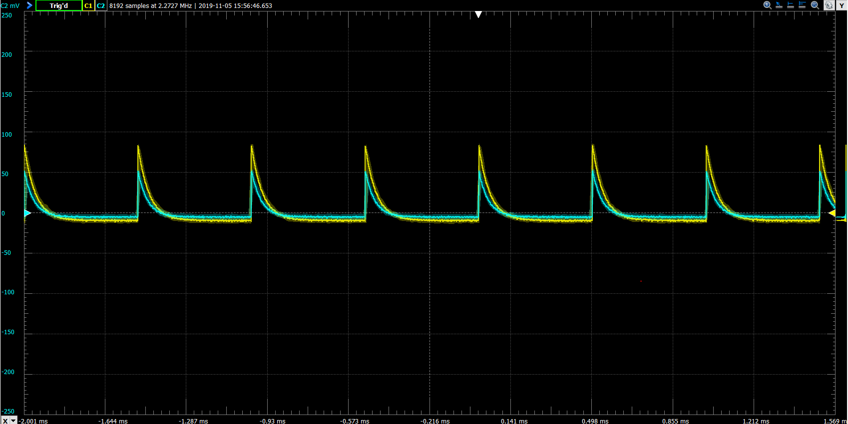
Trying to create a neural network
We tried connecting two neurons directly, using one’s output as the other one’s input. This gave the result seen on this slide.
We have searched for and found the paper Dr. Hasler mentioned during our first call. And by looking at the references made on this paper, we have found some other interesting papers on how to implement synapses on the FPAA board using the Xcos tools. All papers have been uploaded to Github.
The paper does not show a “real life” design that we could just copy and test. It shows a theoretical electric circuit that represents a neuron and its synapses. We are trying to translate that into a usable Xcos circuit! Work in progress.
We think we already have some questions we could ask Dr. Halser about this, which would make our second call even more interesting (more precise questions than just “How to do it?”).

