Slide 1

Brain inspired computing
using a FPAA Board
13 ^{th} week catch-up session
Searching for the Hodgkin Huxley neuron block’s parameters
Matthieu Divet
Jonathan Gomis
Annie Luo
Anonto Zaman
Special problem
ECE 8903
Dr. Alexandre Locquet
Dr. Damien Rontani

Slide 2
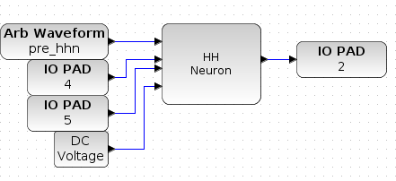
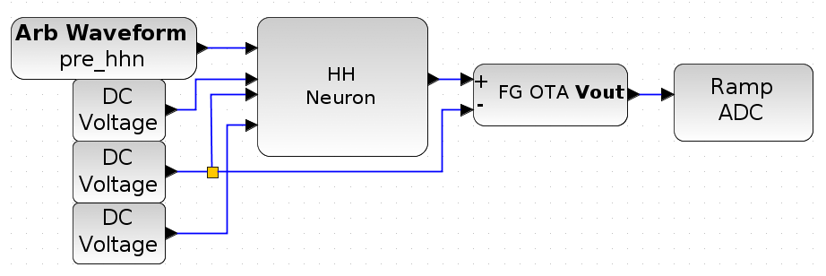
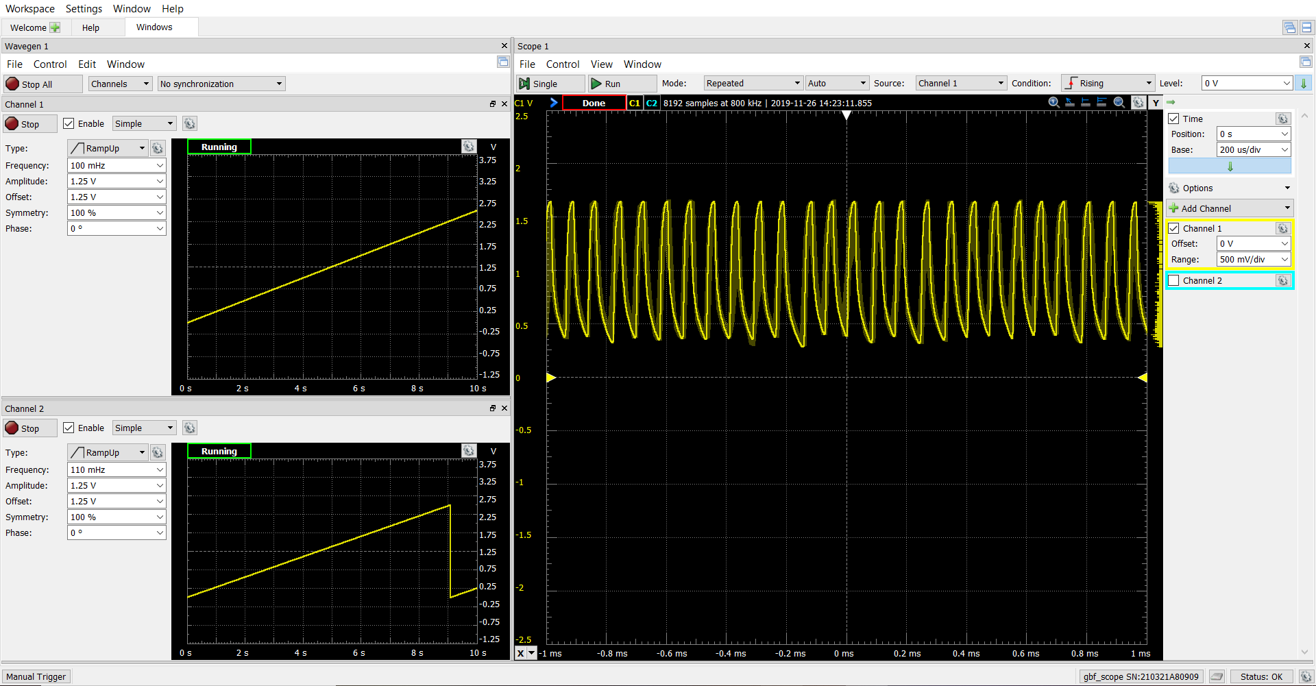
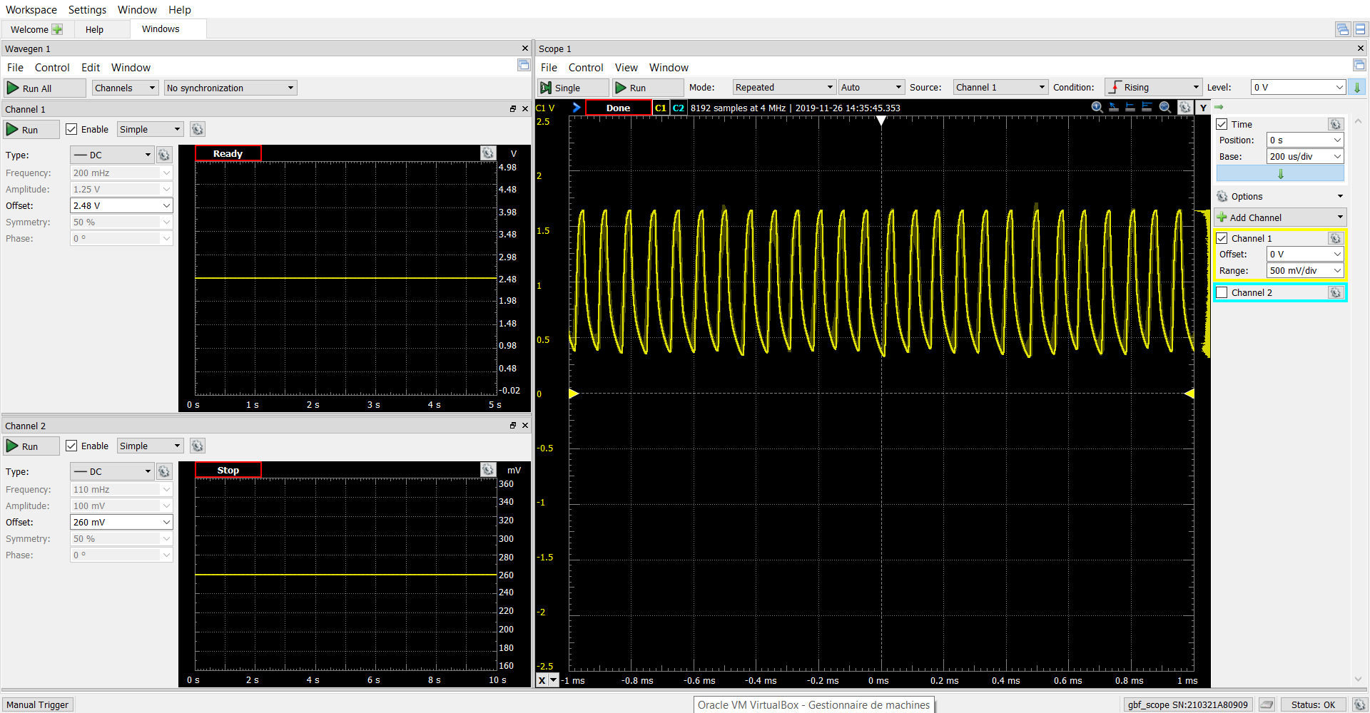
Design used for the search
Original design
Searching for the values
of the Na and K channels V_{ref}
We looked for the values of the Na and K channels V_{ref} by performing sweeps (on range [0, 2.5V], with step of 1mV)
We found that for (2.48V, 260mV) the neuron seemed to produce what looked like spikes. But we were not sure that these were not some kind of artefact => further testing.
These spikes only appear when using pin 2 as the output read pin, pin 4 as the input pin to the K channel V_{ref} and pin 5 as the pin input to the Na channel V_{ref}. Doesn’t appear when we used pins 1, 2 and 3 (in any possible combination).
We tried running the original design with (V_{ref, Na} = 260mV; V_{ref, K} = 260mV) but it returned the same result as always (flat line)
If these are real spikes, they should disappear for an input signal that is not correct. So, we tested with different definitions of pre_hhn (the original signal is a square signal from 0.8 to 0.9 V. We tried a square signal from 0.7 to 0.8 V, and a constant signal at 0.1V)
We still got the same “spikes”. We are now pretty sure they are an artefact.
Any other ideas or updates on the meeting?
We have started looking at Liquid state machines to find a task to accomplish and would like to talk with Dr. Rontani about it.

Slide 5
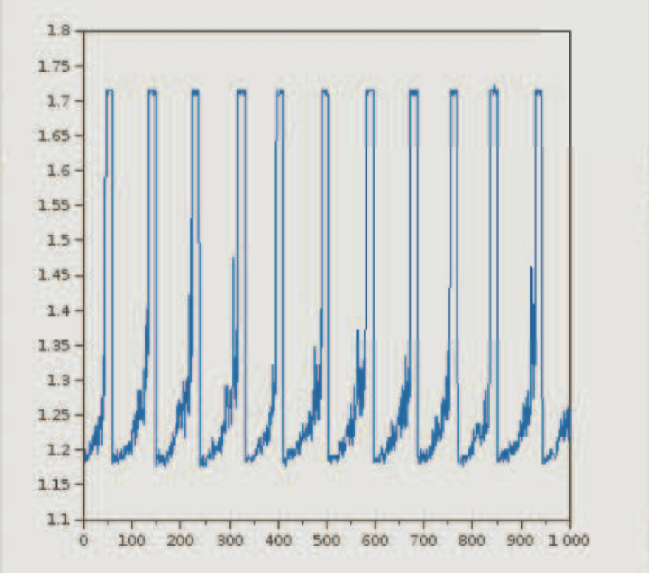
“Spikes” we found
Spikes obtained by Dr. Hasler

