Slide 1
Class 10.
Sampling and Reconstruction
Introduction to Signal Processing
CS580
(Computer Graphics Rendering)
Ulrich Neumann

Slide 2
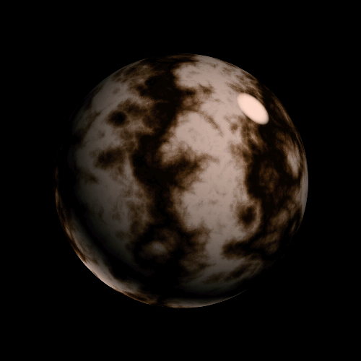
Images are Continuous Functions
Computers represent everything with discrete samples
Intuition tells us that with enough samples (of enough precision) we can capture the continuous function and re-express it everywhere, if needed (reconstruction)
Signal processing theory helps us understand how and why, and models the process
Intensity function of a scan line
Pixels values are samples with finite spacing

Slide 3
Quantization and Aliasing Errors
Quantization errors arise from insufficient accuracy of samples
  compression artifacts
Aliasing errors arise from insufficient samples in space (or time)
  Accuracy of samples is not the issue
  Aliasing creates information that is not really there
    e.g., Moire patterns (a form of noise), staircase steps along edges (edge/corner features)
  Aliasing omits/distorts scene features
    e.g., small-scale geometry between pixels
In contrast, image blurring removes or reduces detail

Slide 4
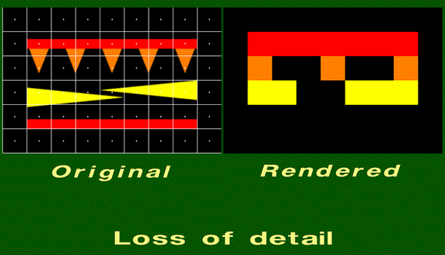
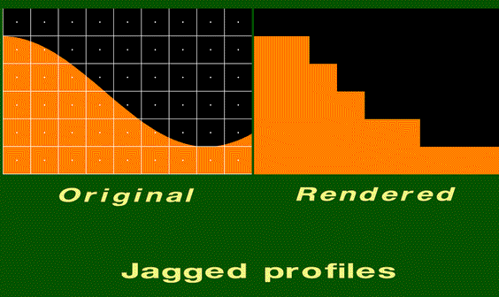
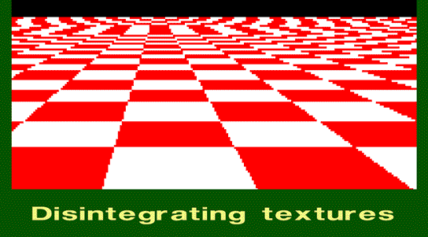
Aliasing Effects

Slide 5
Aliasing Artifacts Occur Throughout the Rendering Process
Everywhere we use discrete representations of continuous functions
  artifacts shows up unless effort is made to manage them
Sampling artifacts occur in
  rasterization (edge uncertainty)
  texturing (sample “far-apart” pixels in environment mapping)
  shading (Gauraud interpolation misses specular highlights)
  animation (samples in time produce backwards wheel rotation)
Reconstruction artifacts occur
  texture lookup when we interpolate between texel samples
  Blocky texture when you zoom into a textured surface
  display device fills visual-image areas between pixel points

Slide 6
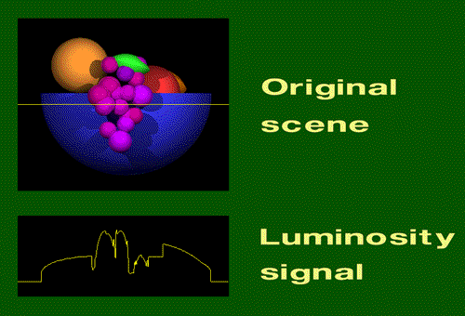
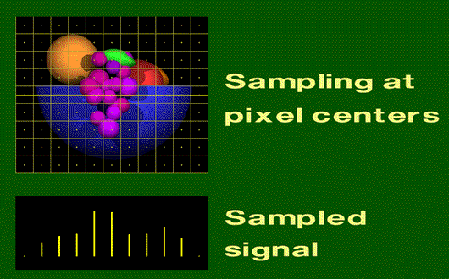
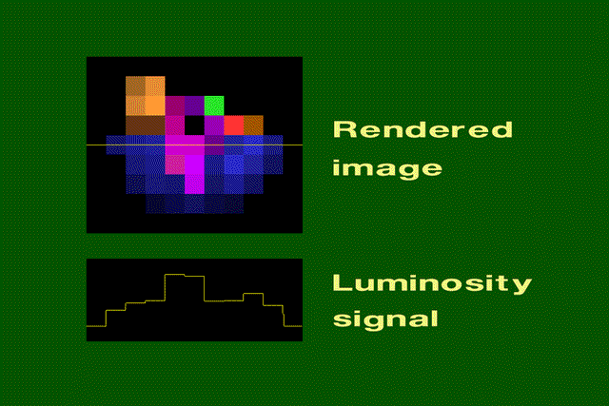
Sampling and Reconstruction in Rendering
Note that the sample values are correct, but the signal values between the samples are a piece-wise constant reconstruction

Slide 7
What to do? How to manage it?
Short answer: Nyquist Theorem
A bandlimited signal f(t) with cutoff frequency ω_{F}, sampled with interval T₀ such that (2π/T₀) ≥ 2ω_{F}, may be perfectly reconstructed from its samples f(nT₀) (n = +/- integers) by convolution with the reconstruction filter r(t) = sinc (ω_{F}/2π (t-nT₀))
  Note: 1/T = f = ω/2π
  Summarize as: sample at least twice the rate of highest frequency present in the signal

Slide 8
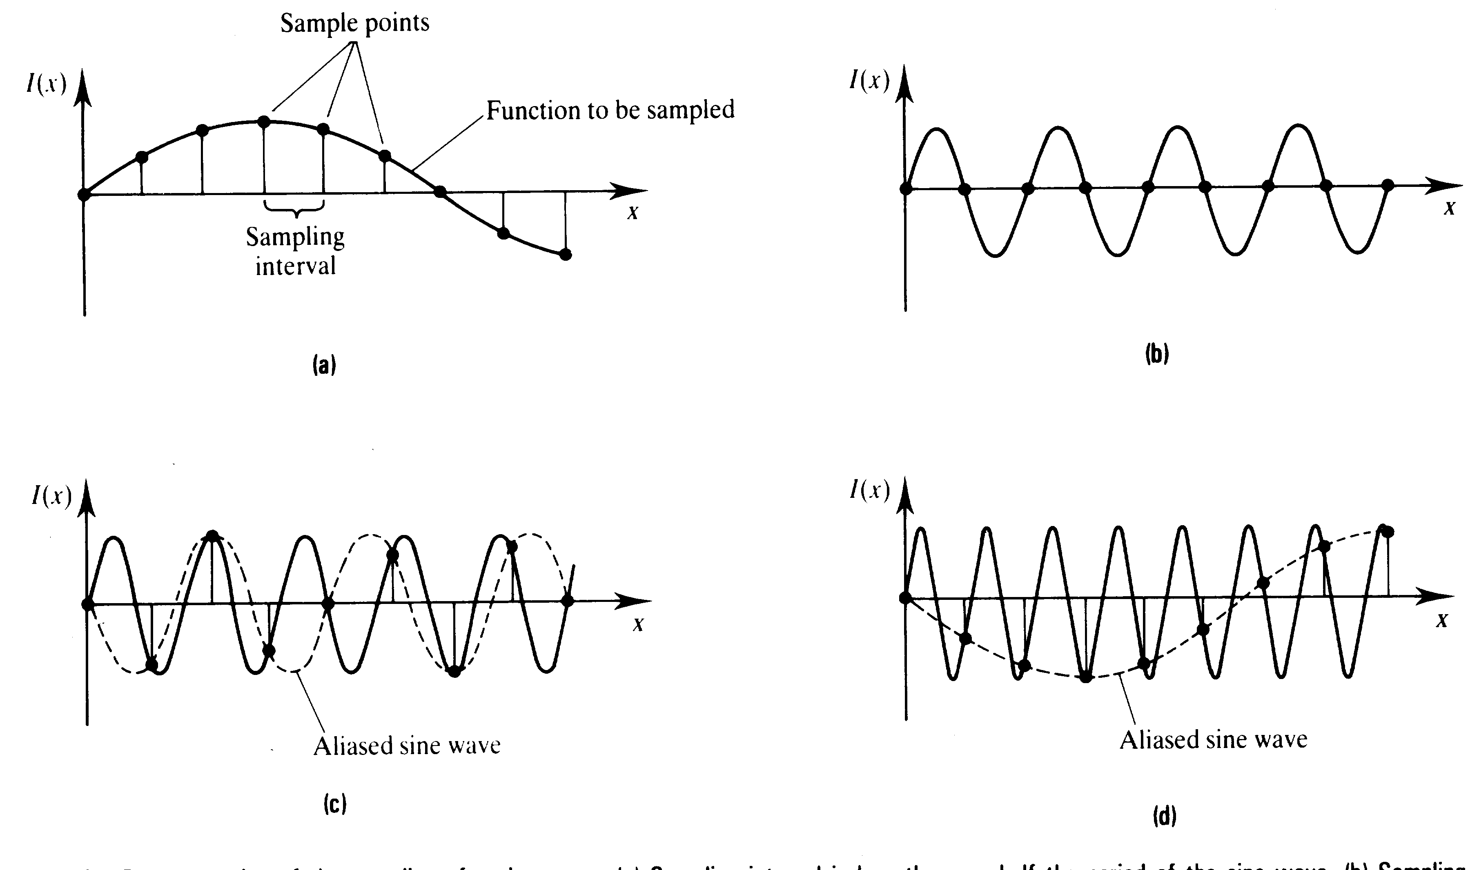
Signal Sampling
Sufficient samples for accurate reconstruction
Insufficient samples and unfortunate sample placement
Insufficient samples create aliasing during reconstruction
The original signal is lost and a new/different signal is created

Slide 9
Nyquist Requirements
f(t) filtered for cutoff freq ω_{F}
(remove high frequencies before sampling)
Sample rate 1/T₀ is greater than 2 ω_{F}
Reconstruct (interpolate) with sinc function
(recreate a continuous signal from samples)
Seems simple – just do the above and get perfect results! But can we do it…?

Slide 10
Modeling the Graphics Process
Begin by modeling signals of interest
  Simplify with1D functions (e.g., scan line)
  Consider domain time (t) or space (x) equivalent
Impulse or Dirac delta function
  δ(t) is infinitely narrow and high at zero
  ∫δ(t) = 1 (area is one)
Use impulse to model point sample
  f(t₀) = ∫f(t) δ(t-t₀) dt
  at t=t₀ integrand is nonzero
  and samples signal f at time t₀
δ(t)
0

Slide 11
Comb, Step and Box Functions
Comb or Shah function is a repeating delta function at intervals of T
  I_{T}(t) = ∑_{k} δ(t - kT)
Comb is a good model for
pixel samples at regular intervals
Step function u(t) = ∫₀^{t} δ(τ)dτ
Box function b_{w}(t) = 1 where |t| < w/2,
b_{w}(t) = 0 elsewhere
Note that Step and Box are good models
of polygon edge functions (in/out)
I_{T}(t)
… -2T -T 0 T 2T …
1
u(t)
-1 0 1
1
b_{w}(t)
-w/2 0 w/2

Slide 12
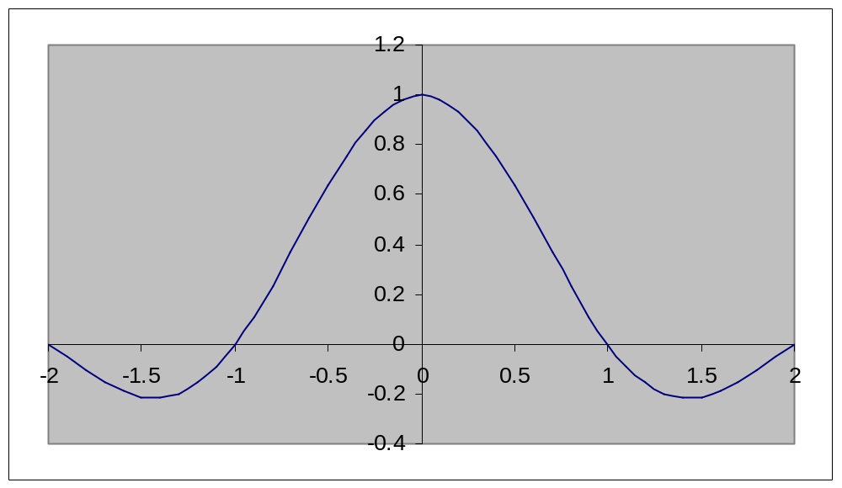
Sinc Function
sinc(t) = sin(πt) / (πt).
  By definition: sinc(0) = 1
  sinc(t) = 0 for integer values of t
  Note that sinc amplitude decreases as t increases, but it has infinite extent

Slide 13
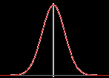
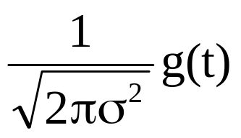
Gaussian
Gaussian g(t) = exp(-t²/(2σ²) )
  σ (sigma) the standard deviation
  is proportional to width of curve
  Gaussian also has infinite extent
  as σ --> infinity, g(t) --> 1 constant
Normalized Gaussian
  G(t) = “normalized” means that ∫±∞G(t) dt = 1
  as σ --> 0, Normalized Gaussian G(t) --> δ(t) delta function
Triangle Function (aka tent or hat)
Λ_{T}(t) = 1- |t| for (-T < t < T), else 0
Triangle is a model of linear interpolation or linear filter
A
Λ_{T}(t)
-T 0 T

Slide 14
Fourier Transform
F{x(t)} is an alternate signal representation based on frequency content or spectrum of signal
  Nyquist theorem requires we bandlimit frequency content of signal prior to sampling
In the Fourier domain signals are represented as a series of weighted sines and cosines.
The coefficients describe the signal frequency content as a spectrum
f(w)
f(t)
=
0
0

Slide 15
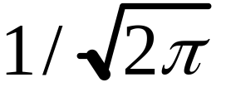
Fourier Transform Definition
For notation convenience, define
k =
F{x(t)} = X(ω) = k ∫ x(t) e^{-jωt} dt
F⁻¹{X(ω)} = x(t) = k ∫ X(ω) e^{jωt} dω
e^{-jωt} = cos(ωt) - j sin(ωt)
e^{jωt} = cos(ωt) + j sin(ωt)

Slide 16
Fourier Pairs
x(t) and X(ω) are called Fourier pairs
x(t) X(ω)
δ(t) | k
I_{T}(t) | (1/(kT)) I_{2π/T}(ω)
a | (a/k) δ(ω)
cos(at) | k/2 [δ (ω+a) + δ (ω-a)]
sin(at) | jk/2 [δ (ω+a) - δ (ω-a)]
b_{w}(t) | kW sinc(Wω/2π)
kW sinc(Wt/2π) | b_{w}(ω)
exp(-t²/(2σ²) ) | exp(-ω²σ²/2)
Λ_{T}(t) (triangle) | AT sinc² (Tπω)

Slide 17
Fourier Pair Properties
Note duality and inverse relationships between sampling rates
  Higher rates in time (tighter sample spacing) produce lower repetition rates (looser spacing) in frequency domain (and vice versa)
  This relationship is essential to both the cause and solution of the sampling problem
Note that the whole signal (in time or space) is represented by a spectrum
We can’t transform a point in the signal (image/scene)
  What is the frequency content of a point?
  What is the signal value of a spectrum?
The two representations provide either
  Value at a point in time (Spatial domain), or
  Frequency content of a signal region (Frequency domain)

Slide 18
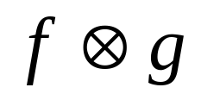



Convolution
A property of linear time-invariant (LTI) systems is
  H{af + bg} = aH{f} + bH{g} (for scalars a and b)
  Graphics sampling and reconstruction in space or time is a LTI system
In LTI systems, convolution is defined as:
f(t)*g(t) = ∫±∞ f(τ) g(t-τ) dτ (also = ∫±∞ f(t-τ) g(τ) dτ)
  Integrate over τ for fixed t offset between functions
  Net effect is that g defines spatial weighting function (filter) whose effect depends on overlap of signals f and g at offsets of t
    NOTE: convolution of f(t) * δ(t) = f(t) → convolution with delta is identity
=
t
Overlap area for shift of t
leads to value of convolution at t
t

Slide 19
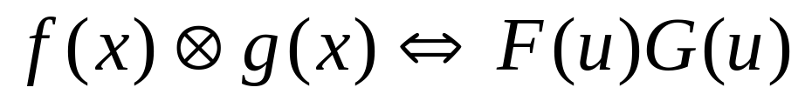
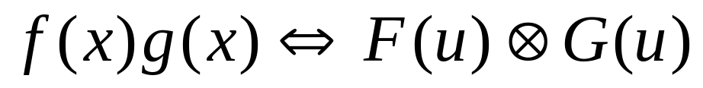
Multiplication Property
Multiplication property is a “payoff” for introducing Fourier Transforms and Convolution
  F(ω) H(ω) = F{ f(t) * h(t) } and f(t) h(t) = F⁻¹{ F(ω) * H(ω) }
By using this property we can better understand graphics sampling, reconstruction, and aliasing by how these processes are modeled in both the spatial and frequency domains
Convolution in the spatial domain represents the same signal as
multiplication in the frequency domain
Multiplication in the spatial domain represents the same signal as
convolution in the frequency domain

Slide 20
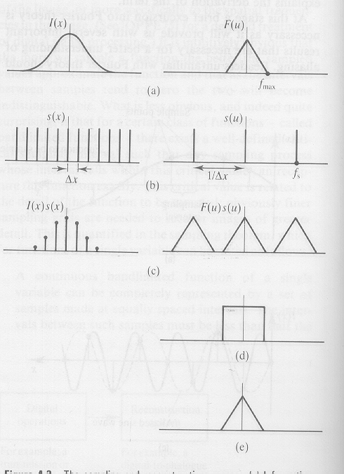
Rasterizing in both domains
Smooth image signal
Bandlimited spectrum
Sampling function is selected for
proper rate given Fmax
Transform of comb sampling function is a comb of inverse rate
Sampling function is multiplied by initial signal
to produce a sampled version of initial signal
Multiplication in spatial domain is convolution in Fourier
domain, producing multiple copies of initial spectrum

Slide 21
Reconstruction by the image display system
Given the sampled function, recover the continuous function
by convolution with sync in spatial domain – or – multiplying
the spectrum by a box in the Fourier domain
Multiplication by box in Fourier domain is a
convolution with sinc function in time domain
Multiplication by box in Fourier domain
isolates the spectrum of the initial signal
Convolution produces multiple sinc copies,
one on each of sample signal points, to
produce exact copy of initial signal
Images courtesy of Watt & Watt, Advanced Animation and Rendering Techniques

Slide 22
What’s wrong with my renderer?
Things are OK iff:
  we bandlimit the initial function
  sample at high enough rate
Then, copies of the sampled spectrum are non-overlapping
and a box function can isolate one copy during reconstruction
If you do not bandlimit the initial function, or if sample rate is too low
  reconstruction becomes impossible… due to overlapping spectrum copies
  No reconstruction filter can isolate a single copy (pre-aliasing)
0

Slide 23
Prealiasing
Triangle edges are “box” or “step” signals which transform to sinc functions with infinite extent in freq domain
This ensures that no sampling rate is sufficient to eliminate overlap of spectrum copies
Can we fix it after sampling?
  NO – its too late
  No filtering, averaging, or blurring of pixel values can separate the components once they mix
This is prealiasing and it is due to the input signal not being bandlimited before sampling

Slide 24
Prealiasing Solution
The solution is to filter the edges of F(x) before or during sampling
  remove the high frequencies (LP filter) to create cutoff frequency ω_{F}
signal spectrum filter function truncated spectrum
Multiply in freq domain or convolve in spatial domain
  Multiply by box function in frequency domain is equivalent to convolution with a sinc function in spatial domain
Rendering algorithms operate in spatial domain
  Convolving with sinc in spatial domain is impractical due to infinite extent of sinc function
      multiply in freq domain to truncate high frequencies
X
=
ω_{F}

Slide 25
Finite Filter Solution
Convolve with a finite filter in spatial domain
  Small filter area (extent) is desirable to minimize integration area
  Gaussian has best “compaction” in spatial and frequency domains
    Best tradeoff of limited extent in spatial and frequency domain
Convolution evaluation is only needed at pixel centers where samples will be taken
  Convolve F(t) by G(t), then sample (multiply) with comb I_{T}(t)
  Compute convolution integral of filter function aligned with pixel sample points
  Evaluate integral of product of triangle function (box) and filter function over filter extent area
Computation requires a discrete integral approximation
  Numerical integration is done as a sum of small portions of the integral

Slide 26
Finite Filter Convolution
f(t)*g(t) = ∫±∞ f(τ) g(t-τ) dτ (evaluate this at t=0)
  Integrate over τ for fixed t=0 offset between functions
  Net effect is that g defines spatial weighting function (filter) of f(t)
f(t) is our triangle coverage function
g(t) is our LP filter (Gaussian or triangle function)
Compute convolution value at a pixel (t=0) and that value is the pixel-sample of a filtered image function (one that has a cut-off frequency)
Red region is non-zero product of functions
Red value is convolution result at t=0
=
Dotted line illustrates a complete convolution result – which we don’t need to compute
shift of t = 0 to compute convolution value at pixel

Slide 27
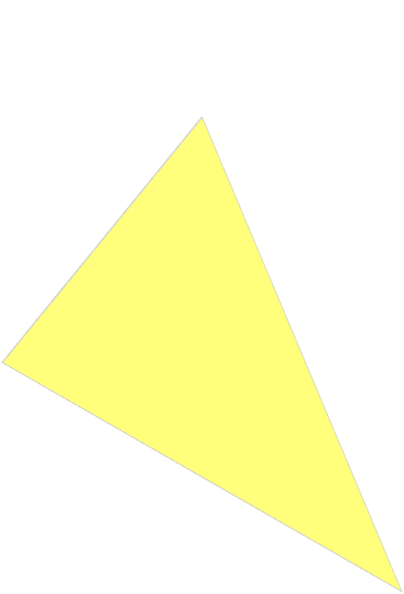
Prefilter Polygons
Rather than point-sample the polygon signal at each pixel…
Sample the polygon signal convolved with a filter (e.g.,truncated Gaussian)
  Compute the integral of the polygon function weighted by the filter function
  Filter extent is bounded to limit the area to consider around each pixel
1D Example:
Polygon function f(t)
2D Filter function g(t) extent at each pixel of a scan line
Filter function g(t) at each pixel of a scan line
Sample points in FB after filtering
Reconstructed polygon function on display

Slide 28
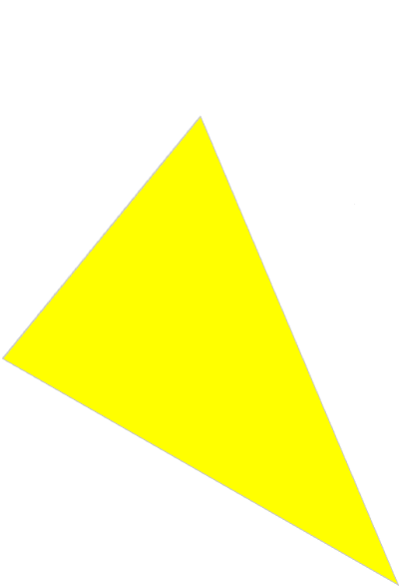

Post Rasterization Filter
If convolution is simply computed for each triangle during rasterization, the filter function produces incorrect results since there may be overlapping triangles within a single pixel filter region and we don’t know what the final arrangement is until all triangles are rendered
Delay integral evaluation until
all triangles are processed
Compute sub-samples of filter
regions (star region supersamples)
during rasterization
Each sub-sample has it’s own
Z-value to determine visibility of
its integral portion
Combine sub-samples at the end
of all triangle drawing to produce
filtered pixel samples

Slide 29
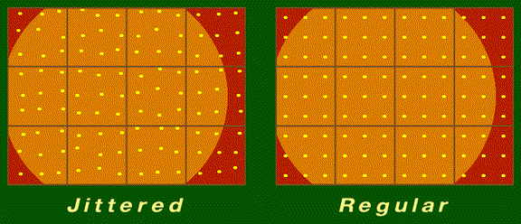
Sub-Sample Options
Sub samples are simply z-buffered rasterizer samples
The filter function determines the weighted summation of the sub-samples to approximate the convolution integral
Filter weights can be applied after all the sub-samples are computed
Any number of sub-samples can be computed per pixel
Sub-samples can be on a regular grid or jittered positions

Slide 30
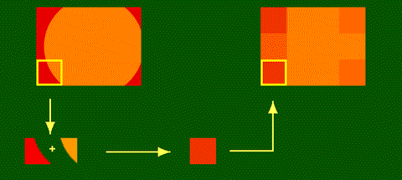
Filter Examples
A box filter g(t) in spatial domain (or sinc in frequency domain) simply averages all of f(t) under the extent of the box

Slide 31
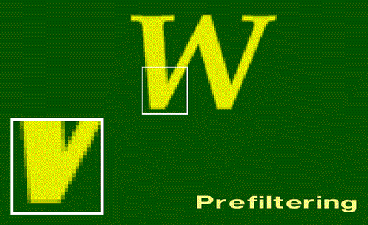
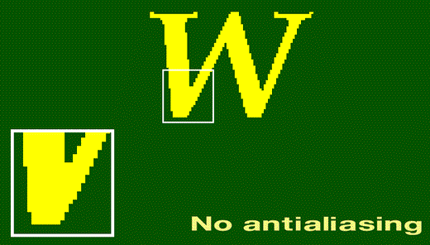
Filtered samples produce smoother edges

Slide 32
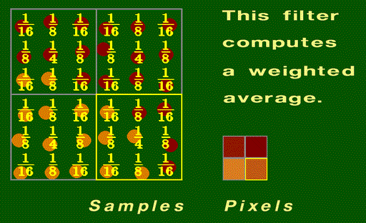
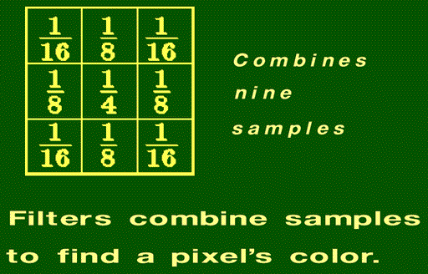
Filters
Convolution with a filter weights sub-samples into a final sample value for a pixel
Filter shape assigns weights to each sub-sample – triangle (linear) or Gaussian filters are common
Box filter weighs all samples equally
All filter weights must sum to 1.0
9 sub-samples shown

Slide 33
Filters and Supersample Rate
The use of sub-samples is often called “Supersampling”
The “Supersample Rate” is defined as how many sub-samples per output pixel (3x3, 4x4, …, etc)
Filter extent after supersamples are computed can be any size
  Same footprint as pixel, or larger --- note that the filter can include samples outside the area of a pixel
  Smaller extent filters produce undersampling and still show aliasing
  Larger extent filters smooth (blur) image excessively
No agreement on “optimal” number of samples, arrangement of samples, filter shape or extent of filter function
  N ~ 5-15
  Jittered samples preferred over regular grid
  Extent ~ 1.0 – 1.7
  Gaussian function preferred over triangle or box

Slide 34
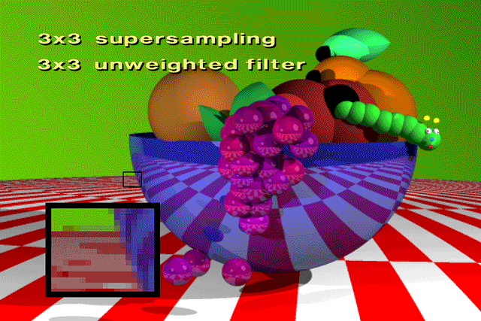
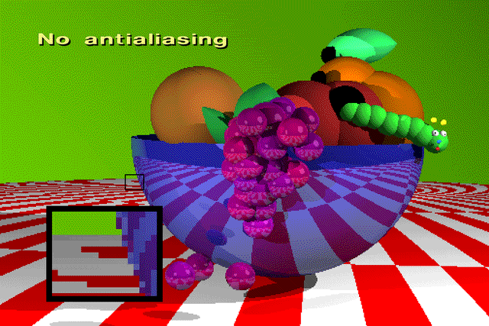
Supersample
Examples
Unweighted filter is a box filter – weight all samples equally

Slide 35


Supersample
Examples (2)
3x3 samples/pixel
5x5 sample filter size
Weighting is linear (triangle filter)
Jittered (above) vs
Regular grid (left)

Slide 36
HW6 - Antialiasing
Use regular-jittered supersampling
  Sample pattern is irregular, but same for each pixel
Aliasing is not a 3D problem – it occurs in 2D (rasterization)
  compute jitter sub-samples in screen space - after transformations
Compute multiple sub-samples per pixel (supersamples) during rasterization
  sample positions are defined by array of x-y offsets from pixel center
Sum weighted supersamples to produce filtered FB pixels after completed rasterization
  what filter shape (2D weight function)?
  what extent?
  what number of samples?
  x-y offsets and weights come from evaluating filter kernel function
Compute offsets and weights as samples of a filter function - then normalize so weights sum to unity (filter gain)

Slide 37
HW6 – Antialiasing by Jittered Supersampling
Samples on a regular grid (offsets) are simply a higher FB resolution
  Could simply increase FB resolution (each pixel also has Z) followed by weighted sum (filter) for computing final output resolution
  This is commonly how supersampling is done since it requires minimal change to a standard rasterizer
Irregular offsets pose problems during rasterization
  Difficult during edge/span traversal – DDA spans are on exact lines
  Not too hard for LEE testing – just test supersample X,Y coords
  Need unique Z for each sample - modify FB – how to index?
For HW6 create separate renderer and FB for each offset supersample
  compute separate sub-image with separate z-buffer, color, etc for each offset of a pixel – same jittered supersample pattern in each pixel
  filter final images at end - use one filter weight for an entire sub-image
  modify renderer to add screen coord offsets to all transformed verts
  Application uses get-pixel operations from each frame buffer to create final filtered image

Slide 38
HW6 Sub-Images from Offsets
For each pixel, compute N offset supersamples
  Each supersample has dx,dy offset wrt to pixel center
Each of the N dx,dy offset supersamples is computed by a separate renderer/FB pair to create an offset-image (N=7 in example above)
Each offset-image can be computed as the pixel-center sample of a simple renderer by shifting the entire image -dx, -dy
dx,dy

Slide 39
HW6 sub-images
An offset-image is created by shifting image -dx, -dy and then computing a sample at the pixel-center
Our current renderer already samples the pixel center so we only need to shift the image by –dx, -dy
The shift is easily accomplished by adding –dx, -dy to each vertex in screen space at the end of the transformation (before rasterization)
Compute this offset image based on dx,dy for this supersample.
Offset the polygon vertices by -dx,-dy and sample at pixel centers.

Slide 40
HW 6 - Approach
You will make changes to the application and renderer to perform multipass supersample antialiasing.
The algorithm computes multiple super samples around each display pixel and weights (filters) these into a final value.
A screen space offset is added to the transformed vertex coordinates of each triangle to produce the sample distribution.
The offset is specified by two new Renderer parameters (GZ_AASHIFTX, GZ_AASHIFTY).
The default offsets = zero --– which makes the renderer work as in prior HWs.
A table specifies the filter offsets and weights in the application. Feel free to build and test your own filters. Offsets are pixel shifts and the sum of all their weights = 1.0.
Note that we define the number of samples, the offsets, and the weights at compile time.
#define AAKERNEL_SIZE 6
float AAFilter[AAKERNEL_SIZE][3] /* each sample is defined by Xshift, Yshift, weight*/
{ -0.52, 0.38, 0.128, 0.41, 0.56, 0.119, 0.27, 0.08, 0.294,
-0.17, -0.29, 0.249, 0.58, -0.55, 0.104, -0.31, -0.71, 0.106 };

Slide 41
HW 6 - Filtering Subimages
Modify the application (for HW 5) to set up multiple Renderers and Frame Buffers -- one pair for each supersample defined in the table.
The new application initializes each Renderer with a different offset.
Each Renderer has it’s own frame buffer to write into. All frame buffers are the same resolution.
All triangles are sent to all renderers.
After rendering all the triangles, the application must read back and combine all the offset subimages by weighting their pixel values.
The filtered (result) image is stored (written back) into one of the frame buffers (or a new one) and then written to disk (and/or displayed).

Slide 42
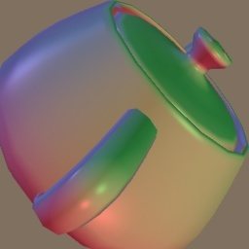


HW 6 result
HW4 result

Slide 43
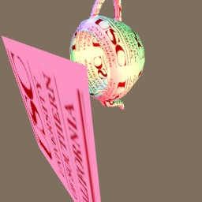
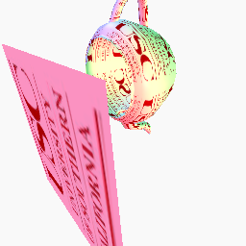
HW 6 result –
-- HW5 result

Slide 44
Reconstruction and Post Aliasing
Reconstruction is needed to fill the screen image
  Usually done by display system (e.g., LCD optics) or D/A conversion system (analog video)
After sampling – points are in FB – these need to be reconstructed into continuous function (see slide 21)
Sampling Theorem says reconstruct by convolution with Sinc function
  Sinc in spatial domain is a box filter in freq domain
    multiplication in frequency domain removes all side-spectrum copies, but leaves center spectrum
    Infinite extent in spatial domain – computation cost too high
If reconstruction filter has too small a footprint in spatial domain
  A series of gaps occur on screen - convolution of filter with FB samples produces regions of zero between pixel samples – poor reconstruction
  Fourier domain signal spectrum will be a wide function causing leakage from side copies of F(ω) spectra
  This leakage and gaps are due to postaliasing - aliasing due to poor reconstruction
If reconstruction filter is too large in spatial domain
  High calculation burden due to large filter area
  Narrow filter in Freq domain narrows spectrum of output signal – blurred image
Consider reconstruction by
  Gaussian – most compact extent in both domains
  Triangle function – linear interpolation ---> sinc² ripples fall off rapidly in freq domain
  Box function – no interpolation ---> sinc ripples extend relatively far in freq domain
  CRT/plasma have Gaussian-like reconstruction, LCDs have a box-like reconstruction

Slide 45
Aliasing is not completely solvable
All image processing is an “art” of best compromise between computing time and quality
  Perfect (infinite) filters can’t be computed
  Perceptual issues are important
  All forms of aliasing are not equally objectionable or noticeable
Some aliasing signals are less-noticeable
Stochastic samples (jittered) make aliasing effects less correlated with image, more like “snow” in image
  Often less objectionable/noticeable to human perception

Slide 46
END OF ALL HW MATERIAL
Second exam covers
Shading (HW4) up to this point

Slide 47
Filtering Textures
We now know about aliasing and how it arises from sampling geometry edge fucntions
How do we address the problem of aliasing for surface textures?

Slide 48
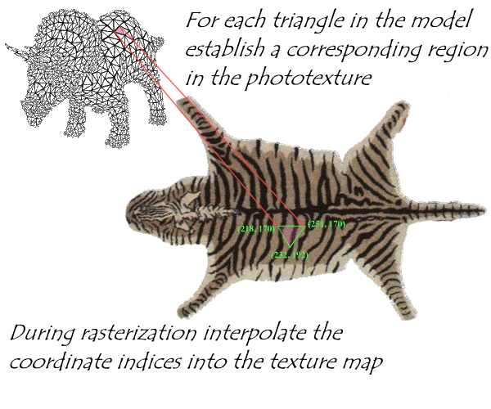
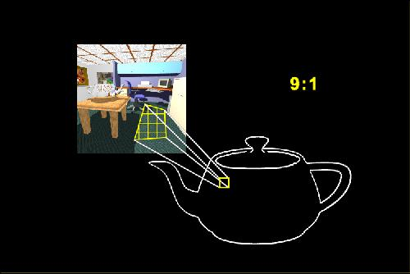
Sample Rate Mismatch
Rendering samples scene geometry and textured surfaces
  Texture has its pixels (texels) resampled onto rendered image pixels
  Texture (texel) sampling rate generally does not match screen pixel sample rate (Texel:Pixel ratio)

Slide 49
Magnifying Image Textures
Projected texture in screen image should sample near same rate: 1:1, to optimally reproduce texture map
When we zoom in… texture image blurs
  1 Texel : >1 Pixels
  No aliasing problem here - just no data
  Fix by using higher resolution textures - nothing else we can do - can't invent data for image textures
  Procedural textures have an advantage since many can provide detail over a range of scale-levels (fractals)

Slide 50
Minifying Image Textures
Texture image aliases when we zoom out – sample rate violates Nyquist rate
  Multiple texels fall in one screen pixel (>1 Texel : Pixel)
  We can't easily increase or control screen sample rate
    fixed by scene and camera and FB resolution
  We need to filter texture (reduce F_{max}) so screen sample rate is twice highest freq in texture (like pre-filtering triangle edges)
    Match the texel resolution (rate) and screen resolution (rate)
  Filter can be applied to whole texture image as a pre-process, or on the fly at each u,v pixel position

Slide 51
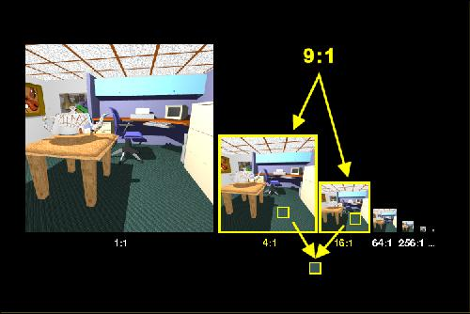
MIP Maps: Precomputed Filtering
Pyramidal Parametrics - Lance Williams [SIG 83]
Precompute filtered versions of texture image at octave scale/size intervals
  Halve image-size in X and Y per pyramid step
  Top of pyramid is single pixel with "average" color of whole image texture

Slide 52
Storage of MIP maps
R
G
Space cost is 33% increase over texture image itself
R
G
B
R
G
B
R
G
B
B
Trivia: MIP = Multum In Parvo (many things in a small place)

Slide 53
MIP map scale
Define a “scale" parameter for each level of texture-map pyramid as du/dx and dv/dy
  Low scale values for hi-res images at base of pyramid
  e.g., for 256x256 image level, scale = du/dx = dv/dy = 1/256
  Scale increases as we move to top pixel in pyramid where du/dx = dv/dy = 1/1
    For square textures, both scale ratios are equal (du/dx = dv/dy) so only one number is needed to represent scale at each level of the pyramid
Note that pixel rates (texel : pixel) are related to “scale” (above) by multiply with texture size
  For case of 256x256 texture map above
  1/256 (scale) * 256 = 1 (texel : pixel)
  1/128 (scale) * 256 = 2 (texel : pixel)
  ….
  1/1 (scale) * 256 = 256 (texel : pixel)

Slide 54
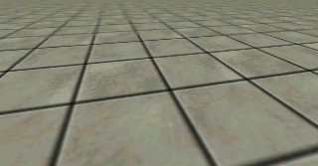
MIP maps: matching scale
Pixel scale during rendering is more complex since it is projection-dependent and it varies over the face of a polygon due to perspective
  pixel scale = du/dx, du/dy, dv/dx, dv/dy (4-tuple)
Pixel scale values are projection-dependent texture sampling rates at each image pixel and these four scale components (derivatives) are generally unequal at each pixel and vary
from pixel to pixel

Slide 55
MIP maps: pixel scale
In rendering, we interpolate perspective-space U,V
We compute dU/dy, dV/dy along edges, and dU/dx, dV/dx along spans, but we need affine scale ratios to select pyramid level
  Derivatives can be estimated from vertex u,v values, but these only approximate the variations along edges and spans
  Can use prior-pixel u,v values to estimate a local scale - computing u,v gradient on the fly
Simple choice is to approximate derivatives from vertex u,v
  Use affine u,v - before perspective warp
  Estimate derivatives using screen vertex positions
  Select a constant scale for whole poly based on average (or peak) du/dx, du/dy and dv/dx, dv/dy values computed along edges
    Good approximation for small triangles
    Use of peak scale values produces over-filtering (blur)
    Blur is often preferred over aliasing

Slide 56
MIP maps: 3D interpolation
Given continuous texture scale values we can either sample between levels (3D filter) as Heckbert describes, or resample in nearest pyramid plane using 2D filter
  Nearest-level rounding or truncation is faster (2D rather than 3D), but causes jumps as scale level switches occur
Most hardware now offers full mipmaps with trilinear (3D) interpolation

Slide 57
MIP-map Weakness
Weakness of MIP maps is isotropic (same) scale filtering for both u and v
The problem is acute in perspective planes
  Ground plane textures are a common problem case
Texture scale is greater in one axis than the other
  d*/dy is typically greater than d*/dx along horizon in ground plane
To keep one dimension from aliasing, the other must be excessively blurred
  Solution is to filter anisotropically (asymmetrically)
  Where an anisotropic filter is needed, a lower resolution mipmap scale is used, and several texels are sampled and merged along the direction of needed additional filtering (approx ellipsoidal filter)

Slide 58
Summed-Area Tables
[Frank Crow SIG 84]
Initialize the texture table so that each pixel has sum of all pixels below and to left (per-process done off-line)
Sum of values of any rectangle region of arbitrary aspect can be computed from 4-corner positions
  Sum of all colors in a region = T(UR) – T(LR) – T(UL) + T(LL)
Divide by the number of pixels in region to obtain average color of region
  Computes a Box Filter of the rectangle region
  Do separate calculations for R,G, and B
All lookups at all scales are constant time!!!
Arbitrary aspects are possible by multiple rectangle approximations
  Do “best-fit” of regions to actual projection of pixels to texture
  Weighted combination of multiple regions - U. Tubingen, Prof. Strasser
UL UR
LL LR

