Slide 1
CS580
(Computer Graphics Rendering)
Rasterization
HW2
Flat-shaded z-buffer triangle teapot
Ulrich Neumann

Slide 2
Rendering HW in steps
first rasterize a screen space triangle
  Input tris (pre-transformed) and output pixels to display built for HW1
  (HW2)
then add transforms
  (HW 3)
then add shading
  (HW 4)

Slide 3
Rasterization
Array of pixels
0
1
2
3
0
1
2
3
4

Slide 4
Rasterizing Lines
Given two endpoints, P= (x₀, y₀), R = (x₁, y₁)
find the pixels that make up the line
R
P

Slide 5
Rasterizing Lines
Requirements
No gaps
Minimize error (distance to true line)

Slide 6
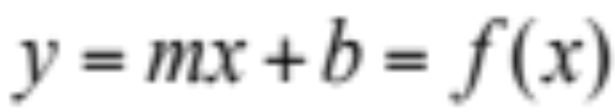
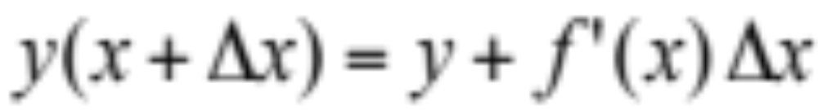
Rasterizing Lines
Equation of a Line:
Taylor Expansion:
So if we have an x,y position on the line,
we can find the next point incrementally

Slide 7
Rasterizing Lines
Assume –1 < m < 1, x0 < x1
Line(int x0, int y0, int x1, int y1)
float dx = x1 – x0;
float dy = y1 – y0;
float m = dy/dx;
float x = x0, y= y0;
for(x = x0; x <= x1; x++)
setPixel(x,round(y));
y = y+m;

Slide 8
Rasterizing Lines
Although correct and usable, there are problems with previous simple algorithm
  rounding takes time – case checking
  uses floating point arithmetic

Slide 9
Midpoint Algorithm
NE
Q
M
E
Start P=(x,y)
If Q <= M, choose East. If Q > M, choose NorthEast
M is midpoint (y = ½ interval between pixel rows)

Slide 10
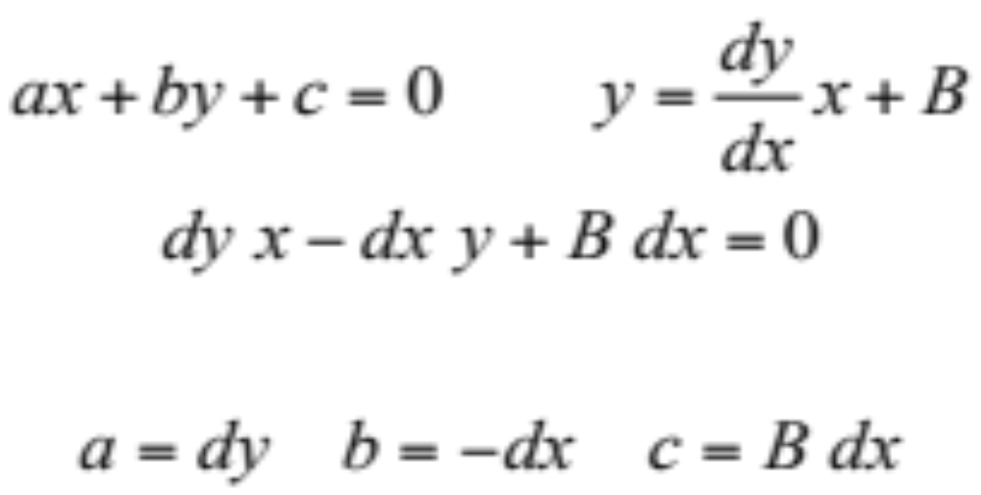
Implicit Form of a Line
Implicit form
Explicit form
Rewrite explicit form and multiply by dx
Result is: Positive below the line, Negative above the line, Zero on the line

Slide 11
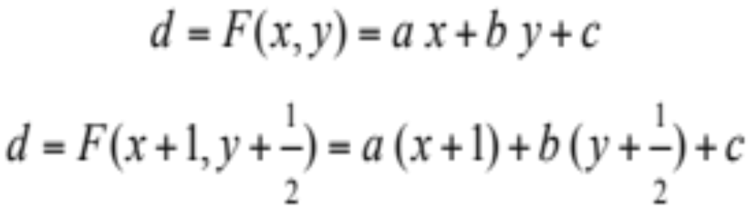
Decision Function
Set up decision point M at x+1,y+1/2
Choose NE if d > 0 Choose E if d <= 0

Slide 12
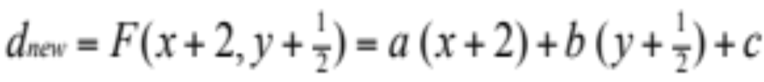
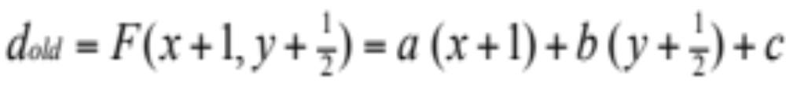
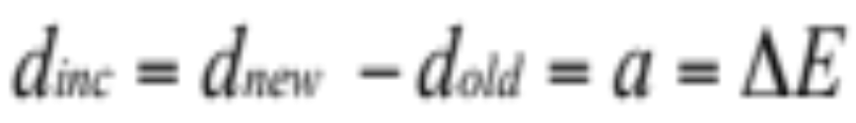
Incrementing d
If choosing E:
But:
So:

Slide 13
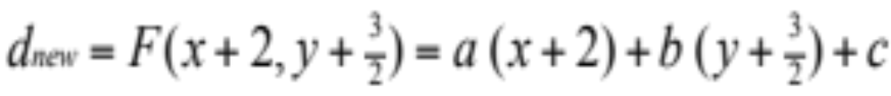

Incrementing d
If choosing NE:
But:
So:

Slide 14
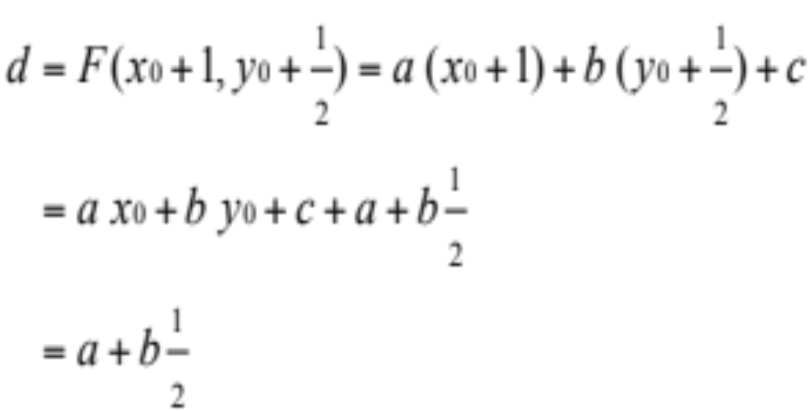
Initializing d
Multiply everything by 2 to remove fractions
(doesn’t change the sign)

Slide 15
Midpoint Algorithm
Assume 0 < m < 1, x0 < x1
Line(int x0, int y0, int x1, int y1)
int dx = x1 – x0, dy = y1 – y0;
int d = 2*dy-dx;
int delE = 2*dy, delNE = 2*(dy-dx);
int x = x0, y = y0;
setPixel(x,y);
while(x < x1)
if(d<=0)
d += delE; x = x+1;
else
d += delNE; x = x+1; y = y+1;
setPixel(x,y);
Note :
No floats and no rounding.
Algorithm uses only ints and a sign test

Slide 16
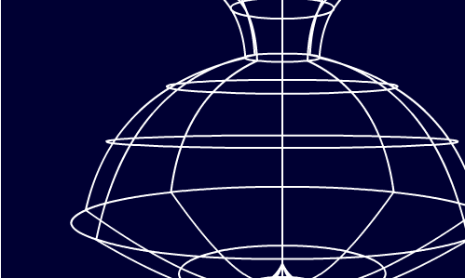
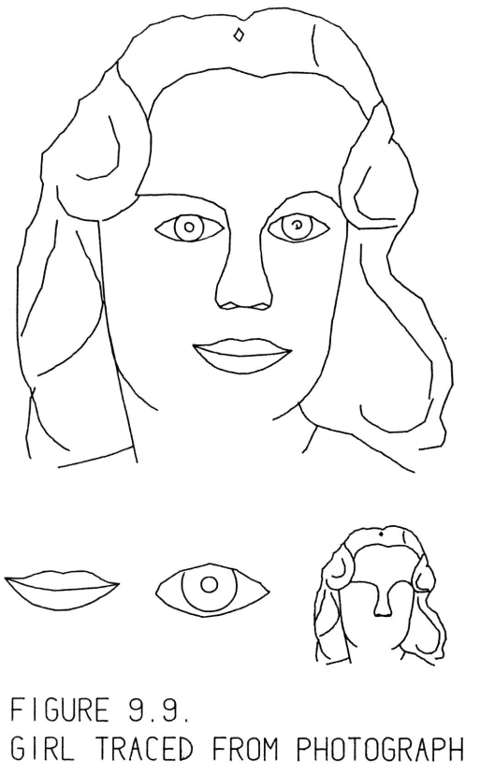
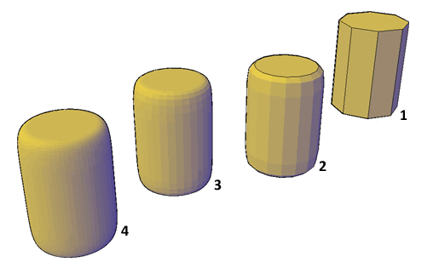
Line and Surface Renderings
3D line drawing is sufficient for conveying or manipulating objects.
More realistic 3D graphics requires an ability to draw surfaces.
Visualizations including both lines and surfaces are possible and useful.
“SketchPad” submitted January
1963 by the author for the degree of Doctor of Philosophy to the
Massachusetts Institute of Technology

Slide 17
Object or Scene Surface Model
Explicit geometry (tris, patches) or implicit description via function (fractal mandlebrot set, threshold (level-set), parametric cylinder or sphere, or sample data (medical volume)
All above provide surface representations that can be drawn or rendered.
Triangles - we use triangles with a vertex list per tri (alt: list of pointers to vertex array)
Convex and concave polys are decomposed into tris
A B
C
  D
    Tri 1 Tri 2
Edge representation: Or tri-strip:
XYZ_{A} XYZ_{B} XYZ_{A}
XYZ_{B} XYZ_{D} XYZ_{B}
XYZ_{D} XYZ_{A} XYZ_{D}
XYZ_{C}
      Implied edges exist between vertices

Slide 18
Vertices
Verts have X,Y,Z coords and other attributes like color, normal, texture coords, etc.
Verts are where we “know something” about the model.
Verts are model "sample points".
Tris are planar approximation of “true” object geometry.
Coords are relative to some origin and axes (e.g., Model Space).
Example of tri from pot4.asc: {X, Y, Z, Nx, Ny, Nz, U, V}
triangle
1.400000 2.250000 0.000000 -0.902861 -0.429934 0.000000 0.000000 0.000000
1.273482 2.323828 0.541834 -0.918898 0.095044 -0.382874 0.250000 0.250000
1.380469 2.323828 0.000000 -0.995495 0.094810 -0.000000 0.000000 0.250000

Slide 19
Rasterization and Hidden Surface Removal
Image order rasterization -- ray tracing / ray casting
  traverse pixels (image), process each in object space
  transform rays from image space to world space - no vertex xforms
  Turner Whitted's paper (sig 79) (Glassner Book, web refs, etc.)
Object order rasterization -- scan-line (pixel-by-pixel) or footprint (LEE hw)
  traverse primitives (objects), process each in image space
  transform objects from world space to screen space
  Reyes (PIXAR) paper (sig87) - classic reference
Rasterizer fills pixel samples inside tri edges and interpolates parameters (like Z)

Slide 20
Linear Expression Evaluation
Use E3 as an example (1st quadrant vector, positive slope dy/dx
  All edges are clockwise (CW) about tri (need to sort verts)
  Tail of vector is (X,Y)
  Head is (X + dX, Y + dY)
Edge Equation: E(x,y) = dY (x-X) - dX (y-Y)
  = 0 for points (x,y) on line
  = + for points in half-plane to right/below line
  = - for points in half-plane to left/above line
Note: these relations hold for all multiples of dY and dX: KdY, KdX (all E vectors within a line)
The in/out tri regions have same sign relative to all edges.
Use above definition and cast into general form of 2D line equation → Ax + By + C = 0
dYx - dYX - dXy + dXY = 0 (multiply terms)
dYx + (-dXy) + (dXY - dYX) = 0 (collect terms)
  A = dY
  B = -dX
  C = dXY – dYX (Computer A,B,C from edge verts)
E3
-
-
+
E2
-
E1

Slide 21
LEE for Rasterization
Given 3 tri verts defining 3 edges,
  Consistent CW or CCW edge orientation is computed by sorting verts in each dimension (e.g., first Y and then X).
  Compute A, B, C for each edge
At each pixel in the bounding box of the verts
  Compute LEE result for all three edges
  Pixels with consistent sign for all three edges are covered by tri and therefore colored (green).
  Note circled pixel falls exactly on line.
    Include edge pixels on left or right edges (also determined by sort) to avoid pinholes between tris.
E3
-
-
+
E2
-
E1

Slide 22
Vertex Sorting
Given 3 tri verts we need to sort them
  Find CW edge cycle
  Determine L/R and Top/Bot edges for edge-pixel ownership
Start by sorting vert Y-coords
  V2, V1, V3 is low-to-high Y ordering (for case shown)
  So, CW edges are either 2-1, 1-3, 3-2 or 2-3, 3-1, 1-2
  depending on which are L/R edges
To find L/R relationship, use mid-Y vert V1 (X₁, Y₁) and find point P (circled) along non-V1 edge (V2-V3) with same y value (y = Y₁)
  Formulate line eq for V2-V3 to get
  Ax + By + C = 0
  Plug in y = Y₁ and solve for x
  Compare x to X₁ and greatest value
  establishes R-edge(s)
  In case shown, x < X₁, so edges with
  V1 (mid-Y vertex) must be R edges
If two verts have exact same Y-values, treat as
special case (horizontal top or bottom edge)
V2
P
V1
-
V3

Slide 23
Interpolate Z
In addition to X,Y coords, verts also have Z
  Need to determine Z values at pixels in tri
  Compute Z during rasterization
A general plane equation has four terms.
  Ax + By + Cz + D = 0
Cross-product of two tri edges produces (A,B,C) vector
(X,Y,Z)₀ X (X,Y,Z)₁ = (A,B,C) = norm to plane of edges (and tri)
Solve for D at any vertex, using (A,B,C) from above
Given (A,B,C,D) for a given tri, evaluate at any pixel (x,y) to get z for that pixel (interpolated Z value).
In addition to Z, we can use any vert parameter (u, v, etc…) to computer new (A,B,C,D) plane coefficients in same approach to interpolate that parameter at each pixel.
  We’ll need this later for interpolations of texture or color…

Slide 24
Z-buffer to remove hidden surfaces
Compute which pixels are inside triangle
Interpolate Z values for those inside pixels
Compare computed Z value against current Z value in Frame Buffer.
If new pixel Z is less than FB Z, write new pixel color and Z into FB. (overwrite old value)
We assume a coord system such that Z increases with distance from the viewer.
We also assume a color is given for each triangle. (no shading yet)

Slide 25
Hardware for LEE Rasterization
Parallel evaluation is possible for all pixels in NxM footprint given 3 edge coef-pairs -- this is the basis of Pixel-Planes and PixelFlow systems from UNC (1980s and 1990s)
First rasterize - find the pixel coverage and hidden surface removal.
Then interpolate parameters for color, material properties, etc.
Then compute (deferred) shading of all visible pixels after all tris are rendered.
  Eliminates all the shading work for occluded surfaces

Slide 26
Rasterization Papers to Read
Siggraph 85 - "Fast Spheres, Shadows, Textures, Transparencies, and Image Enhancements in Pixel-Planes," Henry Fuchs,et. al.
2000 Sig/Euro Workshop on Graphics Hardware - "Tiled Polygon Traversal Using Half-Plane Edge Functions," Joel McCormack, Robert McNamara
Siggraph 88 - "A Parallel Algorithm for Polygon Rasterization," Juan Pineda
Siggraph 05 - “Resolution-Independent Curve Rendering Using Programmable Graphics Hardware,” Charles Loop, Jim Blinn

Slide 27
Scan Line Rasterizer
DDA uses slope dx/dy to compute tri edges at each scan line
Generic DDA has position start, end, current, and slope data
  Add additional parameter value (Z) start, end, current, and slope data for interpolation
Assume conventions:
  Screen origin is UL corner of screen
  Screen coords (RH) -> X = right, Y = down, and Z into screen
X
1
1
2
2
3
3
Y

Slide 28
Scan Line Algorithm
1
1
2
2
3
3
Sort verts by Y into (1-2, 2-3), and (1-3) (sort for sequence of use)
Setup edge DDAs for (1-2), (2-3), (1-3)
Sort edges by L or R (2 possible configurations - above figure)
Ex: Assign edge DDA s as L (1-2-3), and R (1-3) (for right-most tri in figure)
Comparing X-coords of vert 2 and 3 is not valid L/R test
    Use dx/dy slopes (1-2) < or > (1-3) as test
Advance (1-2) and (1-3) DDA current positions to top y-scan line (ceiling)
Setup span DDA on successive lines based on edge DDA values
Set span DDA current and end positions to right and left edge values
Advance span current position to left-most covered pixel (ceiling)
Interpolate span position and parameters (Z) until current position > end
Test interpolated-Z against FB-Z for each pixel - low Z wins
Write color value into FB pixel (default or computed color)
Switch from 1-2 edge to 2-3 edge when current 1-2 edge position > Y(2)
Continue spans until vert 3 is passed: current 1-3 edge position > Y(3)

Slide 29
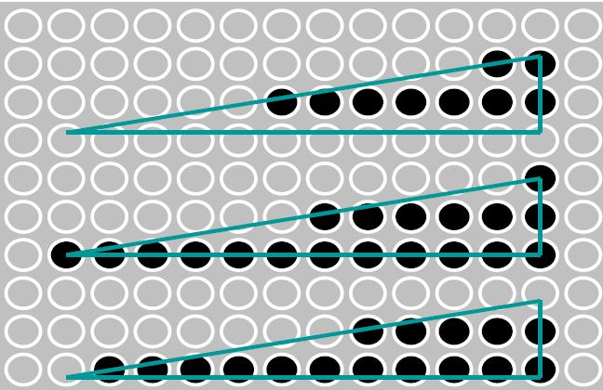
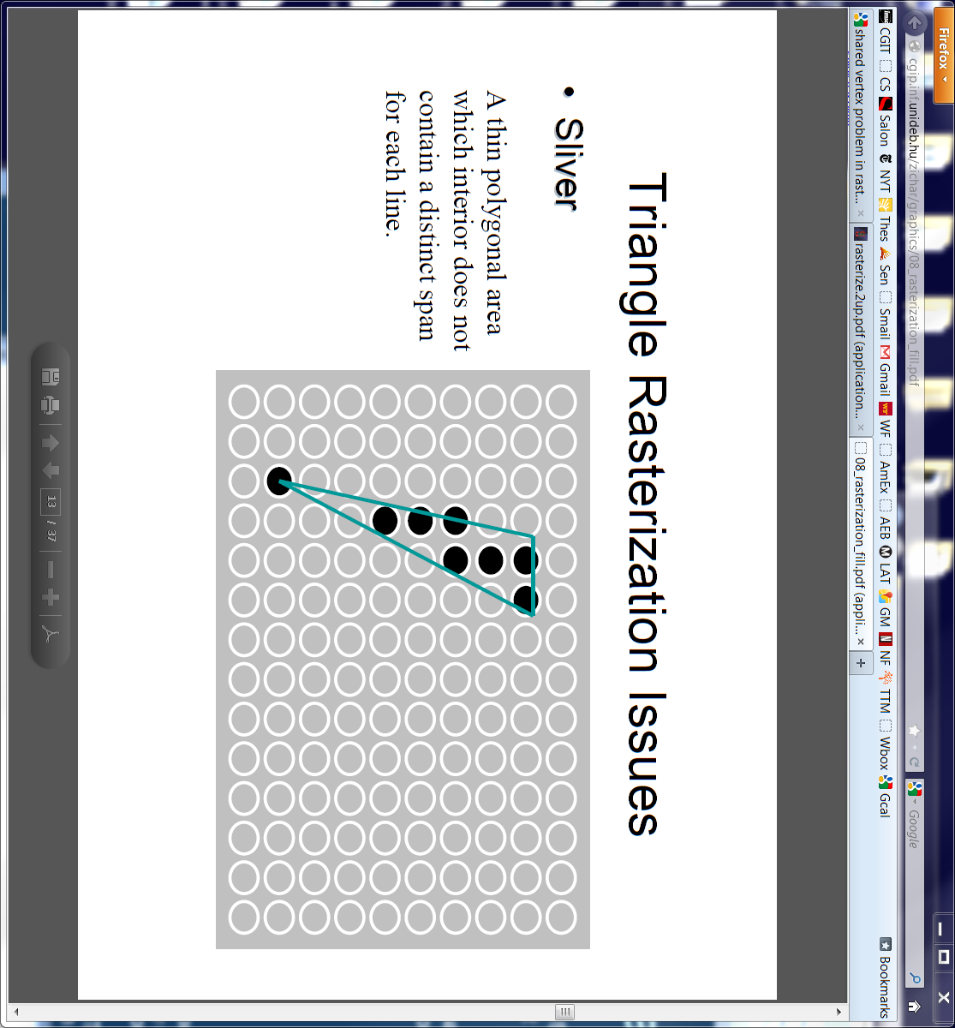
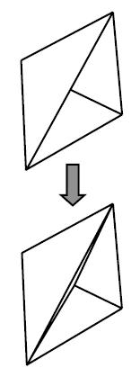
Scan Line – special cases
*** Watch/detect for special cases for
  Define a convention for pixels on exact L/R T/B edges
    one edge covers pixel, the other does not
  Horizontal edges – watch sort and traversals
    Use slope to sort left/right edges
  Thin tris can have zero pixels covered in a span
    Ensure loop controls manage zero-iteration cases
Test yourself (these need not be addressed in your HW)
  What if a vertex falls exactly on a pixel? How can you ensure that one and only one triangle will color that pixel?
  Why is it a bad idea to create a model with a T-junction?
  A T-junction is created when a vertex lies on another triangle’s edge (see example to right)

Slide 30
interpolators – init edges
Setup edge DDAs for E(1-2), E(2-3), E(1-3)
E(1-2) {
  start = V1 (X,Y,Z)
  end = V2 (X,Y,Z)
  current = V1 (X,Y,Z)
  slope_{x} = dx/dy (X2-X1)/(Y2-Y1)
  slope_{z} = dz/dy (Z2-Z1)/(Y2-Y1)
  }
V1
V2
V3

Slide 31
interpolators – advance edges
Advance (1-2) and (1-3) DDA current positions to top y-scan line (ceiling)
Move down edges to first line
ΔY = ceil(V1(Y)) – V1(Y)
E(1-2) {
  start = V1 (X,Y,Z)
  end = V2 (X,Y,Z)
  current =
  V1 (X + slope_{x} ΔY),
  V1 (Y + ΔY),
  V1 (Z + slope_{z} ΔY)
  slope_{x} = dx/dy (X2-X1)/(Y2-Y1)
  slope_{z} = dz/dy (Z2-Z1)/(Y2-Y1)
  }
V1
V2
V3

Slide 32
interpolators - span setup and advance
Setup span DDA on successive lines based on edge DDA values
Set span DDA current and end positions to right and left edge values
SPAN {
  start = L (X, Z)
  end = R (X, Z)
  current = L (X, Z)
  slope_{z} = dz/dx (RZ-LZ)/(RX-LX)
  }
Advance span current position to left-most covered pixel (ceiling) ΔX = ceil(LX) - LX
SPAN {
  start = L (X, Z)
  end = R (X, Z)
  current = LX + ΔX, LZ + ΔX slope_{z}
  slope_{z} = dz/dx (RZ-LZ)/(RX-LX)
  }
V1
L
R
V2
V3

Slide 33
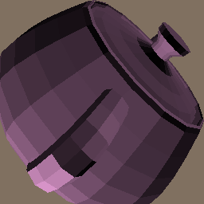
HW2
Tris are pre-transformed into screen coordinates for HW2.
Input file has tris with X,Y,Z ready for rasterization.
Color is assigned for each tri.

Slide 34
HW2.txt
Your assignment is to produce a working scan converter based on the files you're given below.
The API calls in rend.cpp *must* be provided just as they are outlined.
Remember to interpolate Z and do Z-buffer testing on each pixel write to the Display.
*** Changes in the API are not allowed ***
The standard application you are given must work without modification.
Your renderer will link in your display code from HW1.
If your display code is not yet correct, you'll have to complete it since you need it now.
There are several other files there that will be useful.
- Gz.h : Global definitions
- Application2.cpp : new application that calls for your rend.cpp functions
- rend.cpp : new skeleton file with API definition and comments
- pot4.screen.asc : the Utah teapot triangle data transformed for scan conversion
- pot4.ppm : the result of running "app2 <pot4.screen.asc >pot4.ppm"
The result images are made into a 256x256 window to save disk space.
Do not change the resolution/size of your display image since the transformation
is precomputed for that image size.
NOTE - your background color may be different. That's not important. It's not part of the API.

Slide 35
Application API
View Application2.cpp
New API calls to GzNewRender and GzBeginRender
Note: nameListTriangle[] is an array of “type” tokens
and valueListTriangle[] is an array of parameters of that “type”
Note: a simple shading function is within the application and it computes a color for each triangle
Color is sent to renderer via the generic GzPutAttribute call

Slide 36
Renderer API
View Rend.cpp
Note separate GzPutAttribute and GzPutTriangle call
Tokens for “types” for PutTriangle call are only used for GZ_POSITION right now – no need for other triangle data yet
Note Color is passed to Renderer as RGB array of floats defined over the range [0.0, 1.0]
ctoi function convert float color range of
[0.0, 1.0] to GzIntensity 12-bit range for PutPixel calls to the display --- sanity check the float range to ensure conversion doesn’t overflow 12-bit range (0-4095)

Slide 37
The “Original” Scan Line Algorithm
The “classic” scan line algorithm was a variation of what is described in the prior slides.
Walk the screen scan lines (top to bottom) and deal with all triangles that intersect the current line. This requires only one scan-line of Z-buffer for hidden surface calculations.
Y-sort all triangles based on their lowest-Y vertex. Put all of them into the unrenderred list
For all scan lines {
Test the pool of unrendered tri’s to see if any start on the current line. If so, move them to the current tri list.
Render the current list tris for by incrementing their DDAs to the current line – do the same edge stepping and span stepping we discussed. Keep all the DDA parameters for a triangle in each tri data structure since we’ll need them on subsequent lines. Use Z-buffering for all pixel writes.
Increment the scan line and test all current list tris for completion. Remove all completed tris from the current list.
}

