Slide 1
Hidden Surfaces and Introduction to Transforms and Projections
HW3
CS580
(Computer Graphics Rendering)
Ulrich Neumann

Slide 2
Hidden Surface Removal (HSR)
  Image-order (pixel) or object-order (poly) methods
  Edge (line) or surface visibility methods
    wireframe lines are hard to deal with
      simple z-buffer does not work
      edge-crossing and object sorting methods

Slide 3
Raycasting
For every ray through a pixel,
perform a ray-intersection with every object.
Keep the closest intersection.
Image plane
View point or focal point

Slide 4
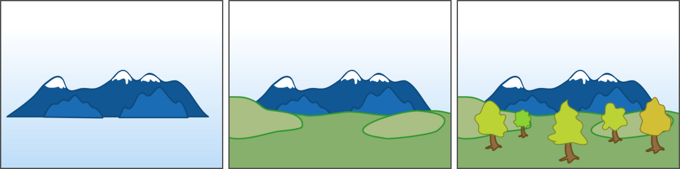
Painter's algorithm
Just render in order
  front to back or back to front.
View dependent and doesn’t work for overlapping tris.

Slide 5
Painter’s Algorithm (2)
Failure cases:
- Farthest z extent is insufficient
- Cannot resolve dependency cycles
View direction
top
front

Slide 6
Warnock algorithm
Overcomes problem of view dependent ordering and intersecting geometry by approach based on divide and conquer.
Subdivide screen until single region has simple front/back relationship
Sub areas are completely visible / hidden, or area is too small to subdivide again
Usually use quad tree subdivision
Useful for curved surfaces and antialiasing where the subdivision is done to sub-pixel levels.
Efficient and concentrates work where needed --adaptively -- common theme in graphics

Slide 7
Area Subdivision (Warnock)
Initialize the area to be the image plane
Four cases:
  No polygons in area: done
  One polygon in area: draw it
  Pixel sized area: draw closest polygon
  Front polygon covers area: draw it
Otherwise, subdivide and recurse

Slide 8
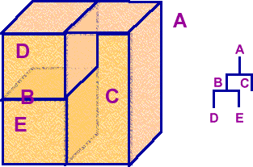
BSP tree
view-independent binary tree structure that allows view dependent front to back or back to front traversal.
  More detail in later class.

Slide 9
BSP Trees
Advantages
view-independent tree
transparency
fast – no Z testing
Disadvantages
many, small polygons
over-rendering
hard to balance tree

Slide 10
Z buffer
Compare each new pixel’s depth to current pixel value
Compare FB Z with new pixel Z.
Lowest Z value (front-most) wins pixel.
Most common today due to cheap/fast memory.
Advantages
simple
reasonably efficient
easy compositing
Disadvantages
large memory & bandwidth
z-quantization errors
over-rendering
no transparency

Slide 11
Culling With Portals
Separate environment into cells
Preprocess to find potentially visible polygons
from any cell

Slide 12
Culling With Portals
Treat environment as a graph
Nodes = cells, Edges = portals
Cell to cell visibility must go along edges

Slide 13
Culling With View Frustum
Check whether all vertices lie outside the clip plane
Speed up: check object bounding box extents before rendering

Slide 14
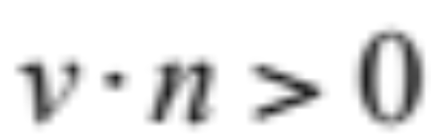
Backface Culling
For closed objects, back facing polygons are not visible
N
Backfacing iff:
V

Slide 15
Coherence makes hidden surface removal efficient
Many types of "coherence" are exploited in HSR algorithms.
  Sutherland, Sproull, and Schumacker paper (1974) on 10 HS methods
Object - all of object A is often farther than all of object B - usually no interpenetration
Face - parameters often vary smoothly over faces facilitating incremental computations
Edge - Visibility of edge only changes at edge crossings
Implied Edge - Visibility of polygon intersection seam is determined by intersection end points or edge crossings
Scan line - Set of visible surfaces in one scan line is similar to adjacent scan lines
Area - adjacent pixels are often covered by same object face
Span - adjacent pixels in horizontal span are often covered by same object face
Depth - Adjacent pixels covered by same object are similar in depth (linear relationship for triangles). Also applies to other surface parameters.
Frame - Most pixel values don't change much from image to image for smooth camera motions. (MPEG Compression is based on this)

Slide 16
Transformations
Linear transformations map coords in one coordinate frame to another (1:1 and invertible).
V_{b} = X_{ba} V_{a}
  homogeneous vectors are 4x1 columns
  homogeneous transforms are 4x4
  Must divide by w for projected 3D values of result vectors - example shown later
General Xforms can be decomposed into scale, translate, rotate, shear, reflection, …
View Xforms are subset based on S T R
  Scale, Translate, Rotate
  do not allow shears and other non-shape preserving transforms

Slide 17
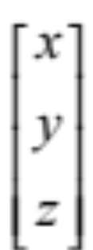
Basic Types
Scalars: s
Points:
Direction vectors:

Slide 18
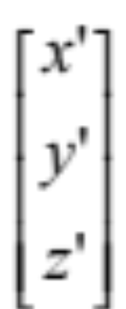
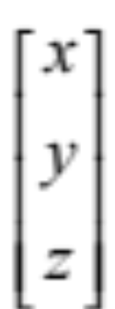
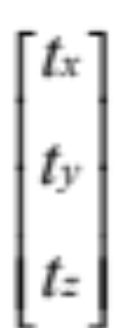
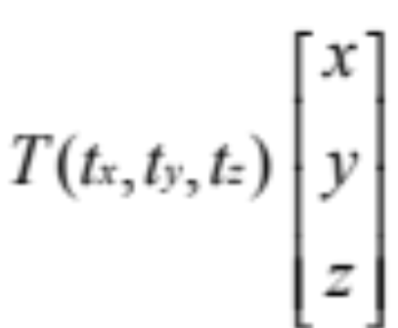
Translations
Translations occur along the axes of the space
Axis directions are preserved, but origin changes
=
+
=
+

Slide 19





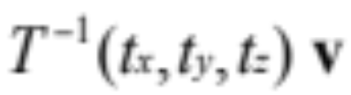

Properties of Translation
=
=
=
=

Slide 20


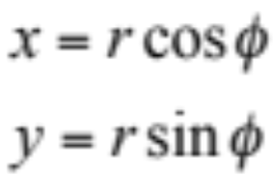

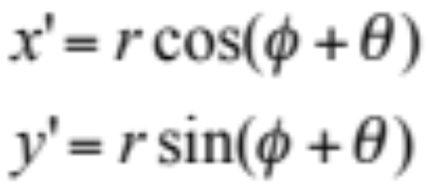



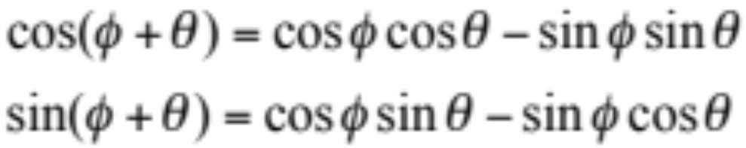
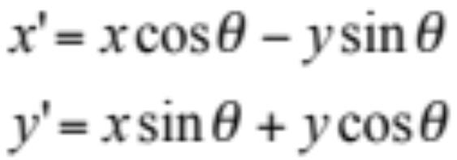
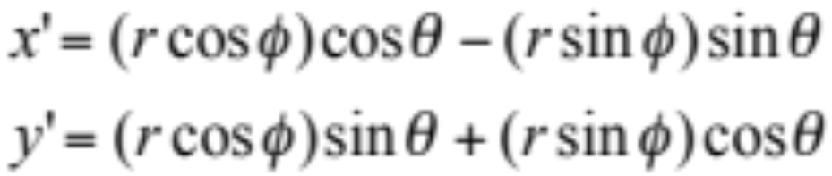
Rotations (2D)

Slide 21
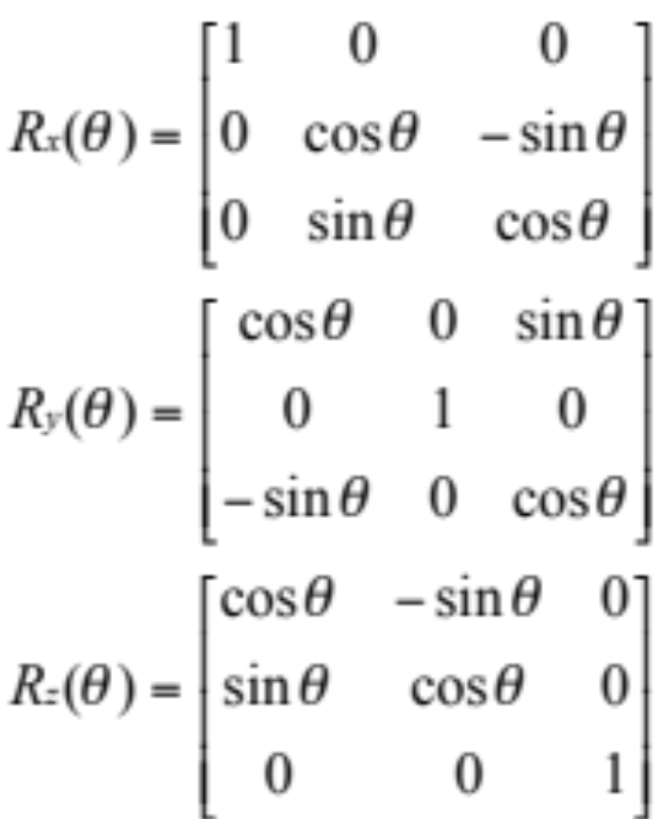
3D Axis Rotations
Rotations occur about the origin of the space
The origin does not change (fixed-point), but the axis directions do
The input axes prior to rotation (e.g., (1,0,0) … ) become some non-axis vectors (x,y,z) in the output space

Slide 22
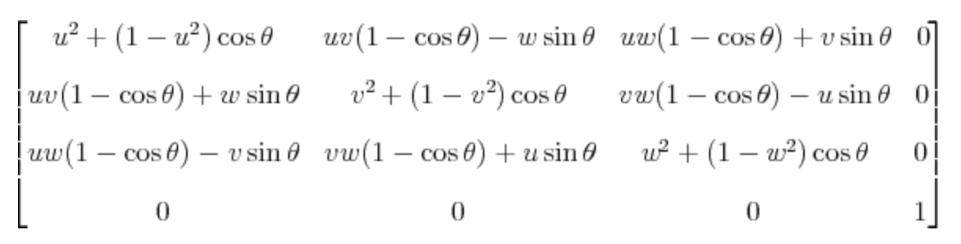
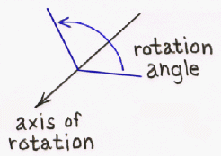
3D General Rotation
This matrix will rotate the point (x,y,z) about the vector ⟨u,v,w⟩ by the angle θ, under the assumption that ⟨u,v,w⟩ is a unit vector; i.e., that u² + v² + w² = 1
http://inside.mines.edu/~gmurray/ArbitraryAxisRotation/

Slide 23
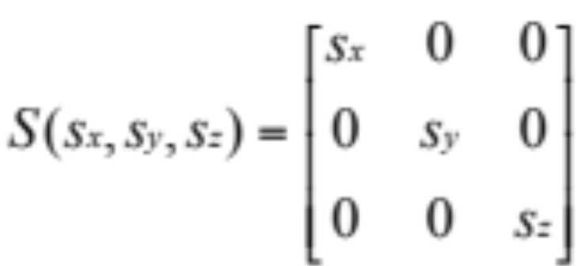
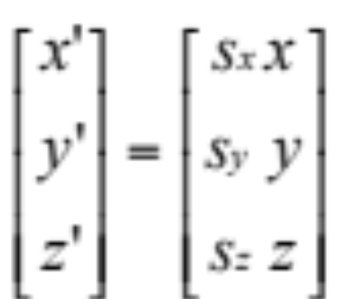

Scaling
Scaling occurs about the origin of the space
The origin does not change (fixed-point)
The axis directions do not change (preserves axes)
Distances change between input and output
Uniform scaling iff

Slide 24
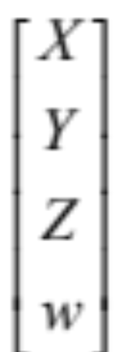
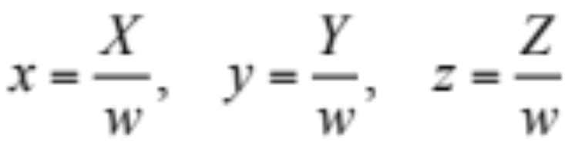
Homogeneous Coordinates
can be represented as
where

Slide 25
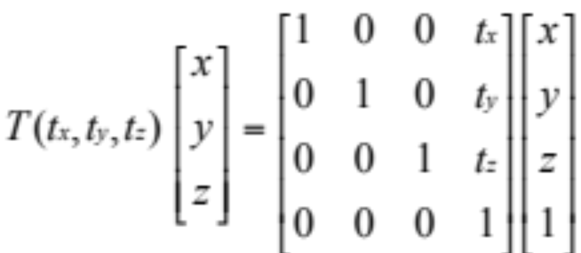
Translation Revisited homogeneous transformation

Slide 26
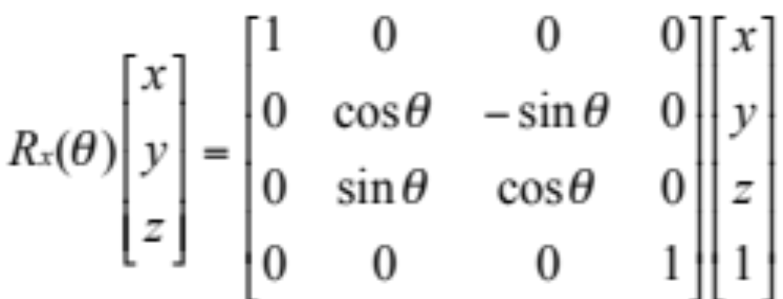
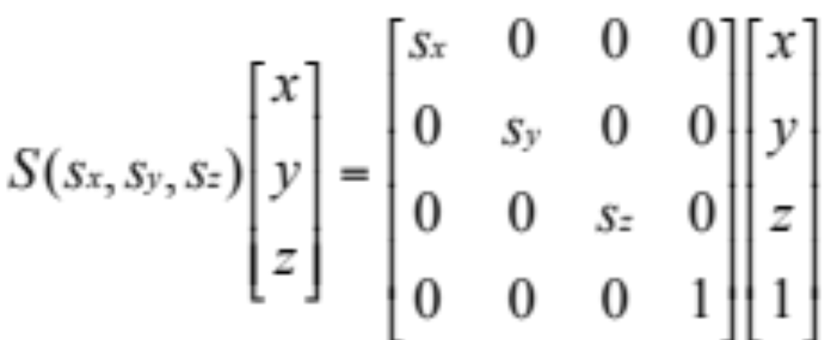
Rotation & Scaling Revisited homogeneous transformation

Slide 27
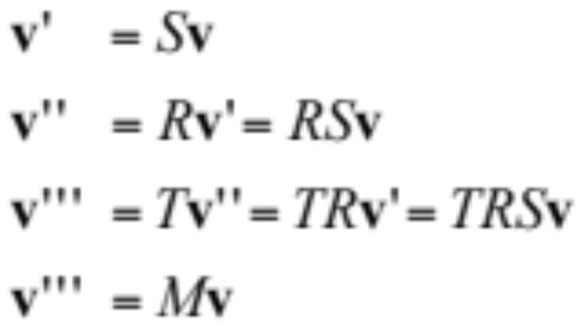

Composing Transformations
where

Slide 28
Scale and Rotation Composed
Xac = Xab Xbc
  chain matrices to arbitrary length (fully associative)
Xac = T S R or T R S
  rotation and scaling commute - neither change origin
  Translations do not commute with R or S
    due to change of origin (fixed-point)
S
v
R
Origin
RSv = SRv

Slide 29
Translation
Translations do not commute with R or S
TR ≠RT TS ≠ST
TRv
RTv
TSv
v
STv
v
Origin
Origin

Slide 30
Rotation and translation composed
Y-rotation and translation = X_{ab} = T R
  Rotation about origin in space-b occurs first
  Then, translation using axis of space-a is applied
A different transformation (and matrix) is obtained if we reorder the operations as: X_{ab} = R T
  The translation occurs first, shifting the origin along the axes in space-b
  The rotation follows about the new origin and the Y-axis of space-b
cos ø 0 sin ø xt
0 1 0 yt
-sin ø 0 cos ø zt
0 0 0 1

Slide 31
Decomposing Transformations
Given 4x4 view/projection matrix - we can decompose it into T R S or T S R
(assume w = 1, and matrix has no shear or non-uniform scaling)
  T is upper three elements of right column
  R is 3x3 in UL corner
    may need to normalize so all ||columns,rows|| = 1
  R = R' S or S R' - rotation and scaling are mixed in same elements
  use any row/col and compute scale factor
    K = 1 / (a² + b² + c²)^{1/2}
  multiply all elements of 3x3 R : R' = K(R)
  R' is normalized (unitary) rotation matrix
  S is a diagonal matrix with elements = 1/K - scale factor extracted from R

Slide 32
Inverse Transformations
Rca = R⁻¹ac = R^{t}ac
  Transpose is inverse for unitary (pure) rotation mat
    Det = +/- 1
    Rows and Cols are orthogonal (R•C = 0)
    ||row|| = ||col|| = 1
Tca = T⁻¹ac = -Tac
  negate elements of column
Sca = S⁻¹ac = 1/Sac
  replace diagonal elements with their reciprocal
Given Xac = T S R
  Then we can get the inverse : X⁻¹ac = R⁻¹ S⁻¹ T⁻¹
  We know it’s the inverse because
    I = X⁻¹ac Xac = (R⁻¹ S⁻¹ T⁻¹) (T S R)

Slide 33
Perspective Projection
Perspective projection of (0,Y,Z) onto the Z=0 plane occurs at point a=(0,y,0)
Camera focal point is at z = -d (0,0,-d)
Use similar triangles ratio to compute y-coord of point a
a/d = Y/(Z+d)
a = Yd/(Z+d) = Y/[(Z/d)+1]
Do the same for X and Y coords to find a projected point (x,y,0) on the image plane x=X/[(Z/d)+1] y=Y/[(Z/d)+1]
y-axis
0,Y,Z
a
z= -d
z-axis

Slide 34
Projection Transformation
X, Y, and Z are transformed the same way in the projection process, so we use the same transformation
Projected points (x, y, z) are =
  Note : Screen-space 3D coords require divide after perspective transformation (divide by w = [(Z/d) +1] )
  Note: other projection formulations are in common use
    e.g., view point is z=0, and image plane at z=d
1 0 0 0
0 1 0 0
0 0 1 0
0 0 1/d 1
X,Y,Z
[(Z/d) + 1]

Slide 35
Z-Projections
Z= 0
Point B is the mid-point between points A and C
  The projection (b) is not at the mid-point of projected points a and c
  Linear interpolation of Z values from a (Z=21) to c (Z=1) would not produce correct z value at point b
  Point b would have Z>11 – which is incorrect for a z buffer test at that pixel
For interpolation of Z during rasterization, we must do the perspective transformation of Z onto the z=0 plane and interpolate the transformed z values z = Z/[(Z/d)+1]
a
bc
Z= -d
Z=1 Z = 11 Z = 21
C B A

Slide 36
Examine projected value of z = Z/(Z/d+1)
For large Z (∞ distance), perspective projected z --> d
For Z=0, X=x, Y=y,
  points in view plane (Z=0) project to themselves
For Z=-d, z = -∞
  FP exceptions with Z = -d !
  Implement a clip (cull) plane at Z ≤ 0 to discard any tri with a negative Z value at any vertex --- before you do divide by w
  Asymptotic curve of Z vs. z approaches d and causes resolution problems for points at high values of Z (map to the same z)
  See Graphics Hardware Workshop 1998 - 2002 For "Optimal Depth Buffer or Low-Cost Graphics Hardware" papers
z
d
Z

