Slide 1
Class 5
Illumination and Shading
CS580
(Computer Graphics Rendering)
Ulrich Neumann

Slide 2
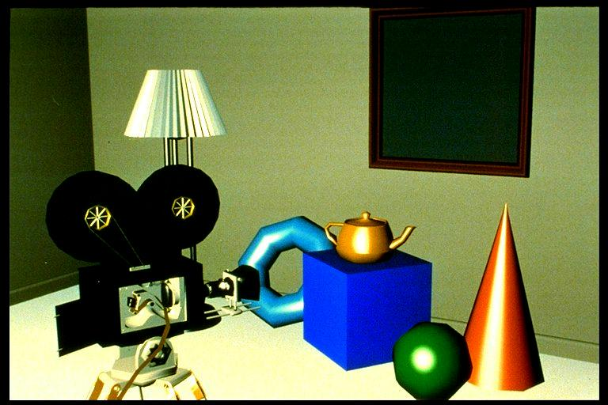
Illumination and shading
Illumination (lighting) and shading
  models simulation of light interactions with scene
  light sources, geometry, propagation, interaction with surfaces, imaging process in camera

Slide 3
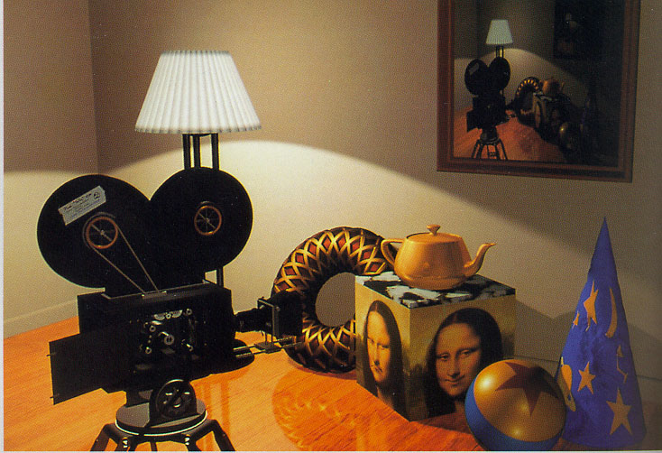
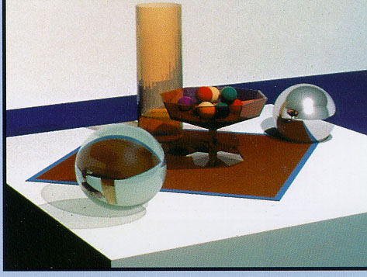
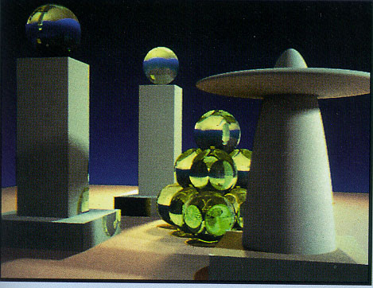
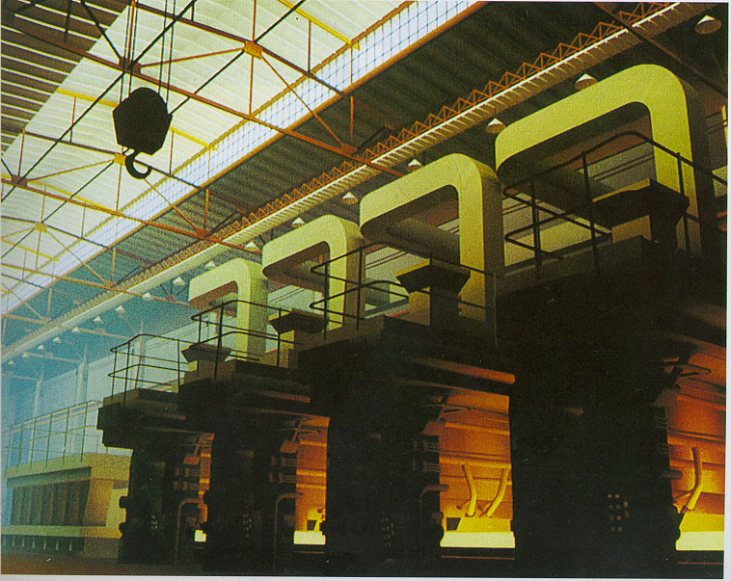
Shading Examples
Images courtesy of Watt, Watt & Watt, and Foley & van Dam

Slide 4


Global versus Local Illumination
Direct Illumination
Indirect Illumination

Slide 5
Global versus Local Illumination
Global Illumination
  Considers indirect illumination and occlusions
    Reflection
    Refraction
    Shadows
Local Illumination
  Only considers direct illumination
    No reflection
    No refraction
    No shadows

Slide 6
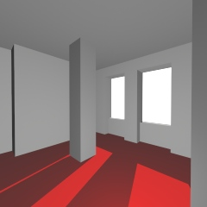
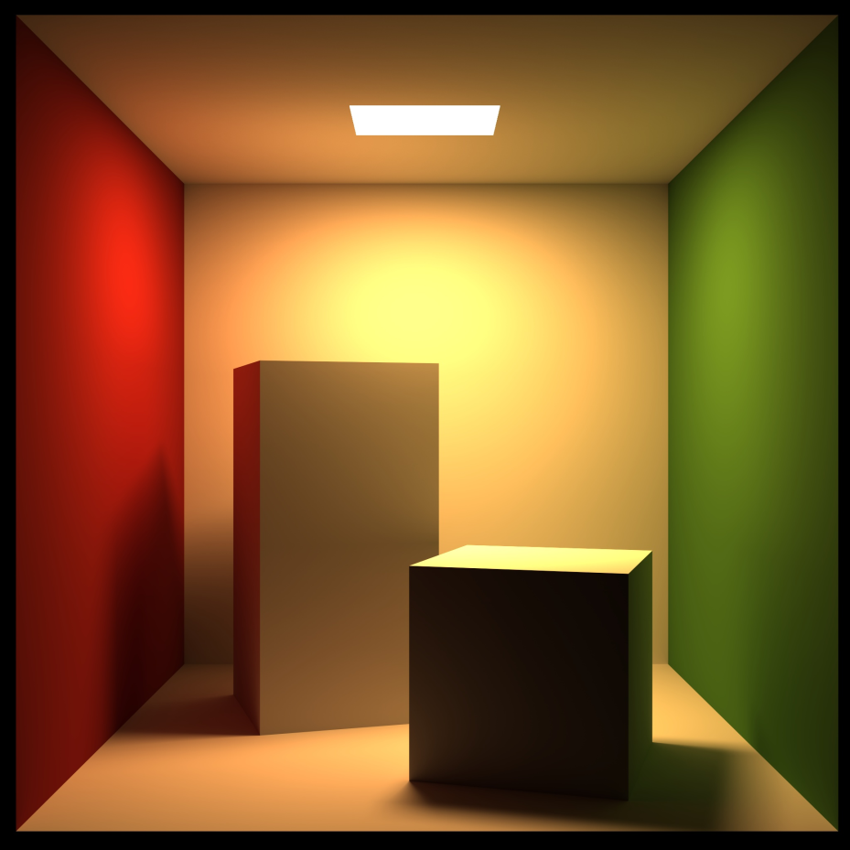
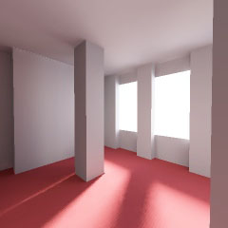
Global versus Local Illumination
We start with simple local illumination and then extend those concepts/models to global illumination. Here are cases showing diffusion and shadows.

Slide 7
Light Terminology
Radiant Intensity (I = W/sr)
  Illuminating energy emitted by a light source
Irradiance or Illuminance (E = W/m² )
  Light energy falling on a surface area
Radiance or Luminance (L = W/m²/sr)
  Light energy reflected by a surface area

Slide 8


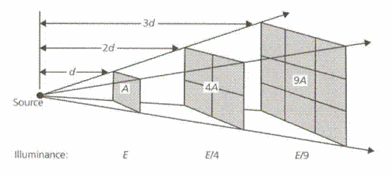
Light Source Radiant Intensity
Radiant Intensity per steradian
  Ie(x) = power/sr (Watts/steradian)
  constant in vacuum at all distances
Ie is constant over distance for a
fixed solid angle
Solid angle
  sr = surface area (a) of portion of sphere divided by r²
    sr = a/r²
  Area of sphere surface = 4 pi r²
  sr = (4pi r²)/r² sr = 4pi steradians over sphere – for any radius
E = Watt/m²
  Radiance or Power Density
  falls off with
  square of distance
Ie = Power over these areas

Slide 9
Light Intensity
Ie is specified as coefficients of color spectrum or basis function (RGB, HSV...)
Ie = (R,G,B) | R,G,B ∈ [0,1]
  for each color channel -- we just set RGB
  arbitrary scale and units
  e.g., Ie = (0.1, 0.6, 0.9)

Slide 10
Light Source Geometry
Geometry parameters that affect illumination of a scene
  Size and shape
  Position and orientation
  Directional distribution
Ie = f(θ) Directional distribution of intensity can vary for a point-source or a region of an area light-source
  Occlusions in the light source structure also modify the intensity and distribution of light energy over different regions in the scene
A large area source can be approximated as multiple uniform-intensity regions that each contribute independently to the scene
A small source and scene-area (relative to distance between light and scene) can be approximated as a uniform fixed-directional distribution

Slide 11
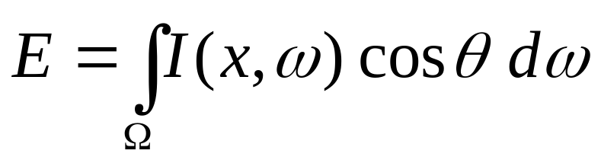
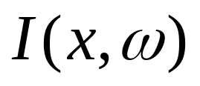
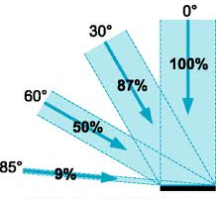


Irradiance
Irradiance: Incident radiant energy per unit area

Slide 12
Lighting of surfaces
The total intensity E(x) falling on some surface area of a scene requires integral of Ie function over subtended solid angle
  even fairly simple cases can be difficult to compute
For Simplicity (for HW4). … assume infinitely distant point-light source (e.g., sun, or light bulb in a large room)
  Source has uniform radial intensity distribution
  E = ~ constant within distances in scene - neglect falloff
    Solid angle per unit surface area is ~ constant everywhere
  Direction to source is constant within scene
  This simple approximation of actual physics only requires two parameters to define a light
    direction (x,y,z) - vector from surface to light source
    intensity (r,g,b)

Slide 13
Propagation
Interaction of light with medium
  scattering and absorption
We use simplifying approximations
  vacuum,
  opaque scene objects,
  ideal camera imaging
No propagation effects
  like haze, smoke, thermal shimmer, lens flare, etc.
FYI: Papers by Ron Henry (USC)
  Color Perception through Atmospheric Haze

Slide 14
Interaction with surfaces
A surface hit by light reflects/refracts light
Two extremes in observed interaction classes:
  mirrors – specular reflection
    reflect incoming ray about surface normal
    no scatter with ideal mirror
    color shift or attenuation is possible
  Ideal white chalk – diffuse reflection
    ray hits area A and scatters in all directions (ideal case)
    color shift or attenuation can occur

Slide 15


Ideal Specular Reflection
Reflection occurs in the “mirror” direction
L reflected about the normal vector = R
Ij = Ie Ks Reflected light is attenuated (colored)
Ks is RGB vector of “specular color” coefficients [0,1]
Ie
Ij
R

Slide 16
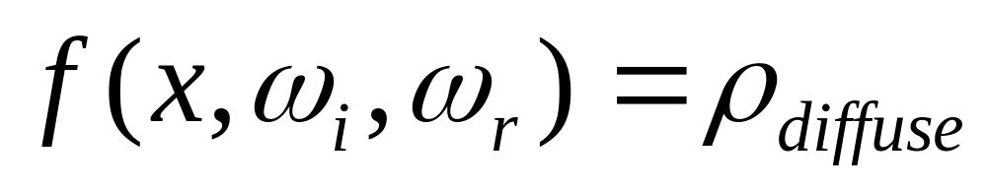
Ideal Diffuse Reflection
Reflection is equal in all directions
Incoming energy is distributed equally in all directions
Rho is the coefficient of out/in intensity for the simple case where L and N are coincident

Slide 17
Absorption model
Reflected intensity Ij (over the exit hemisphere) is Ie scaled by ρ=Kd, to model absorption (color) of a surface
  Ij = Ie Kd (N and L are coincident)
    Kd is RGB vector of “diffuse color” coefficients [0,1]
Ie
Ij

Slide 18
Absorption model (2)
In the general case where L varies
  Ij = Ie Kd cos(θ)
    cos(θ) accounts for change in projected surface area of incident light Ie
    L•N computes cos (θ) function (both unit vectors)
    Kd is RGB vector of “diffuse color” coefficients [0,1]
Ie
Ij

Slide 19
Combined Specular and Diffuse Reflection
Real materials exhibit a mix of both reflection characteristics
There is diffuse reflection energy in all directions and a peak of specular reflected energy in the R direction
A camera will “see” the energy emitted in the direction of the camera (E)
N
R
L
E points toward
the camera
- Ignore power density falloff in light traveling to camera

Slide 20
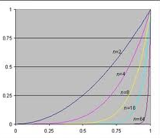
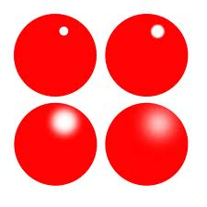
Control of Specular Reflection
Real materials have varying degrees of “shininess” or smoothness that alters the specular reflection directional distribution.
  The reflection distribution can be a sharp peak or a broader bump of reflected energy in the R direction
The specular power “s” is used to control this distribution
  spec intensity seen by camera = Ie Ks(R•E)^{s}
  in direction E
(R•E)^{n}
Ie
N
R
L
E
(R•E)

Slide 21
Ambient Light
Light incident to surface is not only along direct path from sources
Many inter-reflections are modeled as a lumped omnidirectional source called the ambient light
Ambient light Ia is an fixed intensity vector and normal to all surfaces
Ambient light produces an additional diffuse reflection called an ambient reflection
Ka is specified for materials as the “ambient color”
  Use separate Ka for HW4 (other systems may set Ka = Kd)
Only one ambient light is needed/allowed

Slide 22
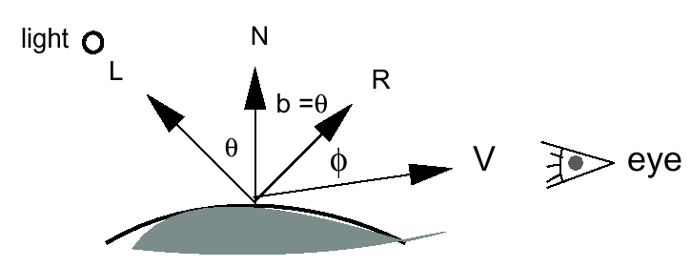
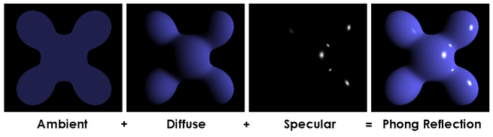
Specular, Diffuse, Ambient
Color Components
Real material surfaces exhibit aspects of all 3 reflection behaviors
Specular reflection intensity
  spec component = Ie Ks(R•E)^{s}
Diffuse reflection intensity
  diff component = Ie Kd (N•L)
Ambient reflection intensity
  ambient component = Ia Ka
E

Slide 23
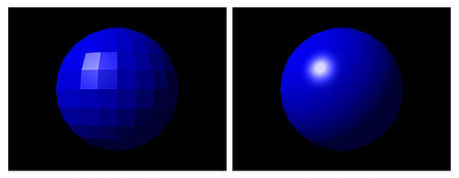
Specular, Diffuse, Ambient
Color Components
Absorption (or color) for each reflection component is modeled by
  Ks, Kd, Ka ---- each is a vector of fractional attenuation [0,1]
For most real materials, these equations are not physically accurate
Cos laws are only approximate behavior of most real materials
  K terms are often a function of incident/reflection angle and wavelength
Surface appearance is set by specifying Kd, Ks, Ka and spec power s
  Kd, Ks, Ka ∈ [0,1] for each rgb vector element
  Sharpness of specular highlight is controlled by specular power “s”
  “s” is often constrained
  to be a binary power
  for fast calculation
  (1, 2, 4, 8, 16, 32, … )
  Surface reflection model
  applies to any geometry

Slide 24
Complete Shading Equation
Surface color seen by camera is modeled by summing all light-surface interactions over all lights
Color C = Σ_{lights} specular + diffuse + ambient components
  = (Ks Σ[Ie (R•E)^{s}]) + (Kd Σ[Ie (N•L)]) + (Ka Ia)
C, Ie, Ks, Kd, Ka, Ia – are all RGB color vectors (∈ [0, 1])
R = reflected ray direction vector (normalized)
E = eye ray direction vector (normalized)
N = surface normal vector (normalized)
L = light ray direction vector (normalized)
This is an approximate model of illumination of opaque surfaces
  But…, geometry is involved -- dot products, cosines
Recall that the rasterizer operates on coordinates after perspective projection. Perspective does not preserve angles or lengths.
Lighting calculations must be done in some space before the perspective projection
  Model, world, or image space?

Slide 25
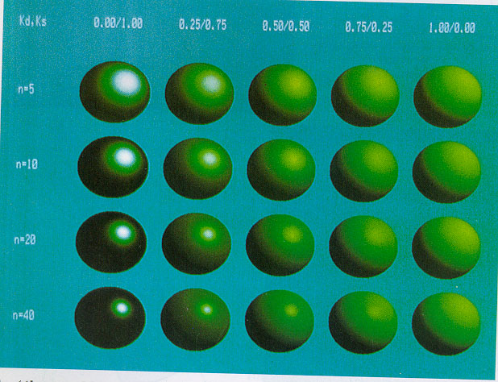
Phong Example with varied Kd, Ks, and s

