Slide 1
Class 7
Screen-Space Interpolation with Perspective Correction
CS580
(Computer Graphics Rendering)
Ulrich Neumann

Slide 2
Problem
Can we interpolate image space parameters over triangles in screen space?
  NO : accurate surface parameter interpolation has to take perspective into account.
  Line on screen in perspective shrinks most of the range into the last few pixels.

Slide 3
Checkerboard Example
Checkerboard defined as integer grid derived from vertex parameters
  red over odd/odd (o, o) and even/even (e, e) intervals
  black over odd/even intervals (e, o), (o, e)
Image midpoint is not actual midpoint of checkerboard
  Straight line along diagonal stays straight under perspective
0,2
1,2
2,2
0,1
2,1
0,0
2,0
1,0
Linear Interpolation
Perspective Interpolation
Mid-image checkerboard
interpolation
point is not mid-object
Correct mid-checkerboard
interpolation to mid-object

Slide 4
Parameter Interpolation
Similarly, linear interpolation of affine (image space) parameters like Z give wrong results at pixels
Interpolation of perspective Z is correct (all HW so far)
  we can recover image space result if we Xform perspective Z back to image (affine) space after interpolation
Effect is modest for scene like teapot where Z range is small, or with narrow FOV
  Roads to horizon, grazing angles on slightly curved surface like a car hood, and wide FOV cameras produce a more dramatic impact
Need correct interpolation of u,v texture coords in HW5
Z= 0
a
bc
Z= -d
Z=1 Z = 11 Z = 21

Slide 5
Color and Normal interpolation
Color and Normal interpolation (Gouraud/Phong) is actually wrong (in HW 4) since parameters are interpolated as image space values
  Colors and Norms are not warped to perspective space where depth is taken into account
Ignore error in color interpolation – an approximation
  Human visual perception is not sensitive to absolute rate of color change
  Poor sense of color interpolation error
  Visual system is sensitive to discontinuities – but those are smoothed by interpolation
  Most triangles have small color change
Ignore error in normal interpolation – an approximation
  Human visual perception is not sensitive to this problem (as above)
  Most triangles have small normal variations – much larger highlight errors usually result from approximations of L and E as constant over the scene.

Slide 6
Perspective warping
Perspective warping should be performed on parameters that can have abrupt effects like texture coords (obvious problem for checkerboard) or normals on mirror surfaces
Note that z-interpolation in screen or perspective space only differ by scale – which does not affect the nature of the perspective warp
  Warping effect is the same for any scaling
  Both spaces interpolate correctly

Slide 7
Any parameter P can be properly interpolated by…
Transforming (warping) vertex parameter values to perspective space
Interpolating at new sample points (pixels)
Transforming (unwarping) interpolated pixel values back to affine space

Slide 8
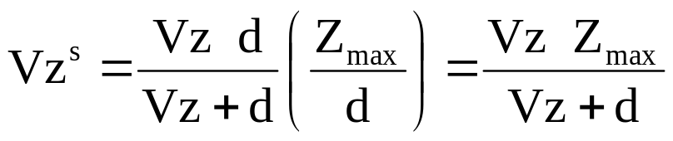
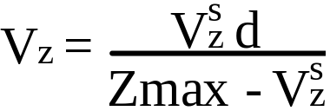
What happens to Z study Z as an example of perspective interpolation
Let: V be image-space point, V^{s} be its transformed screen-space position
Writing the transformation as an equation:
(1)
(2)
We scaled Xpi to scale Vz^{s} ∈ [0, Zmax] to bound it for Z-buffer range
(3)
Scaling by Zmax/d doesn’t alter perspective characteristic that arise from divide by (Vz+d)
Invert the relation to find Vz (image space)
(4)

Slide 9
Interpolating Parameters
Use the unscaled Xpi matrix (Eq 2) for any parameter P
(in image-space) that we wish to transform to screen space, P^{s} for correct interpolation in screen space
(5)
After interpolation of P^{s} parameter values to a pixel, the pixel-value can be transformed back to image space
(6)
Note that d plays a role in the transformations and that we need V_{z} values at each vertex (for Eq5) and pixel (for Eq 6)
We don’t have V_{z}, but we do know V_{z}^{s} the screen space z-values at the vertices and at each pixel
P^{s} = P d / (V_{z} + d)
P = P^{s} (V_{z} + d) / d

Slide 10
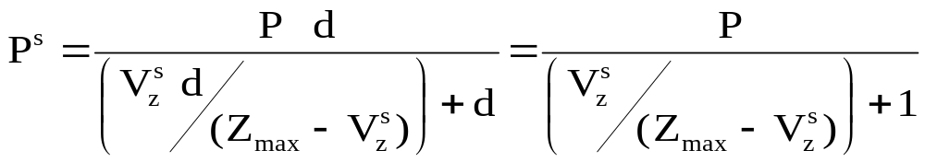
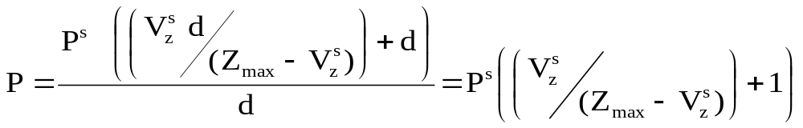
Interpolation Using Screen Z
If we plug in Eq. 4 for Vz in equation 5, we get
(7)
and (6) becomes
(8)
In both cases the d’s cancel so in fact, d is not needed.
Note that Zmax is needed, but it is constant and known.
We can use (7) and (8) as transformations between image and screen space to interpolate any parameter to any pixel using screen-space z-values, which we know everywhere

Slide 11
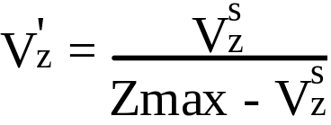
Interpolation Simplified
Create a new term V′z based on screen space Z interpolated during rendering
(9)
Then we use (9) in (7) to transform parameter into perspective space before interpolation
(10)
and in (8) to transform interpolated parameters back to affine space after interpolation
(11)
P^{s} = P / (V'_{z} + 1)
P = P^{s} (V'_{z} + 1)

Slide 12
Summary
By using (9), (10), and (11) we perform perspective-corrected interpolation for any affine-space parameter
  without dealing with d and only using screen-z values
Note that V_{z}^{s} , (screen space Z) is needed (in 9) at each point where transformations are done in or out of perspective space
  We already know it at vertices and we compute
  interpolated V_{z}^{s} (screen-space Z values) for Z-buffer

Slide 13
HW5 texture procedure
The procedure for texture uv coordinate interpolation needed for HW5 is
  1. Use (9) and (10) for each vertex u,v (in affine space) and to transform them to perspective space U,V (use V_{z}^{s} at each vertex)
  2. Interpolate transformed U,V components (like Z)
  3. At each visible pixel in triangle (after Z-buffer test)
  3.a. Use interpolated V_{z}^{s} in (9) and (11) to transform interpolated
  U,V back to affine space u,v values
  3.b. Compute texture color = f(u,v) and evaluate shading equation

