Slide 1
Class 8
Image Textures
HW5
CS580
(Computer Graphics Rendering)
Ulrich Neumann

Slide 2
How can we model a cloth-covered chair next to a wood bowl with oranges?
Geometry, color, lighting model
  Operate over wide range of scales
Geometry defined by triangle faces
  Coarse facets approximate true shape
  Material properties are defined per triangle (K's)
  Lighting parameters are defined at vertices (normals)
Vertex or facet parameters can not convey tri-interior details or variations in color, smoothness, or opacity
Geometry, color, and smoothness variations occur at different scales
  For example a printed picture has a flat simple geometry, but complex color
  An orange peel (or plastic chair) has simple color, and although wrinkled surface is a minor change in overall geometry, the wrinkles have large impact on shading due to complex small scale variation of surface normals

Slide 3
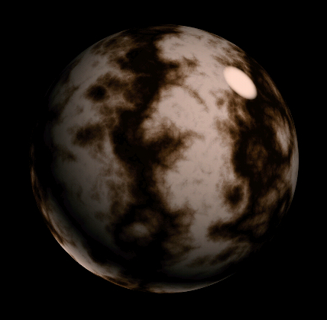
Texture Example
Simple model and complex color
  Could be a sphere equation x² + y² + z² = K
How do we define color everywhere?
  Not just constant K-terms for entire object
  Not just at shading at vertices

Slide 4
Textures
Textures are techniques for conveying small-scale complexity beyond vertex geometry and parameters
Any part of the graphics process can be textured
  use any mapping from the object surface to some set of parameters involved in rendering
A texture could affect, for example:
  Geometry (displacement, cut/stencil)
  Material properties (color, opacity)
  Shading equation parameters (normals, light visibility/shadows)

Slide 5
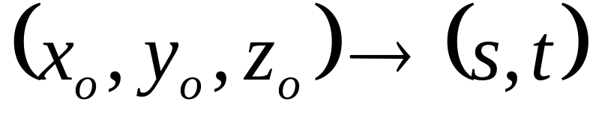

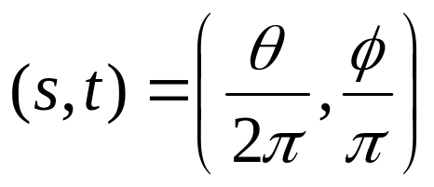
Mapping Function
Many possible mapping functions - in general:
        map 3D points on a surface to 2D parameters
Example - sphere mapping: a computed mapping
Convert sphere coords (x, y, z) to angles
Normalize angles to produce
texture coords (2D) (s, t) spanning [0,1]

Slide 6
Mappings for Arbitrary Models
Computed mappings don’t exist for most objects
  The modeling process includes a surface mapping with coordinates defined at each vertex
Teapot has (u,v) coords at each vertex
  Defined domain [0,1] for the coords
  Each point on the model surface has a surface coordinate (u,v) distinct from its 3D coordinate (x,y,z)

Slide 7
2D Image Textures (HW5)
Surface parameters (u,v) define (2D:2D) mapping from a triangle surface location to a texture-image location
u,v coords range over [0, 1]
  per our model construction and definition
Simply scale these 2to index into a 2D image (pixel array of xs, ys)
u and v are fixed parameters at verts, no transformations needed, however u,v must be warped for perspective-corrected interpolation
Linear Interpolation
Perspective Interpolation
Incorrect
Correct

Slide 8
2D Image Textures (HW5)
Surface parameters (u,v) define (2D:2D) mapping from a triangle surface location to a texture-image location
(u,v) coords range over [0, 1]
  per our model construction and definition
Scale the 2D coords to index into a 2D image
  pixel array of x-size, y-size (e.g., 256x256)
u and v are fixed parameters at verts, no transformations impact these values
  lat, long mapping on earth surface doesn’t change as earth spins
however u,v interpolation must be perspective-corrected to ensure u,v values are consistent for any surface point
Incorrect
Correct
Linear Interpolation
Perspective Interpolation

Slide 9
2D Image Texture Process
Interpolate texture coords to pixels
Warp u,v to perspective space (U,V) at verts
Interpolate U,V to pixel coords
Unwarp U,V to get u,v at each pixel
Do texture look up at a pixel u,v → Color = f(u,v)
Scale u,v to texture image size (x-size, y-size)
  Scaling is done by multiply of pixel u,v by
  x-size -1 and y-size -1 (size of image texture)
Interpolate image-pixel colors to texture sample point
  Reconstruct texture-image color at image sample point

Slide 10

Texture-Image Lookup Example
U,V → u,v
u * (Xsize-1) = 2.4
v * (Ysize-1) = 3.6
0,0
u,v → U,V
U,V
u,v → U,V
u,v → U,V
Rasterized Triangle
Image Texture Map
x-size = 8 y-size = 7
7,6
Color for the triangle pixel is found in the texture map image
…but the sample point lies between pixels
So we interpolate Color (2.4,3.6) as a function of the surrounding pixel colors (locations 2,3 2,4 3,3 3,4)

Slide 11
Bilinear Interpolation
Apply a reconstruction (interpolation) filter
  Bilinear interpolation, cubic, etc.
We will use simple bilinear interpolation
  Triangle/pyramid reconstruction filter (use for HW5)
Color(p) = s t C + (1-s) t D + s (1-t) B + (1-s) (1-t) A
  s, t are fractional distances [0,1]
  A, B, C, D are pixel colors at integer-coord pixels
A
B
t
Interpolation is used to find color between pixel locations
(e,g., at point “p” in figure)
s
p
D
C

Slide 12
Texture Color for Phong Shading HW5
Compute Phong shading as in HW4 – but now set Kd and Ka at each pixel to color computed by texture lookup process
  First, do u,v interpolation to a pixel
  Then, texture color lookup with bilinear interpolation
  Then shading calculation with texture color used as Kd and Ka (with normal interpolation)
    Keep Ks as set by application in the renderer state
    Material specular color is often independent of diffuse color

Slide 13
Texture Color for Gouraud Shading
Normally, Gouraud shading computes shading Eq at verticies – but we can’t do that if we want to use a texture
So…delay the color (K’s) multiplies until we do pixel rasterization where we can do a texture K lookup
For simplicity, we set K_{T} = Kd = Ks = Ka for Gouraud textures
  K_{T} is the texture color (RGB triple)
Gouraud or color interpolation is done as light-intensity interpolation from modified vertex shading calculation
  Delay the multiplication of cumulative light intensities by Ka, Kd, Ks
  Multiply by pixel-by-pixel texture color at pixel rasterization time
C = (Ks Σ_{L} [Ie (R•E)^{s}] ) + (Kd Σ_{L} [Ie (N•L)]) + (Ka Ia)
C = (K_{T}) (Σ_{L} [Ie (R•E)^{s}] + Σ_{L} [Ie (N•L)] + Ia)
pixel-by-pixel texture lookup compute at vertices and interpolate to pixels

Slide 14
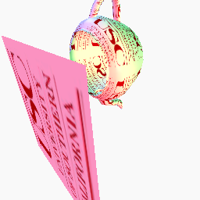
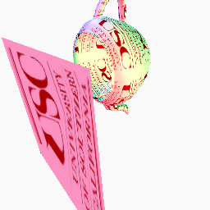

HW5 results
Perspective correction no perspective correction
texture image

Slide 15
HW5
Add texturing capabilities to your renderer.
Load a specific ppm-format texture file ("texture") that is applied to every triangle.
A new input file “ppot.asc” contains a teapot sitting on a plane.
When rendered without perspective correction, it produces ppot.np.ppm.
When rendered with perspective correction, it produces ppot.p.ppm. Note the difference.
Your renderer should make the equivalent of ppot.p.ppm. ppot.np.ppm is only for reference.
Try some other texture images too. Any ppm image should work (e.g., photos or results from prior HWs)
The texture parameter that is passed to the renderer is a pointer to a function.
  tex_fun.skel helps you build your own texture function for image textures
  complete the texture function by adding bilinear interpolation and bounds checking as described in the class slides.
You need to support textures with Phong shading and Gouraud shading (no flat).
  Gouraud shading treats the texture color as Ka, Kd, and Ks.
  Phong shading uses the texture color as Ka and Kd. Ks, the specular parameter, remains as defined for the triangle. The ppm result images (next slide) were created with Phong shading.

Slide 16
tex_fun.cpp code fragments (1)
GzColor *image;
int xs, ys, reset = 1;
int tex_fun(float u, float v, GzColor color) /* accept u,v and write color */
{ unsigned char pixel[3]; unsigned char dummy;
char foo[8]; int i, j; FILE *fd;
if (reset) { /* open and load texture file */
fd = fopen ("texture", "rb");
if (fd == NULL) {
fprintf (stderr, "texture file not found\n");
exit(-1);
}
fscanf (fd, "%s %d %d %c", foo, &xs, &ys, &dummy);
image = (GzColor*)malloc(sizeof(GzColor)*(xs+1)*(ys+1));
if (image == NULL) {
fprintf (stderr, "malloc for texture image failed\n");
exit(-1);
}

Slide 17
tex_fun.cpp code fragments (2)
for (i = 0; i < xs*ys; i++) { /* create array of GzColor values */
fread(pixel, sizeof(pixel), 1, fd);
image[i][RED] = (float)((int)pixel[RED]) * (1.0 / 255.0);
image[i][GREEN] = (float)((int)pixel[GREEN]) * (1.0 / 255.0);
image[i][BLUE] = (float)((int)pixel[BLUE]) * (1.0 / 255.0);
}
reset = 0; /* init is done */
fclose(fd);
}
/* bounds-test u,v to make sure nothing will overflow image array bounds */
/* determine texture cell 4-corner values and perform bilinear interpolation */
/* set color to interpolated GzColor value and return */
}
/* Procedural texture function */
int ptex_fun(float u, float v, GzColor color)
{
}

Slide 18
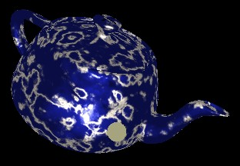
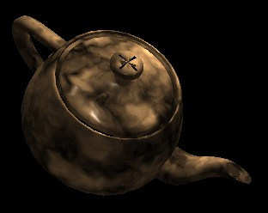

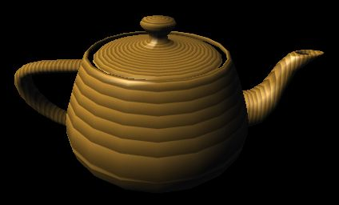
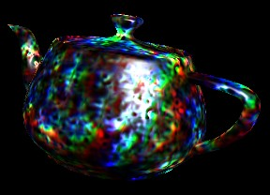
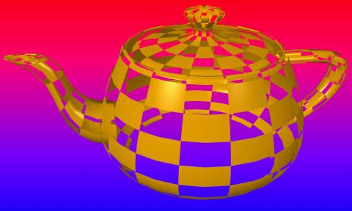
HW5 : procedural texture
Next topic extends HW5
As the second part of HW5, you need to write "ptex_fun()" a procedural texture.
You're free to implement a simple noise function, or Julia set, or whatever function of u,v you want as long the as a texture pattern is clearly evident.
Use your imagination....

Slide 19
Summary of control at various levels of detail
 | Geometry (X,Y,Z) | Surface Properties (colors, norms) | Lighting & Shading
Global | Placement or physical interaction | Micro-facet displacement maps | Area light sources, global illumination (radiosity, environment maps)
Model - poly | point samples at vert coords (planar surface continuity) | per-model, per-poly (no continuity of norms) | per-model or poly lighting / uniform color (no shading)
Vertex - pixel | patches (higher-order surface continuity >C0) | per-vertex or node (C0 continuity of norms) | per-vertex lighting / color interpolation (continuity and radial symmetry)
pixel | displacement/cut texture dx,dy,dz (function, image) | Textured surface parameters Ka,Kd,Ks,s,a,N | per-pixel lighting with interpolated or textured N (Phong, bump-maps,…)
Pixel-sub-pixel BRDF | Micro-facet displacement maps | BRDF model /texture (No radial symmetry assumed in BRDF(λ,η,α,β) | BRDF volume or surface lighting evaluation (No radial symmetry)

