Slide 1
Class 9. Procedural Textures and Environment Maps for HW5
CS580
(Computer Graphics Rendering)
Ulrich Neumann

Slide 2
Texture can set any parameters
Textures can be used to modify or set any parameters of the rendering process
  Geometry, surface characteristics, lighting and shading model,
  Displacement, normal perturbation, shadow maps, reflection, etc...
  (survey of textures - Heckbert, and any books)

Slide 3
Texture Dimensions
Texture output parameters can be 1D, 2D, 3D, ... any-D
Texture input parameters can be 2D (u,v), or 3D (u,v,w) for surface or volume mappings
Input/Output parameters can also include surface orientation vectors
  Tangent (t), normal (n), binormal (s)
  (usually specified in model space as part of model file)
  (u,v, t,n,s) can be used to orient a bumpmap texture on a surface
Normal perturbation is f(u,v) = (dn/dt, dn/ds)
  A 2D parameter (uv) maps to a 2D modification of a 3D vector at each pixel => bump mapping

Slide 4
Bump Mapping
Use texture to perturb normals
- create a bump-like shading effect
+
=
original surface
bump map
modified surface
NOTE: Does not alter the actual geometry
Bump map only affects the shading process
… so there is inconsistency at silhouette edges

Slide 5
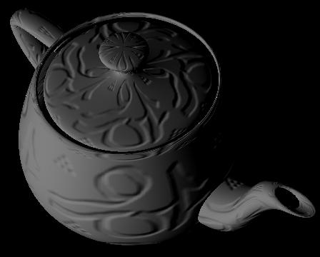
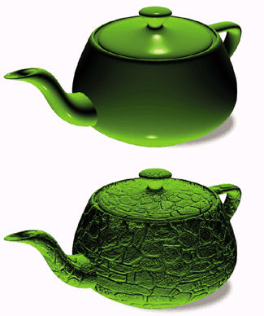
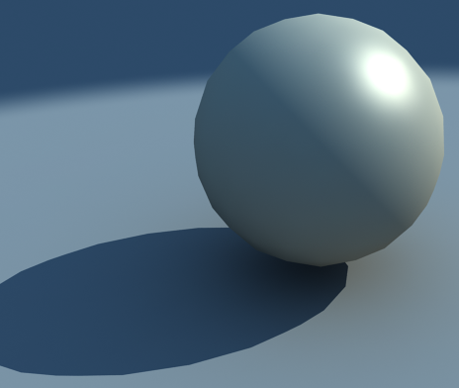
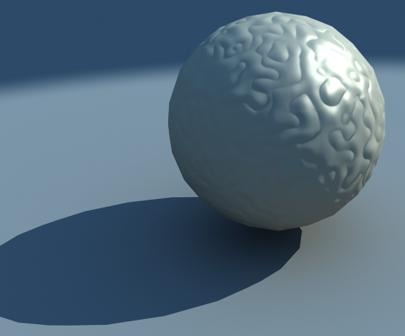

Bump Map Examples

Slide 6
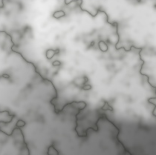
Textures are general functions
Lookup table images are only one f(u,v) evaluation method
Mathematical or procedural functions are another

Slide 7


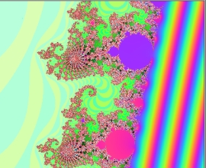




Fractal texture(1)
A fractal texture function is evaluated as an iterative function in the plane
This is perfect for a texture since we have 2D texture coords
A Mandlebrot set X = X² + C where X and C are complex numbers
  X = (Xr + Xi) i=sqrt(-1)
  C = texture coords u+vi,
  X = 0+0i initially
  Complex multiply XY = (Xr Yr - XiYi) r + (Xr Yi + XiYr) i

Slide 8
Fractal texture(2)
The Julia set is also X = X² + C
  X = u+vi
  C = constant
    C = (-0.12375+0.56805i) or (-0.012+0.74i) : possible start values
For either function, do N-iterations and evaluate the result X
  N = 100 – 500 for example (higher N produces more visual detail)
  Length (X) = sqrt(Xr² + |Xi|²) measured after iterations
Map a clamped range (e.g., [0,2]) of Length(X) value to pseudo-colors using a color look up table (LUT) and interpolation
  Color LUT maps scalar S : vector C (R,G,B) returned as texture color
Fractal procedural textures require two functions
  F(u,v) -> scalar length (fractal function)
  G(scalar length) -> color (color function)

Slide 9
Color LUT
Map Scalar to Color (aka pseudocolor)
  At discrete values of S (S1, …, Sn) define colors (C1, …, Cn) to create LUT
  Given a new S, interpolate (reconstruct) its color value from nearest color values
    C = a C_{i} + b C_{i+1} a, b = [0, 1] fractional distances between LUT entries
    i, i+1 are LUT indices for closest (bracketing) scalar values to S S_{i} ≤ S < S_{i+1}
    a = (S_{i+1} - S) / (S_{i+1} - S_{i}) b = (S - S_{i}) / (S_{i+1} - S_{i})
S = 0.47
b = . 07/.2
a = . 13/.2
C_{i}
C_{i+1}
0 0.2 0.4 0.6 0.8 1.0 1.2 1.4 1.6 1.8 2
11 discrete color values span the range of input [0,2]
Continuous input values (S) result in smoothly interpolated color output

Slide 10
Band-limited procedural noise
[Perlin, Sig 85] used for creating water, marble, fire
  Create a 3D lattice of points (x,y,z) with values for scalar random noise and its gradient at each lattice point] H(x,y,z) = [a,b,c,d]
    H is basically a 3D hash function (i.e. LUT)
    d is a scalar amplitude (computed by some noise/random function evaluation)
    a,b,c are gradient of d in x,y,z,
    a.b.c.d are within some +/- range (clamped)
  noise(point) = d (scalar amplitude of texture)
  dnoise(point) = (a,b,c) (vector direction texture)
    off-lattice values are found by tri-cubic interpolation (smooth, 4-point filter)
    lattice addressing is modulo its size - addresses wrap for edge continuity
  color = surface color * noise(point) simply modulates color by noise
    point is either (x,y,z) model space coord, or (u,v,w), or (u,v,k)
    u,v = 2D surface texture coord, k=constant
  color = pseudo(noise(point)) to create colorful surfaces
    pseudo is LUT color function (scalar noise : vector color)
  bump map = normal += dnoise(point)
    normal perturbation by noise-gradient vector
    surface-space defined by Normal, Bi-normal, and cross-product (model space)
    if surface illumination and shading is done in image-space, perturbation vector must also be transformed by Xnorm at each pixel – and added to transformed and interpolated vertex normals

Slide 11
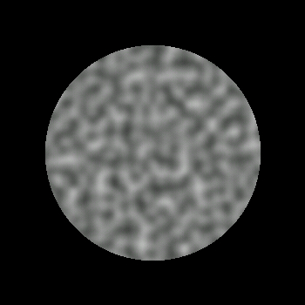
3D Textures - Noise
noise(point) = d
(scalar amplitude of texture)
Band-limited
LUT approach limits high frequencies and ensures smooth variations

Slide 12
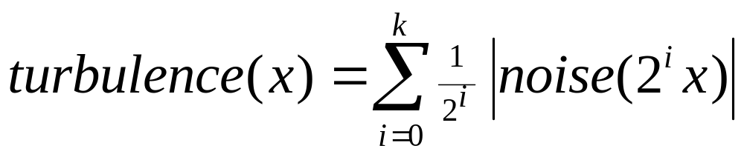
Turbulence (Perlin’s noise)
Noise with self-similarity
Sum octaves of noise with diminishing amplitude (1/f)
1/f amplitudes are often found in nature
  String vibrations, …

Slide 13
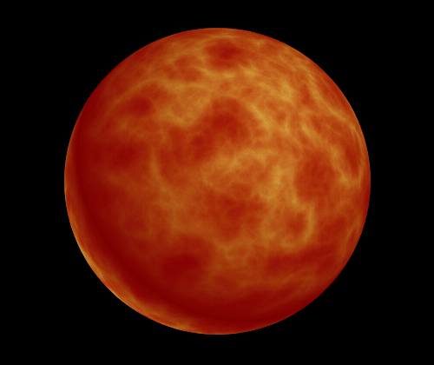
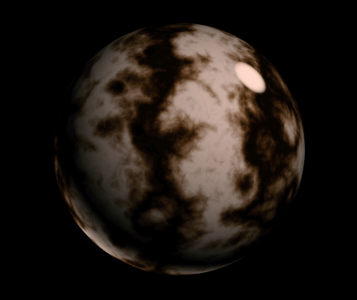
Turbulence Textures
turbulence(u,v)
sin (v + turbulence(u,v) )

Slide 14
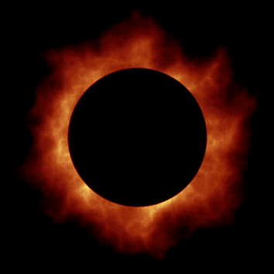

Animating Turbulence
Use an extra dimension as time

Slide 15
HW5 extension
Add a procedural texture function to your renderer
As the second part of HW5, you need to write "ptex_fun()" a procedural texture.
  Input is u,v Output is Color
You're free to implement a simple noise function, or Julia set, or checkerboard…
Any function of u,v is OK as long the as a texture pattern is clearly evident.
Use your imagination.... Have some fun with it.

Slide 16
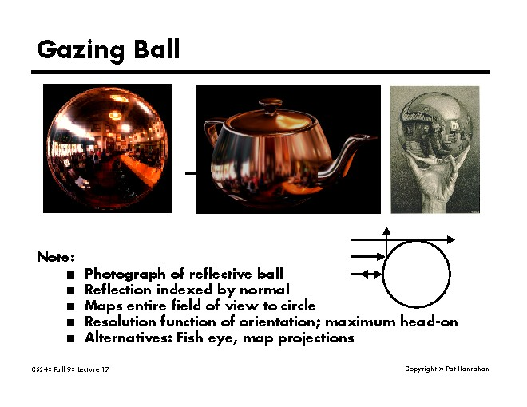
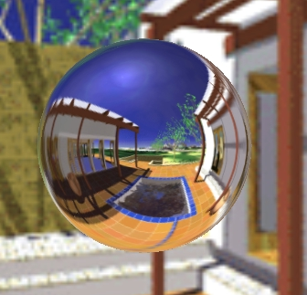
Environment (reflection) Mapping
a.k.a.: poor-man’s global illumination
Ned Green, CG&A Nov. 86).
  A simple idea (approx) but fast and effective.
A texture can approximate global and complex lighting (area sources) and reflections of scenery, windows, sunsets, etc.

Slide 17
Intro Environment Mapping
During rendering, compute the reflection of the Eye vector (not the light vector like in Phong shading).
  Reflection direction is used to map into a "far" scene texture (env map)
  Ignore position of surface point in scene. Treat every reflection vector as emanating from the same point. (centroid or origin of world)
Lights and scenery are all merged into environment texture.
Approximate environment (global illumination) geometry and light sources
Reflections into environment treats all objects encountered as light sources
No object inter-reflections or shadows (limited at best)
Planar environment approximation (like infinite lights)
One-bounce specular reflection direction doesn’t capture diffuse inter-reflections
Blur/filter texture to simulate diffuse lighting/reflection
Sharp texture (no blur) can simulate highly specular material reflections (e.g., chrome dinosaurs)

Slide 18
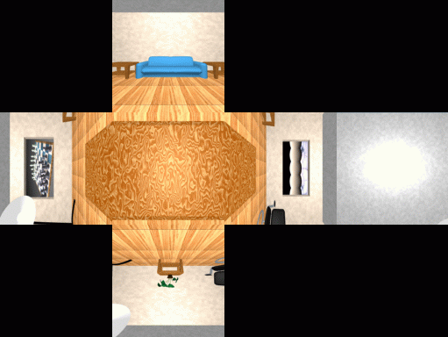
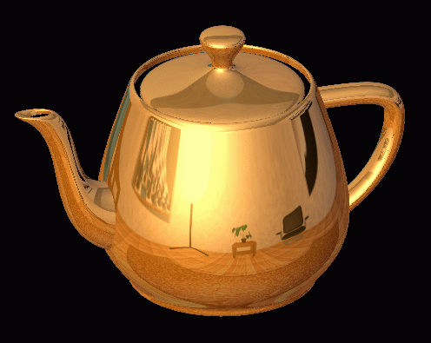
Cube map
Use a cube - 6 faces.
Create texture by rendering 6 views of environment model or use panoramic imagery.

Slide 19
Using Cube map
Align cube center with scene center
Transform each Eye reflection vector R (image space) back to world space find Max component : that indicates which face of cube it would intersect
Compute intersection of R with cube face (from origin along reflection direction)
Scale R so that the Max component equals a fixed value (1.0)
Remaining R components are scaled indices into environment texture image [0, 1]
Other mappings are also possible, latitude/longitude, spherical, etc...
Convert into cylindrical coords to use 360 degree panoramic images as textures
  phi, angle in horizontal plane = tan⁻¹(z/x)
  y = y

Slide 20
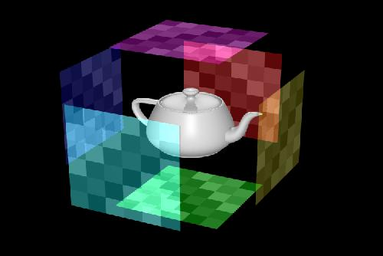
Geometry of Environment Mapping
This instance shows Max component Y = +1 Scaled R = (x, 1, z)
Reflection ray R
Is scaled so Max component = +/- 1.0
The x, z values (scaled) are used to index the texture-pixel in the image
Reflection ray R
Move all Reflection ray tails to center of cube (origin) whose extent is +/- 1.0 in x,y,z
Surface Normal N
Surface Normal N
y
z
x
View of cube with +Z into image.
Origin at cube center
Eye ray E
Eye ray E

Slide 21
Environment Map Problems
Wide variation of surface curvatures create wide variation of sampling positions and scale factors
  projected pixel positions and areas of texture
Sampling problems can occur in all texturing (mapping) process
High curvature (teapot handle) means that neighboring pixels may reflect widely spaced environment map texels

Slide 22
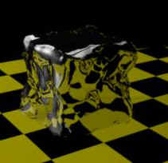
Refraction Maps
Use texture to mimic refraction

Slide 23
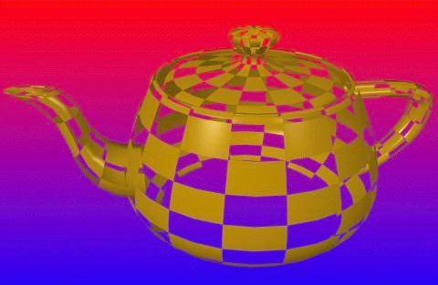
Opacity Maps
Use texture to represent opacity

Slide 24
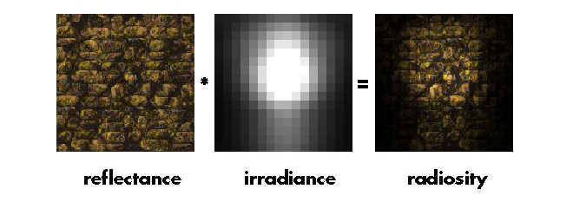
Illumination Maps
Use texture to represent illumination footprint

Slide 25
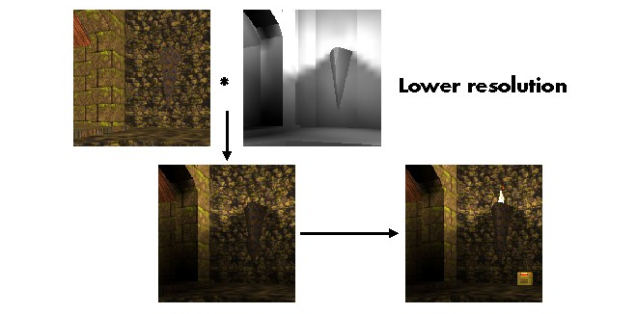
Illumination Maps
Quake light maps

