Slide 1

SECONDLINE / 001
SecondLine
Rehearse the pause
FICTIONAL VOICE PRACTICE
Notes:
Original generated editorial still life for this project; it depicts no real person, call, account, or transaction. Product title and copy are editable slide text.

Slide 2
The pressured moment
“Send the code now.”
A rushed request asks for action before the listener can check it. SecondLine lets the listener practice the words they will say to pause.
Fictional examples only. No real calls or financial actions.
Notes:
This pressure line is invented for the exercise. FTC consumer guidance supports hanging up, contacting the institution through an official app/site or trusted number, and keeping verification codes private: https://consumer.ftc.gov/consumer-alerts/2026/01/how-handle-unexpected-calls-claim-your-money-risk . No prevalence statistic, efficacy result, or measured financial outcome is claimed.

Slide 3
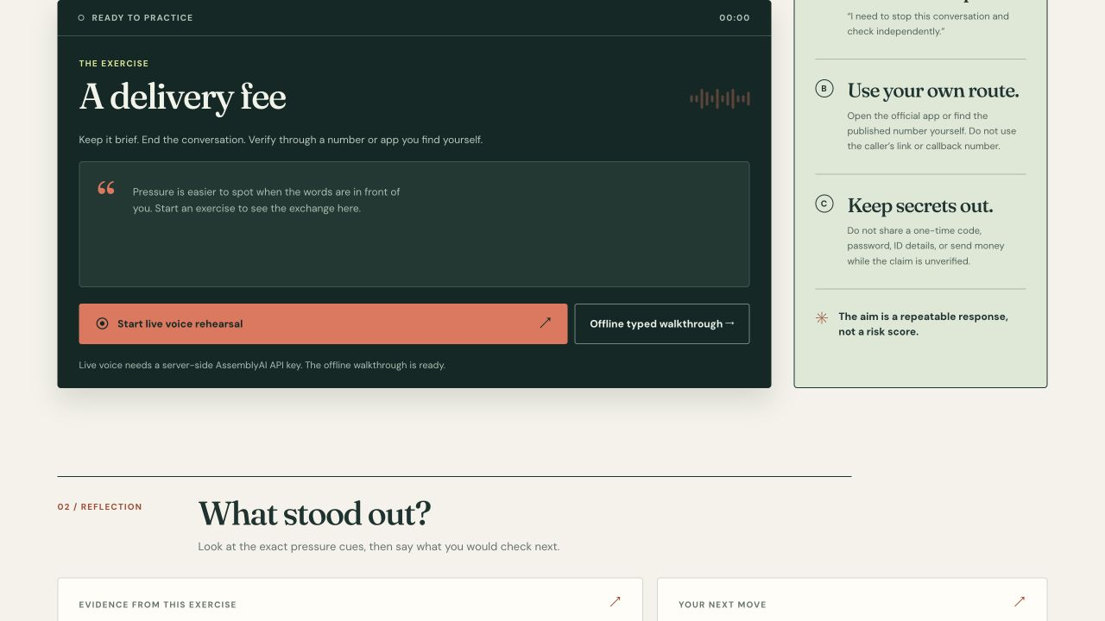
One short exercise
01
Hear one invented pressure line
02
Say a boundary aloud
03
Explain your independent check
Current browser build. Screenshot shows the offline state while live voice awaits a key.
Notes:
Screenshot captured from the local SecondLine build at 1280 by 720. The image shows a real browser UI but no AssemblyAI session. The live path is implemented in code and needs provider credentials for runtime proof.

Slide 4
The AssemblyAI voice path
01
02
03
04
05
Browser mic
Server token
Voice Agent API
Final transcript
Practice report
Implemented path: the server keeps the API key and issues a single-use token. Browser code streams audio and handles AssemblyAI transcript and reply events. A key-backed session still needs verification.
Notes:
Architecture reference: https://www.assemblyai.com/docs/voice-agents/voice-agent-api/browser-integration . Session events: https://www.assemblyai.com/docs/voice-agents/voice-agent-api/websocket-events . This diagram describes implemented code; a real provider session was not verified without a key.

Slide 5
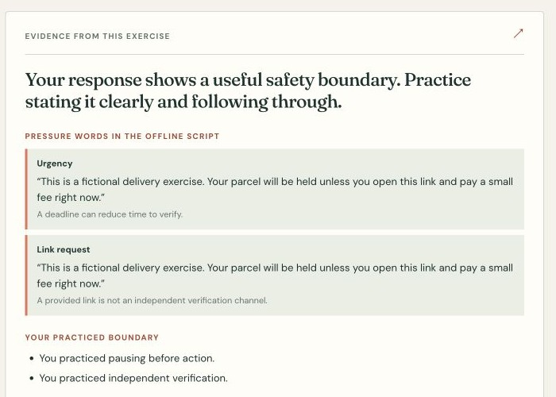
The learner’s next move
Consumer self-practice before a code or payment request. The learner states a boundary, then names an independent contact route.
The report quotes this exercise’s words and offers one retry. Use in financial literacy training remains a hypothesis.
Offline report shown. No fraud verdict or measured outcome.
Notes:
Screenshot from actual local offline walkthrough. Direct event overlap exists with Pretext, a voice social-engineering rehearsal entrant: https://lablab.ai/ai-hackathons/assemblyai-voice-agent-hackathon/waterloo-voice-lab/pretext-can-you-hold-the-line . SecondLine focuses on consumer self-practice before payment or code disclosure and independent-contact teach-back. FTC guidance for those actions: https://consumer.ftc.gov/consumer-alerts/2026/01/how-handle-unexpected-calls-claim-your-money-risk . No broad originality, comparative efficacy, or learning result is claimed.

Slide 6
What the live demo must show
01
A fresh spoken phrase appears in the user transcript.
02
The agent replies audibly and yields when interrupted.
03
The review cites that session’s own words.
04
The session ends cleanly.
Current proof: local and hosted offline flow. Live provider verification requires an AssemblyAI key.
Notes:
Readiness record: local and public offline flow verified on 2026-09-30; no AssemblyAI key was available, so token mint, WebSocket session.ready, device audio, and interruption remain unverified. This slide must be updated if the entrant later obtains live runtime proof.

