Slide 1
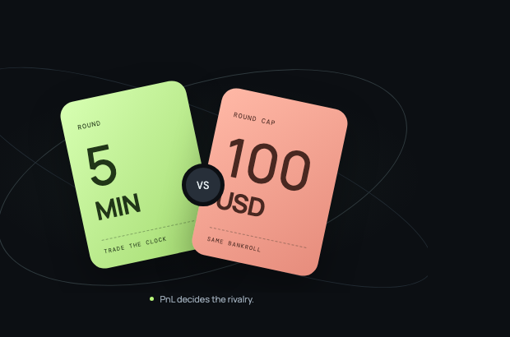
told
you
DREAMDEX EVENT CONTRACT HACKATHON
Trade the clock.
Tell them you told them.
A five-minute, head-to-head Event Contract trading duel.
SAME BANKROLL / SAME TIMER / BETTER JUDGMENT WINS
Somnia Shannon testnet · product demo
Notes:
Visual: Told You platform hero card asset, captured from the local product landing page. Product claim is limited to the current testnet demo.

Slide 2
TOLD YOU · DREAMDEX EVENT CONTRACT DUELS
02
Event Contracts have a social gap.
A trader can buy a view alone. There is no shared clock, no direct rivalry, and no reason to return for a rematch.
THE CURRENT MOMENT
Pick a side.
Buy a contract.
Wait alone.
THE TOLD YOU MOMENT
Invite one rival. Both ready up. Trade the same live market until the clock ends.
The competition is not a forced opposite-side bet. Each trader chooses their own entries and exits.
Notes:
Source: Product concept and current Told You implementation. This slide frames a product hypothesis, not market research.

Slide 3
TOLD YOU · DREAMDEX EVENT CONTRACT DUELS
03
One fair session, from invite to score.
01
02
03
04
Create
Ready
Trade
Score
→
→
→
Creator sets the fixed 100 tUSDC round cap and shares one rival link.
Both wallets pass the same balance check. The timer starts only when both are ready.
Each player trades BTC or ETH Event Contract positions independently for five minutes.
A common final mark compares PnL. If price data is unavailable, no winner or Rating is recorded.
No pooled bankroll. No custody. No forced counter-position.
Notes:
Source: Told You round flow in src/main.js and documented product design. The 100 tUSDC cap is a demo configuration.

Slide 4
TOLD YOU · DREAMDEX EVENT CONTRACT DUELS
04
One decision needs two live signals.
Told You keeps the underlying asset price separate from the Event Contract price so a player understands what they are buying.
UNDERLYING
EVENT CONTRACT
BTC / ETH index
UP / DOWN outcome price
Somnia oracle feed
Current price and recent ticks
DreamDEX market data
Public outcome marks for trade entry and duel scoring
A current asset price is not the same thing as a 60¢ UP contract.
Notes:
Source: @somnia-chain/markets-sdk integration in src/market-service.js. Underlying price uses SOMNIA_TESTNET_PRICE_FEED; outcome marks use DreamDEX market order books.

Slide 5
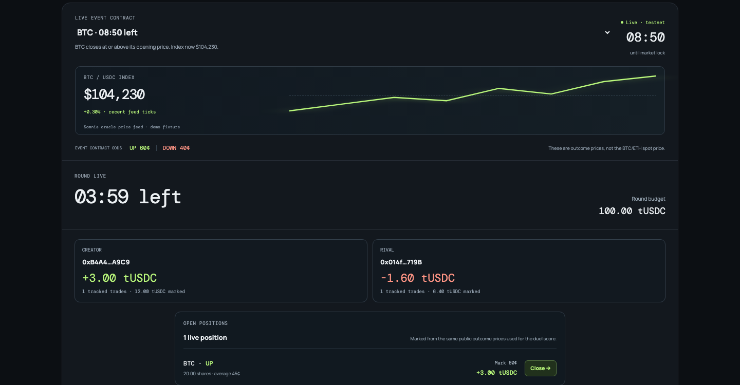
TOLD YOU · DREAMDEX EVENT CONTRACT DUELS
05
The product keeps the rivalry visible.
IN ONE VIEW
Live asset index
Event Contract odds
Round countdown
Both traders' PnL
Open positions
Market and limit entries
The trade panel shows simulated demo execution. It does not claim a wallet order was sent.
Notes:
Source: Told You local product screenshot. Disclosure: execution is simulated in the current demo; market and oracle reads use the SDK.

Slide 6
TOLD YOU · DREAMDEX EVENT CONTRACT DUELS
06
Score integrity is a product feature.
A temporary market-data failure must never turn an open position into a made-up zero-value loss.
01
Live round
Current shared outcome marks update open-position PnL.
02
Round timeout
The last valid common mark determines the demo score.
03
No verified price
The round becomes price unavailable. No winner. No Rating update.
Notes:
Source: Told You timeout-safe scoring implementation in src/domain.js and src/main.js. This is a testnet-demo integrity rule, not a claim about on-chain settlement.

Slide 7
TOLD YOU · DREAMDEX EVENT CONTRACT DUELS
07
The next duel starts with a name.
A shared round gives the result social memory: who won, who lost, and who should get a rematch link.
ONE ROUND
RIVALRY RECORD
SEASON
a five-minute
trading story
head-to-head
win / loss history
Rating, rank,
and a reason back
The reward is social first: a result worth sending to the person you beat.
Notes:
Source: Told You season, rating, and head-to-head UI implementation. Retention outcomes are product hypotheses.

Slide 8
TOLD YOU · DREAMDEX EVENT CONTRACT DUELS
08
A consumer layer for Event Contracts.
NOW
NEXT
LATER
Safe testnet demo
Protocol-native execution
Season incentives
Shared clock, public data, simulated fills, PnL scoring, rivalry record.
Use live DreamDEX orders where liquidity and testing conditions support a reliable match.
Sponsor-funded rewards and transparent, capped fee mechanics for competitive seasons.
Told You makes a useful DreamDEX primitive feel like a game worth returning to.
Thank you
Notes:
Source: Told You product roadmap. Future execution and incentives are proposals, not implemented functionality.

