Slide 1
Cross-platform desktop apps in Rust and Qt
Serhij Symonenko / Bohemia Automation

Slide 2
Why desktop apps in 2023?
No HTTP: industrial devices, databases, clients for 3rd party web services etc.
Sometimes desktop apps are just faster than web ones
Sometimes apps require more access to the local machine than WASM can provide
No limitations - use any crates, use multiple threads, use async runtimes (tokio)

Slide 3
Why Qt?
Two big grown-up players: Qt and GTK
Qt usually looks neater and more Enterprise-ready (but check the license)
Qt has got commercial support, including lots of 3rd party consulting companies
Qt has got Qt Designer and QML
Qt 5 or 6? Check KDE: https://iskdeusingqt6.org

Slide 4
Qt in Rust
- Ritual
https://rust-qt.github.io
- qmetaobjecthttps://github.com/woboq/qmetaobject-rs
- cxx-qt
https://www.kdab.com/cxx-qt/

Slide 5
Qt basics
Signals and slots
Avoid blocking the UI thread with I/O or heavy calc
Beware of auto-drops of dynamic widgets by Rust
No events in Rust (e.g. closeEvent) use C++ wrappers

Slide 6
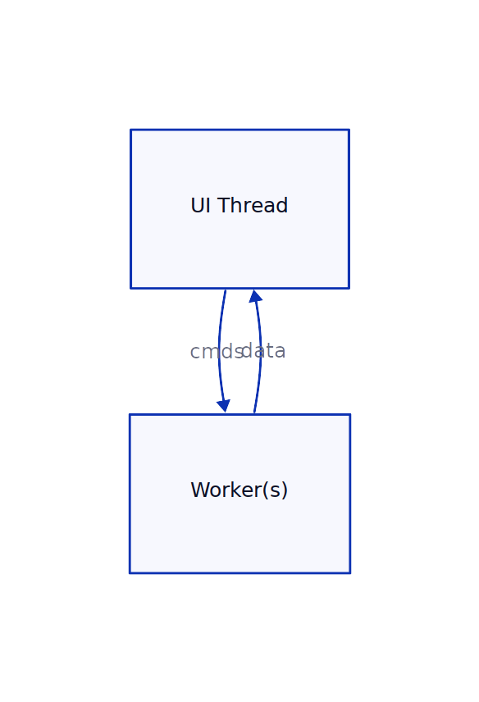
Organizing data flow
Code example (Ritual): https://github.com/divi255/qtx
Production app example: https://info.bma.ai/en/actual/eva4/ecmui/

Slide 7
How to distribute apps
cargo bundle (Linux/OSX) https://github.com/burtonageo/cargo-bundle
cargo wix (Windows) https://github.com/volks73/cargo-wix

Slide 8
Thank you for watching!

