Slide 1
Cross-platform desktop apps in Rust and Qt
Serhij Symonenko / Bohemia Automation

Slide 2
Why desktop apps in 2023?
No HTTP: industrial devices, databases, clients for 3rd party web services etc.
Sometimes desktop apps are just faster than web ones
Sometimes apps require more access to the local machine than WASM can provide
No limitations - use any crates, use multiple threads, use async runtimes (tokio)

Slide 3
Why Qt?
Two big grown-up players: Qt and GTK
Qt usually looks neater and more Enterprise-ready (but check the license)
Qt has got commercial support, including lots of 3rd party consulting companies
Qt has got Qt Designer and QML
Qt 5 or 6? Check KDE: https://iskdeusingqt6.org

Slide 4
Qt in Rust
- Ritual
https://rust-qt.github.io
- qmetaobjecthttps://github.com/woboq/qmetaobject-rs
- cxx-qt
https://www.kdab.com/cxx-qt/

Slide 5
Qt basics for rustaceans
Learn about signals and slots
Avoid blocking the UI thread with I/O or heavy calc
Beware of auto-drops of dynamic widgets by Rust
No events in Rust (e.g. closeEvent) use C++ wrappers

Slide 6

Signals and slots
Note: Signal objects are not completely thread-safe but signal.emit() function is an exception

Slide 7
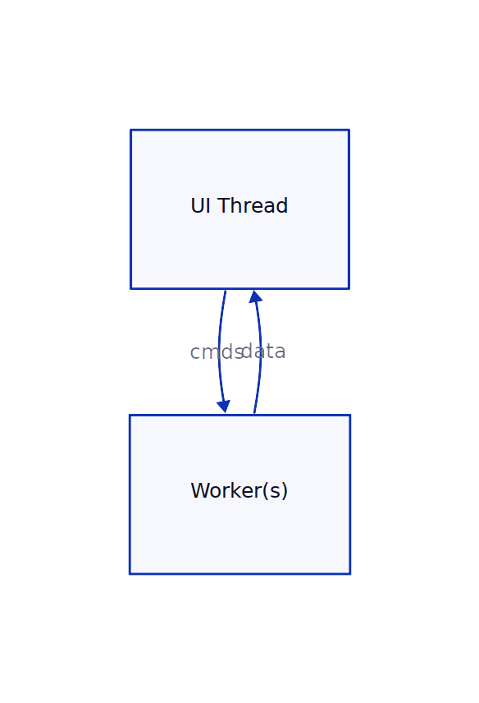
Organizing data flow

Slide 8
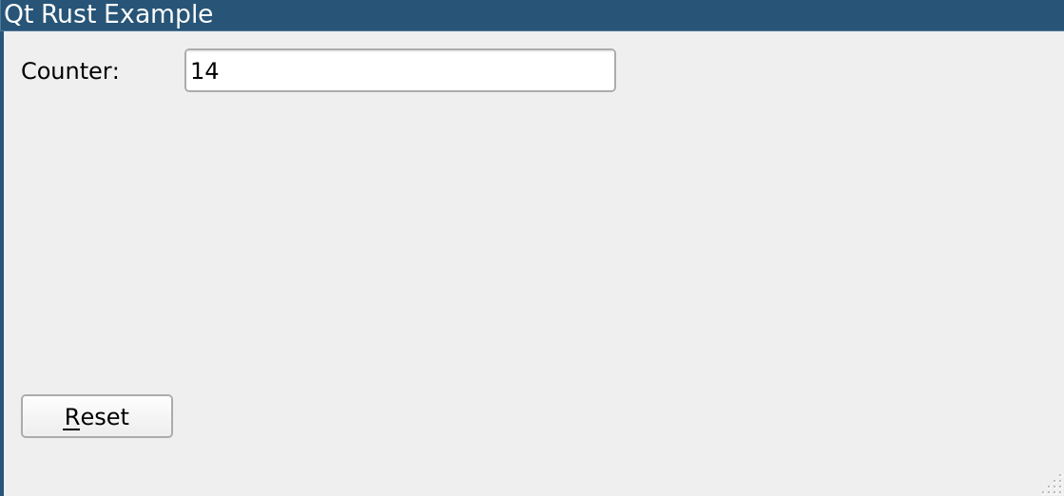
Program example (Ritual)
a background worker increases the counter value every second
when the value is increased, a data event is being sent to the UI thread
UI reset button can send reset commands to the background worker to reset the counter
UI and the worker thread talk via standard mpsc channels
The worker thread uses Qt Signal with no arguments to notify UI thread about new events in the data channel

Slide 9
The main function
1 fn main() {
4 QApplication::init(|_| {
5 // command channel
6 let (command_tx, command_rx) = mpsc::sync_channel::<Command>(64);
7 // data channel
8 let (data_tx, data_rx) = mpsc::sync_channel::<Data>(64);
9 // construct UI
10 let ui = Ui::new(command_tx.clone(), data_rx);
11 unsafe {
12 // data signal
13 let data_signal = unsafe_send_sync::UnsafeSend::new(SignalNoArgs::new());
14 // connect data signal with UI handle_data slot method
15 data_signal.connect(&ui.slot_handle_data());
16 // run the background worker
17 thread::spawn(move || {
18 worker(command_rx, data_tx, data_signal);
19 });
20 // display the UI
21 ui.show();
22 // exec the Qt application
23 let result: i32 = QApplication::exec();
24 // optionally terminate the background worker
25 command_tx.send(Command::Quit).unwrap();
26 result
27 }
28 })
29 }

Slide 10
UI and Main window
1 // main window
2 #[ui_form("../ui/main.ui")]
3 struct Main {
4 widget: QBox<QWidget>,
5 counter: QPtr<QLineEdit>,
6 btn_reset: QPtr<QPushButton>,
7 }
8
9 // UI
10 struct Ui {
11 window: Main,
12 command_tx: mpsc::SyncSender<Command>,
13 data_rx: mpsc::Receiver<Data>,
14 }
15
16 // reqired to transform Rust functions into slots
17 impl cpp_core::StaticUpcast<QObject> for Ui {
18 unsafe fn static_upcast(ptr: Ptr<Self>) -> Ptr<QObject> {
19 ptr.window.widget.as_ptr().static_upcast()
20 }
21 }

Slide 11
UI Implementation
1 impl Ui {
2 // Rc is required to transform Rust functions into slots
3 fn new(command_tx: mpsc::SyncSender<Command>,
4 data_rx: mpsc::Receiver<Data>) -> Rc<Self> {
5 unsafe {
6 let window = Main::load();
7 let ui = Rc::new(Ui { window, command_tx, data_rx, });
8 ui.window.btn_reset.clicked().connect(&ui.slot_handle_btn_reset());
9 //let ctx = ui.command_tx.clone(); // an alternative slot implementation
10 //ui.window.btn_reset.clicked().connect(&SlotNoArgs::new(&ui.window.widget, move || {
11 // let _ = ctx.send(Command::Reset);
12 //}));
13 ui
14 }
15 }
16 #[slot(SlotNoArgs)]
17 unsafe fn handle_btn_reset(self: &Rc<Self>) {
18 let _ = self.command_tx.send(Command::Reset);
19 }
20 unsafe fn show(self: &Rc<Self>) {
21 self.window.widget.show();
22 }
23 }

Slide 12
Worker and Events
1 // commands to the background worker
2 enum Command {
3 Reset,
4 Quit,
5 }
6 // data from the background worker (alternative: slots, but objects must be Qt-ized)
7 enum Data {
8 Counter(u64),
9 }
10 // background worker
11 fn worker(
12 command_rx: mpsc::Receiver<Command>,
13 data_tx: mpsc::SyncSender<Data>,
14 data_signal: unsafe_send_sync::UnsafeSend<QBox<SignalNoArgs>>,
15 ) {
16 let mut counter = 0;
17 loop {
18 while let Ok(command) = command_rx.try_recv() {
19 match command {
20 Command::Reset => counter = 0,
21 Command::Quit => break,
22 }
23 }
24 if data_tx.send(Data::Counter(counter)).is_ok() {
25 unsafe { data_signal.emit(); }
26 }
27 thread::sleep(Duration::from_secs(1));
28 counter += 1;
29 }
30 }

Slide 13
Handling data events in UI
1 impl Ui {
2 // .................
3 // .................
4 // add the following method to UI
5 #[slot(SlotNoArgs)]
6 unsafe fn handle_data(self: &Rc<Self>) {
7 while let Ok(data) = self.data_rx.try_recv() {
8 match data {
9 Data::Counter(v) => {
10 self.window.counter.set_text(&qs(v.to_string()));
11 }
12 }
13 }
14 }
15 }

Slide 14
How to distribute apps
cargo bundle (Linux/OSX) https://github.com/burtonageo/cargo-bundle
cargo wix (Windows)
https://github.com/volks73/cargo-wix

Slide 15
Thank you for watching!
The presentation and the source code: https://github.com/divi255/qtx
Production app example: https://info.bma.ai/en/actual/eva4/ecmui/

